Slide 1
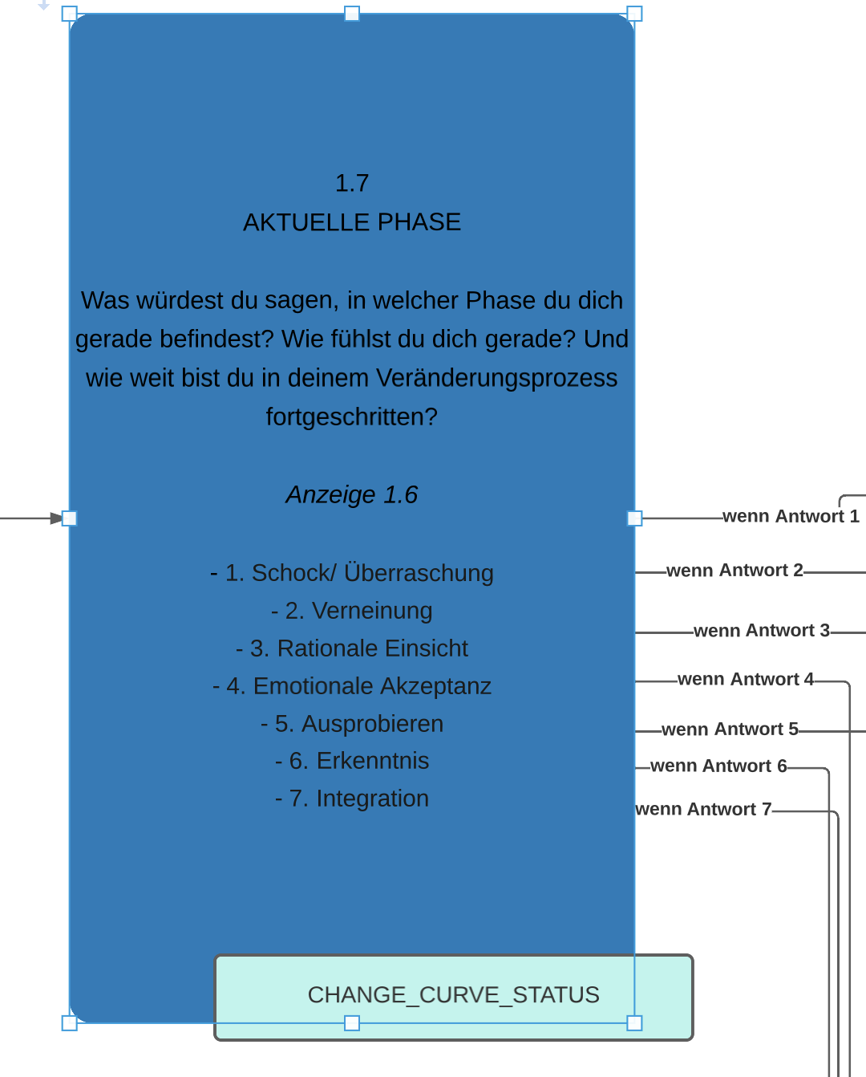
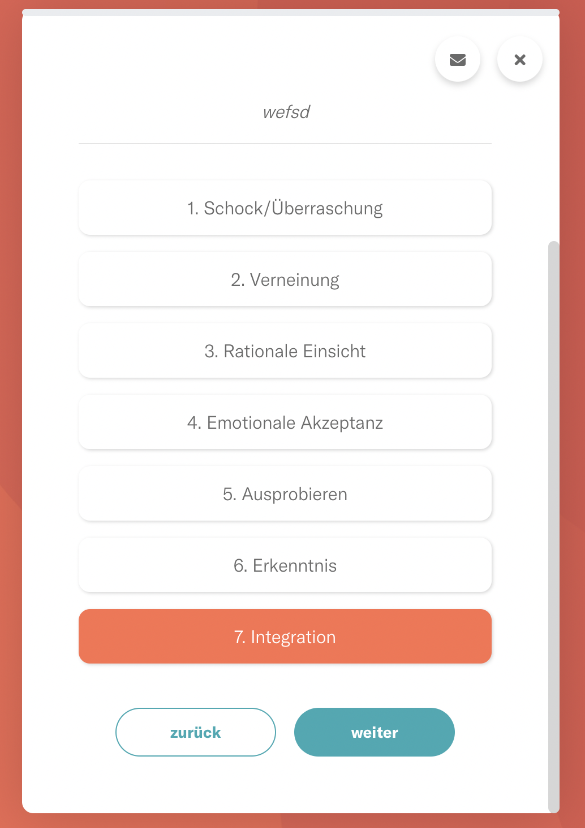
ITEM_LIST_SINGLE_CHOICE+PR+RRR

