Slide 1
CS6320 – Performance
L. Grewe

Slide 2
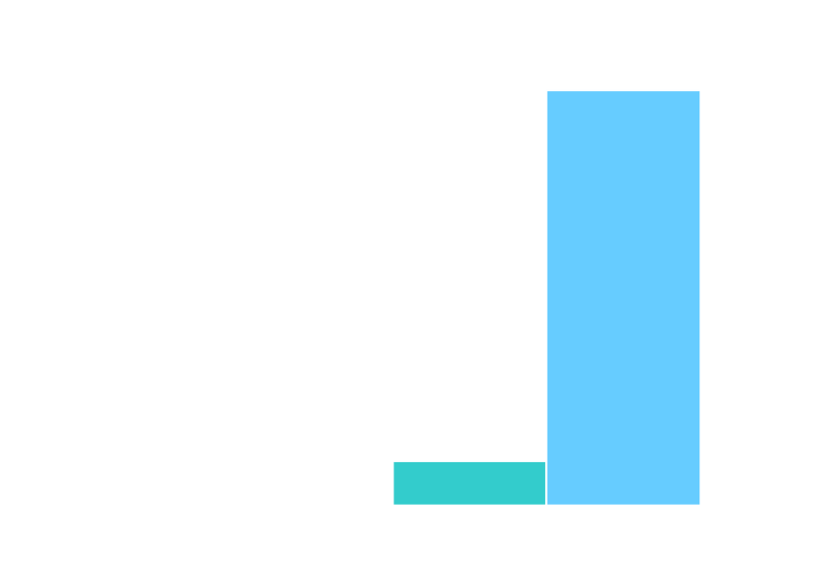
Number of requests a website receives is unpredictable
CNN.com
CNN, NY Times, ABC News
unavailable from 9-10 AM
(Eastern Time)
Page views/day
(in millions)
Content providers’ dilemma: how many resources to
provision?
Need on-demand scalabilty
Notes:
Web Applications are available to a vast population of potential users
As a result, applications don’t know how much resources to provision. 132.4 was the total number of page views. Before the site went down, the site had close to 14 million page views an hour.
Applications face a dilemma in how much resources to provision:
Too little → Risk inability to handle customer load
Too much → Expected customers might not come.

Slide 3

Content Delivery Network (CDN) Solution
CNN.com
50k
Page views/day
(in millions)
1.2k
Page was 1.2k instead of 50k on 12 Sep, 01
50k
Used Akamai on Election day
Source: http://www.tcsa.org/lisa2001/cnn.txt http://www.akamai.com/en/html/about/press/press479.html
Notes:
The CDN solution does not scale the database component.
2K split page was not enough reduction - light page was 1247 bytes of text, logo, one image - lowest ever amount of text

Slide 4
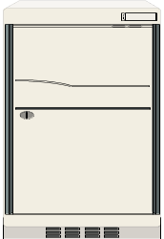
FullStack Web-Site Architecture
Request
Users
Execute
code
Access
DB
Response
Web Server
App Server
DB

Slide 5
CDN Architecture
Internet core
Users
CDN nodes
Content providers
CDNs excel at delivering static content.
Notes:
Note that the CDN solution may easily move the web server and application server to edge proxy nodes, but the centralized database server quickly becomes a performance bottleneck

Slide 6
Advantages of CDNs
Large infrastructure handles load spikes
Clients charged on a per-usage basis
  no need to guess what resources to provision
Moves data closer to end-users
  decreases latency and increases throughput

Slide 7
CDN Application Services
CDN’s can also run applications
Internet
DB
Users
but for data-intensive dynamic applications…
database server becomes the bottleneck!
Notes:
Note that the CDN solution may easily move the web server and application server to edge proxy nodes, but the centralized database server quickly becomes a performance bottleneck

Slide 8
Methods to scale the database component
In-house database scalability:
Database outsourcing: Database as a service Have to cede control of data
Database Scalability Service (DBSS): Shared infrastructure that caches applications’ data

Slide 9
S3 Database Scalability Service
CDN-like proxy nodes cache results of database queries
  reduces load on central database servers
All database updates sent to central server
  clients don’t cede ownership of their data
Uses publish/subscribe system to maintain data consistency
  avoids additional load at the central server
Content provider may encrypt database requests/responses to protect sensitive data

Slide 10
Database Scalability Service
users:
Content Delivery Network
DBSS
Internet
server
databases:
Notes:
DBSS sits between a CDN and centralized database servers. That is the component on which we focus.

Slide 11
Database Scalability Service
users:
Internet
Web and application servers
DBSS
server
databases:
Notes:
DBSS sits between a CDN and centralized database servers. That is the component on which we focus.

Slide 12
Database Scalability Service
client apps:
DBSS
Internet
server
databases:
Notes:
DBSS sits between a CDN and centralized database servers. That is the component on which we focus.

Slide 13
Outline
Need for on-demand scalability
S3 invalidation mechanism
Security-scalability tradeoff
Reducing latency

Slide 14
Addressing consistency
TTL is wasteful: (time to live)
  Often refresh cached data unnecessarily (workloads dominated by reads)
  Must set TTL=0 for strong consistency!
Solution: update or invalidate cached data only when affected by updates
  Naïve approach: organizations notify proxy servers of relevant updates ← not scalable
An approach:
Fully-distributed, proxy-to-proxy
update notification mechanism
Notes:
Say: strong consistency often necessary, especially in applications like civic emergency mgmt.

Slide 15
Distributed Consistency Mechanism
update
users
update notification
Multicast Environment
update notification
proxy node
Distributed app-level multicast environment
Forward all updates to backend servers
Notes:
When an update occurs, that update must be conveyed to all proxy servers caching views that might be affected by the update, so that they can either update or invalidate those views accordingly.
Fully-distributed application-level multicast environments available, e.g. Scribe (built upon Pastry DHT overlay)
Also point out that we continue to forward all updates to backend home servers.
Transactional consistency mechanism to build on top still T.B.D. (requires bi-directional messaging)

Slide 16
Configuring Multicast Channels
Key observation: Web applications typically interact with DB via a small, fixed set of query/update templates (usually 10-100)
Example:
SELECT qty FROM inv WHERE id = ?
UPDATE inv SET qty = ? WHERE id = ?
Templates: natural way to configure channels
Options:
Channel-by-query or Channel-by-update
Notes:
Base channels on query/update templates.
Factor out all these problems and FORECAST in slide 9

Slide 17
Channel-by-Query Option
One channel per query template Q: C(Q)
Few subscriptions/cached result
Many invalidation notifications/update
Begin caching result(s) of query template Q | Subscribe to C(Q)
Evict only query result for Q | Unsubscribe from C(Q)
Issue update | Determine which query templates Q₁, …, Q_{n} affected; send notification on each C(Q_{i})
Conflicts determined lazily (upon update)
Notes:
Say: each time an update occurs, access precomputed “conflict mapping” between update templates and query templates to decide which query templates might be affected
Fewer subscriptions/cached result, more multicast messages/update

Slide 18
Channel-by-Update Option
One channel per update template U: C(U)
Many subscriptions/cached result
Few invalidation notifications/update
Begin caching result(s) of query template Q | Determine which update templates U₁, …, U_{n} apply; subscribe to each C(U_{i})
Evict only query result for Q | Unsubscribe from all C(U_{i}) above
Issue update using template U | Send notification on C(U)
Conflicts determined eagerly (when caching Q)
Notes:
SAY: channel-by-query preferable for read-dominated workloads
[If asked … Caveat: the cost of channel-by-query vs. channel-by-update depends on many factors (where stuff is cached, cost of subscribing/unsubscribing, cost of applying query/update mapping, etc.)]

Slide 19
Parameter-Specific Channels
Optimization: consider parameter bindings supplied at runtime … for example:
Q5: SELECT qty FROM inv WHERE id = ?
  When issued with id = 29, create extra parameter-specific channel C(5, 29)
  Subscribe to both C(5) and C(5, 29)
Upon update:
  If update affects a single item with id = X, send notification on channel C(5, X)
    Saves work if X ≠ 29
  Updates affecting multiple items sent to C(5)
Notes:
Q5 means “query template #5”
Channel identifier for C(5,29) formed by applying a hash function to the combination of those numbers; note that collisions do not affect correctness
… this is ongoing work. Situation gets more complicated with disjunction, conjunction of predicates, etc.

Slide 20
S3 Prototype
Tomcat as proxy web server/servlet container
Proxy database cache written in Java
Queries: access cached data when possible
  Cache JDBC query results (i.e., materialized views)
  Index results by JDBC query representation
MySQL4 as back-end database
Updates: sent to back-end database
Invalidation notifications delivered via Scribe
Experiments on Emulab (Utah) – Thanks!
Notes:
Simple and conservative consistency model -- all query templates are either uncacheable or cacheable with fixed time-to-live. Examples: latest bid on an item in auction, number of copies of a book in stock (TTL = 0). Cacheable: Ten best sellers in bookstore. Final goal is to mark all data as cacheable.
Emphasize that all of this is to get a simple prototype working -- doesn’t necessary match ultimate design decisions

Slide 21
Benchmark Applications
Bookstore (TPC-W, from UW-Madison)
  Online bookseller, a standard web benchmark
  Changed the popularity of books
Auction (RUBiS, from Rice)
  Modeled after Ebay
Bulletin board (RUBBoS, from Rice)
  Modeled after Slashdot
Benchmarks model popular websites
Notes:
RUBiS and RUBBoS are from researchers at Rice University, TPC-W implementation from Wisconsin.

Slide 22
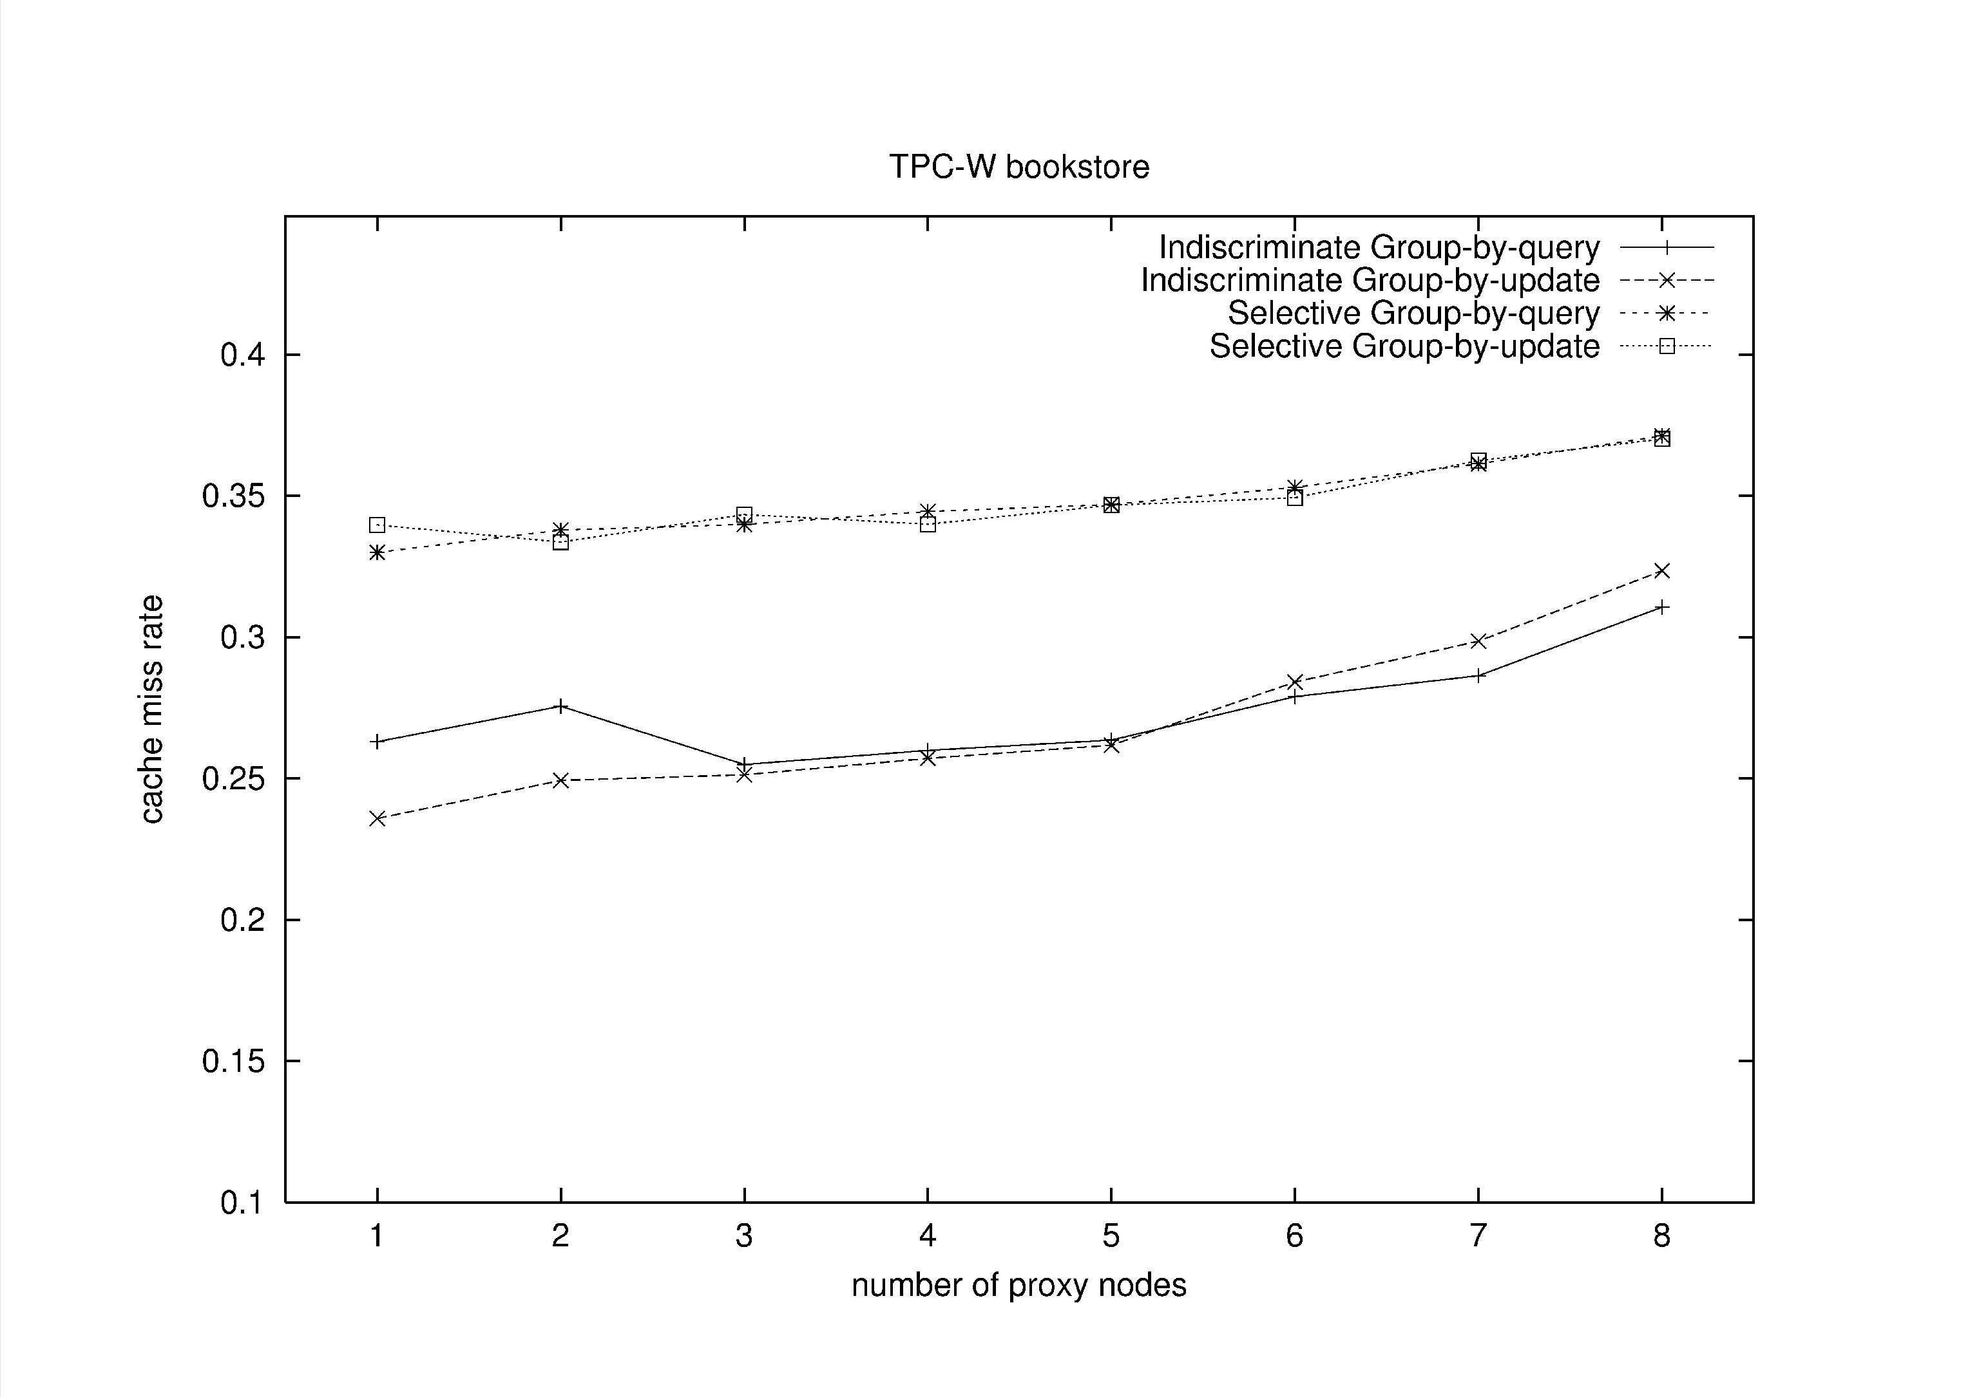
Selective: cache queries only if subscribed to parameter-dependent groups

Slide 23
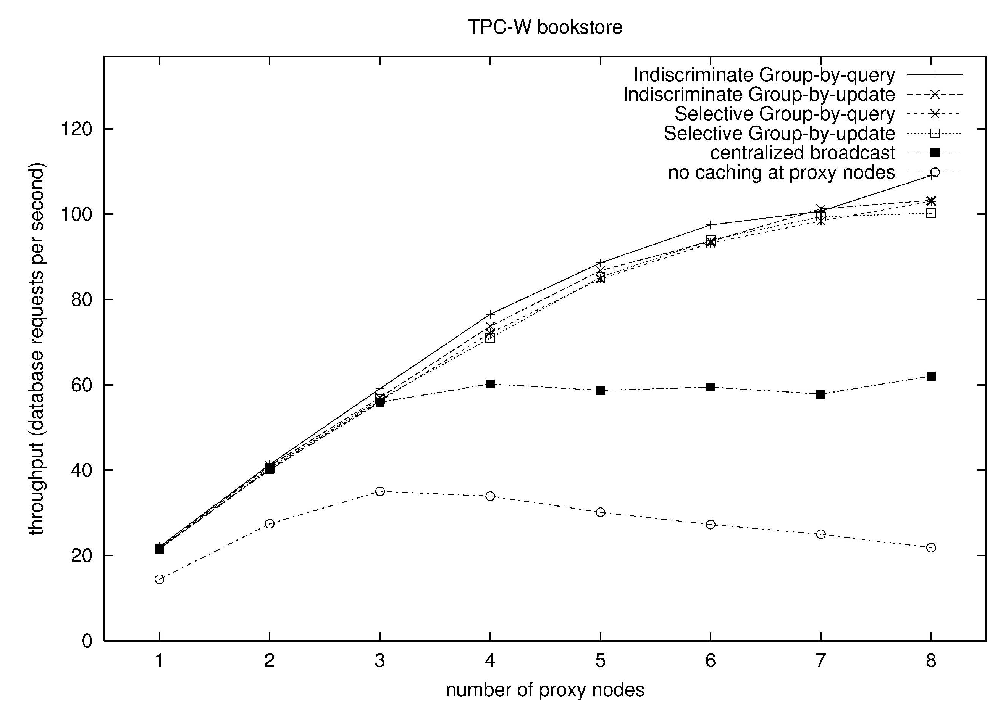

Slide 24
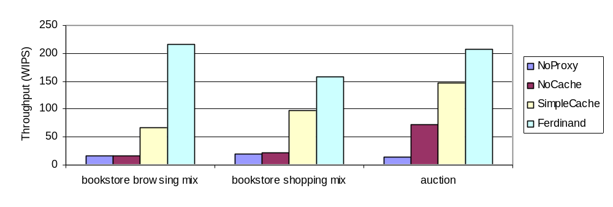
Impact of Cooperative Caching

Slide 25
Outline
Need for on-demand scalability
S3 invalidation mechanism
Security-scalability tradeoff
Reducing latency

Slide 26
Guaranteeing security in a DBSS setting
Limit ability to observe an application’s data by:
  DBSS administrator
  Unauthorized application through the DBSS
Security-Scalability tradeoff in the DBSS setting
Analyzing the code helps in managing this tradeoff

Slide 27
A simple solution for guaranteeing security
Outsource database scalability
  Home server: master copies of all data—handles updates directly
No query execution on the DBSS
  DBSS caches query results (read-only)—kept consistent by invalidation
All data passing through the DBSS can be encrypted:
  Query, Update, Query results
Notes:
However, encrypting all the data means that when updates occur, the DBSS has to invalidate a larger region of its cache.

Slide 28
A Simple Example
toys (toy_id, toy_name)
No Invalidations
Q1:toy_id=15
Empty
11 | Barbie
15 | GI Joe
Nothing is encrypted
Q1: toy_id=15
Q1
U1
DBSS
Home server Database
Q1: SELECT toy_id FROM toys WHERE toy_name=“GI Joe”
U1: DELETE FROM toys WHERE toy_id=5
Invalidate
Result
Q1:
Q1
Empty
Results are encrypted
11 | Barbie
15 | GI Joe
Result
U1
Q1:
More encryption leads to more invalidations

Slide 29
Challenge: providing scalability while guaranteeing security
When updates occur, DBSS needs to invalidate
Application faces a dilemma in what data to encrypt (secure)
Less encryption
More encryption
Conservative Invalidation
Precise Invalidation
Security
Scalability
Security-scalability tradeoff

Slide 30
Opportunity for managing the tradeoff
Not all data is equally sensitive
Data Sensitivity
Completely
insensitive
Moderately
sensitive
Extremely
sensitive
Bestsellers
list
Inventory records,
customer records
Credit Card
Information
Care but worried about scalability impact
Secure at
all costs
Don’t care
But for most data, nontrivial to assess:
Data-sensitivity
Scalability impact of securing the data

Slide 31
Key Insight: arbitrary queries and updates not possible
function get_toy_id ($toy_name) {
$template:=“SELECT toy_id FROM toys
WHERE toy_name=?”;
$query:=attach_to_template ($template, $toy_name);
execute ($query);
…
}
Given templates:
Can statically identify data
not needed for precise invalidation
Notes:
Queries and updates can only be instantiations of templates. And the templates can be found by inspecting the code.

Slide 32
Data not useful for invalidation: examples
Example 1:
Q1: SELECT toy_id FROM toys WHERE toy_name=?
Q2: SELECT toy_name FROM toys WHERE toy_id=?
No data is needed for precise invalidation
Example 2:
Q1: SELECT toy_id FROM toys WHERE toy_name=?
U1: DELETE FROM toys WHERE toy_id=?
Query parameters are not needed for precise invalidation (the query result is needed though)

Slide 33
Security without hurting scalability
Data not needed for invalidation
Can secure “for free” (without hurting scalability)
Security Conscious Scalability Approach
As a result,
Tradeoff has to be only managed over remaining data

Slide 34
Sample experiment: methodology
Scalability: max # concurrent users with acceptable response times
Security: # templates with encrypted results
5 ms
100 ms
Users
CDN and DBSS
Home server
California Privacy Law determined sensitive data
Non-transactional invalidation
Start with a cold cache

Slide 35
Benchmark Applications
Bookstore (TPC-W, from UW-Madison)
  Online bookseller, a standard web benchmark
  Changed the popularity of books
Auction (RUBiS, from Rice)
  Modeled after Ebay
Bulletin board (RUBBoS, from Rice)
  Modeled after Slashdot
Benchmarks model popular websites
Notes:
RUBiS and RUBBoS are from researchers at Rice University, TPC-W implementation from Wisconsin.

Slide 36
Security-Scalability Tradeoff
Q1 | SELECT toy_id FROM toys WHERE toy_name=?
Q2 | SELECT qty FROM toys WHERE toy_id=?
Q3 | SELECT cust_name FROM customers WHERE cust_id=?
U1: DELETE FROM toys WHERE toy_id=5
 | Template | Parameters | Query result | Invalidations
Blind |  |  |  | All Q1, Q2, Q3
Template |  |  |  | All Q1, Q2
Statement |  |  |  | All Q1, Q2 with toy_id=5
View |  |  |  | Q1 with toy_id=5 Q2 with toy_id=5
x
x
x
x
x
Security
x
Scalability
X denotes encrypted, visible
Notes:
Fill the table entries one by one.

Slide 37

Magnitude of Security-Scalability tradeoff
Scalability (number of concurrent users supported)
0
0
Benchmark Applications

Slide 38
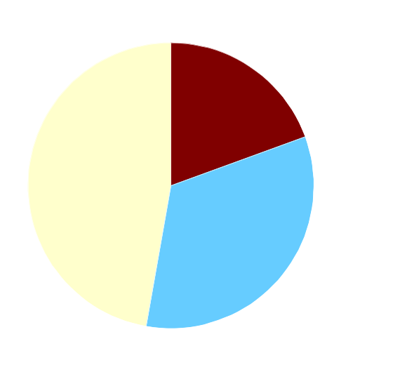
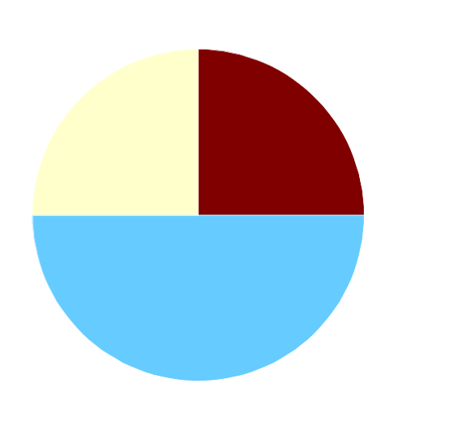
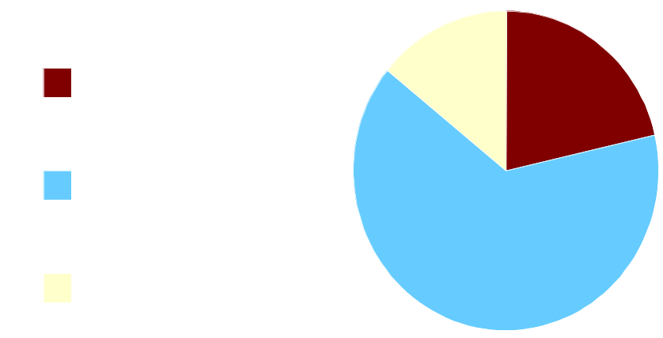
Security Results
Query data that can be encrypted “for free”
4
6
17
7
7
7
and result
18
12
14
Auction
Bboard
Bookstore
Notes:
Put actual numbers in the slides, over the

Slide 39
Security Results in Detail
Auction: The historical record of user bids was not exposed
Bboard: The rating users give one another based on the quality of their posting
Bookstore: Book purchase association rules discovered by the vendor – customers who purchase book A also purchase book B

Slide 40
Scalability Conscious Security Approach (SCSA) to managing the tradeoff
900
Nothing
encrypted
SCSA
600
Scalability (Number of concurrent users supported)
300
Everything
encrypted
0
0
5
10
15
20
25
30
Security (Number of query templates with encrypted results)
1. Easy to either get good scalability or good security
2. SCSA presents a shortcut to manage the tradeoff

Slide 41
Outline
Need for on-demand scalability
S3 invalidation mechanism
Security-scalability tradeoff
Reducing latency

Slide 42
Contributors to User Latency
Request, high latency
Response, high latency
Web server
App server
Database
Traditional architecture
high latency
CDN
DBSS
Database
DBSS architecture
A single HTTP request ➔ Multiple database requests
Notes:
User studies have shown that users go away if the latency is greater than a threshold value. To be able to reduce latency, we need to understand the contributors of user latency.
In a traditional architecture, a single HTTP request has to suffer high latency in reaching the Web server. And after that, the request results in multiple database requests, but they don’t cause extra latency because the application server and the database are close by.
In a DBSS architecture, any database request that misses in the DBSS cache has to suffer the high latency of accessing the database. Even after techniques to improve cache hit rate are employed, if there is more than one database request that misses, the overall user latency could increase.
Because a single HTTP request results in multiple database requests, and the cost of a database request missing in the DBSS cache is high, therefore it is desirable to lower the number of database requests per HTTP request.

Slide 43
Sample Web Application Code
function find_comments ($user_id) {
$template:=“SELECT from_id, body FROM comments
WHERE to_id=?”
$query:=attach_to_template ($template, $user_id)
$result:=execute ($query)
foreach ($row in $result)
print (get_body ($row), get_name (get_id ($row)))
}
(N+1) queries are issued because:
Convenient for programmers to abstract database values
No effect in the traditional setting
Found many examples in the benchmark applications

Slide 44
Reducing User Latency in a DBSS Setting
Transformations to reduce number of round-trips
Group execution of queries: MERGING transformation
Overlap execution of queries: NONBLOCKING transformation
Web Application Code
Transformed Code
Procedural
program with
embedded SQL
Transformed
program and SQL
Holistic transformations using src-to-src compilers
Notes:
We propose two transformations for doing so.
Talk about the transformations.
Holistic transformations: the database query is declarative, whereas the surrounding code is procedural. Our transformations affect both the query and the surrounding code.
Our transformations can be carried out automatically using src-to-src compilers.

