Slide 1
CS6320 – Performance
L. Grewe

Slide 2

The Servlet Interface
Java provides the interface Servlet
Specific Servlets implement this interface
Whenever the Web server is asked to invoke a specific Servlet, it activates the method service() of an instance of this Servlet
(HTTP)
response
MyServlet
service(request,response)
(HTTP)
request

Slide 3
Consistency and Replication
  Why replication?
  Consistency models
    Data-centric consistency models
    Client-centric consistency models

Slide 4
Why replicate?
Data replication: common technique in distributed systems
Reliability
  If one replica is unavailable or crashes, use another
  Protect against corrupted data
Performance
  Scale with size of the distributed system (replicated web servers)
  Scale in geographically distributed systems (web proxies)
Key issue: need to maintain consistency of replicated data
  If one copy is modified, others become inconsistent

Slide 5
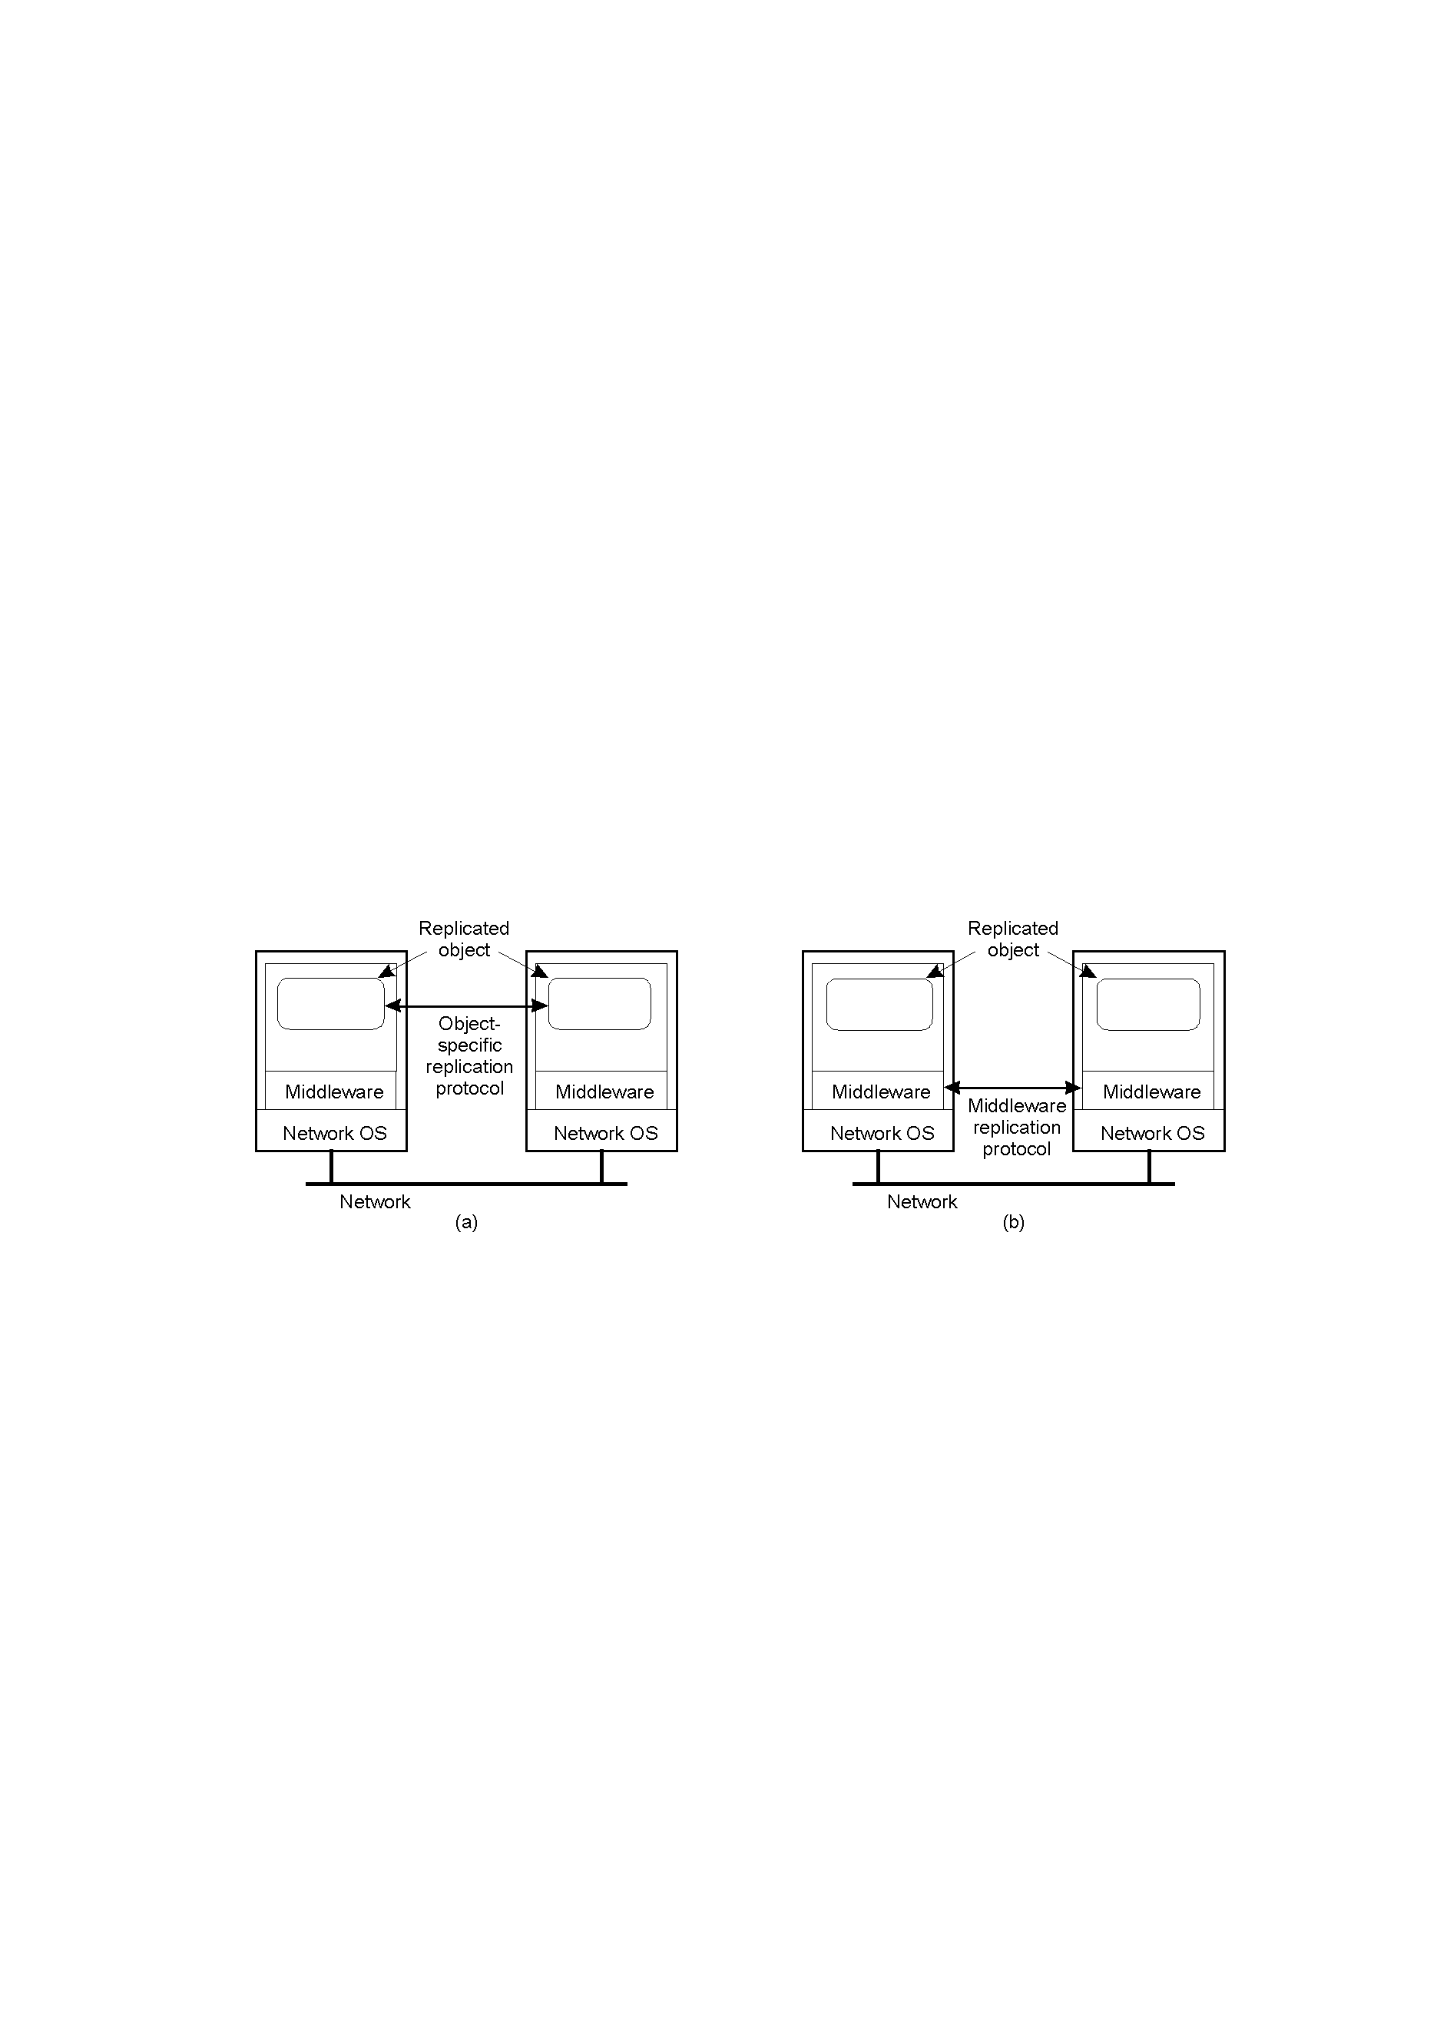
Object Replication
Approach 1: application is responsible for replication
  Application needs to handle consistency issues
Approach 2: system (middleware) handles replication
  Consistency issues are handled by the middleware
  Simplifies application development but makes object-specific solutions harder

Slide 6
Replication and Scaling
Replication and caching used for system scalability
Multiple copies:
  Improves performance by reducing access latency
  But higher network overheads of maintaining consistency
  Example: object is replicated N times
    Read frequency R, write frequency W
    If R<<W, high consistency overhead and wasted messages
    Consistency maintenance is itself an issue
      What semantics to provide?
      Tight consistency requires globally synchronized clocks!
Solution: loosen consistency requirements
  Variety of consistency semantics possible

Slide 7
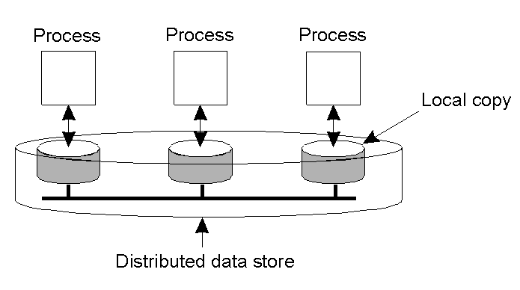
Data-Centric Consistency Models
Consistency model (aka consistency semantics)
  Contract between processes and the data store
    If processes obey certain rules, data store will work correctly
  All models attempt to return the results of the last write for a read operation
    Differ in how “last” write is determined/defined

Slide 8
Strict Consistency
Any read always returns the result of the most recent write
  Implicitly assumes the presence of a global clock
  A write is immediately visible to all processes
    Difficult to achieve in real systems (network delays can be variable)

Slide 9
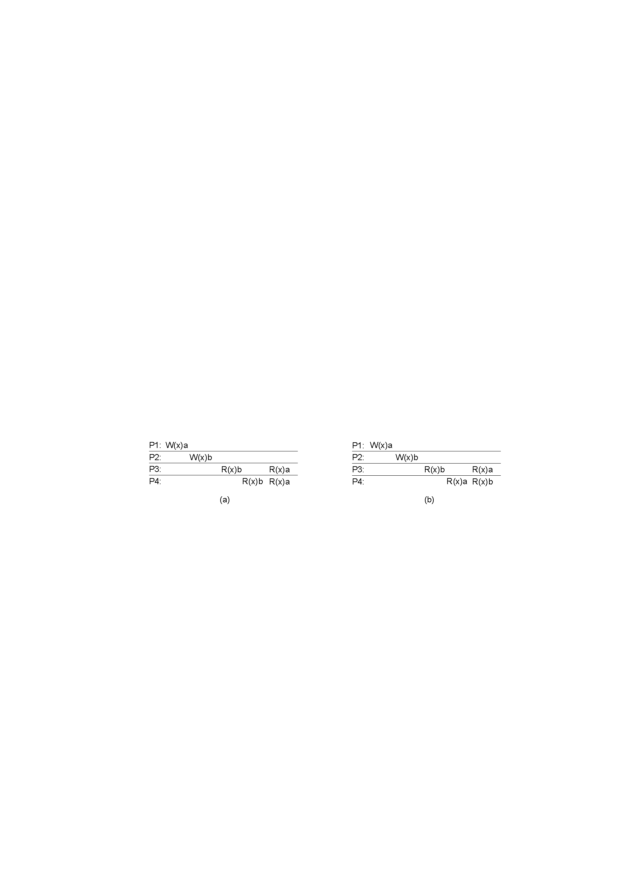
Sequential Consistency
Sequential consistency: weaker than strict consistency
  Assumes all operations are executed in some sequential order and each process issues operations in program order
    Any valid interleaving is allowed
    All agree on the same interleaving
    Each process preserves its program order
    Nothing is said about “most recent write”

Slide 10
Linearizability
Assumes sequential consistency and
  If TS(x) < TS(y) then OP(x) should precede OP(y) in the sequence
  Stronger than sequential consistency
  Difference between linearizability and serializbility?
    Granularity: reads/writes versus transactions
Example:
Process P1 | Process P2 | Process P3
x = 1; print ( y, z); | y = 1; print (x, z); | z = 1; print (x, y);

Slide 11
Linearizability Example
Four valid execution sequences for the processes of the previous slide. The vertical axis is time.
x = 1; print ((y, z); y = 1; print (x, z); z = 1; print (x, y); Prints: 001011 Signature: 001011 (a) | x = 1; y = 1; print (x,z); print(y, z); z = 1; print (x, y); Prints: 101011 Signature: 101011 (b) | y = 1; z = 1; print (x, y); print (x, z); x = 1; print (y, z); Prints: 010111 Signature: 110101 (c) | y = 1; x = 1; z = 1; print (x, z); print (y, z); print (x, y); Prints: 111111 Signature: 111111 (d)

Slide 12
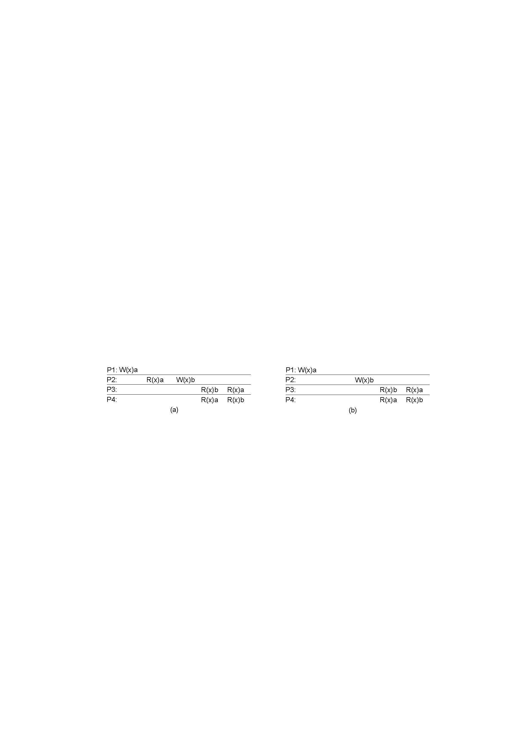
Causal consistency
Causally related writes must be seen by all processes in the same order.
  Concurrent writes may be seen in different orders on different machines
Not permitted
Permitted

Slide 13
Other models
FIFO consistency: writes from a process are seen by others in the same order. Writes from different processes may be seen in different order (even if causally related)
  Relaxes causal consistency
  Simple implementation: tag each write by (Proc ID, seq #)
Even FIFO consistency may be too strong!
  Requires all writes from a process be seen in order
Assume use of critical sections for updates
  Send final result of critical section everywhere
  Do not worry about propagating intermediate results
    Assume presence of synchronization primitives to define semantics

Slide 14
Other Models
Weak consistency
  Accesses to synchronization variables associated with a data store are sequentially consistent
  No operation on a synchronization variable is allowed to be performed until all previous writes have been completed everywhere
  No read or write operation on data items are allowed to be performed until all previous operations to synchronization variables have been performed.
Entry and release consistency
  Assume shared data are made consistent at entry or exit points of critical sections

Slide 15
Summary of Data-centric Consistency Models
Consistency | Description
Strict | Absolute time ordering of all shared accesses matters.
Linearizability | All processes must see all shared accesses in the same order. Accesses are furthermore ordered according to a (nonunique) global timestamp
Sequential | All processes see all shared accesses in the same order. Accesses are not ordered in time
Causal | All processes see causally-related shared accesses in the same order.
FIFO | All processes see writes from each other in the order they were used. Writes from different processes may not always be seen in that order
 | (a)
Consistency | Description
Weak | Shared data can be counted on to be consistent only after a synchronization is done
Release | Shared data are made consistent when a critical region is exited
Entry | Shared data pertaining to a critical region are made consistent when a critical region is entered.
 | (b)

Slide 16


Caching in WWW: Case Study
Dramatic growth in world wide web traffic
Web accesses are non-uniform in nature
  Create hot-spots of server and network load, increase latency
Solution: employ web proxy caches
  Reduces user response times, server load, network load
Network
Network
Servers
Proxies
End-hosts

Slide 17
Content Distribution Network
Servers
End-hosts
Content distribution network (CDN)
  Collection of proxies that act as intermediaries between servers and clients
  Service a client request from “closest” proxy with the object
  Similar benefits as single proxy environments, but larger scale
  Example: Akamai CDN - 13,000+ proxies
Caching in CDN => must maintain cache consistency

Slide 18
Consistency Mechanisms
Time-to-live (TTL) values
  Expiration time of cached document
  Proxy must refresh from server after expiration
    Poll: Use if-modified-since (IMS) HTTP requests
  Weaker guarantees: document can change before expiration
Poll every time
  Poll the server upon request for a cached object
  Increases response time of requests
  Provides stronger consistency guarantees

Slide 19
Consistency with Leases
Lease: fixed duration contract between server and proxy
  Server agrees to notify proxy of all updates to an object over duration d
  “d” is the lease duration
  Lease may be renewed upon expiry
Properties:
  Server needs to notify each proxy caching the object of an update
    Excessive burden for popular objects
  Leases requires a server to maintain state
    Overhead can be excessive for large CDNs
  Leases provide stronger consistency guarantees
  Push-based approach, server-initiated consistency

