Slide 1
Complex form of Fourier series
Group 6

Slide 2
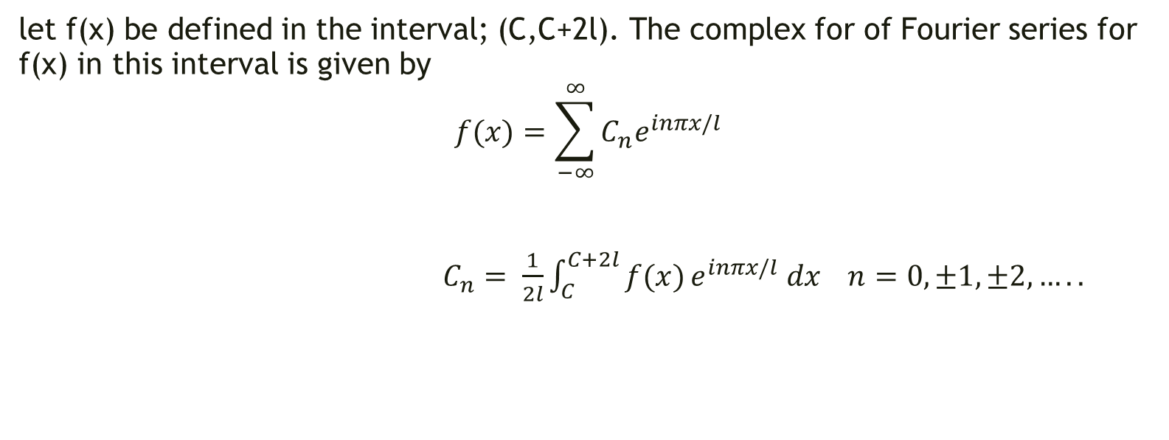
Introduction
let f(x) be defined in the interval; (C,C+2l). The complex for of Fourier series for f(x) in this interval is given by
$$f(x)=\sum_{−∞}^{∞}{C_{n}e^{inπx/l}}$$
$C_{n}= \frac{1}{2l}\int_{C}^{C+2l}{f(x)}e^{inπx/l} dx n=0,±1,±2,…..$

Slide 3
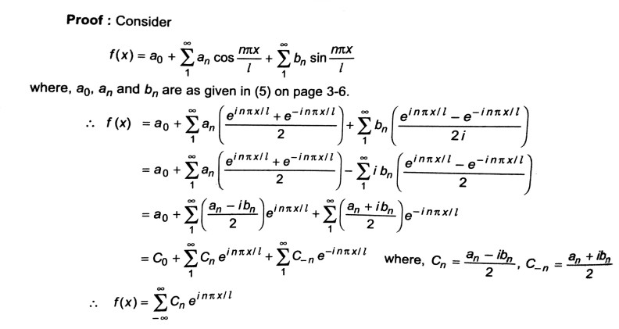
Proof of complex form of Fourier series

Slide 4
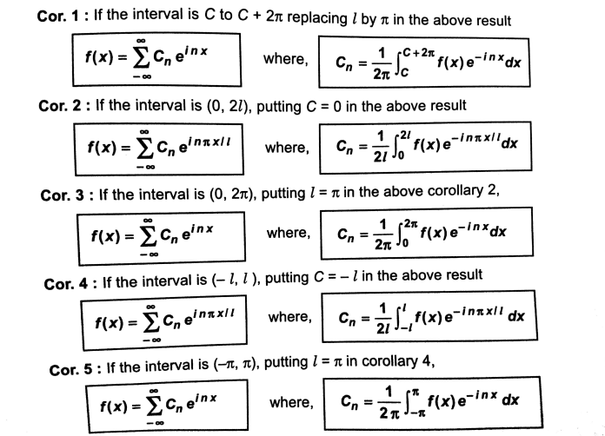
Corollary

Slide 5
Questions

Slide 6
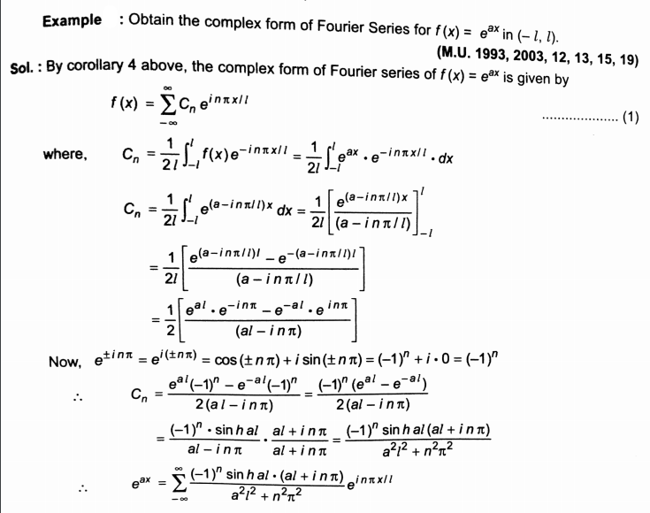

Slide 7
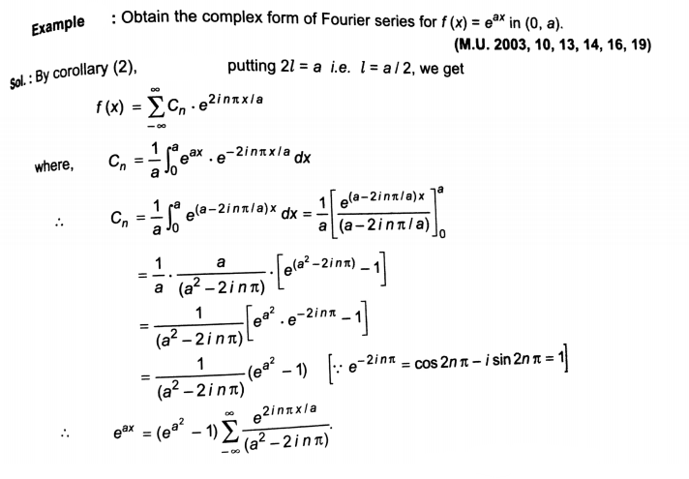

Slide 8
Thank you
Presentation made by Khan Zaki Ur Rahman Farid (19co34)

