Slide 1
Memory mapped IO vs I/O mapped IO
By
Group 6

Slide 2
Introduction
To perform the read and write process between CPU and the peripheral device or the main memory there are 2 complementary method.
Memory Mapped I/O
I/O Mapped I/O or isolated I/O

Slide 3
Memory Bus: | This bus is used for information transform.
I/O Bus: | This bus is used for information between CPU and I/O devices through their I/O interface
Some computer uses common bus system for both memory and i/o interface
Separate control lines for each function
Common address and data lines for both functions
Some computer systems use 2 different buses

Slide 4
Memory mapped I/O

Slide 5
Memory mapped I/O
Share single read / write control lines
Processor doesn’t differentiate between memory and i/o transfer
No specific input output instruction
Memory and I/O address share common address space(or address bus) due to which memory address range is reduce
Data can be transferred using any register of the processor

Slide 6
Memory mapped IO
CPU
Main memory
IO port
1200H
45902
Data Bus
Address Bus
Read
Write

Slide 7
I/O maped I/O

Slide 8
I/O mapped I/O
Separate i/o read/write control line for both memory and I/O
Separate (isolated) memory and I/O address space
We can transfer data from i/o using dedicated i/o instruction like IN and OUT only
Data can be transferred using only fixed specific register E.g..: in 8085 only register A
I/O device are mapped to I/O space not in memory space like memory mapped I/O

Slide 9
I/O mapped IO
CPU
Main memory
IO port
1200H
45266
Data Bus
Address Bus
Read M
Write M
Read IO
Write IO

Slide 10
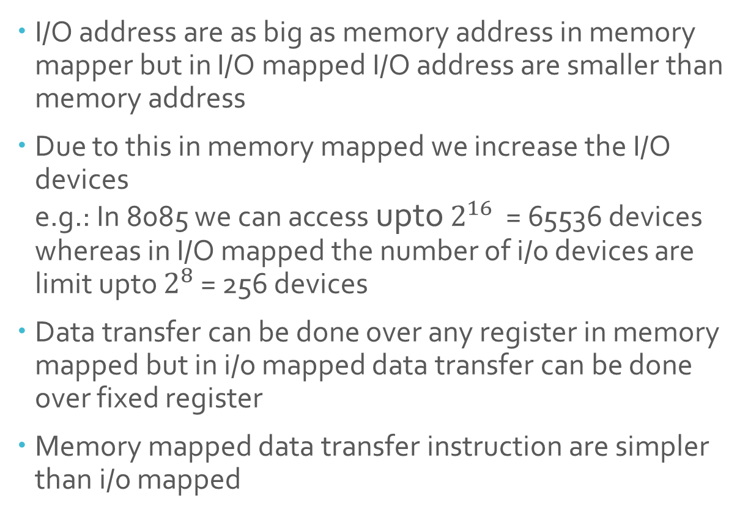
Advantage of Memory mapped over I/O mapped
I/O address are as big as memory address in memory mapper but in I/O mapped I/O address are smaller than memory address
Due to this in memory mapped we increase the I/O devices e.g.: In 8085 we can access upto $2^{16}$ = 65536 devices whereas in I/O mapped the number of i/o devices are limit upto $2^{8}$ = 256 devices
Data transfer can be done over any register in memory mapped but in i/o mapped data transfer can be done over fixed register
Memory mapped data transfer instruction are simpler than i/o mapped

Slide 11
Advantage of I/O mapped I/O over memory mapped I/O
In memory mapped the memory address are so big that decoding will be slower but as in I/O mapped the memory address are small so decoding is fast
Address decoding will be more complex and costly in memory mapped
Complex circuit is required in memory mapped i/o

Slide 12
Thank You

