Slide 1

Instant Messaging Mobile Application

Slide 2
DEVELOPERS: FEYZULLAYEV RASUL, FLOrea-ioana cristina, sadic gunal, DIMITRII GREC, CODRESCU ADRIAN-Cătălin

Slide 3
Key Features
Editable
Messages
Scheduled Messages and Reminders
Live Location with Journey Tracking
Extra Feature: Image-To-Text-To-Speech
Separate Media Display

Slide 4
DESCRIPTION
Editable Messages : The app will allow users to edit messages even after they have been sent. Scheduled Messages and Reminders : Users will be able to schedule messages for future delivery, as well as set reminders for themselves or friends on specific conversations. Live Location with Journey Tracking : Beyond standard live location sharing, we plan to add a journey tracking feature. Users will be able to see the exact path and estimated arrival time of one user to a certain location. Separate Media Display : Users can send documents and photos in chat, displayed separately from text messages in distinct sections. Image-to-Text-to-Speech : This is an extra feature that we aim to implement If time permits. We aim to allow the user to convert text images into text within the chat. Additionally, the text can then be converted into speech, offering an inclusive feature for those who prefer audio messages or have visual disabilities.

Slide 5
PROJECT BACKLOG
Priority | User Story Number | Planning Poker Game: Story Points for every User Story | User Story Description
High | 1 | 8 | Send and receive messages
High | 11 | 21 | Separate section for documents
High | 12 | 21 | Separate section for photos
Medium | 2 | 13 | Edit sent messages
Medium | 3 | 8 | Indication of edited messages
Medium | 4 | 21 | Schedule messages for future delivery
Medium | 5 | 13 | View all scheduled messages
Medium | 6 | 8 | Notification on scheduled message delivery
Medium | 7 | 3 | Set reminders within conversations
Medium | 8 | 34 | Share live location in real time
Medium | 9 | 34 | Allow friends to track journey
Medium | 10 | 34 | View route of shared journey
Low | 13 | 55 | Convert text images into text
Low | 14 | 34 | Convert text to speech
Low | 15 | 21 | Take a picture and send immediately
Low | 16 | 34 | Send instant voice recording

Slide 6
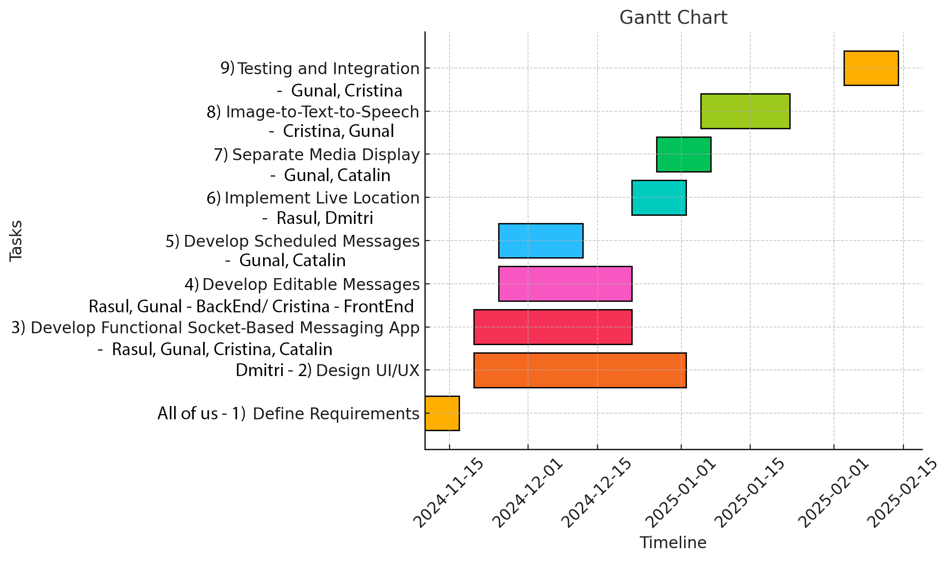

Slide 7
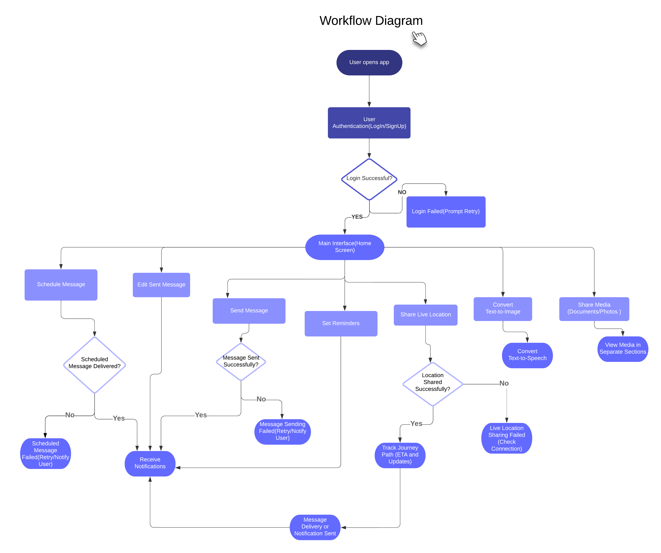
This workflow diagram illustrates a messaging app's key processes: user authentication, message scheduling and sending, live location sharing, media sharing, and accessibility features like text-to-image/speech conversion. Each action includes success or failure paths, with notifications sent based on outcomes.

Slide 8
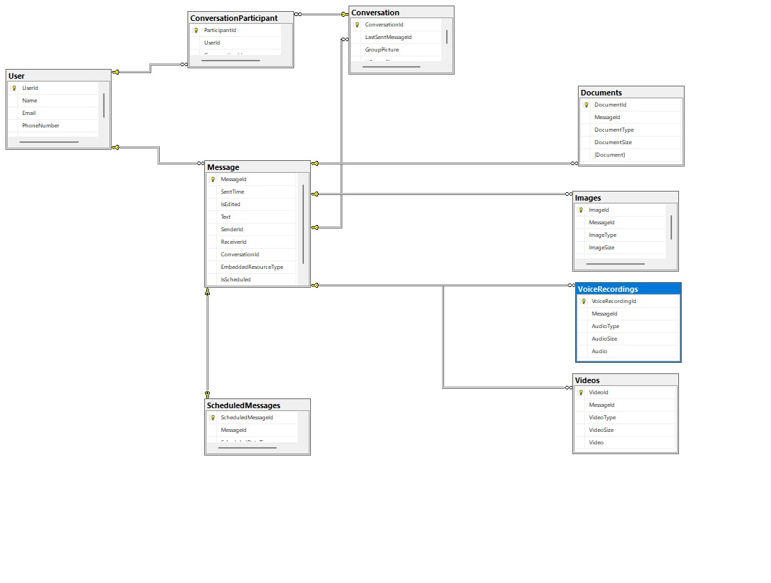
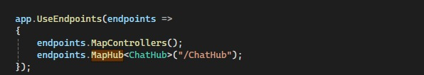
Database diagram
We created the database, tables because we will be using EF (EntityFramework) database first approach for generating Model classes.
We have some basic setting up for the Instant Messaging feature. We will be using SignalR socket connection. Below is the code used to register a Hub

Slide 9
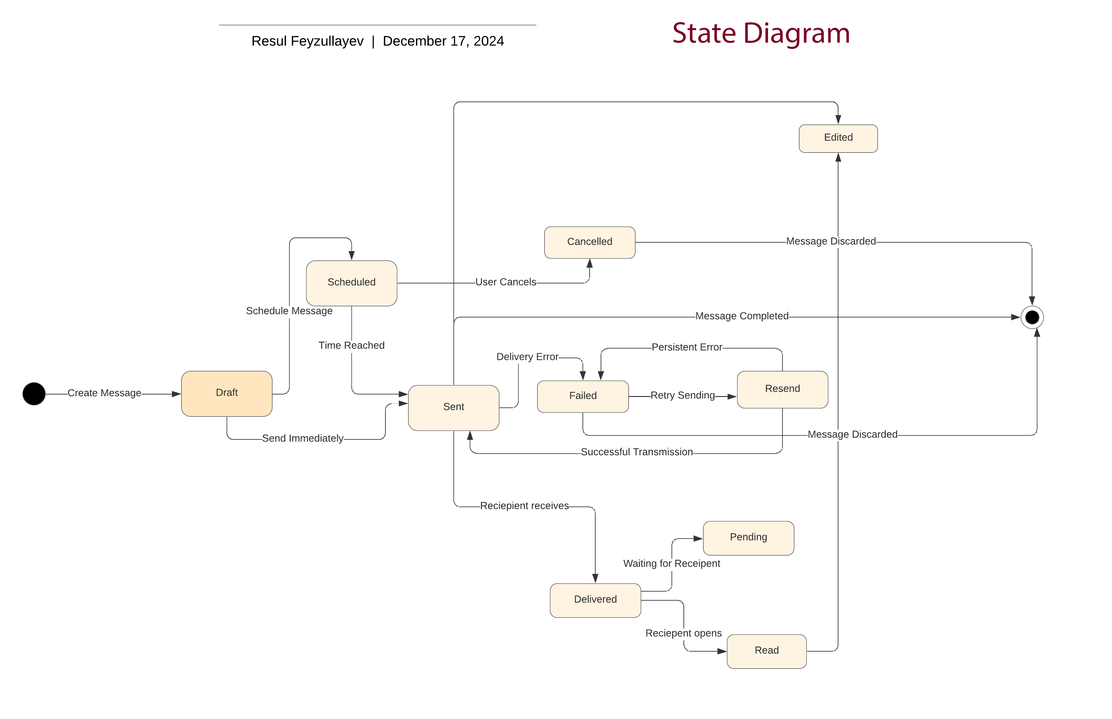

Slide 10
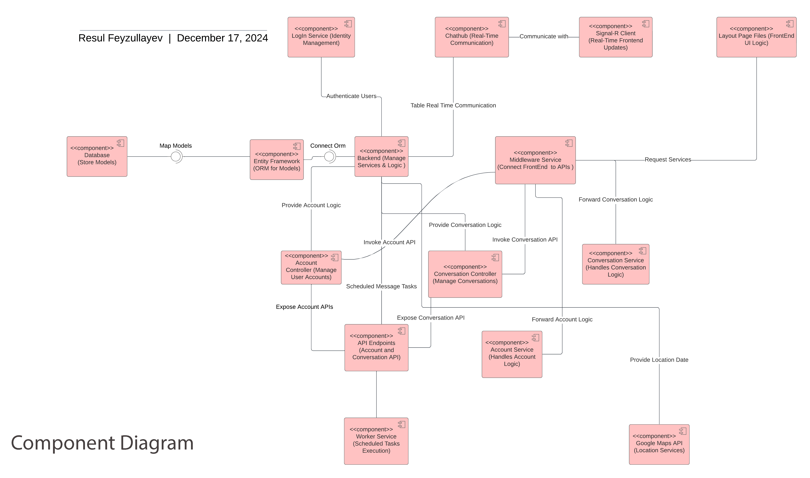

Slide 11
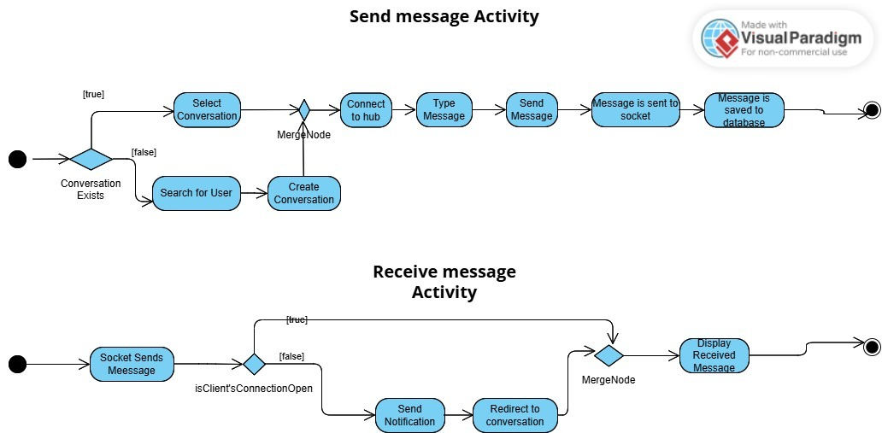
Cristina Florea
Activity Diagram

Slide 12
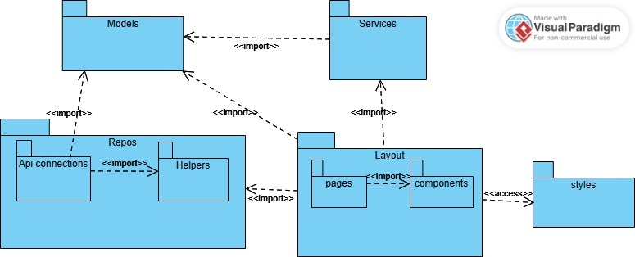
Cristina Florea
Package Diagram

Slide 13
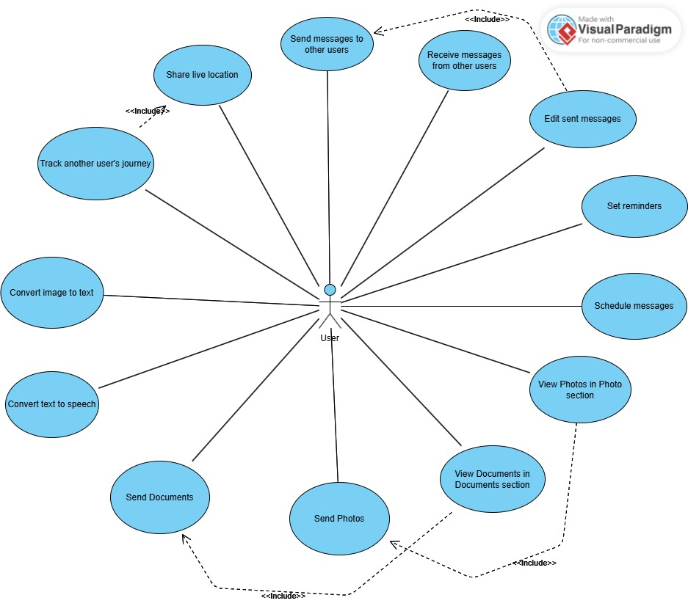
Usecase Diagram
Gunal Sadic

Slide 14
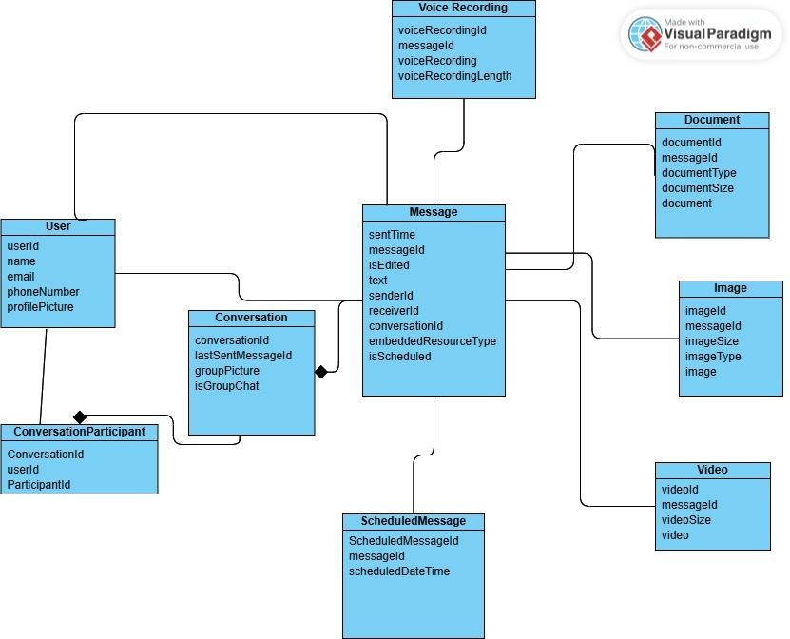
Gunal Sadic
Class Diagram

Slide 15
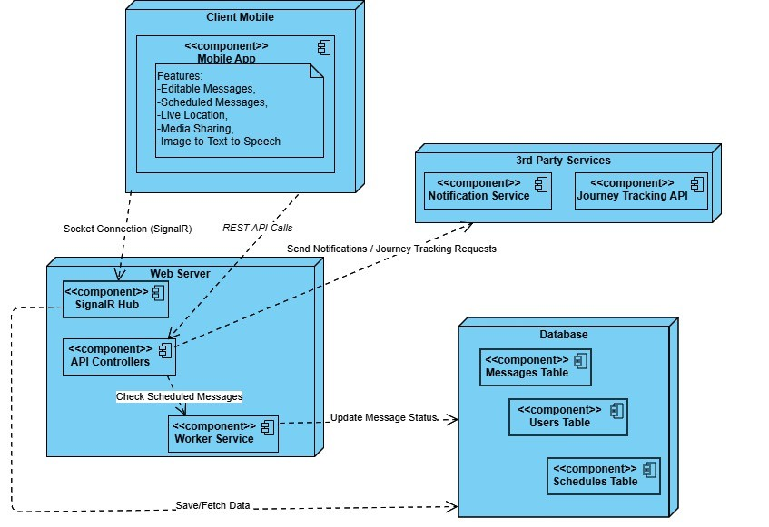
Codrescu Catalin Deployment Diagram

Slide 16
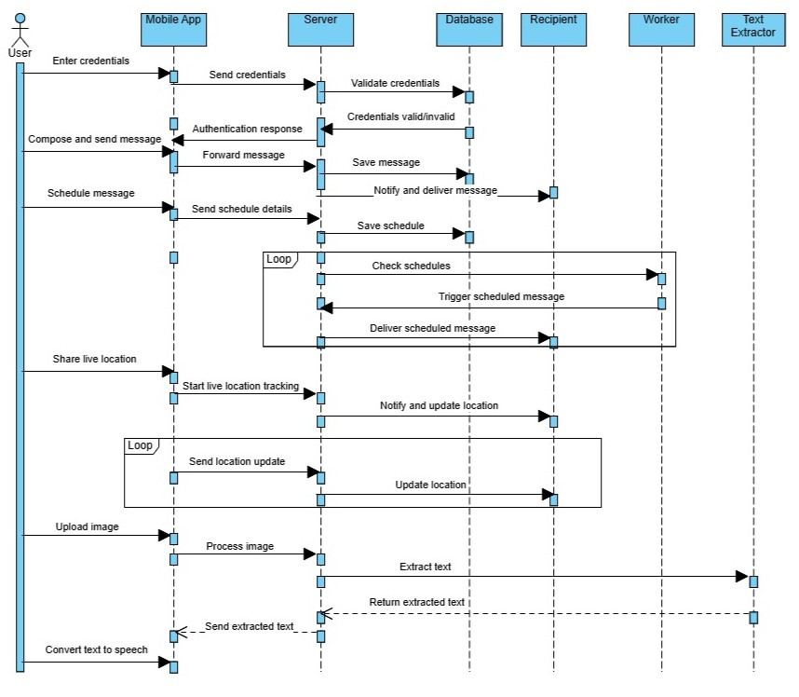
Codrescu Catalin Interaction Diagram

Slide 17
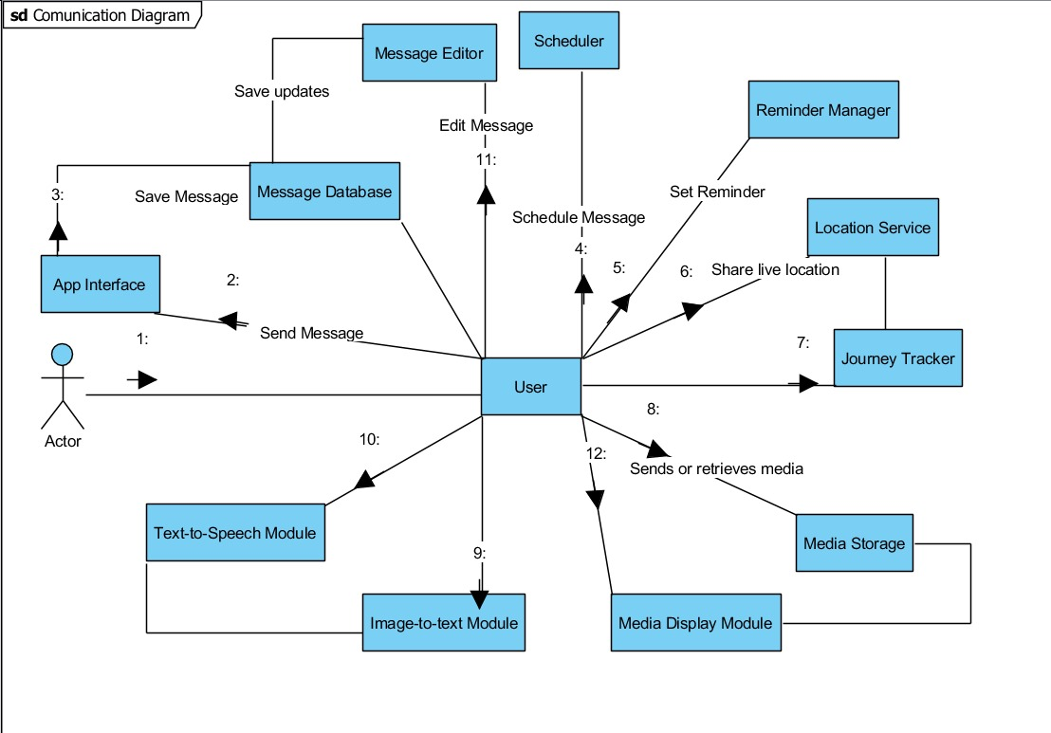
DMITRI GREC

Slide 18
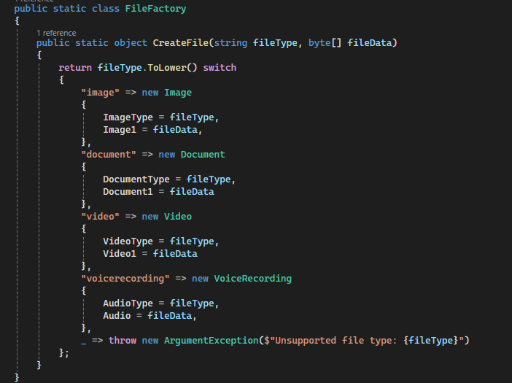
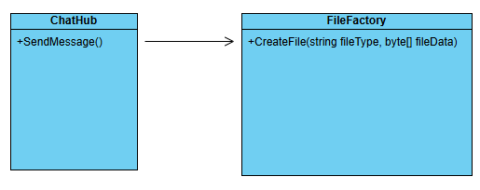
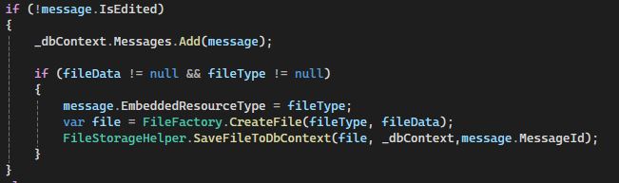
Factory Design Pattern

Slide 19
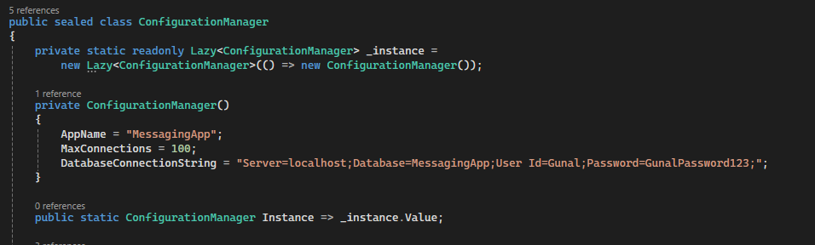
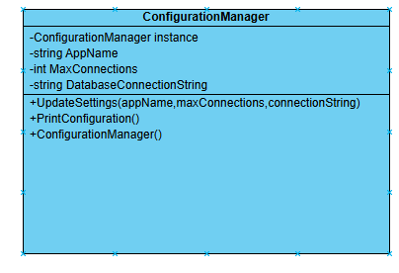
Singleton

Slide 20
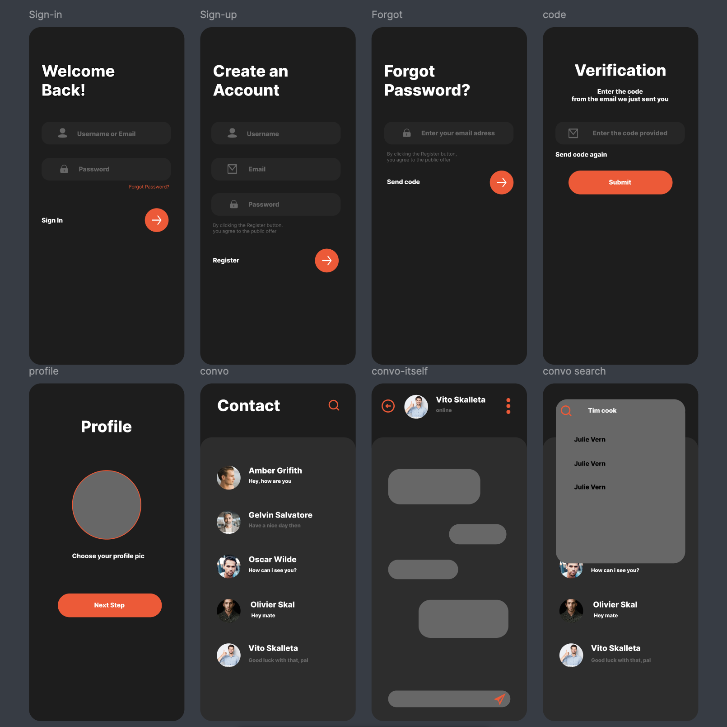
UI/UX Design
https://www.figma.com/design/iLll7IugfNnp3aINactIPF/Proiect-MOPS?node-id=0-1&node-type=canvas&t=wd9k1nyV7mkiWsPL-0

Slide 21
FrontEnd:
We created screens for Forgot password, Validation Code, Create new Password, Profile Picture, Contacts and Conversations. We added validations to the text fields in the forms on these screens.
We made services which execute calls to the back-end. We implemented a Signal-R client which sends and receives messages on sockets.
We've created the layouts for Editable and Scheduling messages and made their respective calls to the back-end. We also stored the jwt token from the login endpoing response in a secure storage.
https://github.com/FloreaIoanaCristina/Mobile_Messaging_App_FE/blob/main/lib/conversation_page.dart
BackEnd:
We created a ChatHub using SignalR which receives and sends messages and saves them in the database. We configured controllers for the api methods and we created a Worker that executes commands regularily to check if a scheduled message is due to be sent or not.
https://github.com/GunalSadic/IMBackend

Slide 22


