Slide 1
15th UBT Annual International Conference on Computer Science and Engineering · 2026
Automated Code Smell Detection and Refactoring Recommendations Using Software Metrics and Machine Learning
Florent Latifi · Altina Salihu
UBT – Higher Education Institution, Kosovo
Session 1 · Software Engineering · 24 October 2026
Notes:
Good morning, everyone. My name is Florent Latifi, and this work comes from my bachelor thesis at UBT, supervised by Altina Salihu. In the next ten minutes I will show how we can detect code smells in Java automatically, how accurate that detection really is, and how far we can go in fixing them.

Slide 2
Code smells make every change expensive, and today's tools only point at them
Code smells are design problems, not bugs
The program works, but every change costs more than it should.
Existing tools use fixed thresholds, calibrated on other code.
They point at the problem, but rarely fix it.
Q1 · Question 1
How accurate are published detection rules?
Q2 · Question 2
Does machine learning on the same metrics do better?
Q3 · Question 3
Can fixes be applied automatically without breaking compilation?
A
Rules
B
Machine learning
C
Refactoring engine
Florent Latifi · UBT 2026
2
Notes:
Every developer knows the class that nobody wants to touch. The program works, but every change takes longer than it should. These design problems are called code smells. They are not bugs, but they make maintenance expensive. Most tools find them with fixed thresholds. For example, if a method is longer than a certain number of lines, it is a Long Method. But these numbers were calibrated on other code, and most tools only point at the problem. They do not fix it. So we asked three questions. First, how accurate are the published detection rules? Second, can machine learning do better with the same metrics? And third, can we fix smells automatically without breaking the code?

Slide 3
Four code smells, each a different design problem
All four are labeled by professional developers in the MLCQ dataset
own class
other class
Blob
A class that does too much.
Data Class
Only holds data; almost no behavior.
Long Method
A method that has grown too long.
Feature Envy
A method that uses another class more than its own.
Blue line = method · gray dot = field (a piece of data) · box = class
Florent Latifi · UBT 2026
3
Notes:
This study looks at four of them. Blob is a class that does too much. Data Class only holds data and has almost no behavior. Long Method is a method that has grown too long, and Feature Envy is a method that uses another class more than its own.

Slide 4
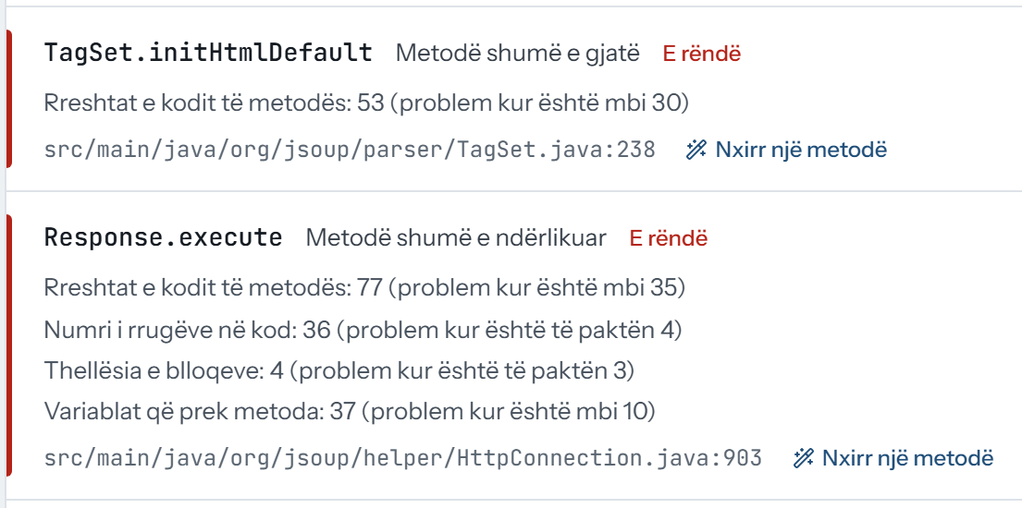
JavaSmell measures 26 metrics once and answers with three approaches
One analyzer: A rules · B machine learning · C refactoring engine
Java source code
26 metrics: lines, complexity, coupling, …
A
8 published rules
B
Machine learning
Smells, each with the conditions that fired
C
Refactoring engine: rewrites only what it can prove
Web interface in plain language (Albanian): every finding shows the conditions that fired
javac check, then a patch — never written in place
Florent Latifi · UBT 2026
4
Notes:
To answer these questions, I built a tool called JavaSmell. It reads Java code and measures 26 metrics for every class and method. On top of these metrics there are three approaches. A uses 8 detection strategies from the literature, such as Lanza and Marinescu and Fowler. B trains machine learning classifiers on the same metrics. And C is a refactoring engine. It rewrites code only when it can prove its preconditions from the syntax tree, and then it checks the result with the Java compiler. Every detection also shows the conditions it checked, so a developer can see why a class was flagged, not only that it was. On the right you can see the web interface. It also has a plain-language mode for people without a technical background.

Slide 5
Professional developers label the code; no model is tested on a project it saw
MLCQ (Madeyski & Lewowski, 2020): reviewed by 26 professional developers
Q1
Q2
Q3
testing Q1 · Q2
9,046
pieces of code (classes or methods) judged by professional developers
512
open-source projects they come from
Why the score is MCC, not accuracy
92.8%
accuracy of a detector that always says “clean” on Feature Envy. Its MCC is 0, the same as guessing.
learn
learn
learn
learn
test
Projects split into 5 groups: learn from four, test on the fifth, which the model has never seen. Five times.
Florent Latifi · UBT 2026
5
Notes:
For a fair test, we need labels from people. We used MLCQ, a public dataset where professional developers reviewed real open-source Java code. After matching the samples to our tool, we have 9,046 labeled samples from 512 repositories, for four smells. One important detail is how we split the data. Code from the same project looks very similar, so we grouped the data by repository: a model is never tested on a project it learned from. And we report the Matthews correlation coefficient, MCC. Most samples are clean, so simple accuracy would look very good even for a detector that never fires.

Slide 6
Learned models beat the rules on all four smells
Same 9,046 samples, same scoring · higher is better
Q1
Q2
Q3
answers Q1 · Q2
How to read MCC
0 = guessing
1 = perfect
Out of 100 real smells
17–47
found by the rules
30–83
found by the models
The price: usually more false alarms.
Florent Latifi · UBT 2026
6
Notes:
Here are the main results. The gray bars are the published rules, and the blue bars are the best machine learning model for each smell. The rules are often correct when they fire, but they catch only 17 to 47 percent of the smells that developers marked. The models are better on all four smells, with MCC from 0.32 to 0.72. Out of every 100 smells, they find 30 to 83; the price is usually more false alarms. We also computed 95 percent confidence intervals by resampling repositories. The improvement is clearly above zero for Blob, Data Class and Long Method. For Feature Envy, the difference could be chance. We also compared with PMD, a popular open-source analyzer, on the same samples. Once the confidence interval is considered, PMD is never ahead, and for Long Method our rules are clearly better.

Slide 7
For Feature Envy, even two experts agree no better than chance
Two reviewers judged the same code: how often did they agree?
Q1
Q2
Q3
explains Q2
How to read MCC
0 = guessing
1 = perfect
−0.07
Feature Envy: agreement of a coin flip
If experts do not agree on what a smell is, no detector can learn it well.
Florent Latifi · UBT 2026
7
Notes:
Why is Feature Envy so hard? We measured how much the human reviewers agree with each other. For Blob, Data Class and Long Method, two reviewers agree only moderately. For Feature Envy, they agree no better than chance. For Feature Envy, their MCC is -0.07, practically zero. This matches the previous slide: Feature Envy is where the model could not clearly beat the rules. So the problem is not only the algorithm. It is the definition of the smell itself. If experts do not agree on what a smell is, no detector can learn it well. For me, this is the main lesson of the detection part.

Slide 8
The engine rewrites only what it can prove, and refuses the rest with a reason
Three transformations: Extract Method · Guard Clauses · Introduce Parameter Object
Q1
Q2
Q3
answers Q3
15,800 places in the code where a fix could apply
3,532 rewritten
22.4%
12,252 refused: not provably safe, each with a reason
77.5%
What happened to the 3,532 rewrites
64.8%
removed the smell they were made for
1.6%
added a new kind of compile error, so they are never written
62.9%
acceptable to a developer, in a manual review of 60
Florent Latifi · UBT 2026
8
Notes:
Now the refactoring engine. It supports three transformations: Extract Method, Replace Nested Conditional with Guard Clauses, and Introduce Parameter Object. On the whole corpus it found 15,800 sites and rewrote 3,532 of them, which is 22 percent. The rest were refused, each with a reason. In 45 percent of the sites, the reason is simply that the code does not have the shape the transformation needs. For us, refusing is a correct result, not a failure. After rewriting, the smell disappeared in 65 percent of the cases. Only 1.6 percent of the rewrites introduced a new type of compilation error, and those never reach the code, because the tool only writes verified rewrites. I also read 60 rewrites by hand: after reweighting, about 63 percent would be acceptable to a developer. Refactoring can also create new smells: 865 appeared after rewriting, most often Long Parameter List, because Extract Method passes every input as a parameter. In that review, Guard Clauses were always acceptable, and Introduce Parameter Object never, because it only moves the long list into a new class.

Slide 9
Real code: the outer if becomes an early return
Apache Geode · DistributedRegion.checkForLimitedOrNoAccess · Guard Clauses
Q1
Q2
Q3
example for Q3
Before
−1 level
of nesting: everything after the guard moves up
@Override
public void checkForLimitedOrNoAccess() {
if (this.requiresReliabilityCheck && this.isMissingRequiredRoles) {
if (getMembershipAttributes().getLossAction().isNoAccess()
|| getMembershipAttributes().getLossAction().isLimitedAccess()) {
synchronized (this.missingRequiredRoles) { /* … 9 unchanged lines */ }
}
}
}
1
The outer condition becomes an early return.
After
@Override
public void checkForLimitedOrNoAccess() {
if (!(this.requiresReliabilityCheck && this.isMissingRequiredRoles)) {
return;
}
if (getMembershipAttributes().getLossAction().isNoAccess()
|| getMembershipAttributes().getLossAction().isLimitedAccess()) {
synchronized (this.missingRequiredRoles) { /* … 9 unchanged lines */ }
}
}
2
Passed the javac check.
3
Judged acceptable as-is in the manual review.
Florent Latifi · UBT 2026
9
Notes:
Here is one real example from Apache Geode. Before, the whole method is wrapped in one if statement, so everything is nested deeply. After the rewrite, the condition becomes a guard clause with an early return, and the rest of the method moves one level up. The engine accepts only exactly this shape: a void method whose whole body is one if statement, without else. It also wraps the condition in a not, instead of inverting it by hand, so it stays correct for every condition. The rewrite passed the compiler check, and in my review it was acceptable as it is.

Slide 10
Three answers, and their limits
Limitations
Answers
Compiles ≠ behaves the same: project tests were not run.
One dataset, four smells, Java only.
Best model chosen on the same predictions: slightly optimistic.
Q1
Rules are precise, but find only 17–47 of every 100 smells.
Q2
Learned models do better on all four, clearly on three.
Q3
Yes, for 22% of places, and nothing that breaks compiling is written.
Thank you · Questions?
github.com/FlorentLatifi/Code-Smell-Detection-and-Refactoring-Recommendations
Florent Latifi · UBT 2026
10
Notes:
To be honest about the limits: compiling is not the same as behaving the same. We did not run the projects' test suites, so behavior preservation is future work. We also used one dataset, four smells, and only Java. And the best model was chosen on the same predictions it is scored on, so its numbers are slightly optimistic. As next steps, I would add a small symbol resolver to support more refactorings, and ask independent reviewers to judge the rewrites. To summarize: learned boundaries beat fixed thresholds. Safe automatic refactoring is possible, but narrow, and it should be reviewed by a developer. The tool is open source, and every number in this talk can be regenerated with a script. Thank you. I am happy to take your questions.

Slide 11
Backup · Full detection results
Precision, recall and MCC for both approaches
Smell | Rules P | Rules R | Rules MCC | Model | Model P | Model R | Model MCC
Blob | 0.816 | 0.174 | 0.336 | Logistic regression | 0.510 | 0.770 | 0.539
Data Class | 0.765 | 0.230 | 0.367 | Gradient boosting | 0.546 | 0.590 | 0.473
Feature Envy | 0.413 | 0.188 | 0.243 | Gradient boosting | 0.438 | 0.297 | 0.321
Long Method | 0.888 | 0.470 | 0.617 | Random forest | 0.690 | 0.833 | 0.723
Florent Latifi · UBT 2026
11
Notes:
Use when asked for precision or recall per smell.

Slide 12
Backup · Confidence intervals
95% bootstrap intervals, resampling whole repositories
Smell | Rules (A) | Model (B) | B − A | Above zero
Blob | [0.274, 0.393] | [0.494, 0.581] | [0.138, 0.271] | yes
Data Class | [0.313, 0.423] | [0.419, 0.530] | [0.050, 0.163] | yes
Feature Envy | [0.158, 0.330] | [0.246, 0.398] | [-0.012, 0.166] | no
Long Method | [0.559, 0.667] | [0.681, 0.768] | [0.050, 0.165] | yes
Florent Latifi · UBT 2026
12
Notes:
Above zero means the model's advantage is not explained by which projects happen to be in the sample.

Slide 13
Backup · Every algorithm
MCC of each classifier, same folds
Smell | Logistic regression | Random forest | Gradient boosting | Rules (A)
Blob | 0.539 | 0.510 | 0.505 | 0.336
Data Class | 0.426 | 0.471 | 0.473 | 0.367
Feature Envy | 0.241 | 0.296 | 0.321 | 0.243
Long Method | 0.707 | 0.723 | 0.700 | 0.617
Florent Latifi · UBT 2026
13
Notes:
If asked whether choosing the best model inflates the result: yes, slightly. Even the weakest learning algorithm beats the rules on three of four smells.

Slide 14
Backup · Comparison with PMD
PMD 7.27.0 with its default thresholds, same samples
Smell | PMD MCC | Our MCC | Difference, 95% CI
Blob (strategy) | 0.382 | 0.342 | -0.088 to +0.008
Blob (with size) | 0.382 | 0.487 | +0.054 to +0.158
Data Class | 0.319 | 0.365 | -0.012 to +0.101
Feature Envy (LawOfDemeter) | 0.056 | — | —
Long Method | 0.221 | 0.615 | +0.316 to +0.475
Florent Latifi · UBT 2026
14
Notes:
PMD is never ahead once the confidence interval is considered. PMD has no Feature Envy rule.

Slide 15
Backup · Verification in detail
Why sites were refused, and what compiling inside the project shows
Code shape does not match the transformation: 7,154 sites (45.3%)
A return, break or continue leaves the block: 4,050 sites (25.6%)
An input value is not definitely assigned: 621 sites (3.9%)
Same 201 rewrites compiled inside their project: 4 → 66 compile fully, 2 add a new error.
After rewriting, 865 new smells appeared, mostly Long Parameter List from Extract Method.
Florent Latifi · UBT 2026
15
Notes:
Isolated files often cannot compile because their neighbours are missing; inside the project many more compile fully.

Slide 16
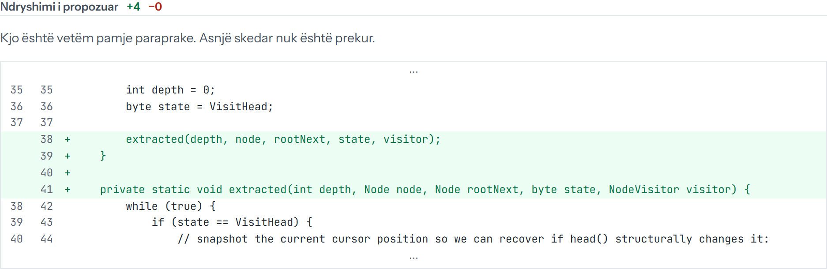
Backup · Extract Method in the interface
jsoup · NodeTraversor.traverse, preview before any file is touched
Florent Latifi · UBT 2026
16
Notes:
The extracted method is named 'extracted'; choosing a meaningful name is left to the developer.

Slide 17
Backup · Comparison with the literature
Madeyski & Lewowski (2023), same MLCQ dataset, DS1
Smell | Rules (A) | Model (B) | Madeyski & Lewowski 2023
Blob | 0.336 | 0.539 | 0.51 (RF)
Data Class | 0.367 | 0.473 | 0.57 (RF)
Feature Envy | 0.243 | 0.321 | 0.31 (FDA)
Long Method | 0.617 | 0.723 | > 0.75 (RF)
Florent Latifi · UBT 2026
17
Notes:
They used random 5-fold cross-validation and tuned hyperparameters; we grouped by repository and did not tune. Our results are in the same range.

