Slide 1
15th UBT Annual International Conference on Computer Science and Engineering · 2026
Automated Code Smell Detection and Refactoring Recommendations Using Software Metrics and Machine Learning
Florent Latifi · Altina Salihu
UBT – Higher Education Institution, Kosovo
Session 1 · Software Engineering · 24 October 2026
Notes:
Good morning, everyone. My name is Florent Latifi. This is my bachelor thesis at UBT, with my supervisor Altina Salihu. In the next minutes I will show three things: how a tool can find design problems in Java code, how accurate it is, and whether it can also fix them.

Slide 2
Code smells make every change expensive, and today's tools only point at them
Code smells are design problems, not bugs [1]
The program works, but every change costs more than it should.
Existing tools use fixed thresholds, calibrated on other code [2].
They point at the problem, but rarely fix it.
Q1 · Question 1
How accurate are published detection rules?
Q2 · Question 2
Does machine learning on the same metrics do better?
Q3 · Question 3
Can fixes be applied automatically without breaking compilation?
A
Rules
B
Machine learning
C
Refactoring engine
Florent Latifi · UBT 2026
2
Notes:
Every developer knows the class that nobody wants to touch. The program works, but every small change takes too long. We call these design problems code smells. They are not bugs. They make the code expensive to change. Most tools use fixed numbers: if a method has more than 30 lines, it is a Long Method. But these numbers come from other projects, and the tools do not fix anything. So I asked three questions. One: how accurate are the published rules? Two: can machine learning do better? Three: can a tool fix these smells automatically, without breaking the code?

Slide 3
What this work adds to earlier studies
Three gaps in earlier studies, and how this work addresses each
Earlier studies
This work
Published rules are taken as correct, with thresholds set on other systems [2].
→
The rules are measured against 26 professional developers in MLCQ [3].
Rules and machine learning are rarely compared on the same data, and scores depend on how the data are built [4], [5].
→
Same 9,046 samples, same score (MCC), split by project, with 95% intervals.
Finding and fixing are studied apart: a fix is proposed, and the decision is left to the developer [6].
→
One chain: find → rewrite → compile → measure again, with the preconditions proven first [7].
And an open tool: a plain-language interface in Albanian, and every number regenerated by one script.
Florent Latifi · UBT 2026
3
Notes:
What is new, compared with earlier studies? Three things. First, I measure the published rules against professional developers, instead of taking them as correct. Second, rules and machine learning are compared on the same samples, with the same score and a split by project. Third, one tool finds a smell, fixes it, checks it with the compiler, and measures it again.

Slide 4
Four code smells, each a different design problem
Definitions after Fowler [1]; all four are labeled by professional developers in MLCQ [3]
own class
other class
Blob
A class that does too much.
Data Class
Only holds data; almost no behavior.
Long Method
A method that has grown too long.
Feature Envy
A method that uses another class more than its own.
Blue line = method · gray dot = field (a piece of data) · box = class
Florent Latifi · UBT 2026
4
Notes:
In this study I look at four smells. A Blob is a class that does too much. A Data Class only holds data and does almost nothing with it. A Long Method is a method that has grown too long. And Feature Envy is a method that works more with another class than with its own.

Slide 5
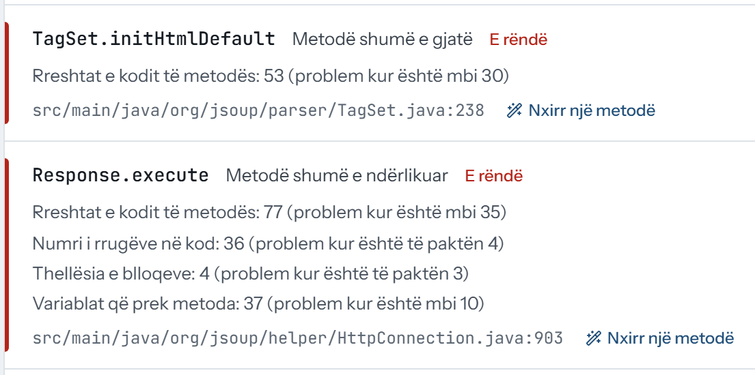
JavaSmell measures 26 metrics once and answers with three approaches
One analyzer: A rules · B machine learning · C refactoring engine
Java source code
26 metrics: lines, complexity, coupling, … [2], [8]
A
8 published rules
B
Machine learning
Smells, each with the conditions that fired
C
Refactoring engine: rewrites only what it can prove
Web interface in plain language (Albanian): every finding shows the conditions that fired
javac check, then a patch — never written in place
Florent Latifi · UBT 2026
5
Notes:
To answer the three questions, I built a tool called JavaSmell. It reads Java code and measures 26 numbers for every class and method, like the number of lines or how complex the code is. Part A uses 8 rules from well-known books and papers. Part B uses machine learning on the same numbers. Part C fixes the code, but only when it can prove that the change is safe. On the right you see the web interface, in plain Albanian, for people who are not experts.

Slide 6
Professional developers label the code; no model is tested on a project it saw
MLCQ [3]: reviewed by 26 professional developers
Q1
Q2
Q3
testing Q1 · Q2
9,046
pieces of code (classes or methods) judged by professional developers
512
open-source projects they come from
Why MCC, not accuracy [9]
92.8%
accuracy of a detector that always says “clean” on Feature Envy. Its MCC is 0, the same as guessing.
learn
learn
learn
learn
test
Projects split into 5 groups: learn from four, test on the fifth, which the model has never seen. Five times.
Florent Latifi · UBT 2026
6
Notes:
To test the tool fairly, I need answers from real people. I used MLCQ, a public dataset where professional developers judged real Java code. In total I have 9,046 pieces of code from 512 open-source projects. A model is never tested on a project it has already seen: it learns from four groups of projects and is tested on the fifth. To score the results I use MCC, not simple accuracy. On Feature Envy, a detector that always says “clean” is 93 percent accurate, but it is useless. Its MCC is zero.

Slide 7
Learned models beat the rules on all four smells
Same 9,046 samples, same scoring · higher is better
Q1
Q2
Q3
answers Q1 · Q2
How to read MCC
0 = guessing
1 = perfect
Out of 100 real smells
17–47
found by the rules
30–83
found by the models
The price: usually more false alarms.
Florent Latifi · UBT 2026
7
Notes:
Here are the main results. Gray is the published rules, blue is machine learning. Higher is better: zero means guessing, one means perfect. The rules are usually right when they raise an alarm, but out of every 100 real smells, they find only 17 to 47. Machine learning is better on all four smells. It finds 30 to 83 out of 100, but usually with more false alarms. For Blob, Data Class and Long Method, the improvement is real, not luck. For Feature Envy, it could be luck.

Slide 8
For Feature Envy, even two experts agree no better than chance
Two reviewers judged the same code: how often did they agree?
Q1
Q2
Q3
explains Q2
How to read MCC
0 = guessing
1 = perfect
−0.07
Feature Envy: agreement of a coin flip
If experts do not agree on what a smell is, no detector can learn it well.
Florent Latifi · UBT 2026
8
Notes:
Why is Feature Envy so hard? I looked at code that two developers judged, and checked how often they agree. For Blob, Data Class and Long Method, they agree only partly. For Feature Envy, they agree no more than a coin flip. So the problem is not only the algorithm. If experts do not agree on what a smell is, no tool can learn it well.

Slide 9
The engine rewrites only what it can prove, and refuses the rest with a reason
Three transformations: Extract Method · Guard Clauses · Introduce Parameter Object
Q1
Q2
Q3
answers Q3
15,800 places in the code where a fix could apply
3,532 rewritten
22.4%
12,252 refused: not provably safe, each with a reason
77.5%
+ 16 (0.1%) could not be found again in the file, so no fix was tried 3,532 + 12,252 + 16 = 15,800
The 3,532 rewrites, by fix
Why the 12,252 were refused
Extract Method
3,298
Code shape does not match the fix
7,154
Introduce Parameter Object
155
A return, break or continue leaves the block
4,050
Guard Clauses
79
An input value is not definitely assigned
621
Three other reasons
427
Florent Latifi · UBT 2026
9
Notes:
Now the third question: can we fix smells automatically? The tool knows three fixes: split a long method, turn a big if into an early exit, and group many parameters into one object. In all the projects, it found 15,800 places where a fix could apply. It changed 3,532 of them, about 22 percent. It refused 12,252, because it could not prove the change was safe, and it always says why. The other 16 could not be found again in the file. For me, a refusal is a good result, not a failure.

Slide 10
Each rewrite is checked before and after, but compiling ≠ the same behavior
How the rewrites were validated, from the syntax tree to a manual review
Q1
Q2
Q3
validates Q3
Before: prove the preconditions [7]
on the syntax tree, or refuse with a reason
3,532 rewritten
12,252 refused
1
Not verified
Compiling ≠ the same behavior
No step runs the program. The projects' own tests were not run: the data keeps only .java files, without build files or libraries.
So the claim is: the rewrite compiles, or adds no new kind of error.
After: compile with javac
the rewritten file may add no new kind of error
3,471 pass (98.3%)
58 fail, never written · 3 no verdict
2
Measure the smell again
does the detector still fire on the new code?
2,287 removed (64.8%)
793 remain · 452 not identifiable
3
Sample: compile inside the project
201 rewrites in 60 files, with their neighbours
66 compile fully
2 new errors · 19 no verdict
4
Read by hand
60 rewrites: behavior, benefit, acceptance
62.9% acceptable
1 changed the behavior
5
Florent Latifi · UBT 2026
10
Notes:
How do I know a rewrite is correct? I check it in steps. Before the change, the tool must prove its conditions on the syntax tree, or it refuses. After the change, the compiler checks the file: 98 percent pass, and the 58 that fail are never written. Then the smell is measured again: it is gone after 65 percent of the rewrites. Finally, I read 60 rewrites by hand: about 63 percent were acceptable, and one changed the behavior. So, to be clear: compiling does not guarantee the same behavior, because I could not run the projects' own tests.

Slide 11
Real code: the outer if becomes an early return
Apache Geode · DistributedRegion.checkForLimitedOrNoAccess · Guard Clauses
Q1
Q2
Q3
example for Q3
Before
−1 level
of nesting: everything after the guard moves up
@Override
public void checkForLimitedOrNoAccess() {
if (this.requiresReliabilityCheck && this.isMissingRequiredRoles) {
if (getMembershipAttributes().getLossAction().isNoAccess()
|| getMembershipAttributes().getLossAction().isLimitedAccess()) {
synchronized (this.missingRequiredRoles) { /* … 9 unchanged lines */ }
}
}
}
1
The outer condition becomes an early return.
After
@Override
public void checkForLimitedOrNoAccess() {
if (!(this.requiresReliabilityCheck && this.isMissingRequiredRoles)) {
return;
}
if (getMembershipAttributes().getLossAction().isNoAccess()
|| getMembershipAttributes().getLossAction().isLimitedAccess()) {
synchronized (this.missingRequiredRoles) { /* … 9 unchanged lines */ }
}
}
2
Passed the javac check.
3
Judged acceptable as-is in the manual review.
Florent Latifi · UBT 2026
11
Notes:
Here is one real example, from the Apache Geode project. Before: the whole method is inside one big if, so all the code is pushed to the right. After: the condition becomes an early return, and the rest of the code moves one level up. The result compiles, and in my review it was acceptable without any change.

Slide 12
Key findings and what comes next
Key findings
Why it matters
Q1
Rules are precise, but find only 17–47 of every 100 smells.
Published thresholds are a starting point: calibrate or learn them for your own code.
An automatic fix is a compiler-checked proposal that a developer reviews and tests.
Q2
Learned models do better on all four, clearly on three.
Future research
Q3
Yes, for 22% of places; 98% compile or add no new error, but behavior is not yet proven.
Run the projects' own tests, to go from “compiles” to “behaves the same”.
Resolve names inside a project, to add Move Method and Encapsulate Field.
More smells beyond MLCQ, and reviewers other than the author.
Limits: one dataset, four smells, Java only; the best model was chosen on the same predictions, so it is slightly optimistic.
Thank you · Questions?
github.com/FlorentLatifi/Code-Smell-Detection-and-Refactoring-Recommendations
Florent Latifi · UBT 2026
12
Notes:
So, the three answers. One: the published rules are precise, but they miss most smells. Two: machine learning on the same numbers does better. Three: about one place in four can be fixed automatically. The compiler checks every change, but the behavior is not yet proven. In practice, published thresholds are a starting point, not a final answer, and an automatic fix is a proposal that a developer reviews. Next, I want to run the projects' own tests, support more fixes, and ask other developers to judge the changes. Everything is open source, every number can be recreated with a script, and the references are on the next slide. Thank you. I am happy to answer your questions.

Slide 13
References
Cited on these slides, in IEEE style; the thesis lists all 45 sources
[1] M. Fowler, Refactoring: Improving the Design of Existing Code, 2nd ed. Boston, MA, USA: Addison-Wesley, 2018.
[2] M. Lanza and R. Marinescu, Object-Oriented Metrics in Practice: Using Software Metrics to Characterize, Evaluate, and Improve the Design of Object-Oriented Systems. Berlin, Germany: Springer, 2006, doi: 10.1007/3-540-39538-5.
[3] L. Madeyski and T. Lewowski, “MLCQ: Industry-relevant code smell data set,” in Proceedings of the 24th International Conference on Evaluation and Assessment in Software Engineering (EASE ’20), 2020, pp. 342–347, doi: 10.1145/3383219.3383264.
[4] F. Arcelli Fontana, M. V. Mäntylä, M. Zanoni, and A. Marino, “Comparing and experimenting machine learning techniques for code smell detection,” Empirical Software Engineering, vol. 21, no. 3, pp. 1143–1191, 2016, doi: 10.1007/s10664-015-9378-4.
[5] D. Di Nucci, F. Palomba, D. A. Tamburri, A. Serebrenik, and A. De Lucia, “Detecting code smells using machine learning techniques: Are we there yet?” in Proceedings of the 25th IEEE International Conference on Software Analysis, Evolution and Reengineering (SANER ’18), 2018, pp. 612–621, doi: 10.1109/SANER.2018.8330266.
[6] N. Tsantalis and A. Chatzigeorgiou, “Identification of Move Method refactoring opportunities,” IEEE Transactions on Software Engineering, vol. 35, no. 3, pp. 347–367, 2009, doi: 10.1109/TSE.2009.1.
[7] W. F. Opdyke, “Refactoring object-oriented frameworks,” Ph.D. dissertation, University of Illinois at Urbana-Champaign, Urbana, IL, USA, 1992.
[8] S. R. Chidamber and C. F. Kemerer, “A metrics suite for object oriented design,” IEEE Transactions on Software Engineering, vol. 20, no. 6, pp. 476–493, 1994, doi: 10.1109/32.295895.
[9] D. Chicco and G. Jurman, “The advantages of the Matthews correlation coefficient (MCC) over F1 score and accuracy in binary classification evaluation,” BMC Genomics, vol. 21, no. 1, Art. no. 6, 2020, doi: 10.1186/s12864-019-6413-7.
[10] PMD Team, PMD: An Extensible Cross-Language Static Code Analyzer, version 7.27.0. (2026). [Online]. Available: https://pmd.github.io/
[11] L. Madeyski and T. Lewowski, “Detecting code smells using industry-relevant data,” Information and Software Technology, vol. 155, Art. no. 107112, 2023, doi: 10.1016/j.infsof.2022.107112.
Florent Latifi · UBT 2026
13

Slide 14
Backup · Full detection results
Precision, recall and MCC for both approaches
Smell | Rules P | Rules R | Rules MCC | Model | Model P | Model R | Model MCC
Blob | 0.816 | 0.174 | 0.336 | Logistic regression | 0.510 | 0.770 | 0.539
Data Class | 0.765 | 0.230 | 0.367 | Gradient boosting | 0.546 | 0.590 | 0.473
Feature Envy | 0.413 | 0.188 | 0.243 | Gradient boosting | 0.438 | 0.297 | 0.321
Long Method | 0.888 | 0.470 | 0.617 | Random forest | 0.690 | 0.833 | 0.723
Florent Latifi · UBT 2026
14
Notes:
Use when asked for precision or recall per smell.

Slide 15
Backup · Confidence intervals
95% bootstrap intervals, resampling whole repositories
Smell | Rules (A) | Model (B) | B − A | Above zero
Blob | [0.274, 0.393] | [0.494, 0.581] | [0.138, 0.271] | yes
Data Class | [0.313, 0.423] | [0.419, 0.530] | [0.050, 0.163] | yes
Feature Envy | [0.158, 0.330] | [0.246, 0.398] | [-0.012, 0.166] | no
Long Method | [0.559, 0.667] | [0.681, 0.768] | [0.050, 0.165] | yes
Florent Latifi · UBT 2026
15
Notes:
Above zero means the model's advantage is not explained by which projects happen to be in the sample.

Slide 16
Backup · Every algorithm
MCC of each classifier, same folds
Smell | Logistic regression | Random forest | Gradient boosting | Rules (A)
Blob | 0.539 | 0.510 | 0.505 | 0.336
Data Class | 0.426 | 0.471 | 0.473 | 0.367
Feature Envy | 0.241 | 0.296 | 0.321 | 0.243
Long Method | 0.707 | 0.723 | 0.700 | 0.617
Florent Latifi · UBT 2026
16
Notes:
If asked whether choosing the best model inflates the result: yes, slightly. Even the weakest learning algorithm beats the rules on three of four smells.

Slide 17
Backup · Comparison with PMD
PMD 7.27.0 [10] with its default thresholds, same samples
Smell | PMD MCC | Our MCC | Difference, 95% CI
Blob (strategy) | 0.382 | 0.342 | -0.088 to +0.008
Blob (with size) | 0.382 | 0.487 | +0.054 to +0.158
Data Class | 0.319 | 0.365 | -0.012 to +0.101
Feature Envy (LawOfDemeter) | 0.056 | — | —
Long Method | 0.221 | 0.615 | +0.316 to +0.475
Florent Latifi · UBT 2026
17
Notes:
PMD is never ahead once the confidence interval is considered. PMD has no Feature Envy rule.

Slide 18
Backup · Verification in detail
Which rewrites succeeded and which had problems, per fix and per check
All 15,800 places, by fix: “pass” = compiles, or adds no new kind of error
Fix | Places | Rewritten | Pass javac | New error | Smell removed | Acceptable*
Extract Method | 10,115 | 3,298 | 3,239 (98%) | 56 | 2,087 (63%) | 65%
Introduce Parameter Object | 1,842 | 155 | 153 (99%) | 2 | 155 (100%) | 0%
Guard Clauses | 3,827 | 79 | 79 (100%) | 0 | 45 (57%) | 100%
Not located again | 16 | — | — | — | — | —
All | 15,800 | 3,532 | 3,471 (98%) | 58 | 2,287 (65%) | 62.9%
The same 201 rewrites (60 files), compiled two ways
Compiled | Compile fully | No new kind of error | New error | No verdict
The file alone | 4 | 197 | 0 | 0
Inside its project | 66 | 114 | 2 | 19
* Manual review of 20 rewrites per fix; “All” is reweighted by how often each fix occurs. 3 rewrites got no javac verdict. After rewriting, 865 new smells appeared, most often Long Parameter List (367).
Florent Latifi · UBT 2026
18
Notes:
Isolated files often cannot compile because their neighbours are missing; inside the project many more compile fully, and 2 show an error the file alone hid.

Slide 19
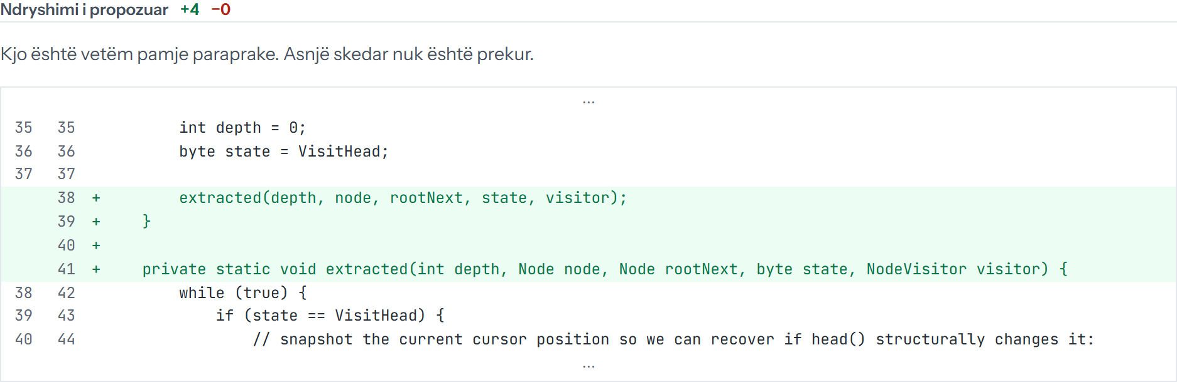
Backup · Extract Method in the interface
jsoup · NodeTraversor.traverse, preview before any file is touched
Florent Latifi · UBT 2026
19
Notes:
The extracted method is named 'extracted'; choosing a meaningful name is left to the developer.

Slide 20
Backup · Comparison with the literature
Madeyski & Lewowski [11], same MLCQ dataset, DS1
Smell | Rules (A) | Model (B) | Madeyski & Lewowski 2023
Blob | 0.336 | 0.539 | 0.51 (RF)
Data Class | 0.367 | 0.473 | 0.57 (RF)
Feature Envy | 0.243 | 0.321 | 0.31 (FDA)
Long Method | 0.617 | 0.723 | > 0.75 (RF)
Florent Latifi · UBT 2026
20
Notes:
They used random 5-fold cross-validation and tuned hyperparameters; we grouped by repository and did not tune. Our results are in the same range.

