Slide 1


AsteroidOS: architecture of a FOSS smartwatch platform
By Florent Revest
January the 30th, 2016

Slide 2
Who am I ?
Mail: revestflo@gmail.com
GitHub: FlorentRevest
LinkedIn: FlorentRevest
IRC: kido@irc.freenode.net
Twitter: @Xenon132
Site: http://florentrevest.github.io/
AsteroidOS
Raspcopter Drone
Quasar Kernel
Nebulae DE

Slide 3
General presentation of AsteroidOS
Why, what and how ?

Slide 4
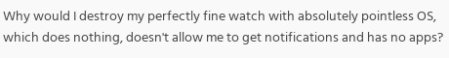
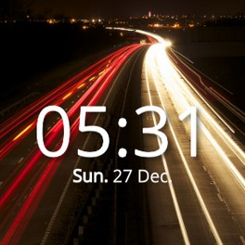
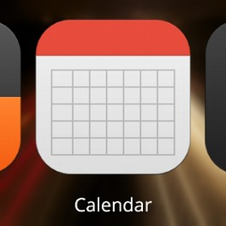
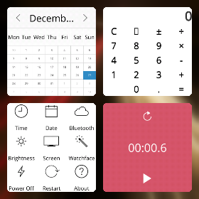
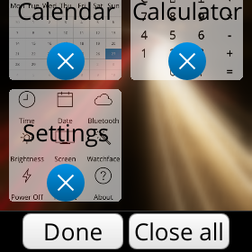
Why AsteroidOS ?
“
Source: xda-developers
More wearable devices and less control over our data
Current operating systems are not open or hackable enough
→ need for an open platform to unleash the full potential

Slide 5
What is AsteroidOS ?

Slide 6
How does AsteroidOS work ? General overview
Standard apps (asteroid-settings, asteroid-timer, asteroid-calendar etc...)
Asteroid-launcher (based on Lipstick)
Qt5.5 (qml-asteroid, qml, qpa-hwcomposer, qtwayland, qtbluetooth...)
NemoMobile Middleware (mce, dsme, ngfd, timed, sensorfwd, statefs, mapplauncherd etc...)
Connectivity (Connman, Bluez5, usb-moded, adbd)
Compatibility layer (libhybris)
Standard GNU/Linux built with OpenEmbedded
(GNU tools, systemd, dbus, udev, etc...)
Minimal Android /system dir (drivers)
Linux Kernel (Android's one with minor modifications for systemd/connmand etc...)
Hardware

Slide 7
Boot Process
Fastboot, Boot.img, Rootfs, Adb...

Slide 8
How does AsteroidOS work ? Boot process
Linux Kernel (Android's one with minor modifications for systemd/connmand etc...)
Hardware

Slide 9
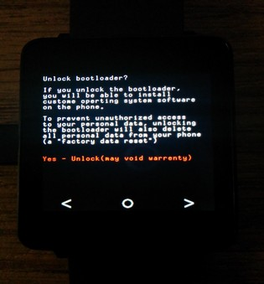
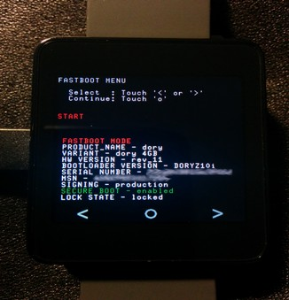
The LG G Watch's bootloader: fastboot
Fastboot: command and protocol implemented by bootloaders
  oem-unlock free your device
  Allows partitions flashing, remote kernels booting etc...
  boot.img format: mkbootimg, unmkbootimg

Slide 10
The LG G Watch's bootloader: diagram
Mount Android Partitions
Rootfs with loop or SYSTEM partition
  System
BOOT Partition
RECOVERY Partition
Remote boot via fastboot
  boot.img format
Android initrd
Recovery initrd
AsteroidOS initrd
Android Kernel
Android Kernel
Modified Android Kernel
  Propri
  etary
Bootloader

Slide 11


Debugging the kernel and init
  CONFIG_TTY_PRINTK and CONFIG_ANDROID_RAM_CONSOLE
    Brings /proc/last_kmesg accessible from Android
  Adbd: Android Debug Bridge Daemon
    Functionfs and usb otg modules of the kernel
    Remote shell from the computer
    Push/Pull files
    ...

Slide 12
Hardware Acceleration
GLES2, Libhybris, Bionic/Glibc, Hwcomposer...

Slide 13
How does AsteroidOS work ? Hardware accel.
Compatibility layer (libhybris)
Minimal Android /system dir (drivers)
Linux Kernel (Android's one with minor modifications for systemd/connmand etc...)
Hardware

Slide 14
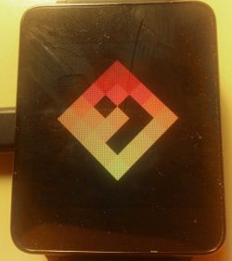
Hardware acceleration choices
Framebuffer not enough for a “smart” experience
  Just used by “psplash”
Free drivers developed by reverse-engineering
  Perfect from the freedom's point of view
  Often unfinished, unmaintained, hard to backport...
Proprietary Android (Wear) drivers via libhybris
  Means integration of a /system directory with proprietary binary blobs: /!\ not 100% free anymore !
  Works really well

Slide 15

Libhybris: General overview
Created by Carsten Munk for Mer and Jolla
Mostly a dirty hack... but with great potential
  Not ideal, but better than nothing
Large imbalance between “Linux” and Android mobile drivers
Due to Bionic - the Android's libc - and its dynamic linker
OEMs provide Android /system with proprietary drivers
Used by Sailfish OS / Mer (via Wayland for ex), Ubuntu Touch (via Mir for ex), WebOS Ports...
Used for EGL/GLES, Camera, NFC, Audio, Sensors, etc...

Slide 16
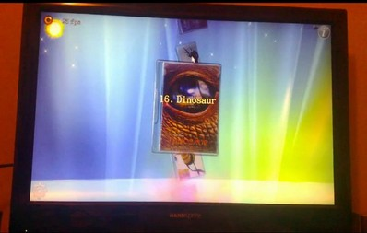
Libhybris: Linking scheme
test-vibrator
vibrator.so
System linker (dlopen/dlsym)
libhybris-common.so
Reimplemented Android linker (android_dlopen/android_dlsym)
Bionic (ex: setjmp, longjmp)
Table Hooks
Glibc (ex: my_fclose → fclose)
Custom code (ex: dlopen, dlsym, pthread)

Slide 17
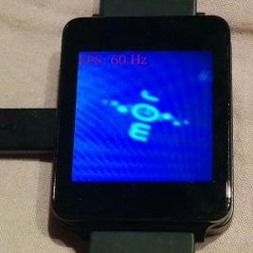
Using HWComposer through libhybris
Compositing HAL used in Android
  Offloads compositing to GPU
  Better performance and battery-life
Since Qt5: Qt Platform Abstraction
  Android, Cocoa, Direct2D, Directfb, Eglfs, iOS, KMS, Fbdev, Offscreen, OpenWfd QNX, Windows, WinRt, Xcb…
  qt5-qpa-hwcomposer-plugin uses hwcomposer via libhybris

Slide 18
Qt5.5 Based UX
QPA, QtWayland, QML, Lipstick, QtBluetooth...

Slide 19
How does AsteroidOS work ? User experience
Standard apps (asteroid-settings, asteroid-timer, asteroid-calendar etc...)
Asteroid-launcher (based on Lipstick)
Qt5.5 (qml-asteroid, qml, qpa-hwcomposer, qtwayland, qtbluetooth...)
NemoMobile Middleware (mce, dsme, ngfd, timed, sensorfwd, statefs, mapplauncherd etc...)
Compatibility layer (libhybris)
Minimal Android /system dir (drivers)
Linux Kernel (Android's one with minor modifications for systemd/connmand etc...)
Hardware

Slide 20
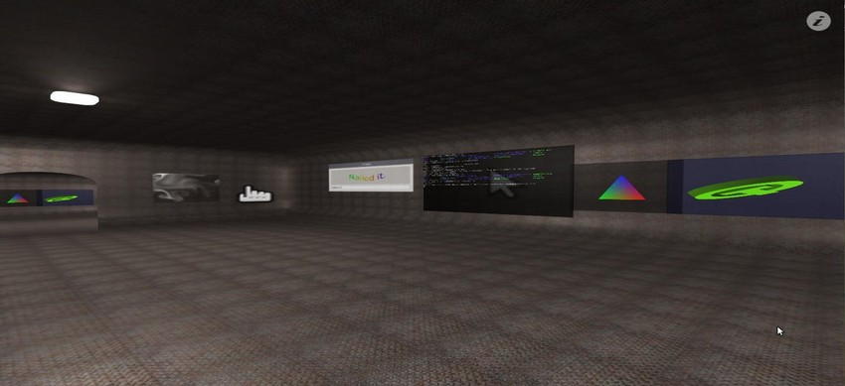
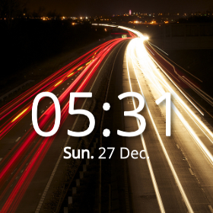
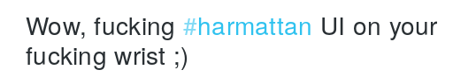
asteroid-launcher: the wayland compositor
Under the hood: QtWayland's API for compositors
Based on Lipstick, like GlacierUX and Jolla-Home
Lipstick: “Home-screen creation toolkit”
“
Source: twitter.com

Slide 21
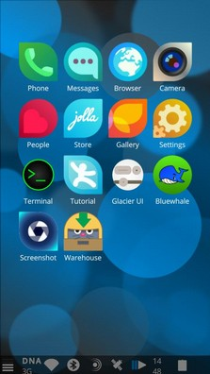
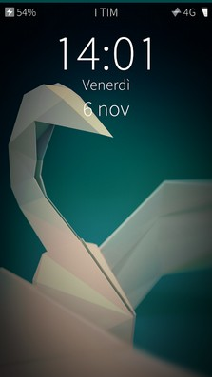
asteroid-launcher: the wayland compositor
Two examples of used NemoMobile daemons :
  MCE
    Handles screen on/off
    Blocks input when off
    Wakelocks all things battery life related…
  DSME
    Handles device state
    Reboot etc...

Slide 22
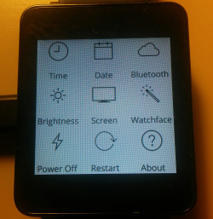
asteroid-settings: an example of app
Developed in QML
  Declaration of elements, properties, states, transitions…
  Extensible with Javascript
  QML-Asteroid set of custom components
  Already used by BlackBerry 10, SailfishOS, NemoMobile, WebOS-Ports, Ubuntu Touch, Plasma Mobile…
Using components like QtBluetooth
  Bluetooth HAL supporting BlueZ5
  Supports Bluetooth Low Energy

Slide 23
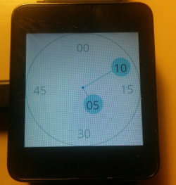
asteroid-settings: an example of app
Two examples of used NemoMobile daemons :
  Mapplauncherd:
    Booster daemons that preloads libraries
    Faster apps startup
    Used through /usr/bin/invoker
  Timed:
    Handles system's time and date
    Alarm clock

Slide 24
Complete graphic stack
asteroid-settings
QML/ qml-asteroid
QtWayland (client API)
Wayland-egl protocol
asteroid-launcher
QML/ qml-asteroid
QtWayland (compositor API)
Lipstick
Qt5-qpa-hwcomposer
libhardware.so (glibc)
libhybris
libhardware.so (bionic)
GPU
Binary blobs

Slide 25
A system based on OpenEmbedded
Layers, Recipes, Distro, BSP, Pkgs, SDK, Jenkins...

Slide 26
How does AsteroidOS work ? OpenEmbedded
Standard apps (asteroid-settings, asteroid-timer, asteroid-calendar etc...)
Asteroid-launcher (based on Lipstick)
Qt5.5 (qml-asteroid, qml, qpa-hwcomposer, qtwayland, qtbluetooth...)
NemoMobile Middleware (mce, dsme, ngfd, timed, sensorfwd, statefs, mapplauncherd etc...)
Connectivity (Connman, Bluez5, usb-moded, adbd)
Compatibility layer (libhybris)
Standard GNU/Linux built with OpenEmbedded
(GNU tools, systemd, dbus, udev, etc...)
Minimal Android /system dir (drivers)
Linux Kernel (Android's one with minor modifications for systemd/connmand etc...)
Hardware

Slide 27
The OpenEmbedded build system
Build-system for creating AsteroidOS from sources
Supported by Yocto from the Linux Foundation
git clone https://github.com/AsteroidOS/asteroid
cd asteroid/
. ./prepare-build.sh dory
# Downloads BB & the layers and configures the target
bitbake asteroid-image
# Downloads, configures, compiles, installs, packages, and gathers in a single image the whole AsteroidOS

Slide 28
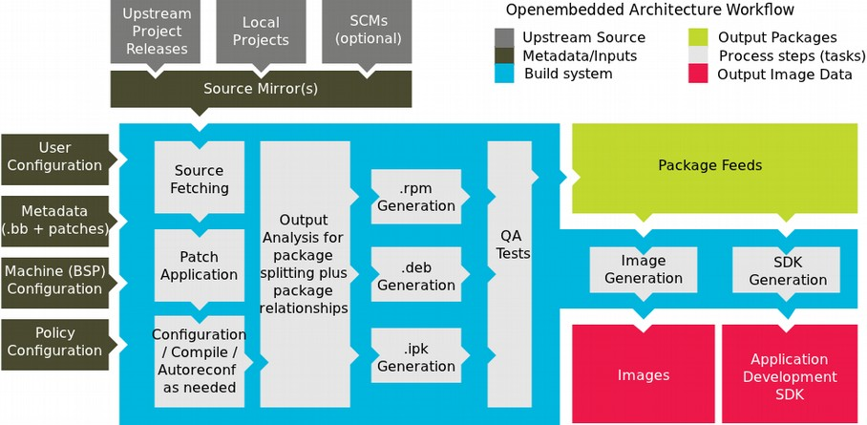
General overview of OpenEmbedded
Images (ex: asteroid-image) made from
Packages (ex: asteroid-launcher-dev) made from
Recipes (ex: asteroid-launcher_git.bb) provided by
Layers (ex: meta-asteroid)

Slide 29
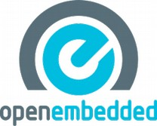
The meta-asteroid layer
meta-asteroid: AsteroidOS definition
  classes/conf: description of the distro and image
  recipes-asteroid: all kind of apps, themes etc…
  recipes-nemomobile: mce, dsme, mapplauncherd etc...
  … : various patches applied to other recipes
Depends on meta-qt5
  Qt5.5 and related libs
  Qt SDK generation

Slide 30
The meta-dory-hybris layer
meta-dory-hybris: BSP for LG G Watch
  recipes-android: the /system directory
  recipes-kernel: the dory's kernel with custom defconfig
  … : various patches applied to other recipes
Depends on meta-smartphone/meta-android
  Provides libhybris
  And various android tools (adbd for ex.)

Slide 31
The future of AsteroidOS
An open platform, You!

Slide 32

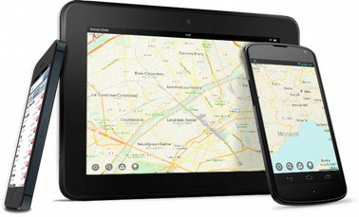
The future of AsteroidOS: an open platform
Open-source personal assistant:
  Sirius ? (open-source research project)
Open-source offline mapping:
  Maps.me (open-source, based on OpenStreetMap)
Use your imagination:
  Pentesting suite
  LibreOffice remote command
  Etc ...

Slide 33

The future of AsteroidOS: You!
Developers: create QML components and apps,
    maintain the OpenEmbedded layers
Porters: port AsteroidOS to new
    smartwatches
Evangelists: spread the word and
    gather a community
Testers: needs users

Slide 34

Thanks … Questions ?
Site: http://asteroidos.org/
GitHub: AsteroidOS
Twitter: @AsteroidOS
IRC: #asteroid@irc.freenode.net
Oh and by the way, I'm looking for a summer internship!

