Slide 1

Value-Quality-Momentum Strategy
George Moschovis & Florent Yigbe
G_5 Gamma Gurus
Hedge Fund Club - Universität Mannheim & Prime Capital
20.11.2025

Slide 2
SUMMARY
CORE IDEA
UNIVERSE & DATA
SIGNAL DISIGN (Alpha)
PORTOFOLIO CONSTRUCTION
POTENTIAL RISKS
RISK MANAGEMENT
BACKTESTING & PERFORMANCE
PERFORMANCE METRICS

Slide 3
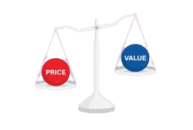


CORE IDEA
What’s the core investment hypothesis ?
Identify undervalued stocks with strong fundamentals and positive momentum outperform over 1–3 years
Why does this opportunity exist ?
Investors often overlook high-quality undervalued companies, creating mispricing opportunities
Asset universe
Top 300 S&P 500 companies

Slide 4
UNIVERSE & DATA
Universe
Data (from yfinance)
Daily/weekly prices
Fundamentals: P/E, P/B, EV/EBITDA, ROE, Debt/Equity
Frequency
Quarterly fundamentals, daily prices
S&P 500
Market cap > $5B
Average daily volume > 500k

Slide 5

SIGNAL DISIGN (Alpha)
Momentum filter: Only select stocks with positive 3 and 12-month price momentum.
Value factors: Low P/E, low EV/EBITDA, low P/B
Quality factors: High ROE, low debt/equity
Composite Score to rank the stocks

Slide 6
PORTOFOLIO CONSTRUCTION
Long top 20 ranked stocks.
5% to each position (Equal weight)
5% per stock
Rebalance semi-annually and when a stock is no more part of the S&P 500 we replace it according to our strategy .

Slide 7

POTENTIAL RISKS
Momentum Crashes
Sudden Regime Change
Sector Concentration
Survivorship Bias
Limited Hedging

Slide 8

RISK MANAGEMENT
Stop-loss: deterioration in fundamentals.
Max 30% exposure per sector.
Track: max drawdown, Sharpe ratio, VaR, CVaR

Slide 9
BACKTESTING & PERFORMANCE
Period: Last 20 years
Benchmark: S&P 500
Metrics: Annualized return, Annualized Volatility, Sharpe ratio, Max Drawdown, VaR, CVaR
Stress test during market crises (2008, 2020).

Slide 10
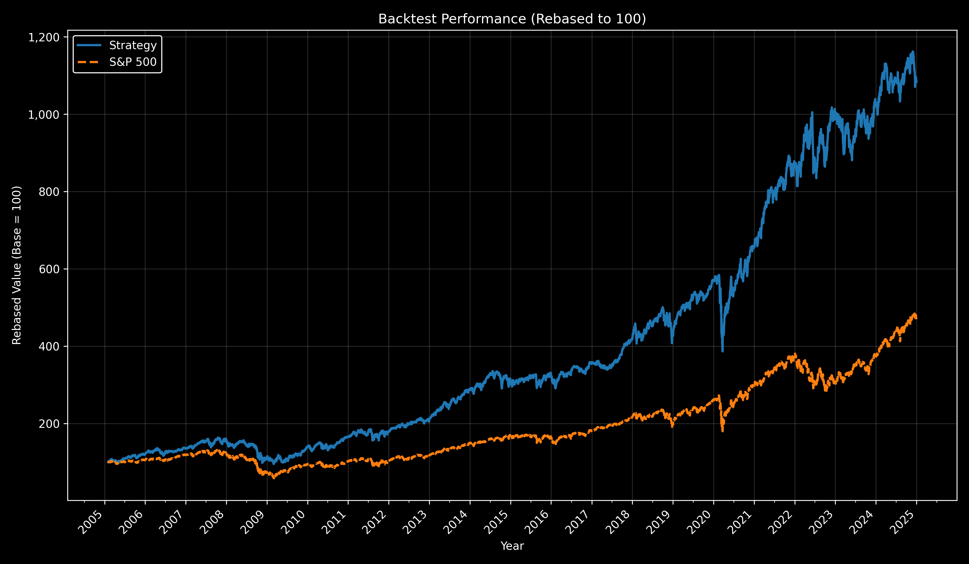

Slide 11
PERFORMANCE METRICS
Annual Return: 12.67% | Benchmark: 8.10%
Annual Vol: 18.96% | Benchmark: 19.20%
Sharpe Ratio: 0.67 | Benchmark: 0.42
Max Drawdown: -41.67% | Benchmark: -56.75%
95% VaR (daily): -1.84% | Benchmark: -1.81%
95% CVaR (Expected daily Shortfall): -2.87% | Benchmark: -2.98%

Slide 12
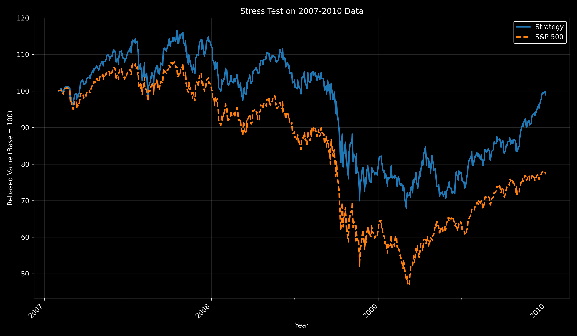

Slide 13
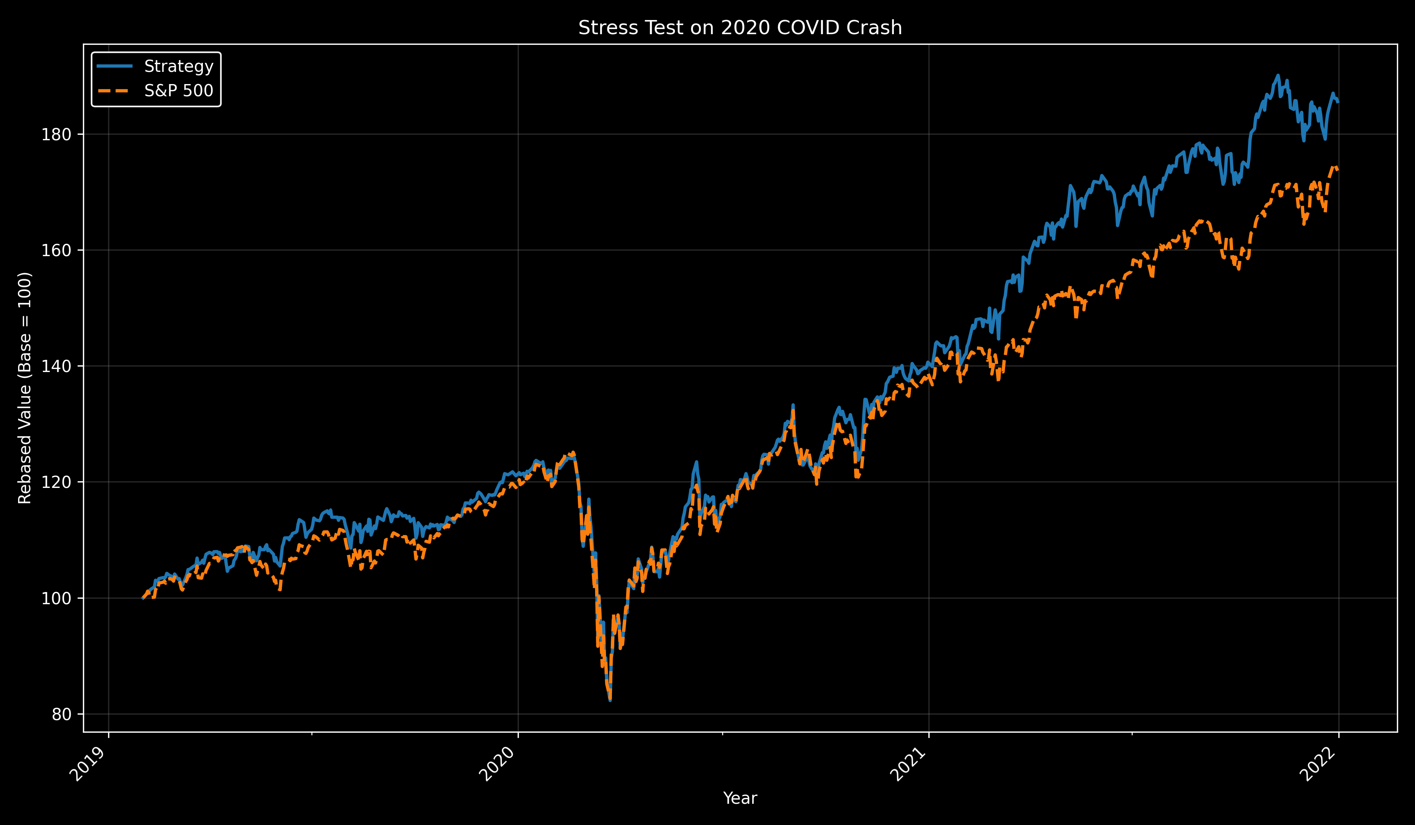

Slide 14
?
How realistic is it

Slide 15
REAL WORLD
Liquidity (S&P 500 Stocks)
Academically Proven Anomalies (Fama & French (1992), Asness et al. (2013) (2019))
Minimal Trading Commisions (Semi-Annual Rebalancing)

Slide 16

THANK YOU FOR YOUR ATTENTION !
All the updated code can be found at:
https://github.com/FlorentYigbe/Value-Quality-Momentum-Strategy
George Moschovis & Florent Yigbe
G_5 Gamma Gurus

