Slide 1
第二章 数据的机器级表示与处理
数值数据的表示
非数值数据的表示
数据的存储
数据的运算

Slide 2
数据的表示和运算
主要教学目标
  掌握计算机内部各种数据的编码表示及其运算方法
  了解高级语言程序中的各种类型变量对应的表示形式
  在高级语言程序中的变量、机器数和底层硬件（寄存器、加法器、ALU等）之间建立关联
  综合运用所学知识，分析高级语言和机器级语言程序设计中遇到的各种与数据表示和运算相关的问题，解释相应的执行结果
C语言参考网站：http://docs.huihoo.com/c/linux-c-programming/
Notes:
存在问题
学生缺乏将机器级数据表示和程序设计及程序调试工作相互关联的意识。许多学生也许对机器级数据表示的基本原理和概念很了解，但在程序设计和调试工作中，往往不会运用所学知识解决实际问题，不会把高级语言中的类型定义、数值范围、数据类型转换等问题和本课程所学的知识联系起来，因而，所学知识没有起到真正的作用。
解决方法
为了增强学生对机器级数据表示的认识，可以让学生亲自编写相关的程序，通过程序的执行结果来理解本章所学的知识。
例如：确定float型变量和double型变量的精度；检查一些特殊表达式的运行结果，如一个非零整数除以0、一个非零实数除以0、0除以0、负数开平方等等；(3) 编程检查机器是大端还是小端方式，数据是对齐存放还是不对齐存放。

Slide 3
数据的表示和运算
分以下三个部分介绍
  第一讲：数值数据的表示
    定点数的编码表示、整数的表示、无符号整数、带符号整数、浮点数的表示
    C语言程序的整数类型和浮点数类型
  第二讲：非数值数据的表示、数据的存储
    逻辑值、西文字符、汉字字符
    数据宽度单位、大端/小端、对齐存放
  第三讲：数据的运算
    按位运算\逻辑运算\移位运算
    位扩展和位截断运算
    无符号和带符号整数的加减运算
    无符号和带符号整数的乘除运算
    变量与常数之间的乘除运算
    浮点数的加减乘除运算
围绕C语言中的运算，解释其在底层机器级的实现
从C程序的表达式出发，用机器数在电路中的执行来解释表达式的执行结果

Slide 4
课程内容概要
/*---sum.c---*/
int sum(int a[ ], unsigned len)
{
int i，sum = 0;
for (i = 0; i <= len–1; i++)
sum += a[i];
return sum;
}
数据的表示
数据的运算
如果程序处理的是图像、视频、声音、文字等数据，那么，
（1）如何获得这些数据？
（2）如何表示这些数据？
（3）如何处理这些数据？
/*---main.c---*/
int main()
{
int a[1]={100};
int sum; sum=sum(a,0);
printf(“%d”,sum);
}

Slide 5
“转换”的概念在数据表示中的反映
感觉媒体信息
问题(应用)
抽象概括
树、链表等结构化数据描述
算法
具体实现
int, float, array, struct等类型
程序(语言)
指令指定寄存器或内存中数据
指令集体系结构(ISA)
ALU中运算或总线上传输的数据
微体系结构
逻辑门
电路
位信息
器件(晶体管)

Slide 6

对连续信息采样，以使信息离散化
对离散样本用0和1进行编码
各类数据之间的转换关系
定点运算指令
逻辑、位操作或字符处理指令
浮点运算指令

Slide 7
数值数据的表示
数值数据表示的三要素
  进位记数制
  定、浮点表示
  如何用二进制编码
  即：要确定一个数值数据的值必须先确定这三个要素。
  例如，机器数 01011001的值是多少？
进位记数制
  十进制、二进制、十六进制、八进制数及其相互转换
定/浮点表示（解决小数点问题）
  定点整数、定点小数
  浮点数（可用一个定点小数和一个定点整数来表示）
定点数的编码（解决正负号问题）
  原码、补码、反码、移码 （反码很少用）
答案是：不知道！

Slide 8

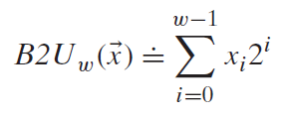
Unsigned integer(无符号整数)
机器中字的位排列顺序有两种方式：（例：32位字: 0…01011₂）
  高到低位从左到右：0000 0000 0000 0000 0000 0000 0000 1011
  高到低位从右到左：1101 0000 0000 0000 0000 0000 0000 0000
  Leftmost和rightmost这两个词有歧义，故用LSB(Least Significant Bit)来表示最低有效位，用MSB来表示最高有效位
  高位到低位多采用从左往右排列
一般在全部是正数运算且不出现负值结果的场合下，可使用无符号数表示。例如，地址运算，编号表示，等等
无符号整数的编码中没有符号位
LSB
MSB
：位向量表示（w位机器数）
真值：

Slide 9
Signed integer（带符号整数，定点整数）
计算机必须能处理正数(positive) 和负数(negative)，MSB表示数符
有三种定点编码方式
  Signed magnitude （原码）
  现用来表示浮点（实）数的尾数
  One’s complement （反码）
  现已不用于表示数值数据
  Two’s complement （补码）
  50年代以来，所有计算机都用补码来表示定点整数
为什么用补码表示带符号整数？
  补码运算系统是模运算系统，加、减运算统一
  数0的表示唯一，方便使用
  比原码和反码多表示一个最小负数

Slide 10
Sign and Magnitude （原码的表示）
Decimal
Binary
Decimal
Binary
01
2
3
4
5
6
7
0000
0001
0010
0011
0100
0101
0110
0111
-0
-1
-2
-3
-4
-5
-6
-7
1000
1001
1010
1011
1100
1101
1110
1111
容易理解, 但是：
  0 的表示不唯一，故不利于程序员编程
  加、减运算方式不统一
  需额外对符号位进行处理，故不利于硬件设计
  特别当 a<b时，实现 a-b比较困难
从 50年代开始，整数都采用补码来表示
但浮点数的尾数用原码定点小数表示
Notes:
Sign and magnitude is convenient for human, but not convenient for computer.
Since 1950’s, all computers use 2’s complement representation.
Complement:
Need different ways to do addition and subtraction. We’ll see soon that 2’s complement need not to distinguish between addition and subtraction.

Slide 11
补码 - 模运算（modular运算）
重要概念：在一个模运算系统中，一个数与它除以“模”后的余数等价。
现实世界中的模运算系统
时钟是一种模12系统
假定钟表时针指向10点，要将它拨向6点， 则有两种拨法：
① 倒拨4格：10- 4 = 6
② 顺拨8格：10+8 = 18 ≡ 6 (mod 12)
模12系统中： 10- 4 ≡ 10+8 (mod 12)
- 4 ≡ 8 (mod 12)
则，称8是- 4对模12的补码 （即：- 4的模12补码等于8）。
同样有 -3 ≡ 9 （mod 12）
-5 ≡ 7 （mod 12）等
结论1： 一个负数的补码等于模减该负数的绝对值。
结论2： 对于某一确定的模，某数减去小于模的另一数，总可以用该数加上另一数负数的补码来代替。
补码（modular运算）：+ 和 – 的统一
Notes:
Supplement slide: More about 2’s complement.

Slide 12
计算机中的运算器是模运算系统
运算器只有有限位，假设为n位，则运算结果只能保留低n位，故可看成是个只有n档的二进制算盘，因此，其模为2^{n} 。
假定一个正数X的补码表示为n位二进制数字 a_{n-1}…a₁a₀
则负数-X的的补码表示为：2^{n} - X = 1_{n}0_{n-1}…00 - a_{n-1}…a₁a₀
——即各位取反后再加1
结论： 一个负数的补码等于对应正数补码的“各位取反、末位加1”
123 = 127 – 4 = 01111111B – 100B = 01111011B
[– 123 ]_{补} = [– 01111011]_{补} = 2⁸ – 01111011
= 10000 0000 – 01111011
= 1111 1111 – 0111 1011 + 1 = 1000 0101
[x]_{补}代表真值x的机器数
真值和机器数的含义是什么？

Slide 13
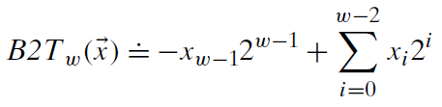

补码表示的带符号整数
：位向量表示（w位机器数）
真值：
Notes:
Supplement slide: More about 2’s complement.

Slide 14
特殊数的补码
假定机器数有n位
① [-2^{n-1}]_{补}= 2^{n} - 2^{n-1} = 10…0（n-1个0） （mod 2^{n}）
② [-1]_{补}= 2^{n} - 0…01 = 11…1（n个1） （mod 2^{n}）
③ [+0]_{补}= [-0]_{补}= 00…0（n个0）
32位机器中，int、short、char型数据的机器数各占几位？

Slide 15
C语言程序中的整数类型
无符号数：unsigned int ( short / long)
带符号整数： int ( short / long)
C语言标准规定了各类型最小取值范围，如: int型至少应为16位，取值范围为-32 768到32 767，而int型数据具体的取值范围则由ABI规范规定。

Slide 16
C语言中整数常量的类型
A plain decimal constant will be fitted into the first in the list that can hold the value:
int unsigned int (C90) long (long) unsigned long (long) (C90)
Plain octal or hexadecimal constants will use the list:
int unsigned int long (long) unsigned long (long)
There are no negative constants; writing -23 is an expression involving a positive constant and an operator.
在一个整数常量的后面加“u”或“U”表示一个无符号数
  2147483647
  2147483648
  -2147483647
  -2147483648
  2147483647U
  int
  unsigned int (C90) / long (C99)
  int
  unsigned int (C90) / long (C99)
  unsigned int

Slide 17
编译器处理常量时默认的类型
C90
范围 | 类型
0~2³¹-1 | int
2³¹~2³²-1 | unsigned int
2³²~2⁶³-1 | long long
2⁶³~2⁶⁴-1 | unsigned long long
2³¹=2147483648，机器数为：100 ┅ 0（31个0）
C99
范围 | 类型
0~2³¹-1 | int
2³¹~2⁶³-1 | long long
2⁶³~2⁶⁴-1 | unsigned long long

Slide 18
C语言程序中的整数
例如，考虑以下C代码：
1 int x = –1;
2 unsigned u = 2147483648;
3
4 printf ( “x = %u = %d\n”, x, x);
5 printf ( “u = %u = %d\n”, u, u);
在32位机器上运行上述代码时，它的输出结果是什么？为什么？
x = 4294967295 = –1
u = 2147483648 = –2147483648
因为–1的补码整数表示为“11…1”，作为32位无符号数解释时，其值为2³²–1= 4 294 967 296–1 = 4 294 967 295。
2³¹的无符号数表示为“100…0”，被解释为32位带符号整数时，其值为最小负数：–2³²⁻¹ = –2³¹ = –2 147 483 648。

Slide 19
C语言整数运算中的类型转换
三种常见转换情况：
  表达式中操作数类型不一致而引起的转换（Usual Arithmetic Conversions）
    例：20*1.5-199 > -100U
  赋值操作引发的类型转换（Conversion During Assignment）
    例：unsigned int x; x = -1;
  强制类型转换（Type Casting）
    例： (unsigned int)199

Slide 20
Usual Arithmetic Conversions
If the operands in an expression have different types, there have to be conversions
  to convert the operand of the narrower type to the type of the other operand, which is the " narrowest" type that will safely accommodate both values – promotion
If either operand is a long double, then the other one is converted to long double and also the type of result.
Otherwise, double …
Otherwise, float …
Otherwise, integral promotions are first applied, then:
  If either operand is an unsigned long int …
  Otherwise, long int ...
  Otherwise, unsigned int ...
  Finally, both operands must be of type int, so that is the result.

Slide 21
C语言程序中的整数
1）在有些32位系统上，C表达式-2147483648 < 2147483647的执行结果为false。Why？
2）若定义变量“int i=-2147483648;”，则“i < 2147483647”的执行结果为true。Why？
3）如果将表达式写成“-2147483647-1 < 2147483647”，则结果会怎样呢？Why？
1）在ISO C90标准下 ，2147483648为unsigned int型，因此
“-2147483648 < 2147483647”按无符号数比较，
10……0B比01……1大，结果为false。
在ISO C99标准下 ，2147483648为long long型，因此
“-2147483648 < 2147483647”按带符号整数比较，
10……0B比01……1小，结果为true。
2）i < 2147483647 按int型数比较，结果为true。
3）-2147483647-1 < 2147483647 按int型比较，结果为true。

Slide 22
C语言程序中的整数
关系 表达式 | 类 型 | 结 果 | 说明
0 = = 0U -1 < 0 -1 < 0U 2147483647 > -2147483647 - 1 2147483647U > -2147483647 - 1 2147483647 > (int) 2147483648U -1 > -2 (unsigned) -1 > -2 | 无 带 无 带 无 带 带 无 | 1 1 0* 1 0* 1* 1 1 | 00…0B = 00…0B 11…1B (-1) < 00…0B (0) 11…1B (2³²-1) > 00…0B(0) 011…1B (2³¹-1) > 100…0B (-2³¹) 011…1B (2³¹-1) < 100…0B(2³¹) 011…1B (2³¹-1) > 100…0B (-2³¹) 11…1B (-1) > 11…10B (-2) 11…1B (2³²-1) > 11…10B (2³²-2)
带*的结果与常规预想的相反！

Slide 23
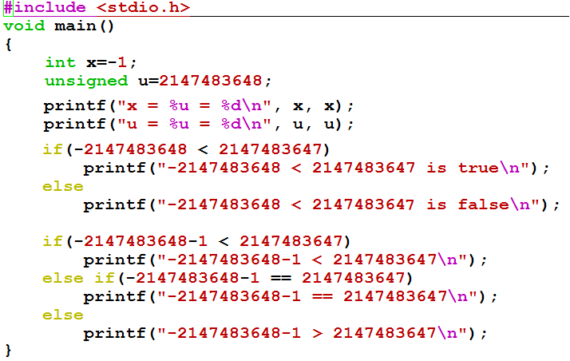

C99的结果大家回去试试。
C90上的运行结果是什么？

Slide 24
Conversion During Assignment
For assignment, C follows the simple rule:
  The expression on the right side of the assignment is converted to the type of the variable on the left side.
下述代码有无问题？
  int j = 80000;
  long long int i;
  i = j * j;
Overflow！
可改为 i = (long long int) j * j ;
The cast operator takes precedence over *
The first j is converted to int, forcing the second j to be converted as well.
改成“i = (int) ( j * j ) ;”又如何？

Slide 25
Type Casting in C
float quotient;
int dividend=30, divisor=50;
quotient = dividend / divisor;
quotient = ?
quotient = (float) dividend / divisor;
quotient = ?
The result of the division-an integer - will be converted to float before being stored in quotient.
The dividend and divisor are converted to float before the division.
C regards type cast (type-name) as a unary operator, which has higher precedence than binary operator.

Slide 26
科学计数法(Scientific Notation)与浮点数
Example:
mantissa (尾数) exponent(阶码、指数)
6.02 x 10 ²¹
decimal point radix (base，基)
° Normalized form（规格化形式）: 小数点前只有一位非0数
° 同一个数有多种表示形式。例：对于数 1/1,000,000,000
• Normalized (唯一的规格化形式): 1.0 x 10⁻⁹
• Unnormalized（非规格化形式不唯一）: 0.1 x 10⁻⁸, 10.0 x 10⁻¹⁰
for Binary Numbers:
mantissa（尾数） exponent（指数）
0.101_{two} x 2 ⁻¹⁰
binary point 基为2
只要对尾数和指数分别编码，就可表示一个浮点数（即：实数）
Notes:
Before we move on to the floating-point representation, let’s review the familiar scientific notation. For example, we can use 6.02x10²¹ to represent 6,020,000,000,000,000,000,000. Here, the part before x is called mantissa, the base is 10, the power of ten is called exponent.
What the exponent mean? Who knows that?
Exponent is used for deciding the position of decimal point. When we change exponent,the decimal point can be floated. In this example, If we change the exponent to 31, it means the number of digits of real value will be 31+1=32,the number become longer and it’s value is more larger, but we need not increase the number of digits in exponent. It’s still 2 digits.
In the scientific notation, a mantissa with no leading 0s and only one digit to left of decimal point is called to be normalized. It means an normalized number should have a nonzero leftmost digit. So, there is only one normalized form, whereas there are many unnormalized forms. For example, if we want to represent 1/1,000,000,000, the normalized form is 1.0x10⁻⁹ , whereas 0.1x10⁻⁸ and 10.0x10⁻¹⁰n are not normalized number. In this example, the exponent is negative (-9), it means the actual decimal point should be to the left of the
9th place.
With this scientific notation, We only need to describe mantissa and exponent. Every normalized mantissa is a fixed-point number because there is only one nonzero digit in the integer part. Every exponent is a integer which decides the place of decimal point, so they are short and can be also represented in fixed-point numbers. So we can use two short fixed-point numbers to represent a very long number.

Slide 27
浮点数(Floating Point)的表示范围
例：画出下述32位浮点数格式的规格化数的表示范围。
0 1 8 9 31
第0位数符S；第1～8位为8位移码表示阶码E（偏置常数为128）；第9～31位为24位二进制原码小数表示的尾数数值部分M 。规格化尾数的小数点后第一位总是1，故规定第一位默认的“1”不明显表示出来。这样可用23个数位表示24位尾数。
+/-0.1xxxxx × 2E
S
阶码E
尾数M
最大正数：0.11…1 x 2^{11…1} =(1-2⁻²⁴) x 2¹²⁷
最小正数：0.10…0 x 2^{00…0} =(1/2) x 2⁻¹²⁸
因为原码是对称的，所以其表示范围关于原点对称。
可表示的负数
零
可表示的正数
负上溢
负下溢
正下溢
正上溢
-
2
4
127
-
-
2
4
127
-
(1
-
2
)
×
2
129
-
(1
-
2
)
×
2
-
2
0
2
129
数轴
机器0：尾数为0 或 落在下溢区中的数
浮点数范围比定点数大，但数的个数没变多，故数之间更稀疏，且不均匀

Slide 28
浮点数的表示
°Normal format（规格化数形式） ：
+/-1.xxxxxxxxxx × R^{Exponent}
°32-bit 规格化数：
31 0
S Exponent Significand
1 bit ? bits ? bits
S 是符号位（Sign）
Exponent用移码（增码）来表示
Significand 表示 xxxxxxxxxxxxx，尾数部分
(基可以是 2/ 4 / 8 / 16，约定信息，无需显式表示 )
°早期的计算机，各自定义自己的浮点数格式
问题：浮点数表示不统一会带来什么问题？
Notes:
we can use the following format to represent any expressible binary number.Here,for normalized format, the leading digit before binary point is always 1. we can also assume that the base is always 2. So we only need to store sign, x’s and exponent in computers.
Therefore, a floating point number has three fields, that is S for storing sign, ……, Here xxxxx is called significand. The base can be 2/ 4/ 8/ 16 , which is implicit and need not to be stored since it is the same for all numbers.
Until about 1980, each manufacturer had its own floating-point format. They are all different. How many bits were used for exponent, how many for significand, and which of 2/ 4/ 8/ 16 was used for base, all of these were decided by manufactures. It led to many problems.We can not exchange floating-point data among different computers. Sometimes we may get different results for the same calculation. It is necessary to have one standard of FP representation. This is IEEE 754 Standard.
Any question before move on to IEEE 754 Standard?

Slide 29


“Father” of the IEEE 754 standard
直到80年代初，各个机器内部的浮点数表示格式还没有统一
因而相互不兼容，机器之间传送数据时，带来麻烦
1970年代后期, IEEE成立委员会着手制定浮点数标准
1985年完成浮点数标准IEEE 754的制定
This standard was primarily the work of one person, UC Berkeley math professor William Kahan.
现在所有计算机都采用IEEE 754来表示浮点数
www.cs.berkeley.edu/~wkahan/
ieee754status/754story.html
Prof. William Kahan
Notes:
In the late 1970s, IEEE set up a committee to standardize floating-point arithmetic. The goal was not only to permit floating-point data to be exchanged among different computers but also to provide hardware designers with a model known to be correct. The resulting work led to IEEE Standard 754 which was finished in 1985. Nowadays, most computers use IEEE 754 standard to represent floating-point numbers. This standard was primarily the work of one person, UC Berkeley math professor William Kahan. People call him the father of the IEEE 754 standard. Because of his contribution to the standard, he won ACM Turing Award in 1989. This is the highest prize in computation field, It’s equivalent to Nobel Prize.

Slide 30
IEEE 754标准
规定：小数点前总是“1”，故可隐含表示。注意：和前面例子规定不一样!
规格化数：+/-1.xxxxxxxxxx_{two} x 2^{Exponent}
Single Precision ：
S Exponent Significand
1 bit 8 bits 23 bits
° Sign bit: 1 表示negative ; 0表示 positive
°Exponent（阶码 / 指数编码）:
  SP规格化数阶码范围为0000 0001 (-126) ~ 1111 1110 (127)
  bias为127 (single), 1023 (double)
全0和全1用来表示特殊值！
  为什么用127？若用128,则阶码范围为多少？
°Significand（尾数）:
• 规格化尾数最高位总是1，所以隐含表示，省1位
• 1 + 23 bits （ single），1 + 52 bits （double）
SP: (-1)^{S} x (1 + Significand) x 2^{(Exponent-127)}
  0000 0001 (-127) ～ 1111 1110 (126)
DP: (-1)^{S} x (1 + Significand) x 2^{(Exponent-1023)}
Notes:
IEEE 754 standard defines three formats: Single precision(32 bits), double precision (64 bits) and extended precision (80 bits). (The extended-precision format is intended to reduce round off errors. It is used primarily inside floating-point arithmetic units.) All of them start with a sign bit for the number as a whole, 1 means negative, 0 means positive. Next is the exponent, using bias (or excess) of 127 for single precision, 1023 for double precision. The minimum 0 and maximum exponent (255 and 2047) are not used for normalized numbers, because they have special uses. It means the exponents of normalized numbers range from 1 to 254 for single precision. Finally, we have significand field. Because normalized numbers always have a leading 1 before binary point, so we needn’t store this bit. In order to pack more bits, the standard use one implicit bit of leading 1 for normalized numbers. So for single precision, the mantissa of an normalized number has 1+23 bits. To summarize the above information, we can get the formula for single precision number. From this formula, we can see that : if s is 1, the number will be negative, if s is 0, the number will be positive. This 1 is the implicit leading 1, and then plus significand, will be the mantissa. Because we store the biased exponent which add 127 to the real value in this bit pattern, it means that the real value of the exponent should be subtract 127 from biased exponent. For normalized double precision numbers, the formula is similar except for ….
Any question for this?
If we know the bit pattern of an normalized floating-point number, we can calculate the value of this number using the formula.

Slide 31
Ex: Converting Binary FP to Decimal
BEE00000H is the hex. Rep. Of an IEEE 754 SP FP number
1011 11101 110 0000 0000 0000 0000 0000
(-1)^{S} x (1 + Significand) x 2^{(Exponent-127)}
°Sign: 1 => negative
°Exponent:
• 0111 1101_{two} = 125_{ten}
• Bias adjustment: 125 - 127 = -2
°Significand:
1 + 1x2⁻¹+ 1x2⁻² + 0x2⁻³ + 0x2⁻⁴ + 0x2⁻⁵ +...
=1+2⁻¹ +2⁻² = 1+0.5 +0.25 = 1.75
°Represents: -1.75_{ten}x2⁻² = - 0.4375
Notes:
If we know the hexadecimal representation of an IEEE 754 single precision number, how to calculate the actual value of this number? Here is an example. Suppose the hex form is BEE00000H. At first, we should convert the hex form to binary form, we get the binary form 1011 1110 1110 0000 0000 …0000, and for single precision, we have 1 sign bit, which is 1, 8 bits for exponent, which is 0111 11101, and the remainder is 23-bit significand. Then we can use the formula to calculate the value.
Step 1: sign bit is 1, it means the number is negative
Step 2: exponent is 01111101=2⁶ +2⁵ + 2⁴ +2³ +2¹ =64+32+16+8+1=125, because we use excess 127, so we should subtract 127 to get the actual value of exponent. 125-127=-2
Step 3: here actual mantissa is 1.1100..0, so the value should be 1+…., …. The result is 1.75
Step 4: So the actual value is
Any question about that?

Slide 32
Ex: Converting Decimal to FP
-12.75
1. Denormalize: -12.75
2. Convert integer part:
12 = 8 + 4 = 1100₂
3. Convert fractional part:
.75 = .5 + .25 = .11₂
4. Put parts together and normalize:
1100.11 = 1.10011 x 2³
5. Convert exponent: 127 + 3 = 128 + 2 = 1000 0010₂
11000 0010 100 1100 0000 0000 0000 0000
The Hex rep. is C14C0000H
Notes:
If we know the value of an number, how to represent it in floating-point form? Here is an exercise. Please spend 4 minutes to try it.
Let’s check your answers. Firstly, then, and then, finally, the result is C14C0000H. Have you got that? Any question?

Slide 33
Normalized numbers（规格化数）
前面的定义都是针对规格化数（normalized form）
How about other patterns?
Exponent Significand Object
1-254 anything Norms
implicit leading 1
0 0 ?
0 nonzero ?
255 0 ?
255 nonzero ?

Slide 34
Representation for 0
How to represent 0?
exponent: all zeros
significand: all zeros
What about sign? Both cases valid.
+0: 0 00000000 00000000000000000000000
-0: 1 00000000 00000000000000000000000
Notes:
If exponent and significand bits are all zeros, it means the value is 0. It could be positive 0 or negative 0. They are equal.

Slide 35
Representation for +∞/-∞
In FP, 除数为0的结果是 +/- ∞, 不是溢出异常.（整数除0为异常）
∞ ：infinity
为什么要这样处理?
  • 可以利用+∞/-∞作比较。 例如：X/0>Y可作为有效比较
How to represent +∞/-∞?
• Exponent : all ones (11111111B = 255)
• Significand: all zeros
+∞ : 0 11111111 00000000000000000000000
-∞ : 1 11111111 00000000000000000000000
Operations
5.0 / 0 = +∞, -5.0 / 0 = -∞
5+(+∞) = +∞, (+∞)+(+∞) = +∞
5 - (+∞) = -∞, (-∞) - (+∞) = -∞ etc
Notes:
Do you know the infinity symbol ∞? Who can tell me the meaning of this symbol? As we know, if x!=0, when y tend to 0, then x/y tend to ∞. So IEEE 754 suggested x/0 (any finite number divided by 0)should produce infinity, not overflow. Because we can do further computations with infinity, For example, if a program have comparison X/0 > Y, it won’t produce overflow, it can be a valid comparison.
If exponent bits are all ones and significand bits are all zeros, the value is infinity. It could be positive infinity or negative infinity. They are not equal. There are some operations with infinity. Any finite number add infinity will be infinity.

Slide 36
Representation for“Not a Number”
Sqrt (- 4.0) = ? 0/0 = ?
  Called Not a Number (NaN) - “非数”
How to represent NaN
Exponent = 255
Significand: nonzero
NaNs can help with debugging
Operations
sqrt (-4.0) = NaN 0/0 = NaN
op (NaN,x) = NaN +∞+(-∞) = NaN
+∞- (+∞) = NaN ∞/∞ = NaN
etc.
Notes:
Who can tell me what is the result of the square root of –4.0 ? Yes, the result is undefined. 0 divided by 0, infinity divided by infinity are all the same. If infinity is not an error, these should not be either. We call them Not a Number. We read it NaN. In this situation, the exponent bits will be all ones, the significand will be nonzero bit pattern.
We can use NaN to help with debugging. If the calculating result is NaN, we can set some test point to see what happened.
There are some operations which may produce NaN. We can define any finite number operate with NaN will produce NaN. Infinity minus infinity will produce NaN, and so on.

Slide 37
Representation for Denorms(非规格化数)
What have we defined so far? (for SP)
Exponent Significand Object
0 0 +/-0
0 nonzero Denorms
1-254 anything Norms
implicit leading 1
255 0 +/- infinity
255 nonzero NaN
Used to represent
Denormalized
numbers
Notes:
We have defined normalized number, we briefly call them norms, we also have defined 0, infinity and NaN, we have know that: …….. we have used all combination except for this one, we can use this combination to represent denormalized numbers.

Slide 38

Representation for Denorms
1.0…0x2⁻¹²⁶~ 1.1…1x2⁻¹²⁶
GAP
0
2⁻¹²⁶
2⁻¹²⁵
2⁻¹²⁴
2⁻¹²³
Normalized numbers
0.0…0x2⁻¹²⁶~ 0.1…1x2⁻¹²⁶
0
2⁻¹²⁶
2⁻¹²⁵
2⁻¹²⁴
2⁻¹²³
Denorms
(-1)^{s}×0.xx…x ×2⁻¹²⁶
Notes:
As we know, in IEEE standard, normalized numbers are those with the form: +/- 1.aa…a x 2^{bb…b}, where aa…a can be anything(from 00…0 to 11…1), bb…b can be from 00…01 ( the value is 1-127=-126) to 11…10 (the value is 254-127=127). Considering positive number, the smallest number is 1.00…0 x 2⁻¹²⁶ . Between 0 and the smallest number there is a big gap. IEEE use the combination of exponent=00…0 and significand=nonzero to fill in this gap. These number are called denormalized numbers. We briefly call them denorms. In denorm form, the exponent is always 00…0, and no implicit leading 1, the significand is nonzero bit pattern. It means denormalized numbers have form of +/- 0.aa…a x 2⁻¹²⁶ , here aa…a can be 0.00…01, 0.000…10, ……., 0.11…1.
Any questions about that?
There are a lot of things you should think about here. Like 1….,2…..3…..

Slide 39
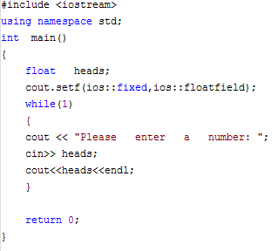
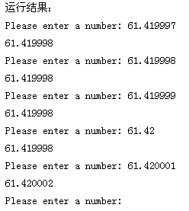
关于浮点数精度的一个例子
61.419998和61.420002是两个可表示数，两者之间相差0.000004。当输入数据是一个不可表示数时，机器将其转换为最邻近的可表示数。

Slide 40
第一讲小结
10在计算机中有几种可能的表示？
-10呢？
在机器内部编码后的数称为机器数，其值称为真值
定义数值数据有三个要素：进制、定点/浮点、编码
整数的表示
  无符号数：正整数，用来表示地址等；带符号整数：用补码表示
C语言中的整数
  无符号数：unsigned int ( short / long)；带符号数： int ( short / long)
浮点数的表示
  符号；尾数：定点小数；指数（阶）：定点整数（基不用表示）
浮点数的范围
  正上溢、正下溢、负上溢、负下溢；与阶码的位数和基的大小有关
浮点数的精度：与尾数的位数和是否规格化有关
浮点数的表示（IEEE 754标准）：单精度SP（float）和双精度DP（double）
    规格化数(SP)：阶码1~254，尾数最高位隐含为1
    “零” (阶为全0，尾为全0)
    ∞ (阶为全1，尾为全0)
    NaN (阶为全1，尾为非0)
    非规格化数 (阶为全0，尾为非0，隐藏位为0)
十进制数的表示：用ASCII码或BCD码表示

Slide 41
数据的表示和运算
分以下三个部分介绍
  第一讲：数值数据的表示
    定点数的编码表示
    整数的表示
    无符号整数、带符号整数
    浮点数的表示
    C语言程序的整数类型和浮点数类型
  第二讲：非数值数据的表示、数据的存储
    逻辑值、西文字符、汉字字符
    数据宽度单位
    大端/小端、对齐存放

Slide 42
逻辑数据的编码表示
表示
  用一位表示 。例如，真：1 / 假：0
  N位二进制数可表示N个逻辑数据，或一个位串
运算
  按位进行
  如:按位与 / 按位或 / 逻辑左移 / 逻辑右移 等
识别
  逻辑数据和数值数据在形式上并无差别，也是一串0/1序列，机器靠指令来识别。
位串
  用来表示若干个状态位或控制位（OS中使用较多）
  例如，x86的标志寄存器含义如下：
OF
DF
IF
TF
SF
ZF
AF
PF
CF

Slide 43
西文字符的编码表示
特点
  是一种拼音文字，用有限几个字母可拼写出所有单词
  只对有限个字母和数学符号、标点符号等辅助字符编码
  所有字符总数不超过256个，使用7或8个二进位可表示
表示（常用编码为7位ASCII码）
  十进制数字：0/1/2…/9
  英文字母：A/B/…/Z/a/b/…/z
  专用符号：+/-/%/*/&/……
  控制字符（不可打印或显示）
操作
  字符串操作，如:传送/比较 等
必须熟悉对应的ASCII码！

Slide 44
汉字及国际字符的编码表示
特点
  汉字是表意文字，一个字就是一个方块图形。
  汉字数量巨大，总数超过6万字，给汉字在计算机内部的表示、汉字的传输与交换、汉字的输入和输出等带来了一系列问题。
编码形式
  有以下几种汉字代码：
  输入码：对汉字用相应按键进行编码表示，用于输入
  内码：用于在系统中进行存储、查找、传送等处理
  字模点阵或轮廓描述: 描述汉字字模点阵或轮廓，用于显示/打印
问题：西文字符有没有输入码？有没有内码？有没有字模点阵或轮廓描述？

Slide 45
汉字内码
至少需2个字节才能表示一个汉字内码。为什么？
  由汉字的总数决定！
可在GB2312国标码的基础上产生汉字内码
  为与ASCII码区别，将国标码的两个字节的第一位置“1”后得到一种汉字内码
  例如，汉字“大”在码表中位于第20行、第83列。因此区位码为0010100 1010011，国标码为00110100 01110011，即3473H。前面的34H和字符“4”的ACSII码相同，后面的73H和字符“s”的ACSII码相同，将每个字节的最高位各设为“1”后，就得到其内码：B4F3H (1011 0100 1111 0011B)，因而不会和ASCII码混淆。

Slide 46
汉字的字模点阵码和轮廓描述
为便于打印、显示汉字，汉字字形必须预先存在机内
  字库 (font)：所有汉字形状的描述信息集合
  不同字体 (如宋体、仿宋、楷体、黑体等) 对应不同字库
  从字库中找到字形描述信息，然后送设备输出
    问题：如何知道到哪里找相应的字形信息？
    汉字内码与其在字库中的位置有关！！
字形主要有两种描述方法：
  字模点阵描述（图像方式）
  轮廓描述（图形方式）
    直线向量轮廓
    曲线轮廓（True Type字形）

Slide 47
数据的基本宽度
比特（bit）是计算机中处理、存储、传输信息的最小单位
二进制信息的计量单位是“字节”(Byte)，也称“位组”
  现代计算机中，存储器按字节编址
  字节是最小可寻址单位 (addressable unit )
  如果以字节为一个排列单位，则LSB表示最低有效字节，MSB表示最高有效字节
除比特和字节外，还经常使用“字”(word)作为单位
“字”和 “字长”的概念不同
  IA-32中的“字”有多少位？字长多少位呢？
  DWORD ：32位
  QWORD：64位
16位
32位

Slide 48
数据的基本宽度
“字”和 “字长”的概念不同
  “字长”指数据通路的宽度。
  （数据通路指CPU内部数据流经的路径以及路径上的部件，主要是CPU内部进行数据运算、存储和传送的部件，这些部件的宽度基本上要一致，才能相互匹配。因此，”字长”等于CPU内部总线的宽度、运算器的位数、通用寄存器的宽度等。 ）
  “字”表示被处理信息的单位，用来度量数据类型的宽度。
  字和字长的宽度可以一样，也可不同。
  例如，x86体系结构定义“字”的宽度为16位，但从386开始字长就是32位了。

Slide 49
数据量的度量单位
存储二进制信息时的度量单位要比字节或字大得多
容量经常使用的单位有：
  “千字节”(KB)，1KB=2¹⁰字节=1024B
  “兆字节”(MB)，1MB=2²⁰字节=1024KB
  “千兆字节”(GB)，1GB=2³⁰字节=1024MB
  “兆兆字节”(TB)，1TB=2⁴⁰字节=1024GB
通信中的带宽使用的单位有：
  “千比特/秒”(kb/s)，1kbps=10³ b/s=1000 bps
  “兆比特/秒”(Mb/s)，1Mbps=10⁶ b/s =1000 kbps
  “千兆比特/秒”(Gb/s)，1Gbps=10⁹ b/s =1000 Mbps
  “兆兆比特/秒”(Tb/s)，1Tbps=10¹² b/s =1000 Gbps
如果把b换成B，则表示字节而不是比特（位）
例如，10MBps表示 10兆字节/秒

Slide 50
程序中数据类型的宽度
高级语言支持多种类型、多种长度的数据
  例如，C语言中char类型的宽度为1个字节，可表示一个字符（非数值数据），也可表示一个8位的整数（数值数据）
  不同机器上表示的同一种类型的数据可能宽度不同
必须确定相应的机器级数据表示方式和相应的处理指令
C语言中数值数据类型的宽度 (单位：字节)
C声明 | 典型32位 机器 | Compaq Alpha 机器
char short int int long int | 1 2 4 4 | 1 2 4 8
char* | 4 | 8
float double | 4 8 | 4 8
从表中看出：同类型数据并不是所有机器都采用相同的宽度，分配的字节数随机器字长和编译器的不同而不同。
Compaq Alpha是一个针对高端应用的64位机器，即字长为64位

Slide 51
数据的存储和排列顺序
65535=2¹⁶-1
[-65535]_{补}=FFFF0001H
80年代开始，几乎所有机器都用字节编址
ISA设计时要考虑的两个问题：
  如何根据一个字节地址取到一个32位的字？- 字的存放问题
  一个字能否存放在任何字节边界？- 字的边界对齐问题
若 int i = -65535，存放在100号单元（占100～103），则用“取数”指令访问100号单元取出 i 时，必须清楚 i 的4个字节是如何存放的。
FF FF 00 01
103 102 101 100
little endian word 100#
Word:
msb
lsb
100 101 102 103
big endian word 100#
大端方式（Big Endian）: MSB所在的地址是数的地址
e.g. IBM 360/370, Motorola 68k, MIPS, Sparc, HP PA
小端方式（ Little Endian）: LSB所在的地址是数的地址
e.g. Intel 80x86, DEC VAX
有些机器两种方式都支持，可通过特定控制位来设定采用哪种方式。

Slide 52
BIG Endian versus Little Endian
Ex3: Memory layout of a instruction located in 1000
即指令地址为1000
假定小端机器中指令：mov AX, 0x12345(BX)
其中操作码mov为40H，寄存器AX和BX的编号分别为0001B和0010B，立即数占32位，则存放顺序为：
00
01
23
45
12
40
1005
1004
1003
1002
1001
1000
45
23
01
00
12
40
40
1
2
45 23 01 00
若在大端机器上，则存放顺序如何？
40
1
2
00 01 23 45
地址
只需要考虑指令中立即数的顺序！

Slide 53
Byte Swap Problem（字节交换问题）
78
3
12
3
56
2
34
2
34
1
increasing
byte
address
56
1
12
0
78
0
Big Endian
Little Endian
上述存放在0号单元的数据（字）是什么？
12345678H？ 78563412H？
存放方式不同的机器间程序移植或数据通信时，会发生什么问题？
每个系统内部是一致的，但在系统间通信时可能会发生问题！
因为顺序不同，需要进行顺序转换
音、视频和图像等文件格式或处理程序都涉及到字节顺序问题
ex. Little endian: GIF, PC Paintbrush, Microsoft RTF,etc
Big endian: Adobe Photoshop, JPEG, MacPaint, etc

Slide 54
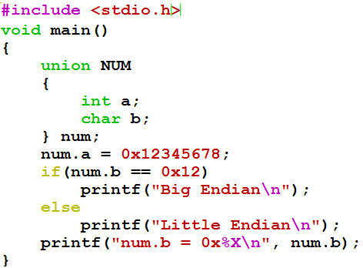

检测系统的字节顺序
union的存放顺序是所有成员从低地址开始，利用该特性可测试CPU的大/小端方式。
请猜测在IA-32上的打印结果。

Slide 55
关于大端小端
有学生告诉我，他的同学写了一下程序，判断出他的PC是大端！
union test {
int a;
char b;
}
main( ) {
test.a=0xff;
if (test.b==0xff)
printf(“Little endian“);
else
printf(“Big endian“);
}
大地址
小地址
未确定行为（unspecified behavior）语句
小端
00
00
00
FF
C语言标准没有明确规定char为无符号还是带符号整型，当程序移植到另一个系统时，其行为可能发生变化，从而造成难以理解的结果。为避免这种情况，程序员应尽量编写行为确定的程序，对于一字节整数，应显式定义成signed char或unsigned char，作字符处理时，则可使用char型。
按照C语言标准，test.b从char型提升为int型，0xff为int型，故按int型比
在IA-32中，char为signed char，扩展为32位后为全1，真值为-1；而0xff的真值是255；等式左右不等！
在RISC-V中，char为unsigned char，扩展为32位后为0x0000 00ff，因而，等式左右都是255，相等！

Slide 56
第二讲小结
非数值数据的表示
  逻辑数据用来表示真/假或N位位串，按位运算
  西文字符：用ASCII码表示
  汉字：汉字输入码、汉字内码、汉字字模码
数据的宽度
  位、字节、字（不一定等于字长）
  k /K / M / G / T / P / E / Z / Y 有不同的含义
数据的存储排列
  数据的地址：连续若干单元中最小的地址，即：从小地址开始存放数据
    问题：若一个short型数据si存放在单元0x08000100和0x08000101中，那么si的地址是什么？
  大端方式：用MSB存放的地址表示数据的地址
  小端方式：用LSB存放的地址表示数据的地址
  按边界对齐可减少访存次数

Slide 57
数据的表示和运算
分以下三个部分介绍（续）
  第三讲：数据的运算
    按位运算和逻辑运算
    移位运算
    位扩展和位截断运算
    无符号和带符号整数的加减运算
    无符号和带符号整数的乘除运算
    变量与常数之间的乘除运算
    浮点数的加减乘除运算
围绕C语言中的运算，解释其在底层机器级的实现方法
从高级语言程序中的表达式出发，用机器数在具体电路中的执行过程，来解释表达式的执行结果

Slide 58
数据的运算
高级语言程序中涉及的运算（以C语言为例）
  整数算术运算、浮点数算术运算
  按位、逻辑、移位、位扩展和位截断
指令集中涉及到的运算
  涉及到的定点数运算
    算术运算
      带符号整数运算：取负 / 符号扩展 / 加 / 减 / 乘 / 除 / 算术移位
      无符号整数运算：0扩展 / 加 / 减 / 乘 / 除
    逻辑运算
      逻辑操作：与 / 或 / 非 / …
      移位操作：逻辑左移 / 逻辑右移
  涉及到的浮点数运算：加、减、乘、除
基本运算部件ALU的设计
浮点数有没有移位操作和扩展操作？为什么？

Slide 59
C语言程序中涉及的运算
算术运算（最基本的运算）
  无符号数、带符号整数、浮点数的+、-、*、/ 运算等
按位运算
  用途
    对位串实现“掩码”（mask）操作或相应的其他处理
    （主要用于对多媒体数据或状态/控制信息进行处理）
  操作
    按位或：“|”
    按位与：“&”
    按位取反：“~”
    按位异或：“^”
    问题：如何从16位采样数据y中提取高位字节，并使低字节为0？
    可用“&”实现“掩码”操作：y & 0xFF00
    例如，当y=0x2C0B时，得到结果为：0x2C00

Slide 60
C语言程序中涉及的运算
逻辑运算
  用途
    用于关系表达式的运算
    例如，if （x>y and i<100）then ……中的“and”运算
  操作
    “‖”表示“OR”运算
    “&&”表示“AND”运算
    例如， if ((x>y) && (i<100)) then ……
    “!”表示“NOT”运算
  与按位运算的差别
    符号表示不同：& 对 && ；| 对 ‖； ……
    运算过程不同：按位 对 整体
    结果类型不同：位串 对 逻辑值

Slide 61
C语言程序中涉及的运算
如何从16位数据y中提取高位字节？
某字长为8的机器中，x、y和z都是8位带符号整数，已知x=-81，则y=x/2=？z=2x=？
移位运算
  用途
    提取部分信息
    扩大或缩小数值的2、4、8…倍
  操作
    左移:：x<<k; 右移： x>>k
    不区分是逻辑移位还是算术移位，由x的类型确定
    无符号数：逻辑左移、逻辑右移
      高（低）位移出，低（高）位补0，可能溢出！
      问题：何时可能发生溢出？如何判断溢出？
    若高位移出的是1，则左移时发生溢出
    带符号整数：算术左移、算术右移
      左移：高位移出，低位补0。可能溢出！
    溢出判断：若移出的位不等于新的符号位，则溢出。
      右移：低位移出，高位补符，可能发生有效数据丢失。
(y>>8) 送8位寄存器
移位！y=-40？ z=-162?

Slide 62
C语言程序中涉及的运算
例2（截断操作）：i和j是否相等？
int i = 32768;
short si = (short) i;
int j = si;
位扩展和位截断运算
  用途
    类型转换时可能需要数据扩展或截断
  操作
    没有专门操作运算符，根据类型转换前后数据长短确定是扩展还是截断
    扩展：短转长
    无符号数：0扩展，前面补0
    带符号整数：符号扩展，前面补符
    截断：长转短
    强行将高位丢弃，故可能发生“溢出”
  例1（扩展操作）：在大端机上输出si, usi, i, ui的十进制和十六进制值是什么？
  short si = -32768;
  unsigned short usi = si;
  int i = si;
  unsingned ui = usi ;
不相等！
i = 32768 00 00 80 00
si = -32768 80 00
j = -32768 FF FF 80 00
原因：对i截断时发生了溢出，即：32768截断为16位数时，因其超出16位能表示的最大值，故无法截断为正确的16位数！
si = -32768 80 00
usi = 32768 80 00
i = -32768 FF FF 80 00
ui = 32768 00 00 80 00
C语言标准规定，长数转换为短数的结果是未定义的，没有规定编译器必须报错

Slide 63
如何实现高级语言源程序中的运算？
总结：C语言程序中的基本数据类型及其基本运算类型
  基本数据类型
    无符号数、带符号整数、浮点数、位串、字符（串）
  基本运算类型
    算术、按位、逻辑、移位、扩展和截断、匹配
计算机如何实现高级语言程序中的运算？
  将各类表达式编译（转换）为指令序列
  计算机直接执行指令来完成运算
逻辑运算、移位、扩展和截断等指令实现较容易，算术运算指令难！
例：C语言赋值语句“f = (g+h) – (i+j);”中变量i、j、f、g、h由编译器分别分配给MIPS寄存器$t0~$t4。寄存器$t0~$t7的编号对应8~15，上述程序段对应的MIPS机器代码和汇编表示（#后为注释）如下：
000000 01011 01100 01101 00000 100000 add $t5, $t3, $t4 # g+h
000000 01000 01001 01110 00000 100000 add $t6, $t0, $t1 # i+j
000000 01101 01110 01010 00000 100010 sub $t2, $t5, $t6 # f =(g+h)–(i+j)
需要提供哪些运算类指令才能支持高级语言需求呢？

Slide 64
整数加、减运算
C语言程序中的整数有
  带符号整数，如char、short、int、long型等
  无符号整数，如unsigned char、unsigned short、unsigned等
指针、地址等通常被说明为无符号整数，因而在进行指针或地址运算时，需要进行无符号整数的加、减运算
无符号整数和带符号整数的加、减运算电路完全一样，这个运算电路称为整数加减运算部件，基于带标志加法器实现
最基本的加法器，因为只有n位，所以是一种模2^{n}运算系统！
Cin
A
n
n
例：n=4，A=1001，B=1100
则：F=0101，Cout=1
加法器
F
n
B
Cout
还记得这个加法器是如何实现的？

Slide 65
n位整数加/减运算器
补码加减运算公式
  [A+B]_{补} = [A]_{补} + [B] _{补} ( mod 2^{n} )
  [A–B]_{补} = [A]_{补} + [–B] _{补} ( mod 2^{n} )
  实现减法的主要工作在于：求[–B] _{补}
问题：如何求[–B]_{补}？
[–B]_{补}=[B]_{补}+1
利用带标志加法器，可构造整数加/减运算器，进行无/带符号整数加/减
当Sub为1时，做减法
当Sub为0时，做加法
Sub
重要认识1：计算机中所有算术运算都基于加法器实现！
A
Cin
4
零标志
ZF
符号
标志
重要认识2：加法器不知道所运算的是带符号数还是无符号数。
重要认识3：加法器不判定对错，总是取低n位作为结果，并生成标志信息。
SF
加法器
4
Sum
B＇
CF
B
0
OF
4
B
MUX
进/借位标志
1
4
溢出标志
4
Cout
整数加/减运算部件
Notes:
Besides detecting overflow, our ALU also needs to indicate if the result is zero.
This is easy to do. All we need is a BIG NOR gate.
Then if any of the Result bit is not zero, then the output of the NOR gate will be low.
The only time the output of the NOR gate is high is when all the result bits are zeroes.
+1 = 43 min. (Y:23)
Supplement: why do we need to check if the result is zero? For instructions such as bne, beq, slt, …

Slide 66


n位带标志加法器
n位加法器无法用于两个n位带符号整数（补码）相加，无法判断是否溢出
程序中经常需要比较大小，通过（在加法器中）做减法得到的标志信息来判断
溢出标志OF：OF=C_{n}⊕C_{n-1}
符号标志SF：
SF=F_{n-1}
零标志ZF=1当且仅当F=0；
进位/借位标志CF：CF=Cout⊕Cin
Notes:
Besides detecting overflow, our ALU also needs to indicate if the result is zero.
This is easy to do. All we need is a BIG NOR gate.
Then if any of the Result bit is not zero, then the output of the NOR gate will be low.
The only time the output of the NOR gate is high is when all the result bits are zeroes.
+1 = 43 min. (Y:23)
Supplement: why do we need to check if the result is zero? For instructions such as bne, beq, slt, …

Slide 67
条件标志位（条件码CC）
Sub
问题：为什么要生成并保存条件标志？
为了在分支指令（条件转移指令）中被用作是否转移执行的条件！
A
Cin
n
ZF
SF
加法器
n
Sum
Sel
B＇
CF
B
0
OF
n
B
Mux
1
n
if (i>j) {
…
}
n
Cout
问题：OF=？ZF=？
SF=？CF=？
整数加/减运算部件
OF：若A与B’同号但与Sum不同号，则1；否则0。SF：sum符号
ZF：如Sum为0，则1，否则0。CF：Cout ⊕ sub
零标志ZF、溢出标志OF、进/借位标志CF、符号标志SF称为条件标志。
条件标志（Flag）在运算电路中产生，被记录到专门的寄存器中
存放标志的寄存器通常称为程序/状态字寄存器或标志寄存器。每个标志对应标志寄存器中的一个标志位。 如，IA-32中的EFLAGS寄存器
Notes:
Besides detecting overflow, our ALU also needs to indicate if the result is zero.
This is easy to do. All we need is a BIG NOR gate.
Then if any of the Result bit is not zero, then the output of the NOR gate will be low.
The only time the output of the NOR gate is high is when all the result bits are zeroes.
+1 = 43 min. (Y:23)
Supplement: why do we need to check if the result is zero? For instructions such as bne, beq, slt, …

Slide 68


整数加法举例
unsigned int x=134;
unsigned int y=246;
int m=x;
int n=y;
unsigned int z1=x-y;
unsigned int z2=x+y;
int k1=m-n;
int k2=m+n;
无符号加公式：
带符号加公式：
x和m的机器数一样：1000 0110，y和n的机器数一样：1111 0110
z2和k2的机器数一样：0111 1100，CF=1，OF=1，SF=0
z2的值为124（=134+246-256，x+y>256）
k2的值为124（=-122+(-10)+256，m+n=-132<-128，即负溢出）

Slide 69
整数加法举例
做加法时，主要判断是否溢出
无符号加溢出条件：CF=1
带符号加溢出条件：OF=1
Sub
A
Cin
n
ZF
SF
Adder
n
Sum
Sel
B＇
CF
B
0
OF
n
B
Mux
1
n
n
Cout
若n=8，计算107+46=？
整数加/减运算部件
107₁₀= 0110 1011₂
46₁₀ = 0010 1110₂
两个正数相加，结果为负数，故溢出！即OF=1
0 1001 1001
溢出标志OF=1、零标志ZF=0、
符号标志SF=1、进位标志CF=0
进位是真正的符号：+153
无符号：sum=153，因为CF=0，故未发生溢出，结果正确！
带符号：sum= -103，因为OF=1，故发生溢出，结果错误！
Notes:
The best thing about 2’s complement representation is that your adder does not have to know about negative number.
You just add the two numbers together and the result will take care of itself.
For example, for the operation 7 minus 6, we simply add negative 6 to positive 7 and ignore the Carry bit coming out of the most significant bit, you will have 0001, the correct result.
+1 = 24 min. (Y:04)

Slide 70


整数减法举例
unsigned int x=134;
unsigned int y=246;
int m=x;
int n=y;
unsigned int z1=x-y;
unsigned int z2=x+y;
int k1=m-n;
int k2=m+n;
无符号减公式：
带符号减公式：
x和m的机器数一样：1000 0110，y和n的机器数一样：1111 0110
z1和k1的机器数一样：1001 0000，CF=1，OF=0，SF=1
z1的值为144（=134-246+256，x-y<0），k1的值为-112。

Slide 71
整数减法举例
-7- 6 = -7 + (-6) = +3 -3 - 5 = - 3 + (- 5) = - 8
9 - 6 = 3 13 - 5 = 8
X
√
√
√
1
0
1
1
1
1
1
0
0
1
1
1
0
1
+
1
0
1
0
+
1
0
1
1
0
0
1
1
1
0
0
0
OF=1、ZF=0
SF=0、借位CF=0
OF=0、ZF=0、
SF=1、借位CF=0
带符号 (1) 最高位和次高位的进位不同
溢出： (2) 和的符号位和加数的符号位不同
无符号减溢出：差为负数，即借位CF=1
做减法以比较大小，规则：
Unsigned: CF=0时，大于
Signed：OF=SF时，大于
验证：9>6，故CF=0；13>5，故CF=0
验证：-7<6，故OF≠SF
-3<5，故OF≠SF
Notes:
The best thing about 2’s complement representation is that your adder does not have to know about negative number.
You just add the two numbers together and the result will take care of itself.
For example, for the operation 7 minus 6, we simply add negative 6 to positive 7 and ignore the Carry bit coming out of the most significant bit, you will have 0001, the correct result.
+1 = 24 min. (Y:04)

Slide 72
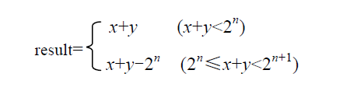
无符号整数加法溢出判断程序
如何用程序判断一个无符号数相加没有发生溢出
/* Determine whether arguments can be added without overflow */
int uadd_ok(unsigned x, unsigned y)
{
unsigned sum = x+y;
return sum >= x;
}
做模拟器实验时，模拟Add指令需要用！
发生溢出时，一定满足 result<x and result<y
否则，若x+y-2^{n}≥x，则 y≥2^{n} ，这是不可能的！

Slide 73
带符号整数加法溢出判断程序
如何用程序判断一个带符号整数相加没有发生溢出
/* Determine whether arguments can be added without overflow */
int tadd_ok(int x, int y) {
int sum = x+y;
int neg_over = x < 0 && y < 0 && sum >= 0;
int pos_over = x >= 0 && y >= 0 && sum < 0;
return !neg_over && !pos_over;
}
做PA2模拟Add指令需要用以下公式：
CF=?, ZF=?, OF=?, SF=?
CF=0, ZF=0, OF=1, SF=1
CF=1, ZF=0, OF=1, SF=0
Lab1实验

Slide 74
带符号整数减法溢出判断程序
带符号整数加
带符号整数减
模拟Sub指令需要！
以下程序检查带符号整数相减是否溢出有没有问题？
/* Determine whether arguments can be subtracted without overflow */
/* WARNING: This code is buggy. */
int tsub_ok(int x, int y) {
return tadd_ok(x, -y);
}
带符号减的溢出判断函数如何实现呢？
无符号减的溢出判断函数又如何实现呢？
当x>=0，y=0x80000000时，该函数判断错误

Slide 75
带符号整数减法溢出判断程序
/*
* subOK - Determine if can compute x-y without overflow
* Example: subOK(0x80000000,0x80000000) = 1,
* subOK(0x80000000,0x70000000) = 0,
* Legal ops: ! ~ & ^ | + << >>
* Max ops: 20
* Rating: 3
*/
int subOK(int x, int y) {
int diff = x+~y+1;
int x_neg = x>>31;
int y_neg = y>>31;
int d_neg = diff>>31;
/* Overflow when x and y have opposite sign, and d different from x */
return !(~(x_neg ^ ~y_neg) & (x_neg ^ d_neg));
}
Sub
A
Cin
n
ZF
SF
Adder
n
Sum
Sel
CF
B
0
OF
n
B
Mux
1
n
n
Cout
当x和~y同号，且和diff不同号，则发生溢出！

Slide 76
整数的乘运算
通常，高级语言中两个n位整数相乘得到的结果通常也是一个n位整数，也即，结果只取2n位乘积中的低n位。
  例如，在C语言中，参加运算的两个操作数的类型和结果的类型必须一致，如果不一致则会先转换为一致的数据类型再进行计算。
  int mul(int x, int y)
  {
  int z=x*y;
  return z;
  }
x*y 被转换为乘法指令，在乘法运算电路中得到的乘积是64位，但是，只取其低32位赋给z。

Slide 77
整数的乘运算
结论：假定两个n位无符号整数x_{u}和y_{u}对应的机器数为X_{u}和Y_{u}，p_{u}=x_{u}×y_{u}，p_{u}为n位无符号整数且对应的机器数为P_{u}；
两个n位带符号整数x_{s}和y_{s}对应的机器数为X_{s}和Y_{s}，p_{s}=x_{s}×y_{s}，p_{s}为n位带符号整数且对应的机器数为P_{s}。
若X_{u}=X_{s}且Y_{u}=Y_{s}，则P_{u}=P_{s}。
例：X_{u}=X_{s}=？，Y_{u}=Y_{s}=？
无符号：若P_{uh}=0，则不溢出
带符号：若P_{sh}每位都等于P_{s}的最高位，则不溢出
可用无符号乘来实现带符号乘，但高n位无法得到，故不能判断溢出。
p_{u}=x_{u}*y_{u}
P_{uh}
P_{u}
p_{s}=x_{s}*y_{s}
P_{sh}
P_{s}
n
n
n
n
P_{uh}
≠
P_{sh}
无符号乘法器
带符号乘法器
n
n
n
n
SKIP
X_{u}
Y_{u}
X_{s}
Y_{s}

Slide 78
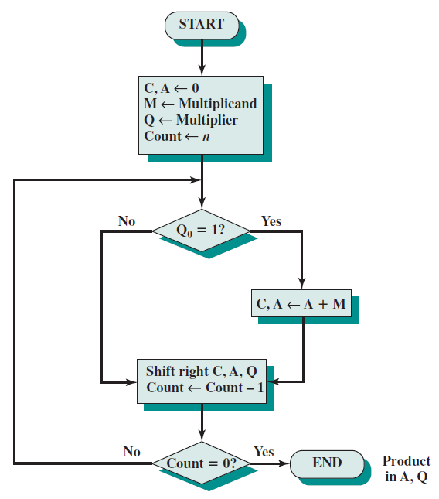
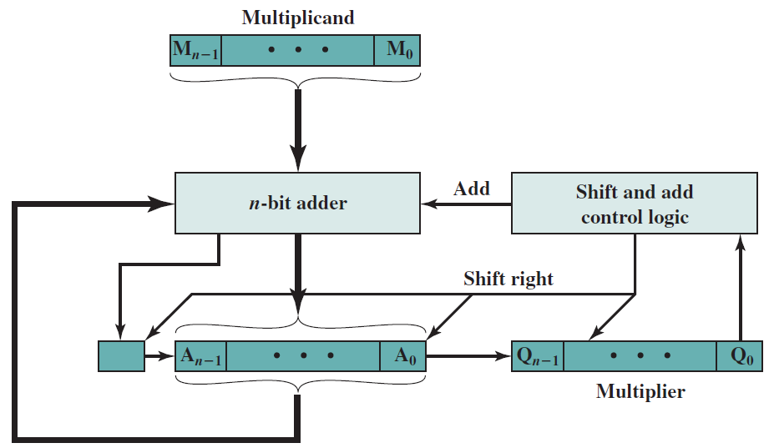
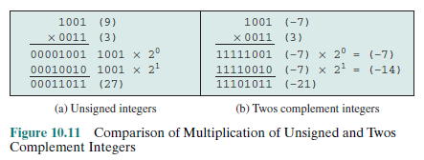
无符号整数乘法

Slide 79
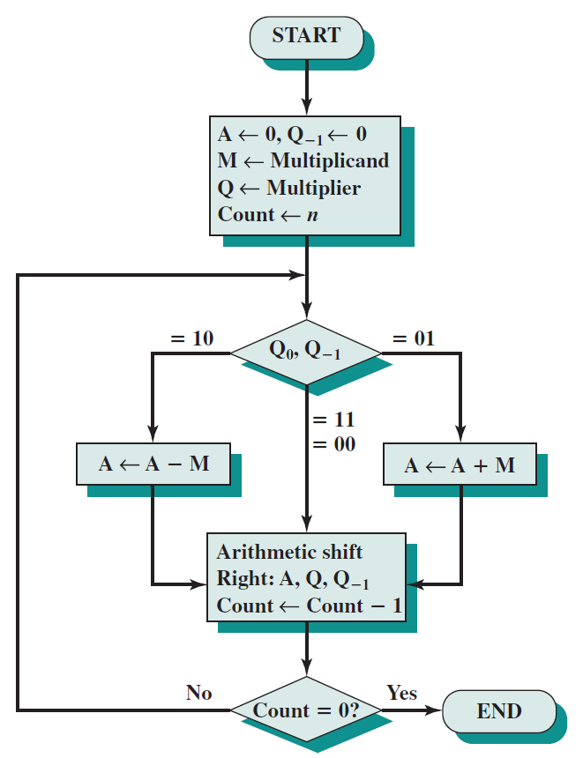
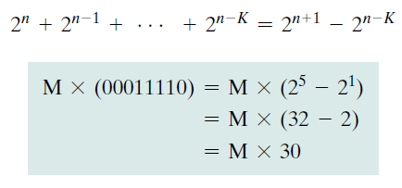
补码乘法：Booth’s algorithm
When Q is positive:
Booth’s algorithm conforms to this scheme by performing a subtraction when the
first 1 of the block is encountered (1–0) and an addition when the end of the block is encountered (0–1).

Slide 80

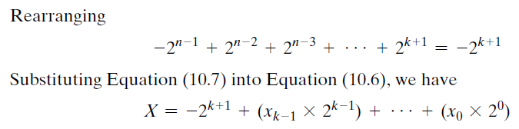
补码乘法：Booth’s algorithm
When Q(X) is negative:
x_{k}
10转换
对应’–’
为正乘数（x_{k}=0），按前述可正确处理

Slide 81
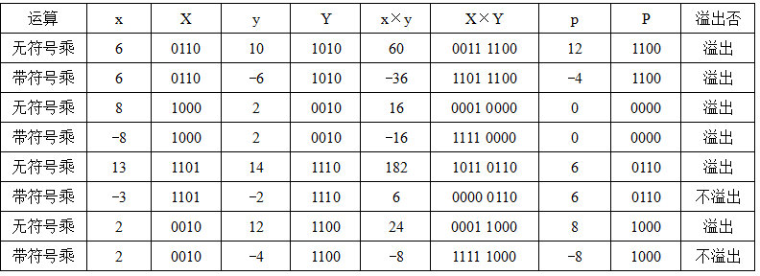
整数的乘运算
X*Y的高n位可以用来判断溢出，规则如下：
  无符号：若高n位全0，则不溢出，否则溢出
  带符号：若高n位全0或全1且等于低n位的最高位，则不溢出。

Slide 82
整数乘法溢出漏洞
以下程序存在什么漏洞，引起该漏洞的原因是什么。
2002年，Sun Microsystems公司的RPC XDR库带的xdr_array函数发生整数溢出漏洞，攻击者可利用该漏洞从远程或本地获取root权限。
/* 复制数组到堆中，count为数组元素个数 */
int copy_array(int *array, int count) {
int i;
/* 在堆区申请一块内存 */
int *myarray = (int *) malloc(count*sizeof(int));
if (myarray == NULL)
return -1;
for (i = 0; i < count; i++)
myarray[i] = array[i];
return count;
}
攻击者可构造特殊参数来触发整数溢出，以一段预设信息覆盖一个已分配的堆缓冲区，造成远程服务器崩溃或者改变内存数据并执行任意代码。
当参数count很大时，则count*sizeof(int)会溢出。如count=2³⁰+1时， count*sizeof(int)=4。
堆（heap）中大量数据被破坏！

Slide 83
变量与常数之间的乘运算
整数乘法运算比移位和加法等运算所用时间长，通常一次乘法运算需要多个时钟周期，而一次移位、加法和减法等运算只要一个或更少的时钟周期，因此，编译器在处理变量与常数相乘时，往往以移位、加法和减法的组合运算来代替乘法运算。
例如，对于表达式x*20，编译器可以利用20=16+4=2⁴+2²，将x*20转换为(x<<4)+(x<<2)，这样，一次乘法转换成了两次移位和一次加法。
不管是无符号数还是带符号整数的乘法，即使乘积溢出时，利用移位和加减运算组合的方式得到的结果都是和采用直接相乘的结果是一样的。

Slide 84
关于乘运算的几个问题
假定CPU中没有乘法器，只有ALU、移位器以及与、或、非等逻辑电路，则其指令系统能提供乘法指令吗？
假定ISA中不包含乘法指令，但包含加、减、移位以及与、或、非三种逻辑运算指令，则基于该ISA的系统能执行以下程序吗？
int imul(int x, int y) {
return x*y;
}
以下两个函数的机器级代码相同吗？ 返回的结果一定相同吗？什么情况下相同？返回的结果一定正确吗？
int imul(int x, int y) {
return x*y;
}
unsigned mul(unsigned x, unsigned y) {
return x*y;
}
上述程序执行时间比较
①无乘法指令 ② 用ALU实现乘法指令 ③用乘法器实现乘法指令
①用循环程序段实现
②直接用较慢乘法指令实现
③直接用较快乘法指令实现
>
>

Slide 85
整数的除运算
对于带符号整数来说，n位整数除以n位整数，除-2^{n-1}/-1= 2^{n-1}会发生溢出外，其余情况（除数为0外）都不会发生溢出。Why?
因为商的绝对值不可能比被除数的绝对值更大，因而不会发生溢出，也就不会像整数乘法运算那样发生整数溢出漏洞。
因为整数除法，其商也是整数，所以，在不能整除时需要进行舍入，通常按照朝0方向舍入，即正数商取比自身小的最接近整数（Floor，地板），负数商取比自身大的最接近整数（Ceiling，天板）。
例如，7/2=?, -7/2=？
7/2=3, -7/2=-3
整数除0的结果可以用什么机器数表示？
整数除0的结果无法用一个机器数表示！
整数除法时，除数不能为0，否则会发生“异常”，此时，需要调出操作系统中的异常处理程序来处理。

Slide 86
变量与常数之间的除运算
对于整数除法运算，由于计算机中除法运算比较复杂，而且不能用流水线方式实现，所以一次除法运算大致需要几十个或更多个时钟周期，比乘法指令的时间还要长！
为了缩短除法运算的时间，编译器在处理一个变量与一个2的幂次形式的整数相除时，常采用右移运算来实现。
  无符号：逻辑右移
  带符号：算术右移
结果一定取整数
  能整除时，直接右移得到结果，移出的为全0
例如，12/4=3：0000 1100>>2=0000 0011
-12/4=-3：1111 0100 >>2=1111 1101
  不能整除时，右移移出的位中有非0，需要进行相应处理

Slide 87
变量与常数之间的除运算
不能整除时，采用朝零舍入，即截断方式
  无符号数、带符号正整数（地板）：移出的低位直接丢弃
  带符号负整数（天板）：加偏移量(2^{k}-1)，然后再右移k 位 ，低位截断（这里K 是右移位数）
举例：
无符号数 14/4=3：0000 1110>>2=0000 0011
带符号负整数 -14/4=-3
若直接截断，则 1111 0010 >>2=1111 1100=-4≠-3
应先纠偏，再右移: k=2, 故(-14+2²-1)/4=-3
即： 1111 0010+0000 0011=1111 0101
1111 0101>>2=1111 1101=-3

Slide 88
变量与常数之间的除运算—举例
假设x为一个int型变量，请给出一个用来计算x/32的值的函数div32。要求不能使用除法、乘法、模运算、比较运算、循环语句和条件语句，可以使用右移、加法以及任何按位运算。
解：若x为正数，则将x右移k位得到商；若x为负数，则x需要加一个偏移量(2^{k}-1)后再右移k位得到商。因为32=2⁵，所以 k=5。
即结果为: ( x>=0 ? x : (x+31))>>5
但题目要求不能用比较和条件语句，因此要找一个计算偏移量b的方式
这里，x为正时b=0，x为负时b=31. 因此，可以从x的符号得到b
x>>31 得到的是32位符号，取出最低5位，就是偏移量b。
int div32(int x)
{ /* 根据x的符号得到偏移量b */
int b=(x>>31) & 0x1F;
return (x+b)>>5;
}

Slide 89
浮点数运算及结果
设两个规格化浮点数分别为 A=Ma . 2^{Ea} B=Mb.2^{Eb} ,则：
A⁺B =(Ma ⁺ Mb.2^{-(Ea-Eb)}). 2^{Ea} (假设Ea>=Eb )
A*B =(Ma * Mb).2^{Ea+Eb}
A/B =(Ma / Mb).2^{Ea-Eb}
上述运算结果可能出现以下几种情况：
阶码上溢：一个正指数超过了最大允许值 =〉+∞/-∞/溢出
阶码下溢：一个负指数比最小允许值还小 =〉+0/-0
尾数溢出：最高有效位有进位 =〉右规
非规格化尾数：数值部分高位为0 =〉左规
右规或对阶时，右段有效位丢失 =〉尾数舍入
IEEE建议实现时为每种异常情况提供一个自陷允许位。若某异常对应的位为1，则发生相应异常时，就调用一个特定的异常处理程序执行。
1.5+1.5=？
1.5-1.0=？
127
SP最大指数为多少？
SP最小指数呢？
-126-23
尾数溢出，结果不一定溢出
运算过程中添加保护位

Slide 90
浮点数加/减运算
十进制科学计数法的加法例子
  1.123 × 10⁵ + 2.560 ×10²
其计算过程为：
  1.123 ×10⁵ + 2.560 ×10² = 1.123 ×10⁵ + 0.002560 ×10⁵
  =(1.123 + 0.00256) ×10⁵ = 1.12556 ×10⁵
  =1.126 ×10⁵
“对阶”操作：目的是使两数阶码相等
  小阶向大阶看齐，阶小的那个数的尾数右移，右移位数等于两个阶码差的绝对值
  IEEE 754尾数右移时，要将隐含的“1”移到小数部分，高位补0，移出的低位保留到特定的“附加位”上
进行尾数加减运算前，必须“对阶”！最后还要考虑舍入
计算机内部的二进制运算也一样！

Slide 91
浮点数加减法基本要点
（假定：Xm、Ym分别是X和Y的尾数， Xe和Ye 分别是X和Y的阶码 ）
(1) 求阶差：∆e=Ye – Xe (若Ye > Xe，则结果的阶码为Ye)
(2) 对阶：将Xm右移∆e位，尾数变为 Xm*2^{Xe-Ye}（保留右移部分附加位）
(3) 尾数加减： Xm*2^{Xe-Ye} ± Ym
(4) 规格化：
当尾数高位为0，则需左规：尾数左移一次，阶码减1，直到MSB为1或阶码为00000000（-126，非规格化数）
每次阶码减1后要判断阶码是否下溢（比最小可表示的阶码还要小）
当尾数最高位有进位，需右规：尾数右移一次，阶码加1，直到MSB为1
每次阶码加1后要判断阶码是否上溢（比最大可表示的阶码还要大）
如果尾数比规定位数长（有附加位），则需考虑舍入（有多种舍入方式）
若运算结果尾数是0，则需要将阶码也置0。为什么？
0.00…0001x2⁻¹²⁶
阶码溢出异常处理：阶码上溢，则结果溢出；阶码下溢到无法用非规格化数表示，则结果为0
尾数为0说明结果应该为0（阶码和尾数为全0）。

Slide 92
浮点数加/减运算-对阶
问题：如何对阶？
通过计算[ΔE]_{补}来判断两数的阶差：
[ΔE]_{补}= [Ex–Ey]_{补}= [Ex]_{移} + [–[Ey]_{移}]_{补} (mod 2^{n})
问题：在ΔE为何值时无法根据[ΔE]_{补}来判断阶差？
溢出时！
例如，4位移码，Ex=7，Ey=-7，则[ΔE]_{补}=1110+0000=1110，ΔE<0,错！
问题：对IEEE754 SP格式来说， |ΔE|大于多少时，结果就等于阶大的那个数（小数被大数吃掉）？
1.xx…x
0.00…01xx…x
24：吃不掉☹
1.xx…x
0.00…001xx…x
25：吃掉了☺
25！
问题：IEEE754 SP格式的偏置常数是127，这会不会影响阶码运算电路的复杂度？
对计算[Ex–Ey]_{补} （mod 2^{n}） 没有影响
[ΔE]_{补}= 256+Ex–Ey=256+127+Ex– (127+Ey)
= 256 + [Ex]_{移} – [Ey]_{移} = [Ex]_{移}+[–[Ey]_{移}]_{补} (mod 256)
但[Ex+Ey]_{移}和 [Ex–Ey]_{移}的计算会变复杂！ 浮点乘除运算涉及之。

Slide 93
浮点数加法运算举例
例：用二进制浮点数形式计算 0.5 +(– 0.4375) =？
0.4375=0.25+0.125+0.0625=0.0111B
解：0.5 = 1.000 x 2⁻¹， - 0.4375 = -1.110 x 2⁻²
对 阶: -1.110 x 2⁻² → -0.111 x 2⁻¹
加 减: 1.000 x 2⁻¹ +( -0.111 x 2⁻¹ ) = 0.001 x 2⁻¹
左 规: 0.001 x 2⁻¹ → 1.000 x 2^{–4}
判溢出: 无
结果为： 1.000 x 2^{–4} = 0.0001000 = 1/16 = 0.0625
问题：为何IEEE 754 加减运算右规时最多只需一次？
因为即使是两个最大的尾数相加，得到的和的尾数也不会达到4，故尾数的整数部分最多有两位，保留一个隐含的“1”后，最多只有一位被右移到小数部分。

Slide 94
Extra Bits(附加位)
"Floating Point numbers are like piles of sand; every time you move one you lose a little sand, but you pick up a little dirt.“
“浮点数就像一堆沙，每动一次就会失去一点‘沙’，并捡回一点 ‘脏’”
如何才能使失去的“沙” 和捡回的“脏”都尽量少呢？
加多少附加位才合适？
在后面加附加位！
无法给出准确的答案！
Add/Sub:
1.xxxxx 1.xxxxx 1.xxxxx 1.xxxxxxxx
+ 1.xxxxx 0.001xxxxx 0.01xxxxx -1.xxxxxxxx
1x.xxxxy 1.xxxxxyyy 1x.xxxxyyy 0.0…0xxxx
IEEE754规定: 中间结果须在右边加2个附加位 （guard & round）
Guard (保护位)：在significand右边的位
Round (舍入位)：在保护位右边的位
附加位的作用：用以保护对阶时右移的位或运算的中间结果。
附加位的处理： ①左规时被移到significand中; ② 作为舍入的依据。

Slide 95
Rounding Digits(舍入位)
举例：若十进制数最终有效位数为 3，采用两位附加位（G、R）。
问题：若没有舍入位，采用就近舍入到偶数，则结果是什么？
2.3400 * 10
0.0253 * 10
2.3653 * 10
2
2
结果为2.36！精度没有2.37高！
2
IEEE Standard: four rounding modes（用图说明）
round to nearest (default)
round towards plus infinity (always round up)
round towards minus infinity (always round down)
round towards 0
称为就近舍入到偶数
round to nearest:
round digit < 1/2 then truncate (截断、丢弃)
> 1/2 then round up (末位加1)
= 1/2 then round to nearest even digit（最近偶数）
可以证明默认方式得到的平均误差最小。
Notes:
Supplement: ULP=units in the last place.

Slide 96
IEEE 754的舍入方式的说明
IEEE 754的舍入方式
( Z1和Z2分别是结果Z的最近的可表示的左、右两个数 )
(1) 就近舍入：舍入为最近可表示的数
非中间值：0舍1入；
中间值：强迫结果为偶数-慢
(2) 朝+∞方向舍入:舍入为Z2(正向舍入)
(3) 朝-∞方向舍入:舍入为Z1(负向舍入)
(4) 朝0方向舍入：截去。正数：取Z1; 负数：取Z2
0
Z1
Z
Z2
0
例如：附加位为
01：舍
11：入
10：(强迫结果为偶数)
例：1.110111 → 1.1110; 1.110101 → 1.1101;
1.110110 → 1.1110; 1.111110 → 10.0000;

Slide 97
浮点数舍入举例
例：将同一实数分别赋值给单精度和双精度类型变量，然后打印输出。
#include <stdio.h>
main()
{
float a;
double b;
a = 123456.789e4;
b = 123456.789e4;
printf(“%f/n%f/n”,a,b);
}
运行结果如下：
1234567936.000000
1234567890.000000
为什么float情况下输出的结果会比原来的大？这到底有没有根本性原因还是随机发生的？为什么会出现这样的情况？
float可精确表示7个十进制有效数位，后面的数位是舍入后的结果，舍入后的值可能会更大，也可能更小
问题：为什么同一个实数赋值给float型变量和double型变量，输出结果会有所不同呢？

Slide 98
C语言中的浮点数类型
C语言中有float和double类型，分别对应IEEE 754单精度浮点数格式和双精度浮点数格式
long double类型的长度和格式随编译器和处理器类型的不同而有所不同，IA-32中是80位扩展精度格式
从int转换为float时，不会发生溢出，但可能有数据被舍入
从int或 float转换为double时，因为double的有效位数更多，故能保留精确值
从double转换为float和int时，可能发生溢出，此外，由于有效位数变少，故可能被舍入
从float 或double转换为int时，因为int没有小数部分，所以数据可能会向0方向被截断

Slide 99
浮点数比较运算举例
Carnegie Mellon
对于以下给定的关系表达式，判断是否永真。
x == (int)(float) x
x == (int)(double) x
f == (float)(double) f
d == (float) d
f == -(-f);
2/3 == 2/3.0
d < 0.0 ⇒((d*2) < 0.0)
d > f ⇒ -f > -d
d * d >= 0.0
x*x>=0
(d+f)-d == f
int x ;
float f ;
double d ;
否
是
是
否
Assume neither
d nor f is NaN
是
否
是
是
自己写程序测试一下！
是
否
否

Slide 100
IEEE 754 的范围和精度
单精度浮点数（float型）的表示范围多大?
  最大的数据: +1.11…1X 2¹²⁷
  双精度浮点数（double型）呢?
以下关系表达式是否永真？
if ( i == (int) ((float) i) ) {
printf (“true”);
}
if ( f == (float) ((int) f) ) {
printf (“true”);
}
浮点数加法结合律是否正确?
x = – 1.5 x 10³⁸, y = 1.5 x 10³⁸, z = 1.0
(x+y)+z = (–1.5x10³⁸+1.5x10³⁸ ) +1.0 = 1.0
x+(y+z) = –1.5x10³⁸+ (1.5x10³⁸+1.0) = 0.0
  约 +3.4 X 10³⁸
  约 +1.8 X 10³⁰⁸
Not always true!
How about double?
True!
Not always true!
How about double?
False!
FALSE!
Notes:
Any questions so far? After this class, we should think of some important questions. Here are some examples:
We should know what’s the range of expressible value for single-precision and double-precision. We consider this question by finding the largest number form. For normalized form, we know the largest one is that the significand should be all ones, exponent should be 11111110, which is 254, the true value is 254-127=127, so the value of the largest number is …., which is about +1.99…99x2⁷x2¹²⁰ = +1.99…99x2⁷x(2¹⁰)¹² ~ +1.99…99x1.28x10²x(10³)¹² ~ +2.0x10³⁸
We should know why use biased exponent. Considering the addition operation for two scientific notation numbers, 3.12x10³ 4.28x10⁻², before adding the fractions, we must adjust the exponents to make them the same. We always convert the smaller one. Here 4.28x10⁻² should be convert to 0.0000428x10³ . So we want to know which is larger and which is smaller. Inside the computer, we compare two numbers by seeing the digits from left to right. If we express the exponent using two’s complement form, the negative numbers will seem to be larger than positive numbers. For example(suppose N=4): –2=>1110₂, +3=>0011₂. If we use biased exponent which add certain excess(here say 8=1000₂), we will have: –2=>0110₂, +3=>1011₂ It is obvious that 1011 is larger than 0110. Generally, we always choose 2^{N-1} as the excess(or bias) for N bits number. Before IEEE 754 standard, Almost all the computer did in this way. IEEE 754 chose 2^{N-1} –1, it’s a clever selection, because it can enlarge the range of the expressible value. Say N=4, if we choose 1000 as bias, the largest number is +7 (=>1111₂), if we choose 0111 as bias, the largest number can be +8 (=>1111₂)
For the first case, we convert i from int to float and then to int. If i is a very large integer, it will lose some lower significant digits when converting to float (because 31>24). So it will be not true. How about Double? (it’s OK, because 31<53). For the second case, we convert f from float to int and then to float. If f is a very small number (<1), it will have no integer representation when converting to int. So it will be not always true. How about Double? The situation is the same, so it’s also not always true.
When we add a very small number to a very large number, we will get the result which is exact the larger number. Because we should adjust the exponents to make them the same, so for very small exponent, the significand will be lost after moving the point to left and truncating the lower significant digits.

Slide 101
举例：Ariana火箭爆炸
1996年6月4日，Ariana 5火箭初次航行，在发射仅仅37秒钟后，偏离了飞行路线，然后解体爆炸，火箭上载有价值5亿美元的通信卫星。
原因是在将一个64位浮点数转换为16位带符号整数时，产生了溢出异常。溢出的值是火箭的水平速率，这比原来的Ariana 4火箭所能达到的速率高出了5倍。在设计Ariana 4火箭软件时，设计者确认水平速率决不会超出一个16位的整数，但在设计Ariana 5时，他们没有重新检查这部分，而是直接使用了原来的设计。
在不同数据类型之间转换时，往往隐藏着一些不容易被察觉的错误，这种错误有时会带来重大损失，因此，编程时要非常小心。

Slide 102
举例：爱国者导弹定位错误
1991年2月25日，海湾战争中，美国在沙特阿拉伯达摩地区设置的爱国者导弹拦截伊拉克的飞毛腿导弹失败，致使飞毛腿导弹击中了一个美军军营，杀死了美军28名士兵。其原因是由于爱国者导弹系统时钟内的一个软件错误造成的，引起这个软件错误的原因是浮点数的精度问题。
爱国者导弹系统中有一内置时钟，用计数器实现，每隔0.1秒计数一次。程序用0.1的一个24位定点二进制小数x来乘以计数值作为以秒为单位的时间
这个x的机器数是多少呢？
0.1的二进制表示是一个无限循环序列：0.00011[0011]…，x=0.000 1100 1100 1100 1100 1100B。显然，x是0.1的近似表示，0.1-x
= 0.000 1100 1100 1100 1100 1100 [1100]… -
0.000 1100 1100 1100 1100 1100B，即为：
=0.000 0000 0000 0000 0000 0000 1100 [1100]…B
=2⁻²⁰×0.1 ≈ 9.54×10⁻⁸
这就是机器值与真值之间的误差！

Slide 103
举例：爱国者导弹定位错误
已知在爱国者导弹准备拦截飞毛腿导弹之前，已经连续工作了100小时，飞毛腿的速度大约为2000米/秒，则由于时钟计算误差而导致的距离误差是多少？
100小时相当于计数了100×60×60×10=36×10⁵次，因而导弹的时钟已经偏差了9.54×10⁻⁸×36×10⁵ ≈ 0.343秒
因此，距离误差是2000×0.343秒 ≈ 687米
小故事：实际上，以色列方面已经发现了这个问题并于1991年2月11日知会了美国陆军及爱国者计划办公室（软件制造商）。以色列方面建议重新启动爱国者系统的电脑作为暂时解决方案，可是美国陆军方面却不知道每次需要间隔多少时间重新启动系统一次。1991年2月16日，制造商向美国陆军提供了更新软件，但这个软件最终却在飞毛腿导弹击中军营后的一天才运抵部队。

Slide 104
举例：爱国者导弹定位错误
若x用float型表示，则x的机器数是什么？0.1与x的偏差是多少？系统运行100小时后的时钟偏差是多少？在飞毛腿速度为2000米/秒的情况下，预测的距离偏差为多少？
  0.1= 0.0 0011[0011]B=+1.1 0011 0011 0011 0011 0011 00B×2⁻⁴，故x的机器数为0 011 1101 1 100 1100 1100 1100 1100 1100
  Float型仅24位有效位数，后面的有效位全被截断，故x与0.1之间的误差为：|x–0.1|=0.000 0000 0000 0000 0000 0000 0000 1100 [1100]…B。这个值等于2⁻²⁴×0.1 ≈ 5.96×10⁻⁹。100小时后时钟偏差5.96×10⁻⁹×36×10⁵ ≈ 0.0215秒。距离偏差0.0215×2000≈43米。比爱国者导弹系统精确约16倍。

Slide 105
举例：爱国者导弹定位错误
若用32位二进制定点小数x=0.000 1100 1100 1100 1100 1100 1100 1101 B表示0.1，则误差比用float表示误差更大还是更小？
  当x=0.000 1100 1100 1100 1100 1100 1100 1101 B时，与0.1之间的误差约为：|x–0.1|=0.000 0000 0000 0000 0000 0000 0000 0000 00 1100 [1100]…B。这个值等于2⁻³⁰×0.1 ≈ 9.31×10⁻¹¹。100小时后时钟偏差9.31×10⁻¹¹×36×10⁵ ≈ 0.000335秒。预测的距离偏差仅为0.000335×2000 ≈ 0.67米。

Slide 106
举例：浮点数运算的精度问题
从上述结果可以看出：
  用32位定点小数表示0.1 ，比采用float精度高64倍
  用float表示在计算速度上更慢，必须先把计数值转换为IEEE 754格式浮点数，然后再对两个IEEE 754格式的数相乘，故采用float比直接将两个二进制数相乘要慢
Ariana 5火箭和爱国者导弹的例子带来的启示
程序员应对底层机器级数据的表示和运算有深刻理解
计算机世界里，经常是“差之毫厘，失之千里”，需要细心再细心，精确再精确
不能遇到小数就用浮点数表示，有些情况下（如需要将一个整数变量乘以一个确定的小数常量），可先用一个确定的定点整数与整数变量相乘，然后再通过移位运算来确定小数点

Slide 107
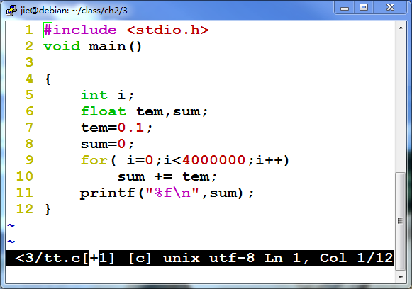
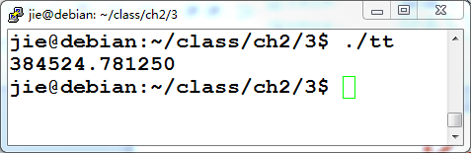
浮点数累加
对阶引入精度损失，舍入误差
大数吃小数

Slide 108
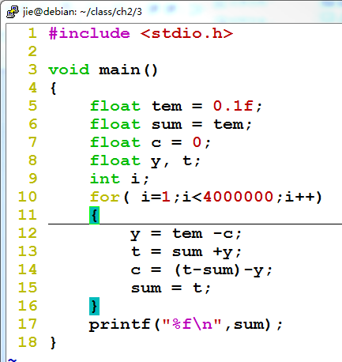
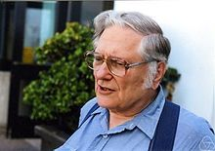
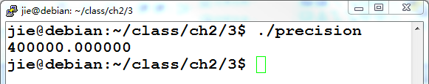
Kahan累加算法
http://en.wikipedia.org/wiki/Kahan_summation_algorithm
将每次累加因舍入造成的截断误差保存起来，再加入到下一次的累加中。

Slide 109
Kahan累加算法
算法
function KahanSum(input)
var sum = 0.0
var c = 0.0 // A running compensation for lost low-order bits.
for i = 1 to input.length do
var y = input[i] - c // So far, so good: c is zero.
var t = sum + y // Alas, sum is big, y small, so low-order digits of y
are lost.
c = (t - sum) - y // (t - sum) cancels the high-order part of y;
subtracting y recovers negative (low part of y)
sum = t // Algebraically, c should always be zero.
Beware overly-aggressive optimizing compilers!
next i // Next time around, the lost low part will be added
to y in a fresh attempt.
return sum
将每次累加因舍入造成的截断误差保存起来，再加入到下一次的累加中。

Slide 110
数据的运算小结
C语言中涉及的运算
  整数算术运算、浮点数算术运算
  按位、逻辑、移位、位扩展和位截断
整数的加、减运算
  计算机中的“算盘”：模运算系统（高位丢弃、用标志信息表示）
  带符号整数和无符号数的加、减都在同一个“算盘”中
  现实与计算机中的运算结果有差异（计算机是模运算系统）
整数的乘、除运算
  无符号整数：逻辑左移k位等于乘2^{k}、逻辑右移k位等于除2^{k}
  带符号整数乘：算术左移k位等于乘2^{k}
  带符号整数除：(x>=0 ? x : x+2^{k}-1）算术右移k位，等于x除以2^{k}
浮点数运算
  加减：对阶/尾数加减/规格化/舍入(就近舍入到偶数)（大数吃小数）
  乘除：尾数相乘除，阶码相加减

