Slide 1


Software Development Skills Bootcamp
CSS
Copyright © e-Careers. All Rights Reserved

Slide 2


What is CSS?
Cascading Style Sheets, referred to as CSS, is a simple design language intended to simplify the process of making web pages presentable.
CSS handles the look and feel part of a web page.
Using CSS, you can control the color of the text, the style of fonts, the spacing between paragraphs, how columns are sized and laid out, what background images or colors are used, as well as a variety of other effects.

Slide 3
Advantages of CSS?
CSS save time - You can write CSS once and then reuse the same sheet in multiple HTML pages. You can define a style for each HTML element and apply it to as many web pages as you want.
Pages load faster - If you are using CSS, you do not need to write HTML tag attributes
every time. Just write one CSS rule of a tag and apply it to all the occurrences of that tag.
So, less code means faster download times.
Easy maintenance - To make a global change, simply change the style, and all the
elements in all the web pages will be updated automatically.
Multiple Device Compatibility - Style sheets allow content to be optimized for more than one type of device. By using the same HTML document, different versions of a website can be presented for handheld devices such as PDAs and cellphones or for printing.

Slide 4
CSS Syntax
A CSS comprises of style rules that are interpreted by the browser and then applied to the corresponding elements in your document.
A style rule is made of three parts:
Selector : A selector is an HTML tag at which a style will be applied. This
could be any tag like <h1> or <table> etc.
Property : A property is a type of attribute of HTML tag. Put simply, all the
HTML attributes are converted into CSS properties. They could be color,
border, etc.
Value : Values are assigned to properties. For example, color property can
have the value either blue or #F1F1F1 etc.
Selector
h1
{ color : blue; Font-size : 12px; }
Property
Value
Property
Value

Slide 5
CSS Syntax
Property Declaration : A CSS property declaration consists of a property name and a property value.
Example: “color : blue”
CSS Rule : A CSS rule is a grouping of one or more CSS properties which are to be applied to one or more target HTML elements.
Example:
div {
border : 1px solid black;
font-size : 18px;
}

Slide 6
Types of CSS
Inline CSS
You can use style attribute of any HTML element to define style rules. These rules will be applied to that element only.
<h1 style = “color:red;”> this is inline CSS </h1>
Embedded or Internal CSS
You can put your CSS rules into an HTML document using the <style> tag.
This tag is placed inside the <head>...</head> tags.

Slide 7
Internal CSS
<!DOCTYPE html> <html> <head> <style> body {background-color: blue;} h1 {color: blue;} p {color: red;font-weight: bold} </style> </head> <body> <h1>This is a heading</h1> <p>This is a paragraph.</p> </body> </html>

Slide 8
External CSS
The <link> tag can be used to include an external stylesheet file in your HTML document.
An external style sheet is a separate text file with .css extension. You define all the Style rules within this text file and then you can include this file in any HTML document using
styles.css
body { background-color: blue; } h1 { color: blue; } p { color: red; }

Slide 9
External CSS
<!DOCTYPE html> <html> <head> <link rel="stylesheet" href="styles.css"> </head> <body> <h1>This is a heading</h1> <p>This is a paragraph.</p> </body> </html>

Slide 10
Quiz

Slide 11
Quiz
1. In CSS what does h1 can be called as :-
Selector
Attribute
Value
Tag

Slide 12
Quiz
2. In css what does “color:red” can be called as :-
selector
rule
declaration
none

Slide 13
Quiz Ends

Slide 14
Working with Text
Color :
The color property is used to set the color of the text.
The color is specified by:
a color name - like "red"
a HEX value - like "#ff0000"
an RGB value - like "rgb (255,0,0)“
color: green;
Background-color :
Changes the background color of that section
background-color: blue;

Slide 15
Working with Text
Text-align :
Used to set horizontal alignment of text.
text-align: center;
text-align: left;
text-align: right;
text-align: justify; // Each line is stretched so that so that
every line has equal width.
Text-direction :
To change the direction of text.
direction: rtl;

Slide 16
Working with Text
Text-decoration :
Used to set remove decorations from text.
text-decoration: none; // No decorations
text-decoration: overline; //horizontal line above the text
text-decoration: line-through; //line through the text
text-decoration: underline; // horizontal line below the text
Text-transform :
Used to specify uppercase and lowercase letters in a text.
text-transform: uppercase;
text-transform: lowercase;
text-transform: capitalize;

Slide 17
Working with Text
Used to set remove decorations from text.
text-indent: 40px; // put a space of 40 px at the beginning
Text-indent :
Used to specify space between the characters in a text.
letter-spacing: 5px;
Letter-spacing :
Used to specify space between the lines.
line-height: 1.8;
Line-height :
Used to specify space between the words.
word-spacing: 10px;
Word-spacing :

Slide 18
Working with Text
Adds shadow to the text.
text-shadow: 2px 2px; // adds horizontal and vertical shadow
Text-shadow :
text-shadow: 2px 2px red; // adds shadow with color.
text-shadow: 2px 2px 5px red; // 3rd parameter adds blur effect

Slide 19
Quiz

Slide 20
Quiz
3. Which of the following is the correct syntax to display
the hyperlinks without any underline?
a {text-decoration : underline;}
a {decoration : no-underline;}
a {text-decoration : none;}
none

Slide 21
Quiz
4. Which of the following syntax is correct in CSS to make each
word of a sentence start with a capital letter?
text-style : capital;
transform : capitalize;
text-transform : capital;
text-transform : capitalize;

Slide 22
Quiz Ends

Slide 23
CSS Selectors
Selectors are patterns used to select the element(s) you want to style.
Selector | Example | Description
* | * | Selects all elements
#id | #uname | Selects the element with id=“uname"
element | p | Selects all <p> elements
element.class | p.intro | Selects all <p> elements with class="intro"
element, element | div, p | Selects all <div> elements and all <p> elements
element element | div p | Selects all <p> elements inside <div> elements
.class | .textbold | Selects all elements with class="textbold"
element >element | div > p | Selects all <p> elements where the parent is a <div> element
element+element | div+p | Selects the first <p> element that is placed immediately after <div> elements
element1 ~ element2 | p ~ ul | Selects every <ul> element that is preceded by a <p> element

Slide 24
CSS Selectors
Selectors are patterns used to select the element(s) you want to style.
Selector | Example | Description
:active | a:active | Selects the active link
::after | p::after | Insert something after the content of each <p> element
::before | p::before | Insert something before the content of each <p> element
:hover | a:hover | Selects links on mouse over
:focus | input:focus | Selects the input element which has focus
:first-child | p:first-child | Selects every <p> element that is the first child of its parent
:last-child | p:last-child | Selects every <p> element that is the last <p> element of its parent
:nth-child(n) | p:nth-child(2) | Selects every <p> element that is the second child of its parent

Slide 25
Quiz

Slide 26
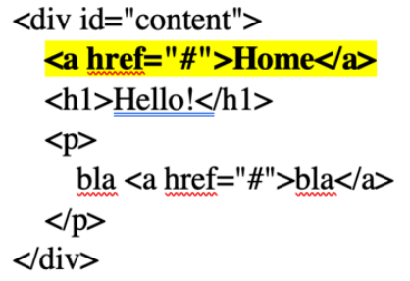
Quiz
1. Which CSS selector applies to the yellow element(s) only?
Select the correct answers!
div a {…}
div + a {…}
div > a {…}
None

Slide 27
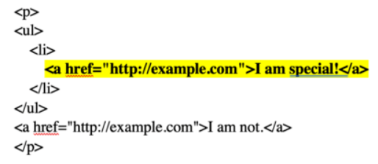
Quiz
2. Which CSS selector applies to the yellow element(s) only? Select the
correct answers!
li a {…}
li.a {…}
li, a{…}
None

Slide 28
Quiz Ends

Slide 29
CSS Fonts
CSS Font property is used to control the look of texts.
It can change the text size, color, style and more.
CSS Font family : This property is used to change the face of the font.
font-family: Arial, Helvetica, sans-serif;
2. CSS Font style : This property is used to change the style of the font.
font-style: normal;
font-style: italic;
font-style: oblique;

Slide 30
CSS Fonts
3. CSS Font weight : This property is used to specify weight of the font.
font-weight: normal;
font-weight: bold;
font-weight: lighter;
font-weight: 900;
4. CSS Font variant : This property is used to specify whether or not a text should
be displayed in a small-caps font.
font-variant: normal;
font-variant: small-caps;

Slide 31
CSS Fonts
3. CSS Font size: This property is used to set size of the font.
The font-size value can be an absolute, or relative size.
Absolute size
Sets the text to a specified size.
Absolute size is useful when the physical size of the output is known.
Relative size
Sets the size relative to surrounding elements.
Allows user to change the text size in browsers.

Slide 32
CSS Fonts
UNIT | TYPE | DESCRIPTION | Example
px | Absolute | 1 viewport pixel (default size=16px) | font-size: 40px;
pt | Absolute | 1 pt = 1/72 inch | font-size: 100pt;
pc | Absolute | 1 pc = 12 pt | font-size: 100pc;
% | Relative | Relative to parent elements font size | font-size: 150%
em | Relative | 1 em = 16 px | font-size: 2.5em
rem | Relative | Relative to root html | margin-left: 1rem
keyboard | Relative | xx-small, x-small, small, medium, large, x-large, xx-large | font-size:x-small
vw | Relative | 1 viewport width. 1vw = 1% of viewport width | font-size:10vw

Slide 33
CSS Google Fonts
If you do not want to use any of the standard fonts in HTML, you can use Google Fonts.
Google Fonts are free to use, and have more than 1000 fonts to choose from.
<head> <link rel="stylesheet" href="https://fonts.googleapis.com/css?family=Sofia"> <style> body { font-family: "Sofia", sans-serif;
font-size: 30px; text-shadow: 3px 3px 3px #ababab; } </style> </head>
<link rel="stylesheet" href="https://fonts.googleapis.com/css?family=Sofia&effect=fire">

Slide 34
CSS Font property shorthand
To shorten the code, it is also possible to specify all the individual font properties in one property.
The font property is a shorthand property for:
font-style
font-variant
font-weight
font-size/line-height
font-family
font: italic small-caps bold 12px/30px Georgia, serif;
font: 20px Arial, sans-serif;

Slide 35
Quiz

Slide 36
Quiz
3. How many type faces inside property "font-family" ?
1
Maximum 2
No Limit
Maximum 3

Slide 37
Quiz
4. “font-style comes first than font-weight in font attribute”
True
False

Slide 38
Quiz Ends

Slide 39
CSS COLORS
Where do we put colors?
Background
Text
Border
Colors are specified using predefined color names, or RGB, HEX, HSL, RGBA, HSLA values.

Slide 40



CSS COLORS
RGB: An RGB color value represents RED, GREEN, and BLUE light sources.
RGBA: RGBA color values are an extension of RGB color values with an
alpha channel - which specifies the opacity for a color.
The alpha parameter is a number between 0.0 (fully transparent) and 1.0 (not transparent at all):

Slide 41

CSS COLORS
Hex Value: In CSS, a color can be specified using a hexadecimal value in the form.
#rrggbb : Where rr (red), gg (green) and bb (blue) are hexadecimal
values between 00 and ff
Shorthand Hex value: The 3-digit hex code is a shorthand for some 6-digit hex codes.
background-color: #fc9; /* same as #ffcc99 */

Slide 42

CSS COLORS
HSL Value: A color can be specified using hue, saturation, and lightness (HSL)
in the form.
hsl(hue, saturation, lightness)
Hue is a degree on the color wheel from 0 to 360. 0 is red, 120 is green, and 240 is blue.
Saturation is a percentage value, 0% means a shade of gray, and 100% is the full color.
Lightness is also a percentage, 0% is black, 50% is neither light or dark, 100% is white.

Slide 43

CSS COLORS
HSLA Value: HSLA color values are an extension of HSL color values with an
alpha channel - which specifies the opacity for a color.
hsl(hue, saturation, lightness, alpha)

Slide 44
CSS Backgrounds
Used to add background effects to elements.
Background-color : specifies the background color of an element.
Background-image : specifies an image to use as the background of an element.
Background-repeat : repeats an image both horizontally and vertically.

Slide 45
CSS Backgrounds-repeat
Repeats an image both horizontally and vertically.
Value | Description | Example
repeat | The background image is repeated both vertically and horizontally. The last image will be clipped if it does not fit. This is default | background-repeat: repeat;
repeat-x | The background image is repeated only horizontally | background-repeat:repeat-x;
repeat-y | The background image is repeated only vertically | background-repeat:repeat-y;
no-repeat | The background-image is not repeated. The image will only be shown once | background-repeat:no-repeat;
space | The background-image is repeated as much as possible without clipping. The first and last images are pinned to either side of the element, and whitespace is distributed evenly between the images | background-repeat:space;

Slide 46
CSS Backgrounds-repeat
Value | Description | Example
round | The background-image is repeated and squished or stretched to fill the space (no gaps) | background-repeat: round;
initial | Sets this property to its default value | background-repeat: initial; NOTE: The initial keyword is used to set a CSS property to its default value
inherit | Inherits this property from its parent element. | background-repeat: inherit; NOTE: The inherit keyword specifies that a property should inherit its value from its parent element.

Slide 47
CSS Background- attachment
The background-attachment property specifies whether the background image should scroll or be fixed.
background-attachment: fixed; // image will be stationary while the
entire page scrolls.
background-attachment: scroll; // image will scroll with the page
it may cause the image to hide.

Slide 48
CSS Background- shorthand
When using the shorthand property the order of the property values is:
background-color
background-image
background-repeat
background-attachment
background-position
background: #ff2aac url("img1.png") no-repeat right top;
More CSS backgrounds to look for:
background-clip -> Specifies the painting area of the background.
background-size -> Specifies the size of the background image.

Slide 49
CSS Border
The CSS border properties allow you to specify the style, width, and color of an element's border.
border-style: specifies what kind of border to display.
border-style | Result
border-style: dotted;
border-style: dashed;
border-style: solid;
border-style: double;
border-style: groove;
border-style: ridge;
border-style: inset;
border-style: outset;
border-style: dotted dashed solid double

Slide 50
Border-width
The border-width property specifies the width of the four borders.
border-width: 5px; // values can be in px, %, em, pt etc.
border-width: thick; // values can be thin, medium, thick
border-width: 5px 20px; // 5px top and bottom, 20px on the sides
border-width: 25px 10px 4px 35px; // 25px top, 10px right, 4px bottom and 35px left
Border-color
Property is used to set the color of the four borders.
border-color: blue; // Sets the border color to blue.
border-color: red green blue yellow; // top-red, right-green, bottom-blue and left- yellow

Slide 51
Border-shorthand
The border property is a shorthand property for the following individual border properties:
border-width
border-style (required)
border-color
border: 5px solid red;

Slide 52
CSS-margins
Used to create space around elements, outside of any defined borders.
CSS has properties for specifying the margin for each side of an element:
margin-top
margin-right
margin-bottom
margin-left
All the margin properties can have the following values:
auto - horizontally center the element within its container.
Length - specifies a margin in px, pt, cm, etc.
% - specifies a margin in % of the width of the containing element
inherit - specifies that the margin should be inherited from the parent element

Slide 53
CSS-margins-shorthand
To shorten the code, it is possible to specify all the margin properties in one property.
The margin property is a shorthand property for the following individual margin properties:
margin-top
margin-right
margin-bottom
margin-left
margin: 25px 50px 75px 100px;

Slide 54
CSS-Padding
Used to generate space around an element's content, inside of any defined borders.
padding-top: 50px; padding-right: 30px; padding-bottom: 50px; padding-left: 80px;
CSS-Padding-shorthand
padding:25px 50px 75px 100px
top padding is 25px
right padding is 50px
bottom padding is 75px
left padding is 100px

Slide 55
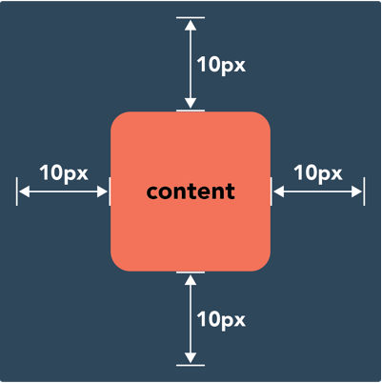
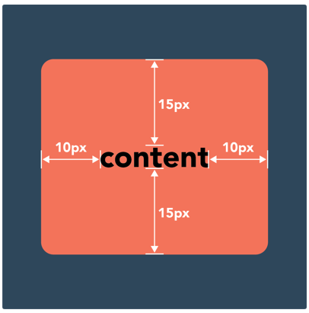
Difference between
margin and padding
margin property controls the space outside an element
padding property controls the space inside an element

Slide 56
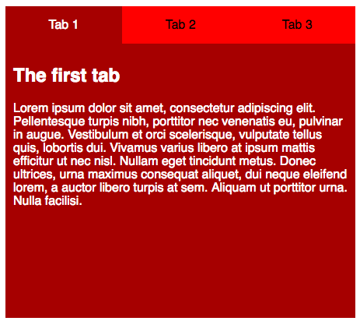
Assignment #1
Create a page that would look something like this:
You may choose to have different color.
When you hover your mouse on the tabs they should change their color.
Active tag should be highlighted.
You can make separate html pages that would render on clicking different tabs.

Slide 57
CSS-Layout
There are five different position values:
static
- positioned according to the normal flow of the page: position: static;
relative
- positioned relative to its normal position. position: relative; left: 30px;
fixed
- stays in the same place even if the page is scrolled: position: fixed; bottom: 0; right: 0;
absolute
- is positioned relative to the nearest positioned ancestor
- if no positioned ancestors, it uses the document body.

Slide 58
Quiz

Slide 59
Quiz
1. If we want to use a nice looking green dotted border around an image,
which CSS property will we use?
border-color
border-decoration
border-style
border-line

Slide 60
Quiz
2. Which CSS property you will use if you want to add some margin
between a DIV’s border and its inner text
spacing
margin
padding
Inner-margin

Slide 61
Quiz
3. Default value of position attribute is
fixed
absolute
inherit
static

Slide 62
Quiz
When using the padding property; are you allowed to use negative values?
No
Yes

Slide 63
Quiz Ends

Slide 64
Different position values:
static
- positioned according to the normal flow of the page: position: static;
relative
- positioned relative to its normal position. position: relative; left: 30px;
fixed
- stays in the same place even if the page is scrolled: position: fixed; bottom: 0; right: 0;
absolute
- is positioned relative to the nearest positioned ancestor
- if no positioned ancestors, it uses the document body.

Slide 65
CSS Layout – display property
Display property specifies if an element is displayed or not.
It also specifies how an element is displayed.
Every HTML element has a default display value depending on what type of element it is.
Block-level Elements :
A block-level element always starts on a new line and takes up the full width available.
<div>
<h1> - <h6>
<p>
<form>
<header>
<footer>
<section>

Slide 66
CSS Layout – display property
Inline-Elements :
An inline element does not start on a new line and only takes up as much width as necessary.
<span>
<a>
<img>
display: inline;
Inline-block :
Allows to set width and height on the element
display: inline-block; width: 100px; height: 100px;

Slide 67
CSS Layout –width and max width
Width and max width :
Setting the width of a block-level element will prevent it from stretching out to the edges of its container.
If the browser window is smaller than the width specified then a horizontal scrollbar will be added.
Using max-width instead, in this situation, will improve the browser's handling of small windows. This is important when making a site usable on small devices
Display: none;
Used to hide the element. Commonly used with JavaScript to show/hide.
visibility:hidden; → does the same work.

Slide 68
CSS Layout – Overflow
The CSS overflow property controls what happens to content that is too big to fit into an area
visible - Default. The overflow is not clipped. The content renders outside the element's box
hidden - The overflow is clipped, and the rest of the content will be invisible.
scroll - The overflow is clipped, and a scrollbar is added to see the rest of the content.
auto - Similar to scroll, but it adds scrollbars only when necessary
div { width: 250px; height: 50px; overflow: visible; }

Slide 69
CSS Layout – Float
The CSS float property specifies how an element should float.
In its simplest use, the float property can be used to wrap text around images.
left - The element floats to the left of its container
right - The element floats to the right of its container
none - The element does not float (will be displayed just where it occurs in
the text). This is default
inherit - The element inherits the float value of its parent
NOTE: Normally div elements will be displayed on top of each other. However, if we
use float: left we can let elements float next to each other:
div { float: left; padding: 15px; }

Slide 70
CSS Layout – z-index
The z-index property specifies the stack order of an element.
An element with greater stack order is always in front of an element with a lower stack order.
z-index only works on positioned elements and flex items.
<style>
img {
position: absolute;
left: 0px;
top: 0px;
z-index: -1;
}
</style>

Slide 71
CSS Box Sizing
The CSS box-sizing property allows us to include the padding and border in an element's total width and height.
Without Box-sizing :
actual width of an element = width + padding + border actual height of an element = height + padding + border
Result of using the box-sizing: border-box; is much better
With Box-sizing :
actual width of an element = width (provided) actual height of an element = height (provided)

Slide 72
CSS Flexbox
The Flexible Box Layout Module, makes it easier to design flexible responsive layout structure without using float or positioning.
Before flexbox, following layout modes were present:
Block, for sections in a webpage.
Inline, for text.
Table, for two-dimensional table data.
Positioned, for explicit position of an element.
First thing we need to have here is a flex container:
The flex container becomes flexible by setting the display property to flex:
.flex-container { display: flex; }

Slide 73
CSS Flexbox
The flex container properties are:
flex-direction
flex-direction: column|row|column-reverse|row-reverse;
flex-wrap
flex-wrap: wrap|nowrap|wrap-reverse;
flex-flow
flex-flow: row wrap; //shorthand to set direction and wrap both
justify-content
justify-content: center|flex-start|flex-end|space-around|space-between;
//this property is used to align the flex items.

Slide 74
Header
Aside
Article
Image
Image
Image
Footer

Slide 75
Quiz

Slide 76
Quiz
If we don't want to allow a floating div to the left side of an element, which css property will we use ?
margin
clear
float
padding

Slide 77
Quiz
Suppose we want to arrange five nos. of DIVs so that DIV4 is placed above DIV1. Now, which css property will we use to control the order of stack?
d-index
s-index
x-index
z-index

Slide 78
Quiz Ends

Slide 79
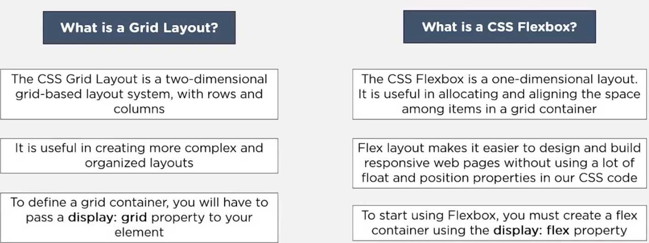
Flexbox and Grid Comparison

Slide 80
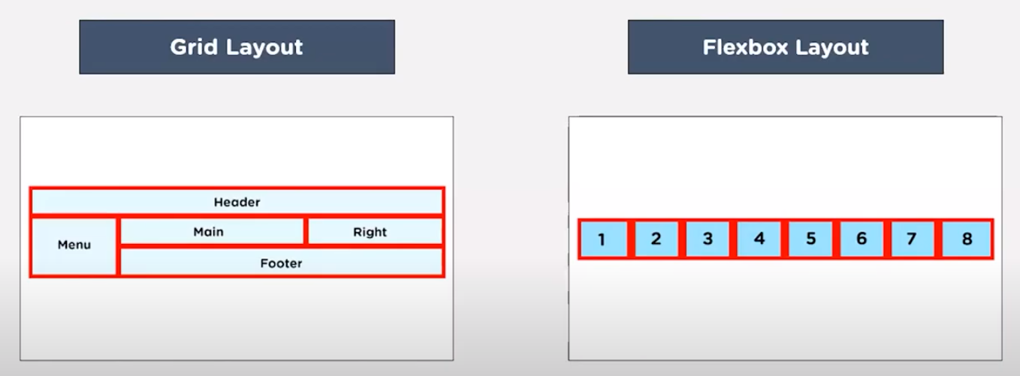
Flexbox and Grid Comparison

Slide 81
CSS Grid
CSS Grid Layout is a two-dimensional grid-based layout system that, compared to any web layout system of the past, completely changes the way we design user interfaces.
Important Terminology:
1. Grid Container
It’s the direct parent of all the grid items.
The element on which display: grid is applied
2. Grid Item
Children of the grid container.
The element on which display: grid is applied

Slide 82
CSS Grid
<div class="container">
<div class="item"> </div>
<div class="item">
<p class="sub-item"> </p>
</div>
<div class="item"> </div>
</div>
In the above example container is the grid-container and item elements are grid-items but sub-item is not.

Slide 83
CSS Grid
Properties of Grid container
display: grid | inline-grid; // grid generates block level grid
// inline grid generates an inline level grid
grid-template-columns: 80px 200px auto 30px;
// property defines the number of columns in your grid layout,
and it can define the width of each column.
grid-template-rows: 80px 200px; // property to specify the size (height) of
each row.
justify-content: start | end | center | space-between;
justify-content: space-around | space-evenly;

Slide 84
CSS Grid
Properties of Grid container
justify-content: start | end | center | space-between | space-around | space-evenly;
// property is used to align the whole grid inside the container.
// The grid's total width has to be less than the container's width for
the justify-content property to have any effect.
align-content: start | end | center | space-between | space-around | space-evenly;
// property is used to vertically align the whole grid inside the container.
// The grid's total height has to be less than the container's height for
the align-content property to have any effect.

Slide 85
CSS Grid
Properties of Grid Items
grid-column: 1 / 5; // This property defines on which column(s) to place an item.
// Make "item1" start on column 1 and end before column 5:
.item2 { grid-column: 2 / span 3; // Make "item2" start on column 2 and span 3 columns: }
grid-row: 1 / 4; // This property defines on which row(s) to place an item.
// Make "item1" start on row-line 1 and end on row-line 4:
.item1 { grid-row: 1 / span 2; //Make "item1" start on row 1 and span 2 rows: }

Slide 86
CSS Grid
Properties of Grid Items
.item1 { grid-row-start: 2; //This property defines on which row-line the item will start. }
.item1 { grid-column-start: 2; // This property defines on which column-line the item will start. }
.item1 { grid-row-end: span 3; // Make "item1" span 3 rows: }
.item1 { grid-column-end: span 3; // Make "item1" span 3 columns: }

Slide 87
CSS Grid
Properties of Grid Items
The grid-area Property: This property can be used as a shorthand property for the grid-row-start, grid-column-start, grid-row-end and the grid-column-end properties.
.item8 { grid-area: 1 / 2 / 5 / 6; // Make "item8" start on row-line 1 and column-line 2,
and end on row-line 5 and column line 6: }
Naming Grid Items :
The grid-area property can also be used to assign names to grid items.
Named grid items can be referred to by the grid-template-areas property of the grid container.

Slide 88
CSS Grid
Properties of Grid Items
.item1 { grid-area: myArea; } .grid-container { grid-template-areas: 'myArea myArea myArea myArea myArea'; }
Item1 gets the name "myArea" and spans all five columns in a five columns grid layout:

Slide 89
CSS Grid
Properties of Grid Items
.item1 { grid-area: header; } .item2 { grid-area: menu; } .item3 { grid-area: main; } .item4 { grid-area: right; } .item5 { grid-area: footer; } .grid-container { grid-template-areas: 'header header header header header header' 'menu main main main right right' 'menu footer footer footer footer footer'; }

Slide 90
CSS Media Queries:
CSS Media queries are used to make web page responsive.
CSS Media queries are a way to target browser by certain characteristics, features, and user preferences, then apply styles or run other code based on those things.
@media screen and (min-width: 600px) {
body {
background-color: blue;
}
}

Slide 91
CSS Animation
You can use animation in HTML using CSS animation without using JavaScript of flash.
An animation lets an element gradually change from one style to another.
You can change as many CSS properties you want, as many times as you want.
Key Properties:
@keyframes
When we specify CSS styles inside the @keyframes rule, the animation will gradually change from the current style to the new style at certain times.
To get an animation to work, you must bind the animation to an element.

Slide 92
CSS Animation
/* The animation code */ @keyframes change-color { from {background-color: blue;} to {background-color: green;} } /* The element to apply the animation to */ div { width: 100px; height: 100px; background-color: blue; animation-name: change-color; animation-duration: 5s; }

Slide 93
CSS Animation
Delay an Animation: The animation-delay property specifies a delay for the start of an animation.
animation-delay: 2s; // Animation will start after 2 seconds
animation-delay: -2s; // Animation will start as if it is already
been playing for 2 seconds
No. Of times: This property specifies how many times the animation should run.
animation-iteration-count: 3 | infinite ;
Animation Direction: specifies whether an animation should be played forwards,
backwards or in alternate cycles.
animation-direction: reverse | alternate | alternate-reverse;

Slide 94
CSS Animation
Speed curve of Animation: specifies the speed curve of the animation
ease - Specifies an animation with a slow start, then fast, then end slowly (this is default)
linear - Specifies an animation with the same speed from start to end
ease-in - Specifies an animation with a slow start
ease-out - Specifies an animation with a slow end
ease-in-out - Specifies an animation with a slow start and end
#div1 {animation-timing-function: linear;} #div2 {animation-timing-function: ease;} #div3 {animation-timing-function: ease-in;} #div4 {animation-timing-function: ease-out;} #div5 {animation-timing-function: ease-in-out;}

Slide 95
CSS Animation
Animation Shorthand Property :
animation: example 5s linear 2s infinite alternate;
Animation Shorthand Property :
animation-name: example; animation-duration: 5s; animation-timing-function: linear; animation-delay: 2s; animation-iteration-count: infinite; animation-direction: alternate;

Slide 96
CSS Animation
CSS Media Queries
CSS Media queries are a way to target browser by certain characteristics, features, and user preferences, then apply styles or run other code based on those things.
Perhaps the most common media queries in the world are those that target particular viewport ranges and apply custom styles, which birthed the whole idea of responsive design.
Anatomy of a Media Query
The first ingredient in a media query recipe is the @media rule itself, which is one of many CSS at-rules.

Slide 97
CSS Animation
CSS Media Queries
CSS Media queries are a way to target browser by certain characteristics, features, and user preferences, then apply styles or run other code based on those things.
Perhaps the most common media queries in the world are those that target particular viewport ranges and apply custom styles, which birthed the whole idea of responsive design.
Anatomy of a Media Query
The first ingredient in a media query recipe is the @media rule itself, which is one of many CSS at-rules.

Slide 98
CSS Media Queries
Media Types
What type of media are we trying to target? In many (if not most) cases, you’ll see a screen value used here, which makes sense since many of the media types we’re trying to match are devices with screens attached to them.
But screens aren’t the only type of media we can target, of course. We have a few, including:
all: Matches all devices
print: Matches documents that are viewed in a print preview or any media that breaks the
content up into pages intended to print.
screen: Matches devices with a screen
Media features:
Once we define the type of media we’re trying to match, we can start defining what features we are trying to match it to. We’ve looked at a lot of examples that match screens to width, where screen is the type and both min-width and max-width are features with specific values.

Slide 99
CSS Media Queries
Media queries support logical operators like many programming languages so that we can match media types based on certain conditions. The @media rule is itself a logical operator that is basically stating that “if” the following types and features are matches, then do some stuff.
Targeting Width:
@media only screen and (max-width: 600px) { body { background-color: aqua; } }
Responsive Images and the viewport Metatag:
img { width: 500px; // current width
height: 500px; // current height
}
@media (max-width:767px){
img { width: 200px; // new width for screen <768px
height: 200px; // new height for screen <768px }
}

Slide 100
CSS Media Queries
/* Custom, iPhone Retina */
@media only screen and (min-width : 320px) { }
/* Extra Small Devices, Phones */
@media only screen and (min-width : 480px) { }
/* Small Devices, Tablets */
@media only screen and (min-width : 768px) { }
/* Medium Devices, Desktops */
@media only screen and (min-width : 992px) { }
/* Large Devices, Wide Screens */
@media only screen and (min-width : 1200px) { }

Slide 101

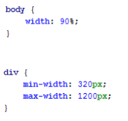
Different Layouts
Fixed layout –
Fixed Layout is an approach to create site pages with a given width. The width of the components on the page does not change. A horizontal scroll bar appears on monitors with a small resolution. This type of layout is not suitable for convenient displaying information on mobile devices.
An example of a strict width specification for the body tag is demonstrated below:
Elastic layout –
Elastic layout means the ability of the site components to change their sizes depending on the size of the browser window, to stretch from the specified minimum to the specified maximum. It was achieved by using relative values, max-width / min-width (maximum / minimum width), max-height / min-height (maximum / minimum height).
Using of elastic layout method examples:

Slide 102
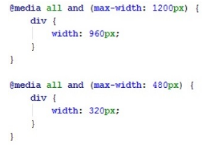
Different Layouts
Adaptive Layout –
Adaptive Layout allows adjusting the main container and any other elements of the site to the screen resolution, making it possible to change a font size, objects location, color, etc. It happens dynamically, for example, using media requests (@media). It allows determining automatically the monitor resolution, the device type and substitute the specified values ​​in automatic mode. In the example below, the equal to 960px div width is set for all devices that are less than 1200px and 320px is set for all devices that are less than 480px wide.

Slide 103
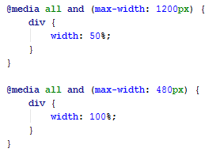
Different Layouts
Responsive Layout –
Responsive Layout is a combination of rubber and adaptive layout. In this approach, both media requests and percentages of the component width are used. Using this type of layout, the site will certainly adapt to any device.
Below, the width of div is equal to 50% of the parent component size for all devices. If the width is less than 1200px and 100% for all devices with width less than 480px.

Slide 104
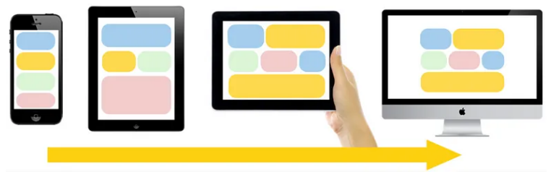
1. Mostly Fluid Design Pattern
The Mostly Fluid design pattern relies on a fluid grid for large and medium screens and it adjusts the margins on wider screens. One major advantage of this pattern is that it usually requires only one breakpoint between small screens and large screens.

Slide 105
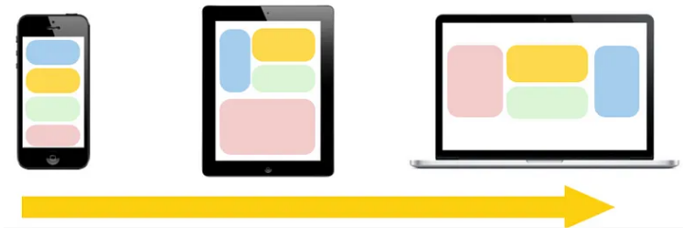
Layout Shifter
The next pattern is the Layout Shifter. The Layout Shifter has multiple breakpoints across several screens making it the most responsive pattern. This will require the most effort to implement but it also provides greater flexibility to be creative, implementing different layout design across multiple devices.

Slide 106
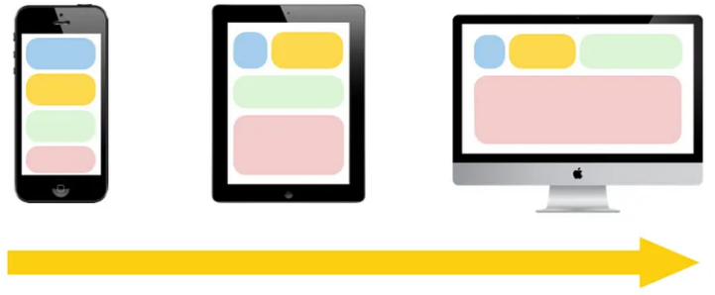
Column Drop
The Column Drop pattern implements a multi-column layout and ends up with a single column layout, dropping columns along the way as the screen size becomes more narrow. This pattern relies on stacking columns which adapt to the screen size.

Slide 107
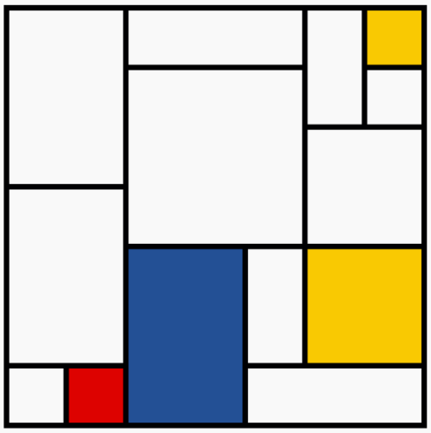
Mondrian Pattern
Mondrian is famous for paintings with big thick black lines forming a grid, where each cell is white, red, yellow, or blue. This aesthetic pairs well with the notoriously rectangular web, and that hasn’t gone unnoticed over the years with CSS developers.

Slide 108
CSS for Print:
CSS plays a crucial role in making web pages printer-friendly. The article outlines how to use CSS to create print stylesheets that ensure web content is presented in an optimal format when printed. This includes using specific media queries for print, adjusting layout and styles, and ensuring that the printed page is legible and well-organized.
/* on-screen styles */
@media screen {
body {
margin: 2em;
color: #fff;
background-color: #000;
}
}
/* print styles */
@media print {
body {
margin: 0;
color: #000;
background-color: #fff;
} }

Slide 109
Floating sidebar:
#content {
background: brown;
width: 75%;
height: 500px;
float: left;
}
#sidebar {
background: gray;
width: 25%;
height: 500px;
float: left;
}

Slide 110
Responsive Design:
Simply put, responsive design utilizes a single web page layout that flexibly adjusts to optimize the user’s viewing experience, whether they are on a desktop, laptop, tablet, or mobile phone.
Adaptive design
Adaptive design is generally considered to be fixed layouts that adapt to specific screen sizes. In short, it involves having multiple versions of a web page that are responsive to different devices, as opposed to a single static page that looks the same but reorders or resizes content on all devices.

Slide 111
Let’s compare the main differences
Difficulties
What is more difficult to create: multiple layouts for different devices or one universal?
While responsive design only requires one layout across all devices, it demands more effort and time during the initial development phase. This involves paying extra attention to CSS and organizing your site to ensure its full functionality on all screen sizes.
Layout
Responsive layout design is determined directly by the user’s browser. The adaptive layout is determined using factors such as device type and operating system to send the correct layout.
SEO optimization
Google recommends and marks sites that use responsive design. A mobile-friendly website ranks higher on search results pages. Adaptive design can face the complexities of SEO promotion.
Flexibility
Adaptive design is considered less universal, as each new device with a specific screen size requires the implementation of new layouts.
In the long run, a responsive layout requires less maintenance. Responsive sites are more versatile, allowing them to work well by default even if new devices or screen sizes appear on the market.

Slide 112
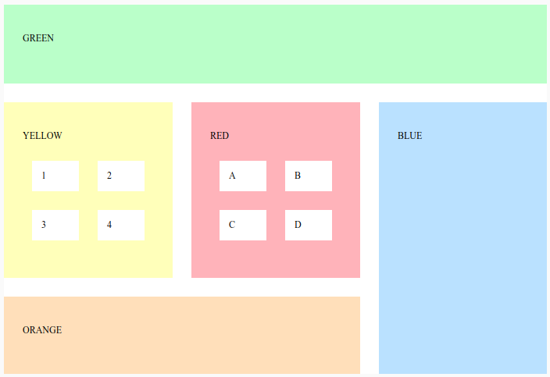
Assignment #2
Create a layout as shown below:

Slide 113
Thank you

