Slide 1


Software Development Skills Bootcamp
Module 1 - HTML
Copyright © e-Careers. All Rights Reserved

Slide 2


Today’s Agenda
Introduction to HTML
Where to write the code? – IDE
Where to put the code? – Git and GitHub

Slide 3
Introduction to HTML
HTML stands for Hypertext Markup Language and it is a widely used programming language used to develop web pages.
Hypertext stands for link between web pages.
Markup Language means Text between tags that define the structure.
Every HTML document should be saved with .html or .htm extension
All browsers have the capability to translate an html page and render it.

Slide 4
HTML Release Year
HTML 1
HTML 2
HTML 3
HTML 4
HTML 5
1993
1995
1997
1997
2014

Slide 5
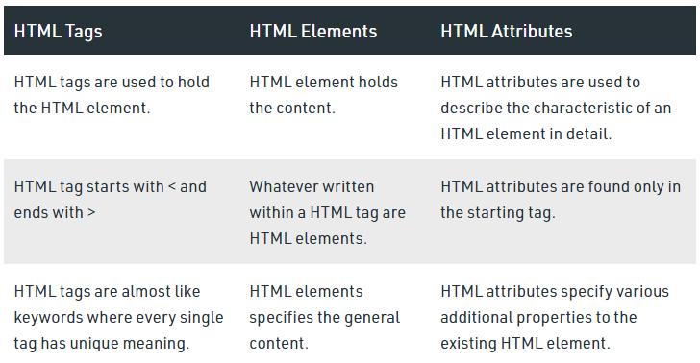
HTML Tags, Elements & Attributes

Slide 6
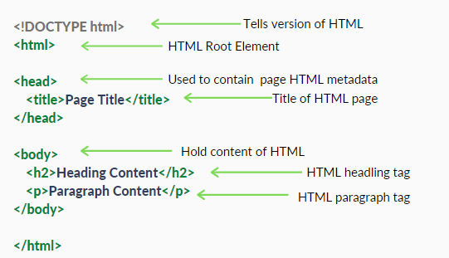
HTML Page Structure

Slide 7
Sample HTML
<!DOCTYPE html>
<html>
<head>
<title>Demo Web Page</title>
</head>
<body>
<h1>Hello World</h1>
<p>Welcome to the HTML Training</p>
</body>
</html>

Slide 8
Quiz

Slide 9
Quiz
HTML stands for :-
Hypertext Machine Language
Hypertext and Link Markup Language
Hypertext Markup Language
None

Slide 10
Quiz
The correct sequence of HTML tags for starting a webpage is :-
Head, Title, HTML, body
HTML, Body, Title, Head
HTML, Head, Title, Body
HTML, Head, Title, Body

Slide 11
Quiz
Which character is used to represent the closing of a tag in HTML?
\
!
/
.

Slide 12
Quiz Ends

Slide 13
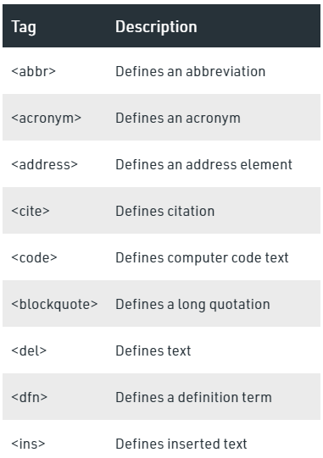

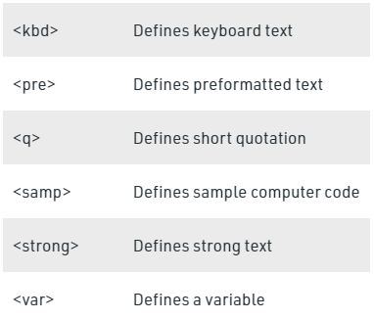
Logical and Physical Tags
Logical Tags are used in HTML to display the text according to the logical styles. Following are the Logical tags commonly used in HTML.

Slide 14
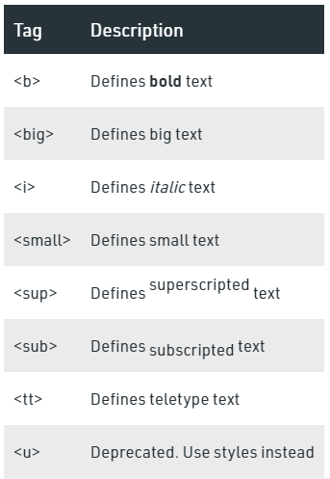
Logical and Physical Tags
Physical Tags are used in HTML to provide actual physical formatting to the text. Following are the Physical tags commonly used in HTML.

Slide 15
Semantic Elements
A semantic element clearly describes its meaning to both the browser and the developer.
<article> -- specifies independent, self-contained content.
<aside> -- defines some content aside from the content it is placed in
<details> -- specifies additional details that the user can open and close on demand.
<footer> -- defines a footer for a document or section.
<header> -- represents a container for introductory content or a set of navigational links.
<main> -- specifies main content of a document.
<mark> -- defines text that should be marked or highlighted.
<nav> -- tag defines a set of navigation links.
<section> -- defines a section in a document.
<summary> -- defines a visible heading for the <details> element. The heading can
be clicked to view/hide the details.

Slide 16
Managing Space
A commonly used entity in HTML is the non-breaking space:
&nbsp;
&ensp;
&emsp;

Slide 17
Quiz

Slide 18
Quiz
Which of the following element is responsible for making the text bold in HTML?
<pre>
<b>
<a>
<br>

Slide 19
Quiz Ends

Slide 20
HTML Img Tag
The HTML <img> tag is used to embed an image in web pages by linking them.
2 ways to insert the images into a webpage
By providing a full path or address (URL) to access an internet file.
By providing the path relative to the location of the current web page file.
Syntax:-
<img src="url" alt="some_text" width="" height="">

Slide 21
HTML Table Structure
<table> <tr> <th></th> <th></th> <th></th> </tr> <tr> <td></td> <td></td> <td></td> </tr> <tr> <td></td> <td></td> <td></td> </tr> </table>

Slide 22
HTML Table Structure
Each table cell is defined by a <td> and a </td> tag
Each table row is defined by a <tr> and a </tr> tag
Sometimes you want your cells to be headers, in those cases use the <th> tag instead of the <td> tag

Slide 23
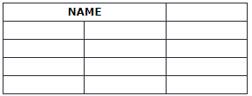
HTML Table Colspan
To make a cell span over multiple columns, use the colspan attribute:
Example:-
<th colspan="2">Name</th>

Slide 24
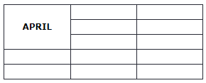
HTML Table Rowspan
To make a cell span over multiple rows, use the rowspan attribute:
Example:-
<th rowspan=“3">April</th>

Slide 25
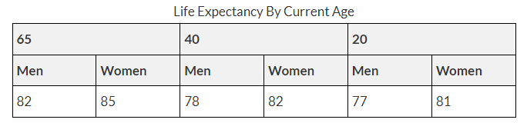
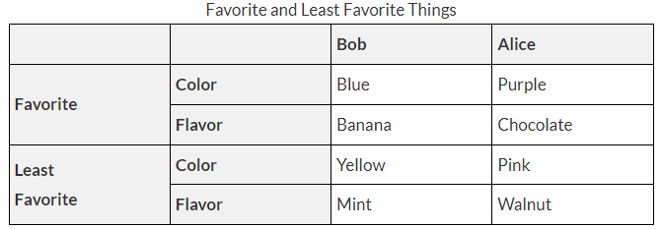
Design Below Tables

Slide 26
Quiz

Slide 27
Quiz
Choose the correct option.
<th> is used for defining the heading of a table
By default, contents written between <th> and </th> are bold and centered.
Both A and B.
None

Slide 28
Quiz
Which attribute you’ll use with TD tag to merge two cells horizontally?
colspan = 2
merge = row2
rowspan = 2
merge = colspan2

Slide 29
Quiz
Each cell of the table can be represented by using _____
<tr>
<td>
<th>
<thead>

Slide 30
Quiz Ends

Slide 31
HTML Lists
HTML lists allow web developers to group a set of related items in lists.
Unordered List:-
An unordered list starts with the <ul> tag. Each list item starts with the <li> tag.
<ul> <li>Coffee</li> <li>Tea</li> <li>Milk</li> </ul>

Slide 32
HTML Lists
Ordered List:-
An ordered list starts with the <ol> tag. Each list item starts with the <li> tag.
<ol> <li>Coffee</li> <li>Tea</li> <li>Milk</li> </ol>

Slide 33
HTML Lists
Description List:-
A description list is a list of terms, with a description of each term.
The <dl> tag defines the description list, the <dt> tag defines the term (name), and the <dd> tag describes each term
<dl> <dt>Coffee</dt> <dd>- black hot drink</dd> <dt>Milk</dt> <dd>- white cold drink</dd> </dl>

Slide 34
Quiz

Slide 35
Quiz
Which of the following can’t be the value of list-style-type?
square
disc
ellipse
circle

Slide 36
Quiz
What is the default start of item marker in ordered list?
C
A
1
None

Slide 37
Quiz Ends

Slide 38
HTML Forms
An HTML form is used to collect data from user.
<input> : To take single line input
<label> : To label any element
<select> : To create a dropdown
<textarea> : To input multiple lines
<button> : A clickable button
<fieldset> : To group related data in a form
<legend> : Caption for fieldset element
<datalist> : Specifies list of pre-defined options
<option> : Drop down values
<optgroup> : Group related to option
HTML Form Elements:-
The HTML <form> element can contain one or more of the following form elements:

Slide 39
Examples
<label for="firstname">First name:</label> <input type="text" id="firstname" name="firstname">
<input type="radio" id="html" name="fav_language" value="HTML"> <label for="html">HTML</label><br> <input type="radio" id="css" name="fav_language" value="CSS"> <label for="css">CSS</label><br> <input type="radio" id="javascript" name="fav_language" value="JavaScript"> <label for="javascript">JavaScript</label>
<input type="checkbox" id="vehicle1" name="vehicle1" value="Bike"> <label for="vehicle1"> I have a bike</label><br> <input type="checkbox" id="vehicle2" name="vehicle2" value="Car"> <label for="vehicle2"> I have a car</label><br> <input type="checkbox" id="vehicle3" name="vehicle3" value="Boat"> <label for="vehicle3"> I have a boat</label>

Slide 40
<input type =“submit”>
defines a button for submitting the form data to a form-handler.
The form-handler is typically a file on the server with a script for processing input data.
The form-handler is specified in the form's action attribute.
<form action="/home.html"> <label for="fname">First name:</label><br> <input type="text" id="fname" name="fname" value=“Mark"><br> <label for="lname">Last name:</label><br> <input type="text" id="lname" name="lname" value=“Spencer"><br><br> <input type="submit" value="Submit"> </form>

Slide 41
Examples
<label for="cars">Choose a car:</label> <select id="cars" name="cars"> <option value="volvo">Volvo</option> <option value="fiat">Fiat</option> <option value="audi">Audi</option> </select>
<fieldset> <legend>Personal Information:</legend> <label for="fname">First name:</label><br> <input type="text" id="fname" name="fname"><br> <label for="lname">Last name:</label><br> <input type="text" id="lname" name="lname"><br><br> </fieldset>
<fieldset> <legend>Educational Qualification:</legend> <label for=“masters">Masters:</label><br> <input type="text" id=" masters " name=" masters "><br> <label for=“bachelors">Bachelors:</label><br> <input type="text" id=" bachelors " name=" bachelors "><br><br> </fieldset>
<textarea name="message" rows="10" cols=“30"> I was playing with my friends when he came
</textarea>
<button type="button" onclick="alert(‘Hi There!’)”>
Click Me!
</button>

Slide 42
Examples
<fieldset> <legend>Personal Information:</legend> <label for="fname">First name:</label><br> <input type="text" id="fname" name="fname"><br> <label for="lname">Last name:</label><br> <input type="text" id="lname" name="lname"><br><br> </fieldset>
<fieldset> <legend>Educational Qualification:</legend> <label for=“masters">Masters:</label><br> <input type="text" id=" masters " name=" masters "><br> <label for=“bachelors">Bachelors:</label><br> <input type="text" id=" bachelors " name=" bachelors "><br><br> </fieldset>

Slide 43
Examples
<input list="browsers"> <datalist id="browsers"> <option value="Internet Explorer"> <option value="Firefox"> <option value="Chrome"> <option value="Opera"> <option value="Safari"> </datalist>

Slide 44
HTML form - more tags
The <input type="date"> defines a date picker
The <input type="number"> defines a field for entering a number
Use the following attributes to specify restrictions:
max - specifies the maximum value allowed
min - specifies the minimum value allowed
step - specifies the legal number intervals
value - Specifies the default value
The <input type="range"> defines a control for entering a number whose exact value is not important (like a slider control).

Slide 45
HTML form - more tags
The <input type="email"> defines a field for an e-mail address.
The input value is automatically validated to ensure it is a properly formatted e-mail address.
To define an e-mail field that allows multiple e-mail addresses, add the "multiple" attribute.
Progress Tag:-
The progress tag is used to check the progress of a task during the execution. Progress tag can be used with the conjunction of JavaScript.
<label for="file">Downloading progress:</label>
<progress id="file" value="32" max="100"> 32% </progress>

Slide 46
HTML form - more tags
The <span> tag is an inline container used to mark up a part of a text, or a part of a document.
<p>My mother has <span style="color:blue">blue</span> eyes.</p>
The <div> tag defines a division or a section in an HTML document.
<div id="myDiv"> <h2>This is a heading in a div element</h2> <p>This is some text in a div element.</p> </div>

Slide 47
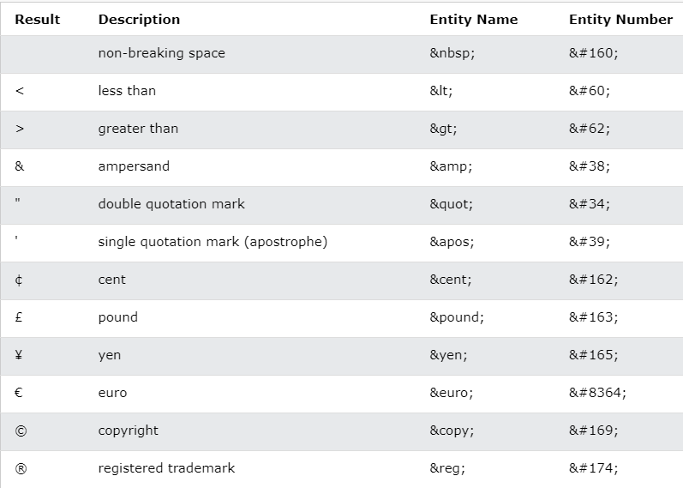
HTML entities
Reserved characters in HTML must be replaced with character entities.

Slide 48
HTML charset
ASCII was the first character encoding standard. ASCII defined 128 different characters that could be used on the internet: numbers (0-9), English letters (A-Z), and some special characters like ! $ + - ( ) @ < > .
ISO-8859-1 was the default character set for HTML 4. This character set supported 256 different character codes. HTML 4 also supported UTF-8.
ANSI (Windows-1252) was the original Windows character set. ANSI is identical to ISO-8859-1, except that ANSI has 32 extra characters.
The HTML5 specification encourages web developers to use the UTF-8 character set, which covers almost all of the characters and symbols in the world!
charset specified in the <meta> tag:

Slide 49
HTML meta
The <meta> tags are typically used to provide structured metadata such as a document's keywords, description, author name, character encoding, and other metadata
Metadata will not be displayed on the web page, but will be machine parsable, and can be used by the browsers, search engines like Google or other web services.
Character encoding:-
<meta charset="utf-8">

Slide 50
HTML meta
Defining Author:
<meta name="author" content=“Harry Porter">
Keyword and description for search engines:
<meta name="keywords" content="HTML, CSS, javaScript">
<meta name="description" content="Easy to understand tutorials and references on HTML, CSS, javaScript and more...">
Configuring the viewport:
<meta name="viewport" content="width=device-width, initial-scale=1">

Slide 51
HTML emojis
Emojis are characters from the UTF-8 character set
Emojis look like images, or icons, but they are not.
They are letters (characters) from the UTF-8 (Unicode) character set
Get list of all emoji character set at:
https://www.w3schools.com/charsets/ref_emoji.asp
<p>I will display &#129409;</p>

Slide 52
HTML favicon
A favicon is a small image displayed next to the page title in the browser tab.
<head> <title>My Page Title</title> <link rel="icon" type="image/x-icon" href="/images/favicon.ico"> </head>
Note: In order to show favicon on chrome the size should be multiple of 48.
16x16 size will not show up.

Slide 53
Quiz

Slide 54
Quiz
Which of the following is a new input attribute introduce by HTML5?
Text
Checkbox controls
Submit buttons
Date

Slide 55
Quiz
Month attribute defines ___________
The only month
Month and year
Date
Date and time

Slide 56
Quiz
Which element is used to create multi-line text input?
Text
Textarea
Submit
Radio button

Slide 57
Quiz
Which attribute is used with <select> element?
Multiple
Selected
For
Value

Slide 58
Quiz
What is the default type of <input> element?
Number
Password
Text
Button

Slide 59
Quiz Ends

Slide 60
Assessment #1
HTML:-
Create a form with input fields for "Name," "Age," and "Grade."
Create a table with columns for "Name," "Age," "Grade," and "Actions" (Edit/Delete).
Add buttons for "Add Student" and "Update Student."

Slide 61
Thank you

