Slide 1
Annual Activity and Digital Performance Report
Financial year 2026 — consolidated version for the management board
a sustained growth trajectory despite pressure on margins.

Slide 2
Executive summary
Over the year, the company confirmed a sustained growth trajectory despite an uncertain macroeconomic environment marked by volatile input costs and increased pressure on margins, which was partly absorbed by productivity gains across the main operating units.
consolidate commercial positions in the core markets
gradually restore the gross margin rate
reduce dependence on critical suppliers

Slide 3
Market context and competitive environment
Commercial momentum was particularly strong in the European markets, where the roll-out of a packaged offering accelerated the sales cycle and significantly improved the conversion rate of qualified prospects into recurring customers with multi-year commitments.
consolidate commercial positions in the core markets
gradually restore the gross margin rate
reduce dependence on critical suppliers

Slide 4
Commercial performance by region
From a financial standpoint, gross margin grows in absolute value while the margin rate contracts slightly under the effect of a deliberately aggressive pricing policy on the acquisition segments deemed strategic for the conquest of additional market share.
consolidate commercial positions in the core markets
gradually restore the gross margin rate
reduce dependence on critical suppliers

Slide 5
Detailed financial analysis
Digital transformation translated into the modernisation of the technical foundation, the rationalisation of the application portfolio and the industrialisation of the data processing chains, now governed by quality and freshness indicators measured continuously.
consolidate commercial positions in the core markets
gradually restore the gross margin rate
reduce dependence on critical suppliers

Slide 6
Digital transformation and information system
The operational risk map was updated; the main areas of exposure concern the dependence on a limited number of critical suppliers, cybersecurity and regulatory compliance, for which remediation plans have been initiated and are tracked at the operational committee.
consolidate commercial positions in the core markets
gradually restore the gross margin rate
reduce dependence on critical suppliers

Slide 7
Operational risk management
The organisation continued to build capability with a sustained training effort, a strengthening of cross-functional functions and particular attention paid to the retention of scarce profiles whose contribution is decisive for the success of the projects.
consolidate commercial positions in the core markets
gradually restore the gross margin rate
reduce dependence on critical suppliers

Slide 8
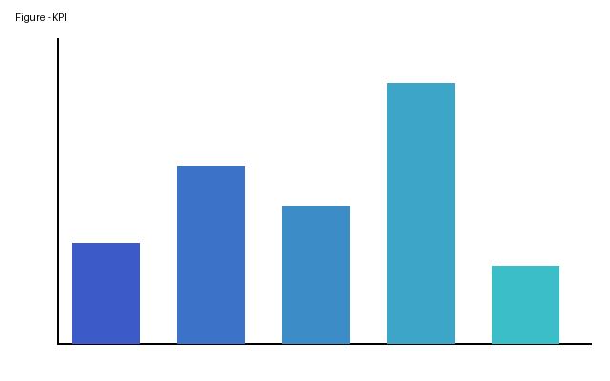
Executive summary

Slide 9
Table 1 — Key performance indicators by region (in thousands of euros)
Region | Revenue | Gross margin | Growth | Headcount
Europe | 12,480 | 4,742 | +12.4 % | 184
Americas | 8,930 | 3,215 | +8.1 % | 97
Asia-Pacific | 5,210 | 1,980 | +15.7 % | 63

Slide 10
Market context and competitive environment

