Slide 1
AirWatcher

Slide 2
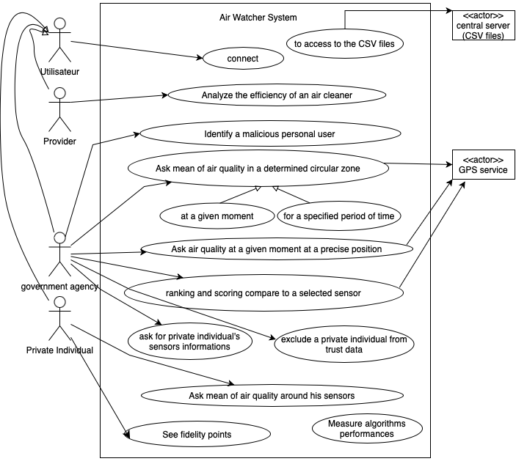
Use case Diagram

