Slide 1
AirWatcher

Slide 2
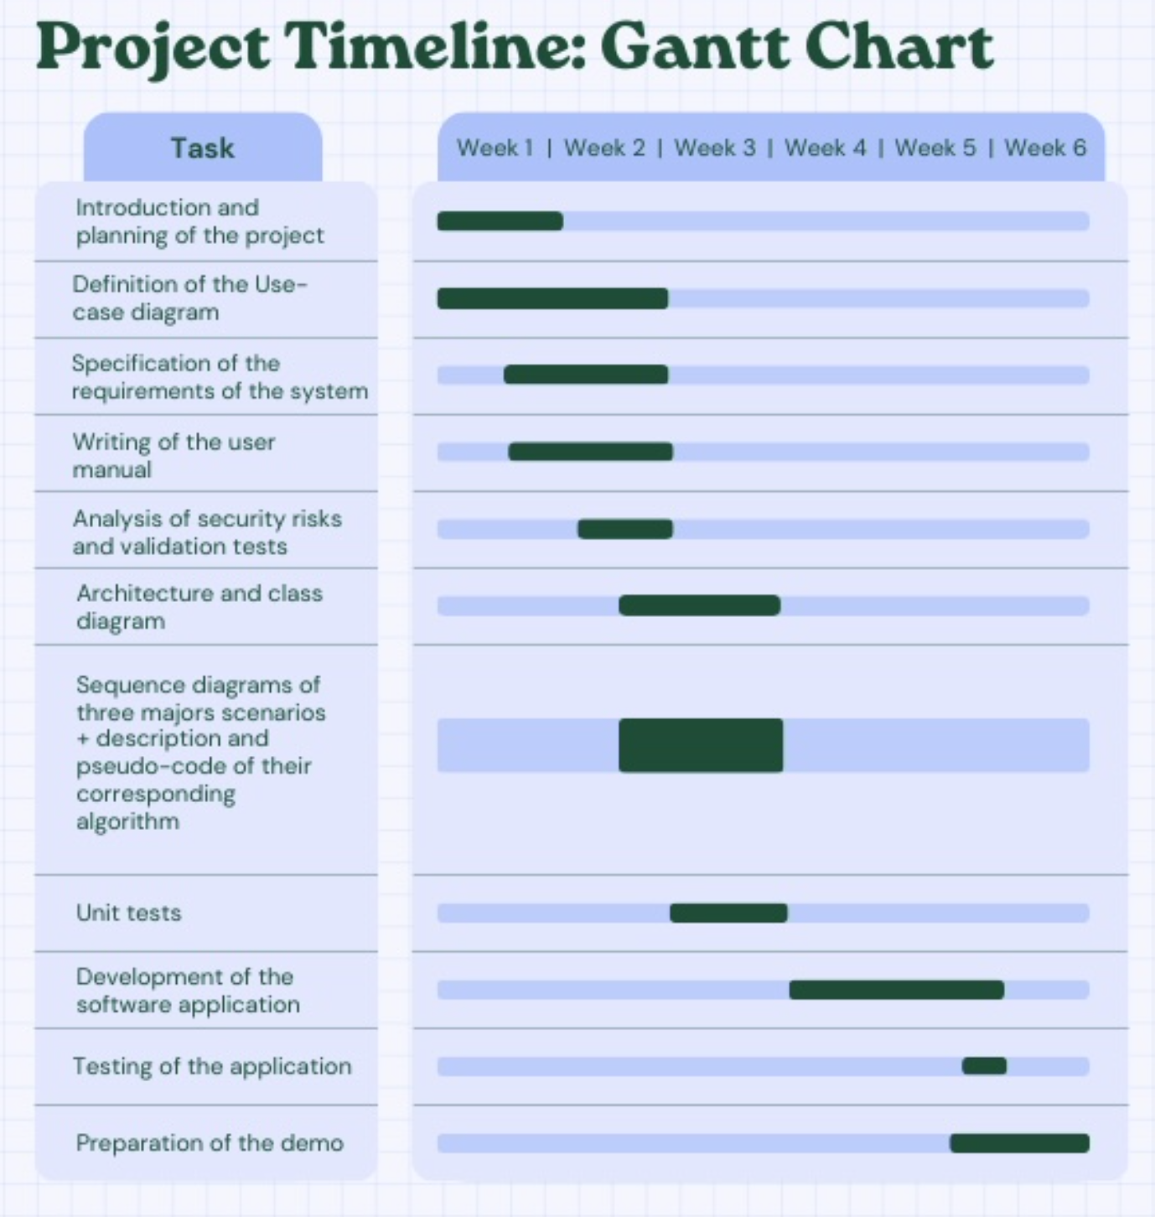

Slide 3
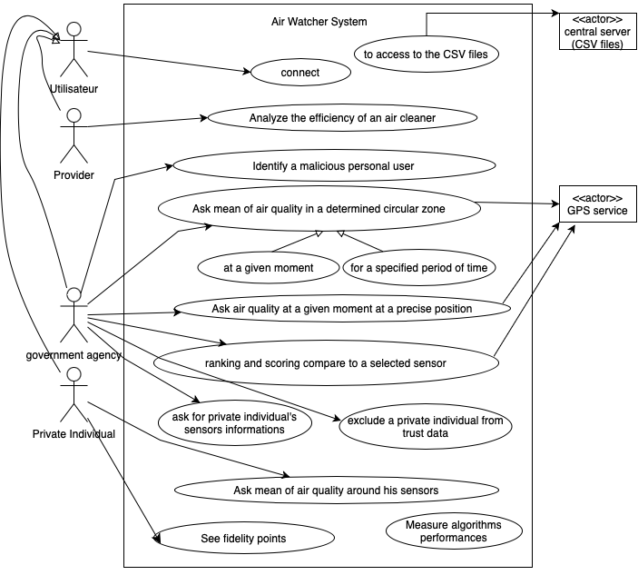
Use case Diagram

Slide 4
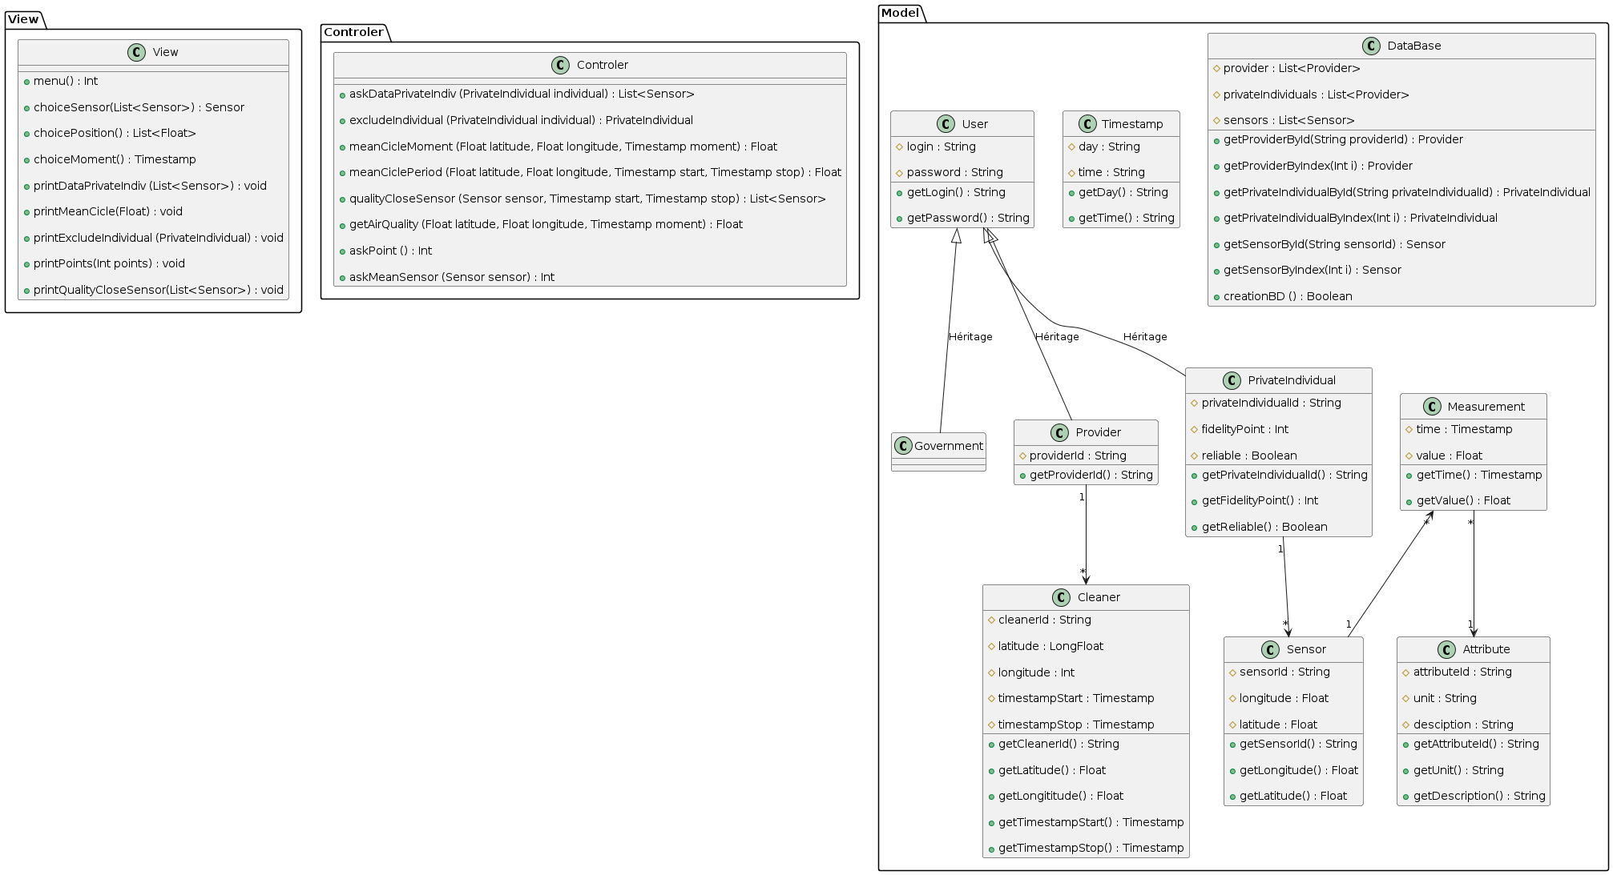
Class Diagram

