Slide 1
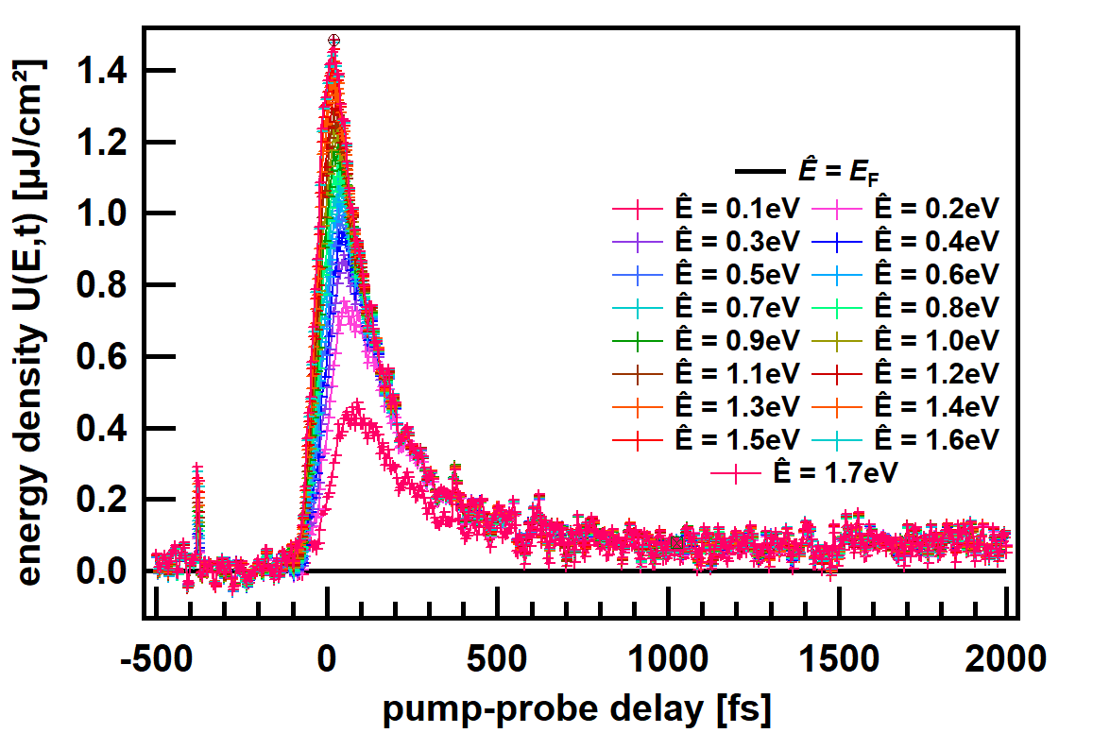
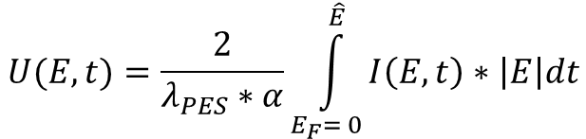
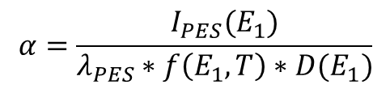
$$U(E,t)=\frac{2}{λ_{PES}∗α}\int_{E_{F}= 0}^{\hat{E} }{I\left(E,t\right)∗\left|E\right|dt}$$
$$α=\frac{I_{PES}(E_{1})}{λ_{PES}∗f\left(E_{1},T\right)∗D(E_{1})}$$

