Slide 1
Auswertung
6.5.2020

Slide 2
Update sample preparation
-nitrogen is available
-planned chamber opening, Thursday morning
-transport to photoemission chamber in argon
atmosphere, mount sample
-give sample to Franzka for profilometry
Line scans over the edge of the 5nm layer,
one scan over the wedge
and couple scans from 5nm layer over wedge back to 5nm layer at defined distances

Slide 3
Problematic colour display of background subtracted data

Slide 4
Energy resolved population dynamics -5nm back pump
Δt = 60 fs
Data below the Fermi edge expanded

Slide 5
Energy resolved population dynamics -5nm front pump
Δt = 60 fs

Slide 6
Energy resolved population dynamics -15nm back pump
Δt = 30 fs

Slide 7
Energy resolved population dynamics -30nm back pump holes

Slide 8
Energy resolved population dynamics -30nm back pump
Δt = 60 fs

Slide 9
Energy resolved population dynamics -15nm front pump
Δt = 60 fs

Slide 10
Energy resolved population dynamics -30nm front pump
Δt = 60 fs

Slide 11
Shoulder peak present in back pump measurement
Δt = 60 fs
Δt = 60 fs

Slide 12
Shoulder peak present in back pump measurement 15 and 30 nm
For 15nm Δt = 30 fs
For 30nm Δt = 60 fs

Slide 13
Shoulder peak comparison between front and back pump
Front pump measurement is representative for all thicknesses
No peak was found
Δt = 60 fs

Slide 14
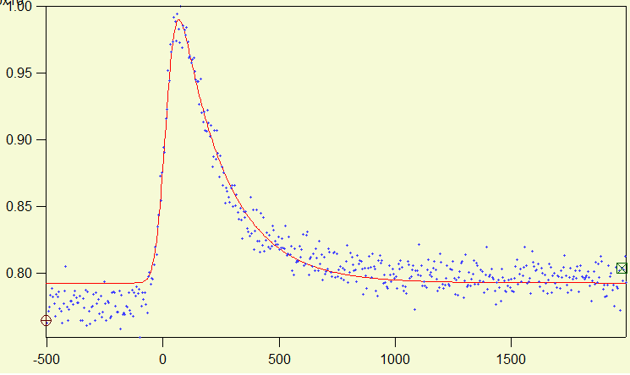
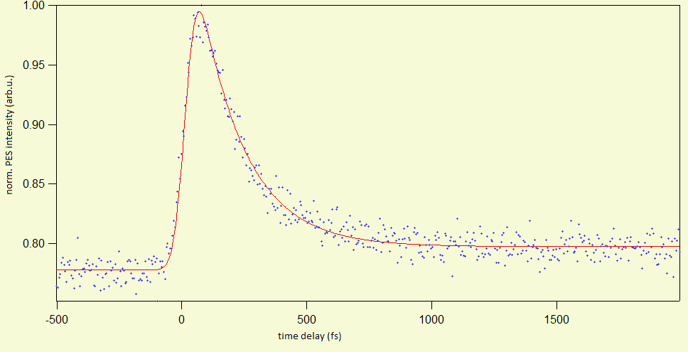

Slide 15
Appendix

Slide 16
Appendix

Slide 17
Comparison of different thicknesses and configurations

