Slide 1
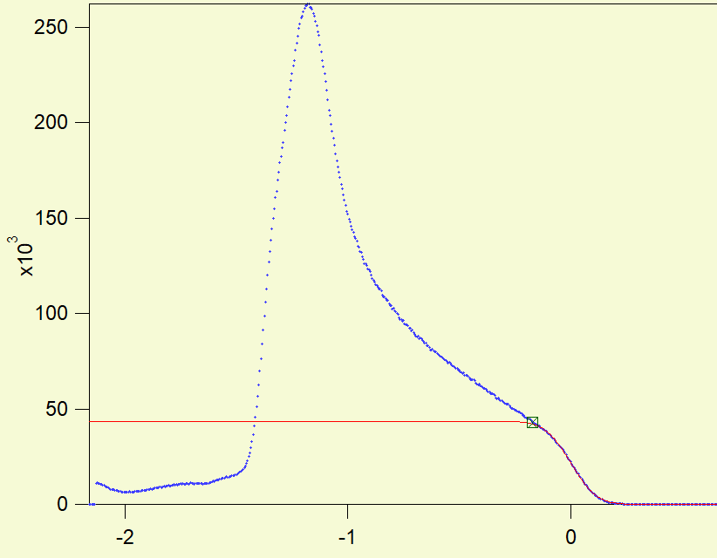
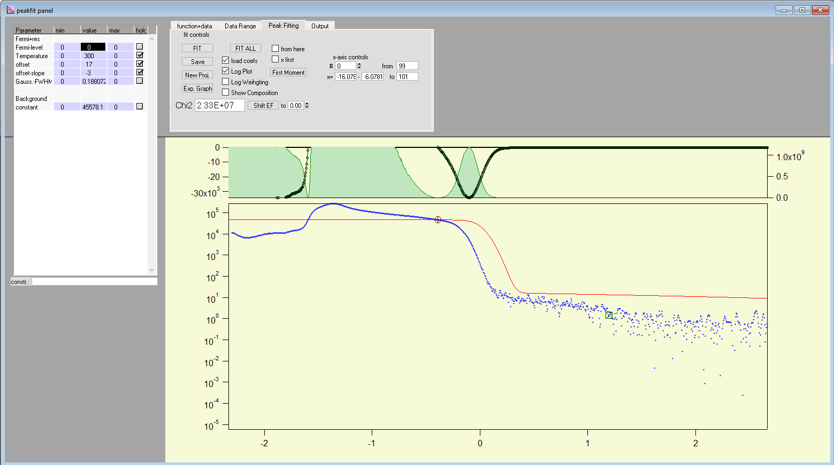
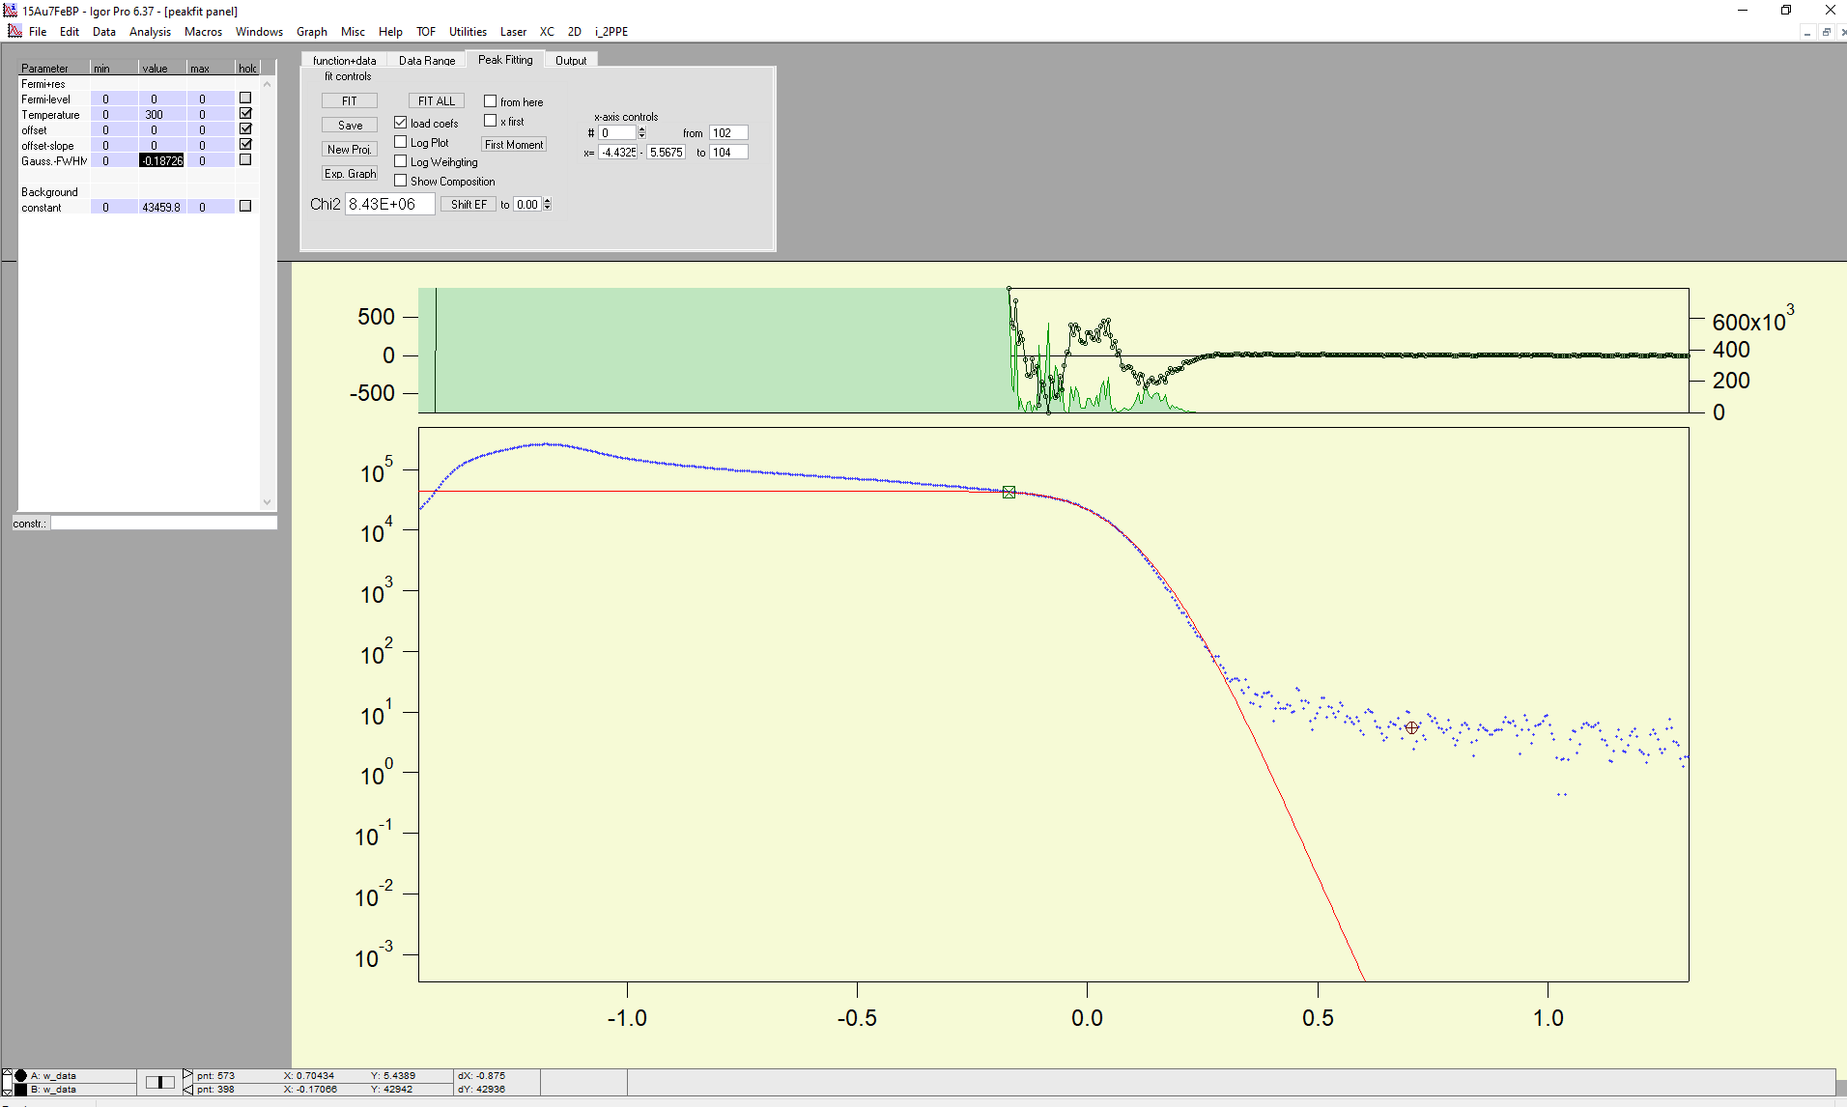
Fermi edge shiftet by setting fastest electrons to 1.55eV
Fermi edge by fit

Slide 3
Fermi edge shiftet by setting fastest electrons to 1.55eV
Fermi edge by fit

Slide 4
5nm back pump

Slide 5
15 nm back pump

Slide 6
30nm Back pump
Slope near Fermi edge

Slide 7
5nm front pump

Slide 8
15nm front pump

Slide 9
30nm front pump

Slide 10
Overview
 | Front pump | Back pump
5nm | Integrated Signal: 0.08 to 1.58 Neg. Signal: -0.13 to -0.36 Pos. Slope:-1.1 to -1.42 | Integrated Signal: 0.01 to 1.71 Neg. Signal:-0.05 to -0.26
15nm | Integrated Signal: 0.03 to 1.66 Neg. Slope: -0.25 to -0.35 Pos. Slope: -0.8 to -1.25 | Integrated Signal: -0.125 to 1.45 Neg. Block: -0.12 to -1.45 Pos. Block: -1.45 to 1.90
30nm | Integrated Signal: 0.19 to 1.69 Pos. Slope: -0.95 to -1.25 | Integrated Signal: 0.05 to 1.52 Neg. Drop: 0 to -0.08 Neg. Slope: 0 to -1 Pos. Slope: -1.1 to -1.4

Slide 11
Open Energy Question and Fermi edge parameter
at 5nm Au Back pump
1.68 eV total Energy window
0.2 eV Signal below Fermi
Edge
0.05 eV Window without Signal

