Slide 1







U_{B} < 0
E_{kin}
U_{B} = connected
E_{kin}
hν
$${\text{E}}_{\text{vac}}^{\text{sample}}$$
hν
$${\text{E}}_{\text{vac}}^{\text{sample}}$$
hν
$${\text{E}}_{\text{vac}}^{\text{sample}}$$
$${\text{E}}_{\text{vac}}^{\text{spec}\text{.}}$$
0
$${\text{E}}_{\text{vac}}^{\text{spec}\text{.}}$$
0
Φ_{sample}
Φ_{spec}
Φ_{sample}
hν
Φ_{sample}
Φ_{spec}
hν
$${\text{E}}_{\text{F}}^{\text{spec}\text{.}}$$
$${\text{E}}_{\text{F}}^{\text{sample}}$$
$${\text{E}}_{\text{F}}^{\text{sample}}$$
$${\text{E}}_{\text{F}}^{\text{spec}\text{.}}$$
$${\text{E}}_{\text{F}}^{\text{sample}}$$

Slide 2
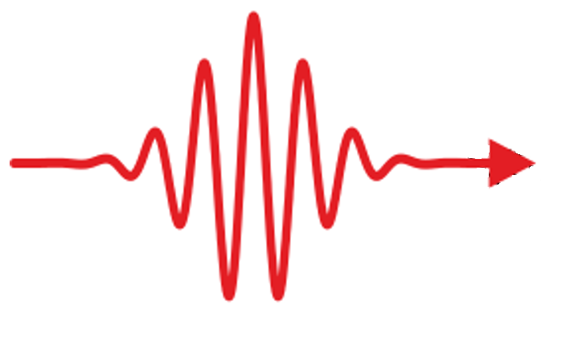
Hot e⁻
Fe
Au
n(z)
t > t₀
t < t₀
z
E(z)
injection
Secondary electron generation
z
excitation
Fe
Au
Fe
Au
Hot e⁻
E_{F}
z
z

Slide 3
U_{B} < 0
E_{kin}
hν
$${\text{E}}_{\text{vac}}^{\text{sample}}$$
$${\text{E}}_{\text{vac}}^{\text{spec}\text{.}}$$
0
Φ_{spec}
Φ_{sample}
$${\text{E}}_{\text{F}}^{\text{spec}\text{.}}$$
$${\text{E}}_{\text{F}}^{\text{sample}}$$

