Slide 1
Predicting Life Expectancy of Indians
Capstone Project
for Springboard Intermediate Data Science course

Slide 2
Client
Fictional Indian government agency
Aims to increase the average life expectancy of Indians
Name: Life Expectancy Action Agency (LEAA)

Slide 3
Tasks
To create a machine learning model that can predict the life expectancy of Indians using the dataset provide by the client
To give recommendations to my client based on this process

Slide 4
Dataset
About 770’000 rows and exactly 121 columns
Each row represents one deceased Indians
Based on a survey by the LEAA (my client) in which members of the household of the deceased were asked about the deceased

Slide 5
Thematical groups of variables
Variables used for creating target variable
Variables about the death of the deceased
Variables about the deceased himself/herself
Variables about the household/family of the deceased
Variables without or with unknown meaning
The only group of variables that can be used for fitting the linear regression model is group 4 about the householdof the deceased

Slide 6
Data Cleaning process
Creating the target variable ‘lifetime’ - the number of years from birth until death
Deleting unrealistic ‘lifetime’ values
Deleting all columns which are not about the household of the deceased (besides ‘lifetime’)
Dealing with missing values
Deleting columns with mainly the same value
Converting integer encodings for categories to strings describing the categories
Deleting rows with undefined categories
Dividing Data in training and test set

Slide 7
Shape of dataset after Data Cleaning
715’550 rows left (training set + test set)
1 target variable, ‘lifetime’
29 categorical variables (mainly nominal)
1 numerical variable (discrete) – the number of rooms in possession of the household

Slide 8
Exploratory Data Analysis (Part 1)
‘Lifetime’ target variable is not normally distributed – taking the log didn’t make it Gaussian either
  Thus I chose permutation test for evaluating whether there are statistically significant differences within the categories
    Within all categories there are statistically significant differences in average ‘lifetime’

Slide 9
Exploratory Data Analysis (Part 2)
The sole numerical variable (number of rooms) is weakly but statistically significantly correlated to the target variable
It is not strongly correlated to any of categorical feature variables (judged by Spearman’s rank order correlation)
Some of the categorical feature variables are strongly associated with each other (Cramer’s V > 0.3)

Slide 10
Fitting the Linear Regression model
The following is True for all iterations of the fitting process:
  I’ve used 3-fold cross validation
  Error metric I’ve used: Mean Absolute Error
  I’ve calculated the statistics such as Pearson’s R between actual and predicted values, MAE, p value for normality of residuals, mean of residuals
  I’ve created plots such as histogram of residuals, quantile-quantile plot of residuals, scatter plot of actual vs predicted values, scatter plot of predicted values vs residuals
  Categorical variables are one-hot encoded, the discrete variable from 0 to 1

Slide 11
Feature Selection for Linear Regression Model
First I tried to add variables step by step, ordered by the biggest difference of average lifetime variables within the variables
I left out variables highly associated with any variable already in the model
Assessing improvement after each added variable

Slide 12
Fitting the Linear Regression model (Part 3)
I’ve tried out the following adjustments (The best option in parentheses):
Taking the log of the target variable and not (not)
Removing outliers of the target variables and not (not)
Fitting with and without intercept (without)

Slide 13
Performance of best model
Overall the performance was rather weak
MAE about 11.32
Heteroscedascidity
Residuals not normally distributed
Rather weak correlation of predicted vs. actual values
no predictions above about 34.6 years and only few above about 70

Slide 14
‘Experimental’ model with added personal variables
(compared to ‘’real’ model)
Performed clearly better
MAE about 2 years better
Residuals still not gaussian
Less Heteroscedascidity than
A far higher range of predicted values
Clearly stronger correlation between actual and predicted values

Slide 15
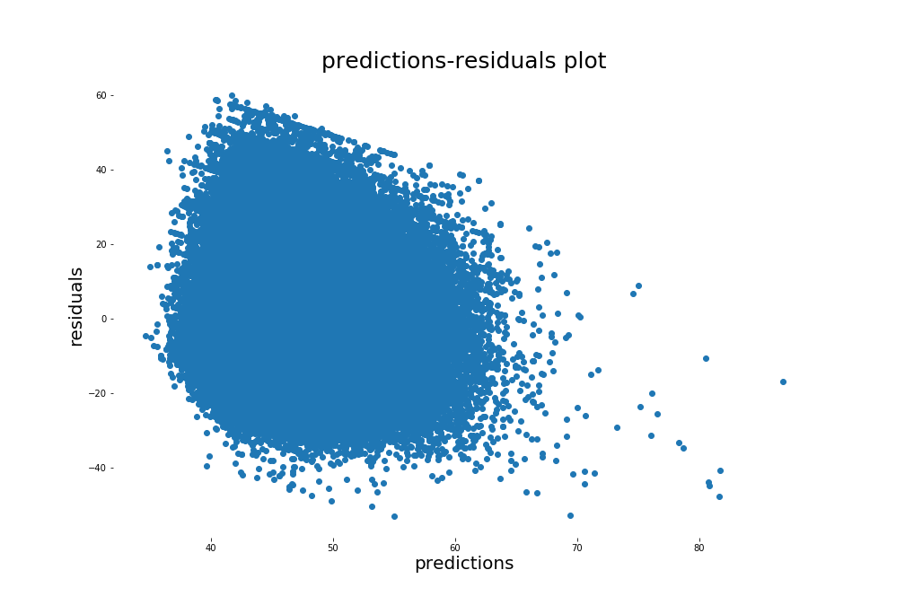
‘Real’

Slide 16
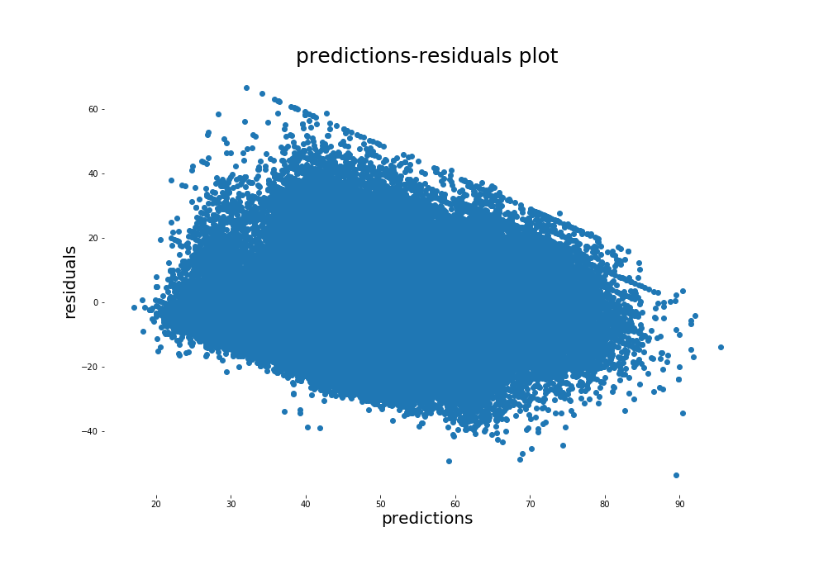
‘Experimental’

Slide 17
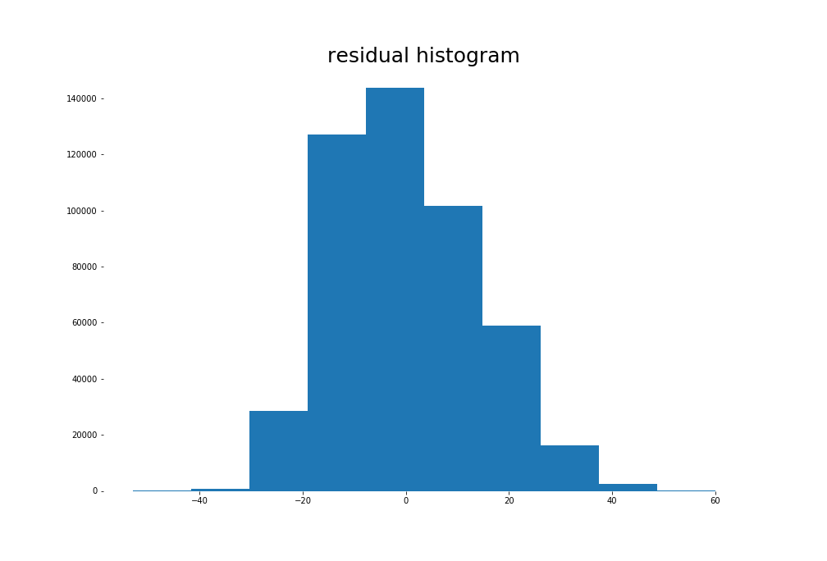
‘Real’

Slide 18
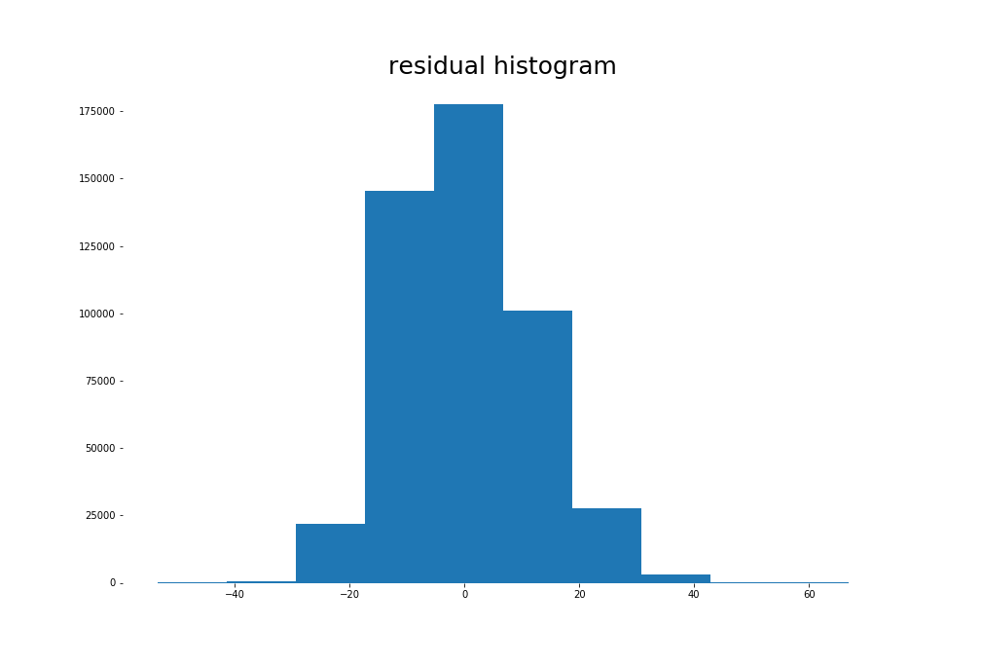
‘Experimental’

Slide 19
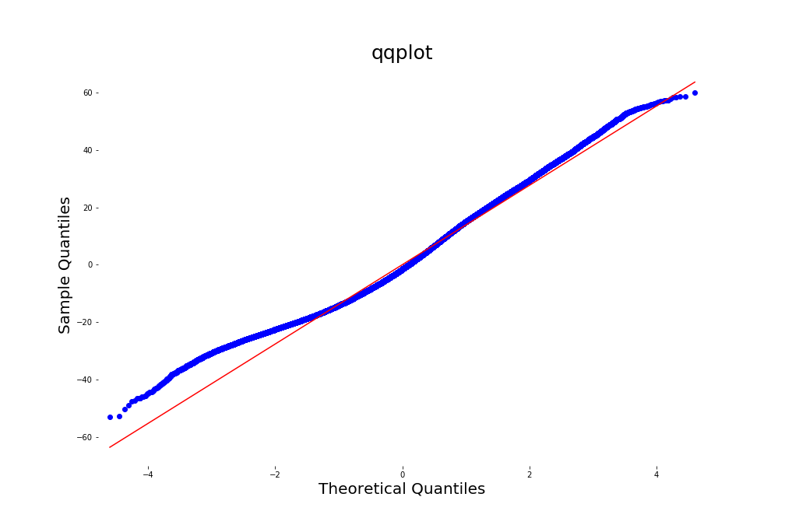
‘Real’

Slide 20
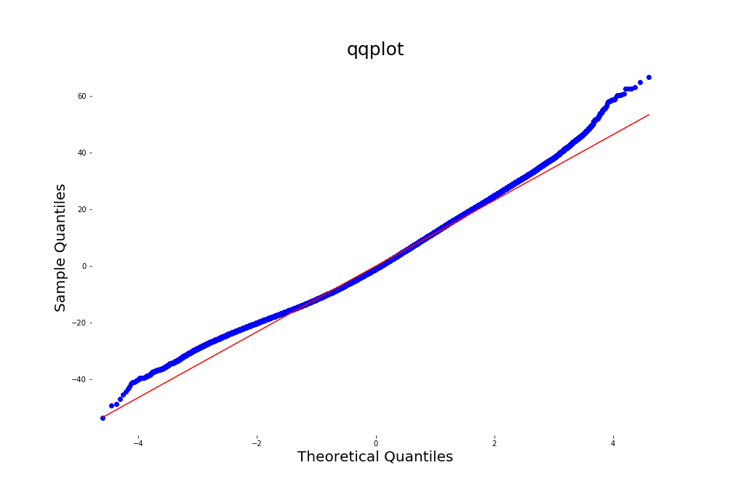
Experimental

Slide 21
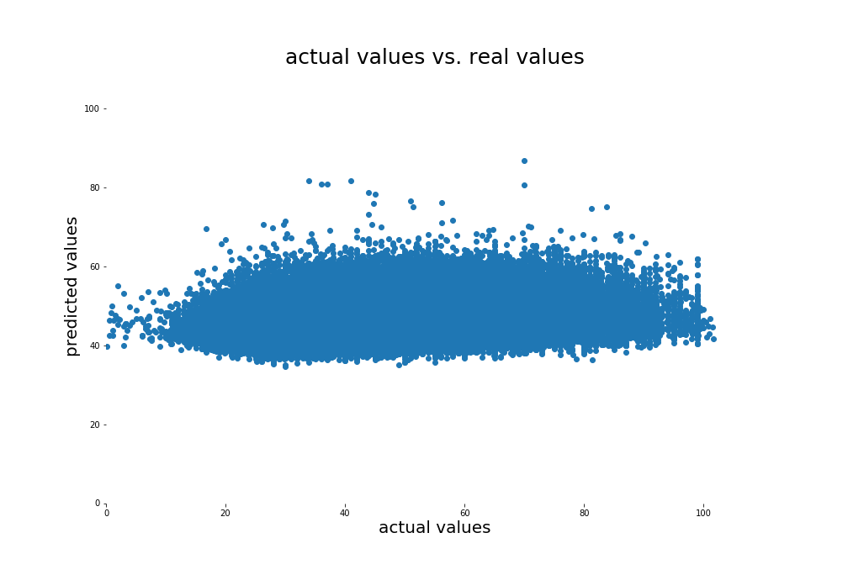
‘Real’

Slide 22
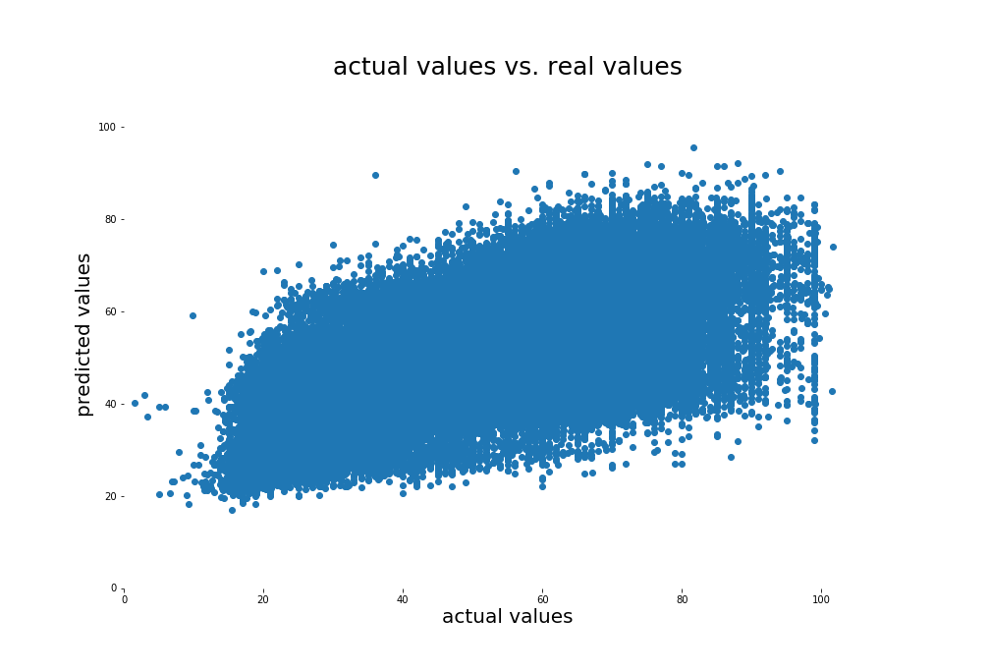
‘Experimental’

Slide 23
Recommendations
The model is rather weak, so I would use it carefully. It can be used for getting a first impression of a situation however.
The coefficients of the model can be used in order to educate the staff in the field.
I would consider to redo the survey in a better way. This might improve the model, because personal variables could be used.

