Slide 1
Expected Outcome of the Capstone project
The 12-minute presentation serves as a platform for students to showcase their capstone project, demonstrating their understanding, problem-solving abilities, and communication skills. The presentation should concisely cover the project’s key aspects, including the problem addressed, theoretical analysis, methodology, results, and conclusions.
Suggested Presentation Structure (12 minutes Presentation + 8 minutes Q&A)
Introduction & Problem Statement (3 minutes)
Briefly explain the project’s purpose and relevance.
Theoretical Foundation (3 minutes)
Discuss key theoretical concepts and methods used.
Practical Application (3 minutes)
Showcase your implementation, challenges faced, and the results.
Future Work & Conclusion (3 minutes)
Share potential future applications, possible improvements, and a final summary.
Q&A – Discussion (8 minutes)

Slide 2
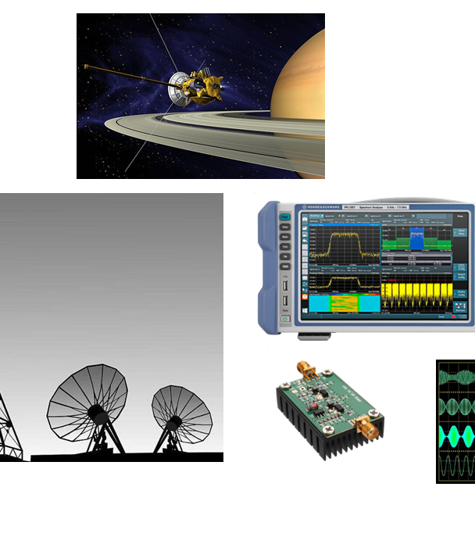
Project 4: KALM
Modulschlussprüfungen
Digital Communication (dcom)
Florian Meier

Slide 3
Outline Subtitle
I - Introduction
The problem
What is a Kalman filter
III – Practical Application
The tracking of a moving car
The effects of convergence parameters
II – Theoretical Foundation
Kalman Filter: Functionality
Kalman Filter: Convergence
IV - Conclusion
Challenges
Future Work
Conclusion

Slide 4
Introduction

Slide 5
The problem
Sensor data consisting of random movement
Example: Tracking a driving car
Signal heavily influenced by varying noise
Weather, electromagnetic pollution
How do you get a consistenly clear reading of the actual values?

Slide 6
The solution
A Kalman filter(also known as linear quadratic estimation)
What is a Kalman filter?
The Kalman filter combines:
A model how the system evolves over time
A model of how observations relate to the system
Noisy observations
To estimate the true state of a system over time

Slide 7
Theoretical Foundation

Slide 8
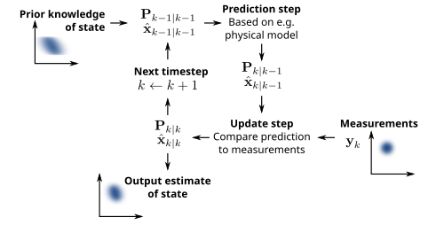
Kalman Filter: Functionality

Slide 9
Kalman Filter: Convergence
Measurement Noise Covariance (R)
Higher R → Trust the measurement less
Lower R → Trust the measurement more
Process Noise Covariance (Q)
Higher Q → Trust the model less, adapt faster to changes
Lower Q → Trust the model more, respond slower
Initial State Estimate (x₀) and Error Covariance (P₀)
Set x₀ as close as possible to the true state
Set P₀ high if uncertain about the initial estimate or low if confident

Slide 10
Kalman Filter: Convergence
How do you adjust your filter to the use case and improve convergence?
Adjust key parameters strategically
1. Start with high Error Covariance(P₀) to let the filter adapt fast
2. Set Measurement Noise Covariance (R) according to sensor specs
3. Start with small Process Noise Covarince (Q), increase until responsive but stable
4. Analyze convergence by observing how fast estimates stabilize

Slide 11
Practical Application

Slide 12
The tracking of a moving car
The tracking of a moving car by GPS sensor was simulated and filtered with a Kalman filter
Code showcase

Slide 13
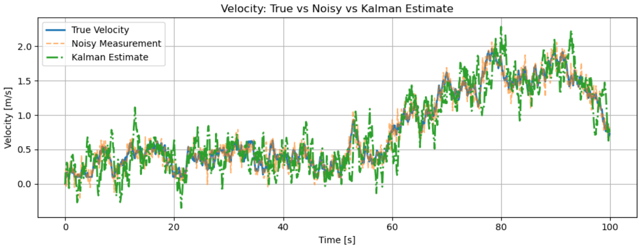
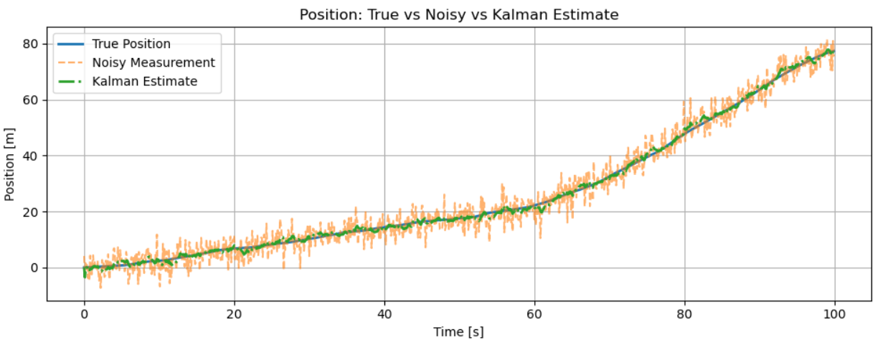
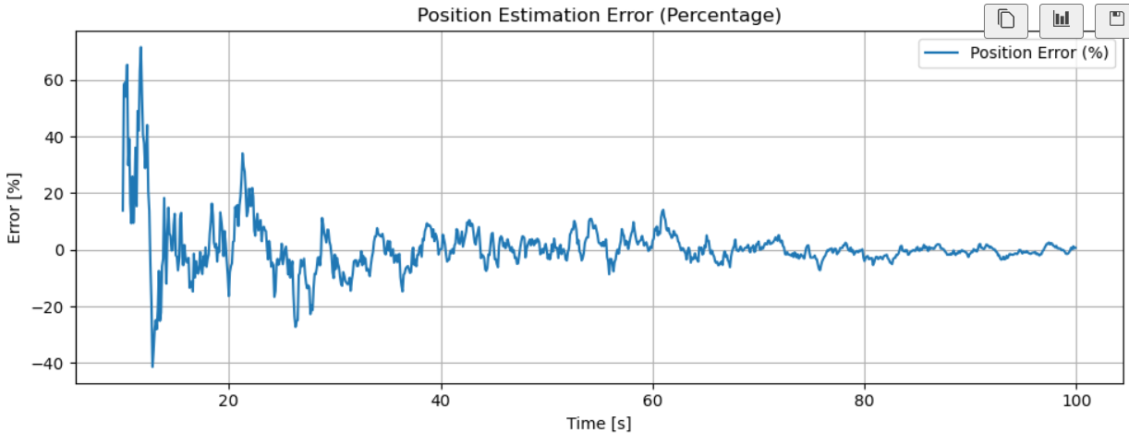
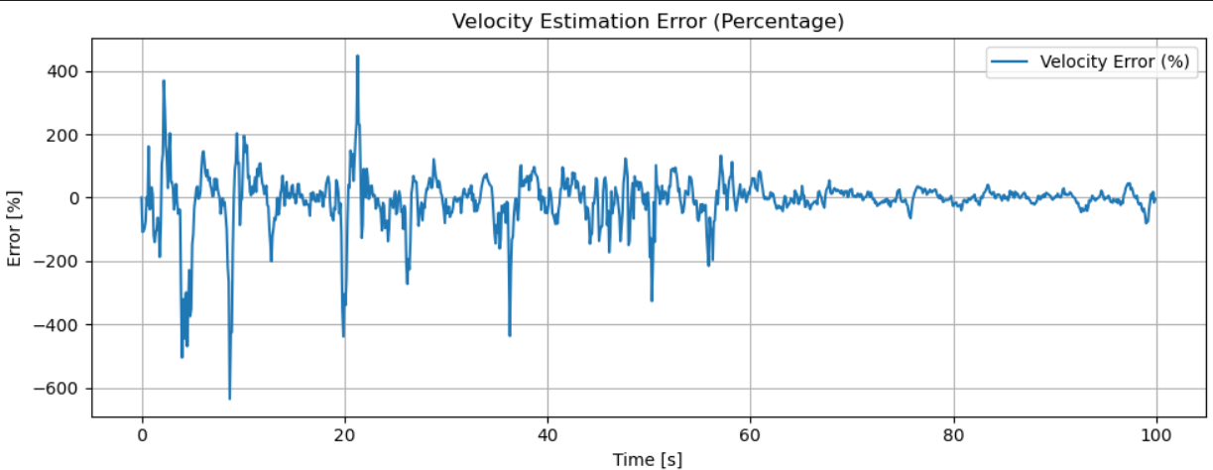
The effects of convergence parameters Balanced: Q=1e-4 R=0.01
[12:07]
[12:07]
[12:07]

Slide 14
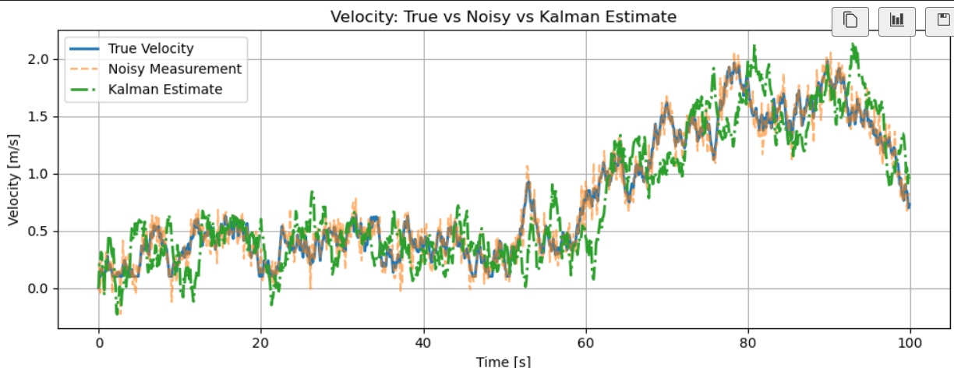
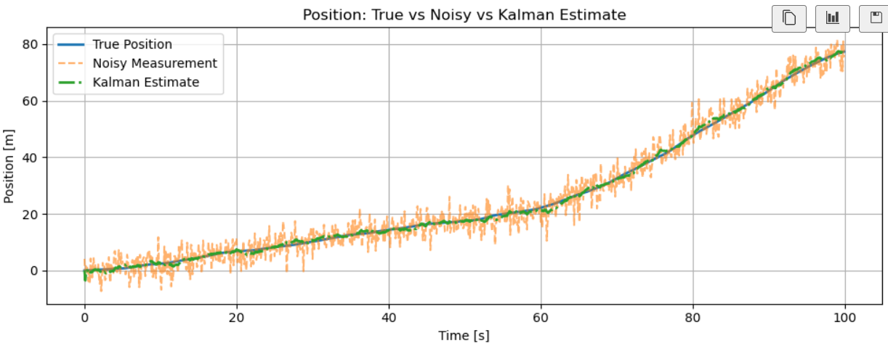
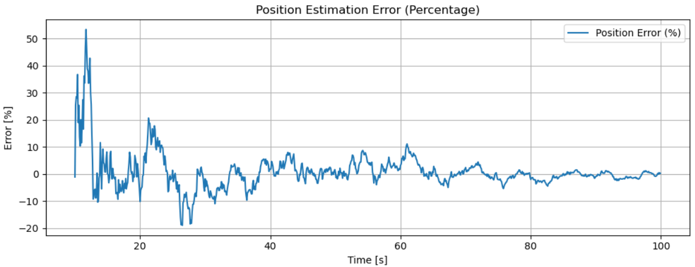
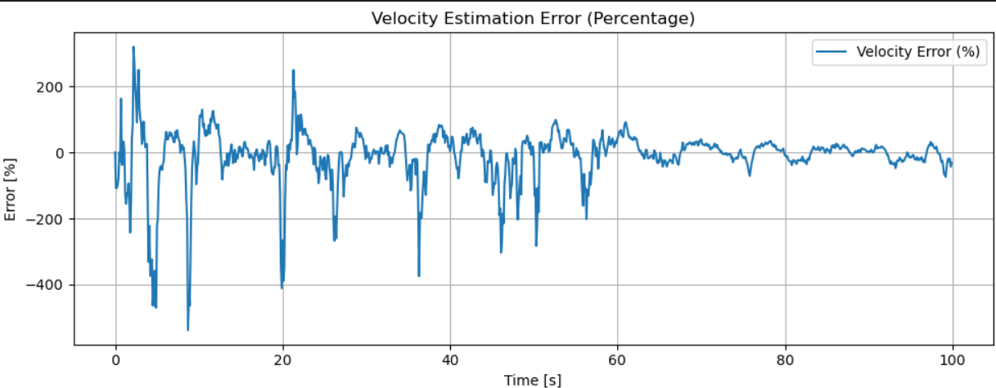
The effects of convergence parameters Trust Model More: Q=1e-5 R=0.01
[12:07]
[12:07]
[12:07]

Slide 15
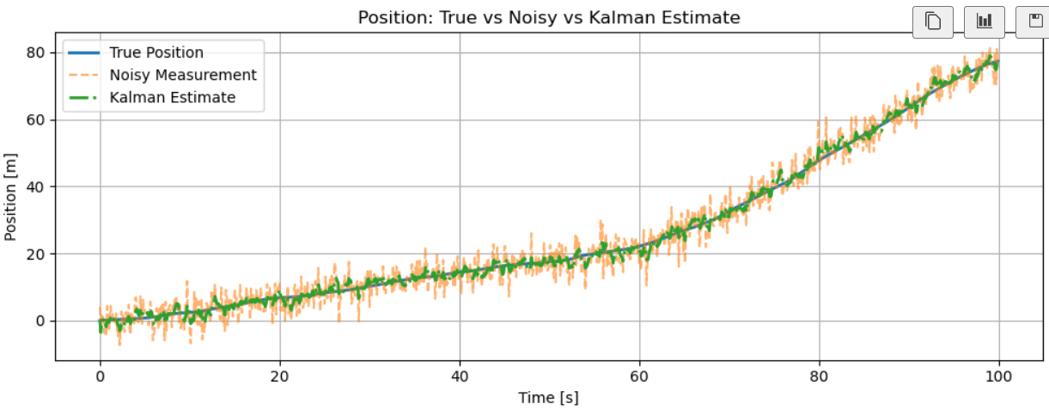
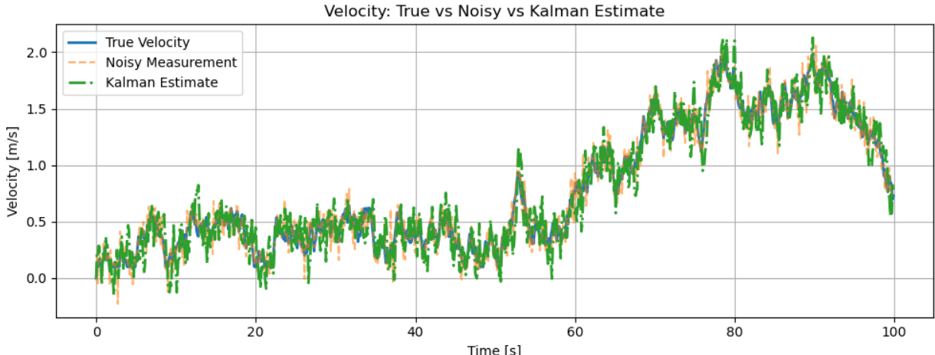
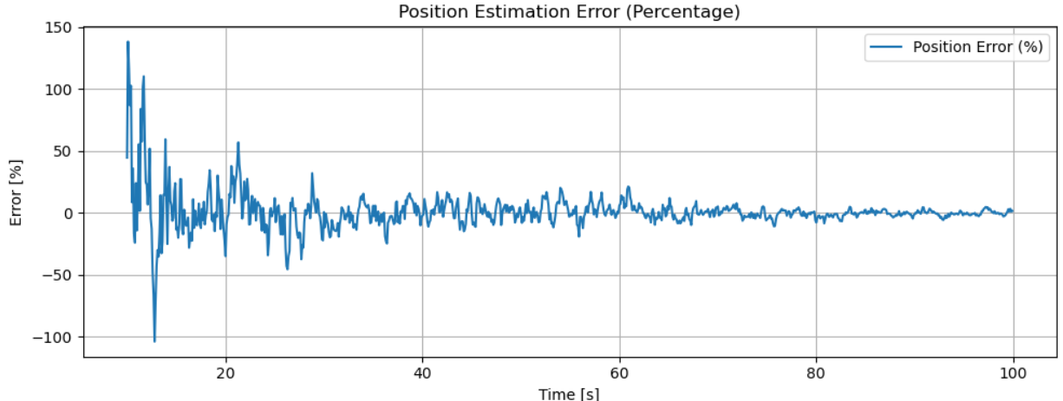
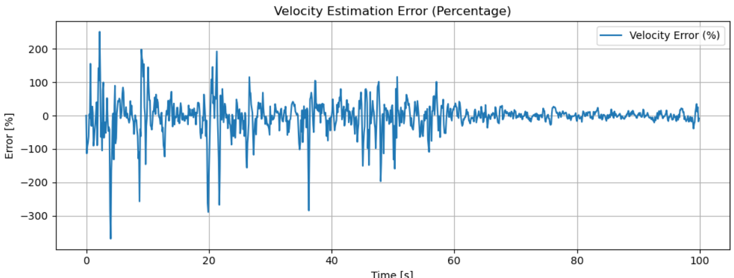
The effects of convergence parameters Trust measurement More: Q=1e-4 R=0.001
[12:07]
[12:07]
[12:07]

Slide 16
Conclusion

Slide 17
Challenges
-Understanding the task
-Simulating an extended Kalman filter
-Using a real sensor to compare the simulation with a real life scenario
Future work

Slide 18
Conclusion
The Kalman filter is broadly usable for noisy signals that can be predicted by a model
The parameters have a big influence on the performance

Slide 19
Discussion

Slide 20
Sources
Picture Page 8: https://en.wikipedia.org/wiki/Kalman_filter#:~:text=In%20statistics%20and%20control%20theory,those%20based%20on%20a%20single

