Slide 1
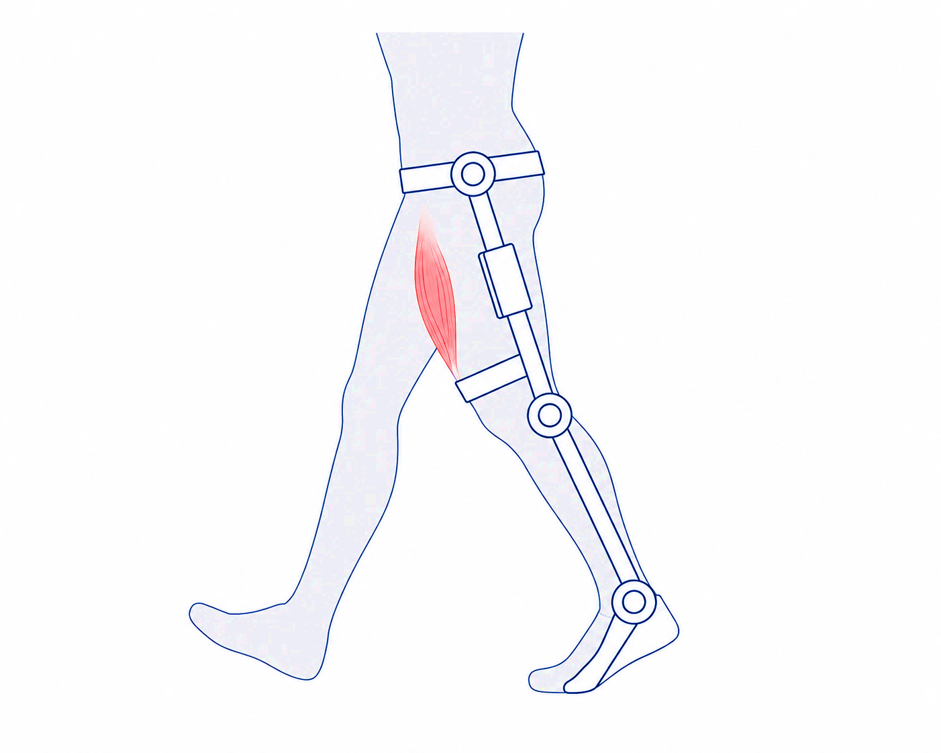

Slide 2
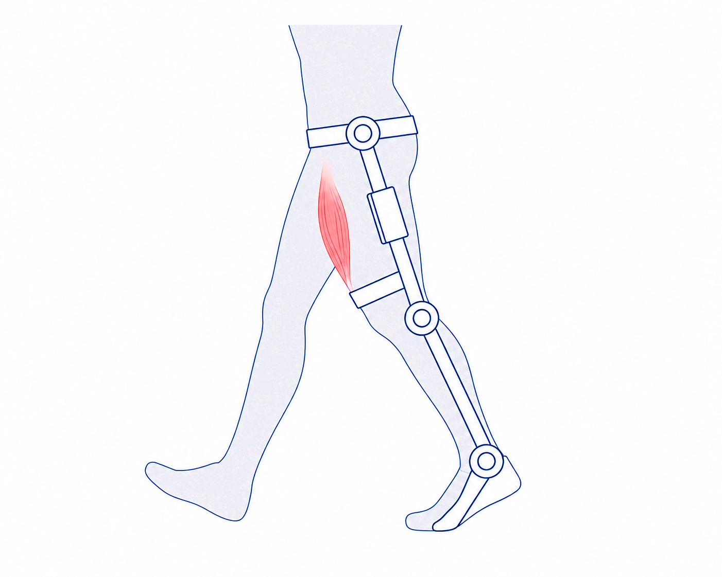
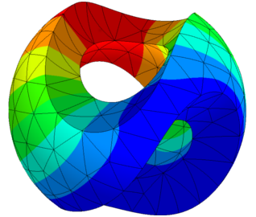

Structural Mechanics
Finite Element
Analysis
Human Biomechanics
Actuators, Control and Sensors
Netgen/NGSolve
Human Biomechanics
Musculoskeletal Modelling
Structural Mechanics
Actuators, Control, and Sensors
Equation-based Modelling
Netgen/NGSolve

Slide 3
Human Biomechanics
Musculoskeletal Modelling
Actuators, Control, and Sensors
Equation-based Modelling
Structural Mechanics
Finite Element
Analysis
Netgen/NGSolve

Slide 4






Multi-Fidelity and Runtime Switching
Subsystem
Model $M_{L}$
Low Fidelity
Low Cost
Global Behavior
Model $M_{H}$
High Fidelity
High Cost
Local Behavior
Definition
State transfer
Execution
$M_{L}$ active
$M_{H}$ active
$M_{L}$ active
$$t$$
High-fidelity interest region
At switch: State is transferred between models

Slide 5


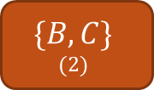


Framework Requirements
General Modeling
Heterogeneous Integration
A
B
Component
UR-01
Components and Ports
UR-02
Physical Units
UR-03
System
Assembly
UR-04
Hybrid Behavior
UR-05 to UR-07
Backend Wrappers FEM, MBD, equation-based
UR-08
Uniform Interface
UR-09
Runtime Switching
Simulation
Interaction
algebraic loop
$$A$$
$$(1)$$
$$\{B,C\} \\ (2)$$
$$D$$
$$(3)$$
UR-10 (1)
Structural Analysis
UR-10 (2)
Hybrid Events
UR-11 (1)
Algebraic Loops
UR-11 (2)
Pluggable Algorithms
UR-12
System Graph
UR-13
Simulation History
UR
derive
SR
realize
Features
validate
Case Study

