Slide 1

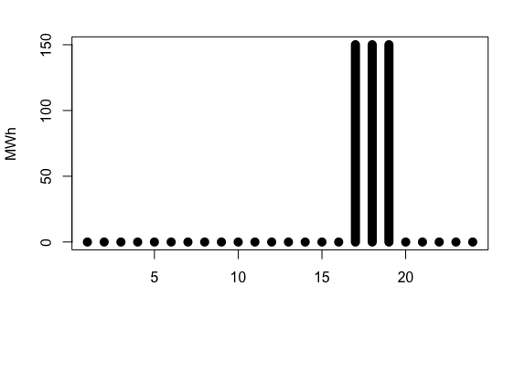


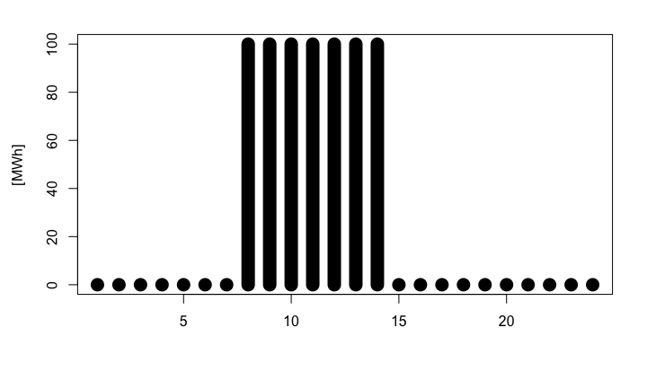

200 MWh
Transmission capacity
DK1
DK2
600 MWh

