Slide 1



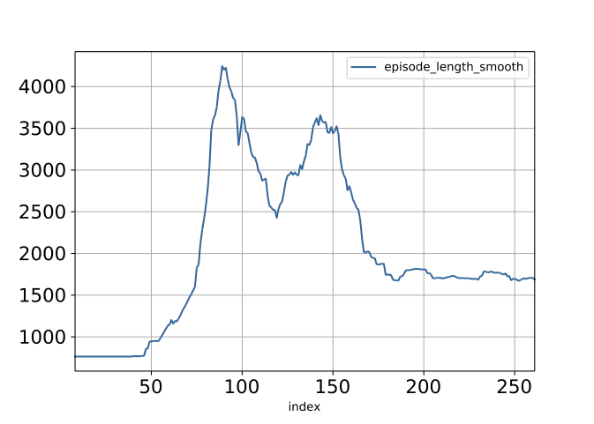
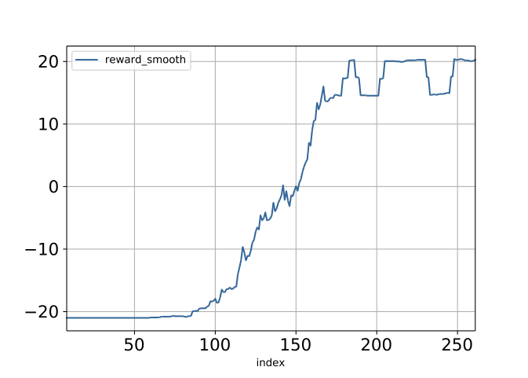
Imagination Augmented Agents for Deep Reinforcement Learning
Angela Denninger, Felix Schober, Florian Klemt, Max-Philipp Schrader
Imagination Augmented Agent Architecture
Adopted implementation of the paper Imagination Augmented Agents for Deep Reinforcement Learning by DeepMind [1] (I2A)
We were not able to replicate the specifc results of DeepMind using their proposed design choices, as they used a custom implementation of Atari games and we used OpenAI Gym as an Atari environment. [1,4]
Combines model based and model free Reinforcement Learning Architectures
Different Imagination Rollouts explore an imagined future of available actions
Environment Model
  … predicts the next state and reward
  The Environment Model differs from the ones proposed
  in the paper due to different environment state sizes
  We used the architecture proposed in [3]. The model
  takes one hot encoded actions and the current state
  as input to predict the next state and the reward. We
  tried the current state in different settings. The last three recorded frames, combined to three channels, worked best.
  In the latent space the Action FC and the State Encoding are combined by element wise multiplication
  For training we found the Negative Log Likelihood Loss
  in combination with Adam and a learning rate of 10⁻⁴ generate the best results for Pong, MsPacMan, and Breakout
General Environment Model
One Hot Encoding
FC Reward
State Encoding
Action FC
FC Decode
State Decoding
FC Encode
X
Full I2A Architecture
Fig. 2: Architecture of the Environment Model
Imagination Core
Policy
Net
Environment
Model
Single Imagination Rollout
Imag
Core
Imag
Core
. . .
Imag
Core
Imagination Future
Conv
Conv
Conv
Encoding
LSTM
LSTM
. . .
LSTM
Imagination Augmented Path
Input
Prediction
Ground Truth
Model Free Path
Path Aggregator
Fig. 3: Prediction Example for the MsPacMan Environment
Evaluation
Fig. 1: Full Imagination Augmented Agent – Architecture
Scott Reed, DeepMind, 01/30/2018: “Oh… That’s a very ambitious project” and “What you want to use real PacMan?”
For training the I2A network we used the asynchronous method proposed in DeepMinds A3C paper [2]
Due to computational resources, we were not able to train a very strong model. DeepMind trained their I2A model for 10⁹ Atari environment steps.
Nevertheless we were able to train a working version for Pong, but we can not proof the advantages of the I2A-Architecture with such a simple environment
We saw a changing duration length, which is based on learning and it’s ability to win faster in the end.
Imagination Augmented Path (IAP)
  … uses rollouts to imagine the best future action
  The IAP consists of one Imagination Rollout for all available actions
  All Imagination Rollout outputs will be aggregated by concatenating them to
Single Rollout
  … evaluates how a selected action performs in the future
  Imagines the future by chaining multiple imagination cores. At the beginning it takes
  the current state as well as a start action. Finally the predicted state gets passed into the next Imagination Core.
  After performing n rollout steps a convolutional LSTM encodes the result of the Imagination Rollout
Imagination Core (IC)
  … predicts the next state based on an internal selected action
  Consists of a Policy Net and a pretrained Environment Model
  The policy net predicts the next action to perform. As proposed by [1] we used architecture from the A3C paper [2] as our policy net
  Output: predicted reward and the next state
Fig. 4: Pong episodes played
Fig. 5: Reward archived per episode of Pong
Model Free Path
  … provides the network with an option to deal with insufficient future predictions
  Uses the convolutional layers of A3C model free architecture [2] but does not include the fully connected layer
Path Aggregator
  … calculates based on both paths a policy and value
  First, the output of the paths and
  gets concatenated
  This then is followed by a fully connected
  net which outputs the policy and the value
Summary
As described above, we were not able to train a sufficiently strong model, but we were able to implement a working I2A model, which is able to learn and play Atari Games
Our code will be published as Open-Source on Github [5] after the class
Literature
[1] Racanière, Sébastien, et al. "Imagination-Augmented Agents for Deep Reinforcement Learning." Advances in Neural Information Processing Systems. 2017.
[2] Mnih, Volodymyr, et al. "Asynchronous methods for deep reinforcement learning." International Conference on Machine Learning. 2016.
[3] Leibfried, Felix, Nate Kushman, and Katja Hofmann. "A deep learning approach for joint video frame and reward prediction in atari games." arXiv preprint arXiv:1611.07078 (2016).
[4] Brockman, Greg, et al. "Openai gym." arXiv preprint arXiv:1606.01540 (2016).
[5] https://github.com/mpSchrader/I2A-for-Deep-RL
Get in Touch
Angela Denninger angela.denninger@tum.de
Felix Schober felix.schober@tum.de
Florian Klemt florian.klemt@tum.de
Max-Philipp Schrader m.schrader@tum.de

