Slide 1
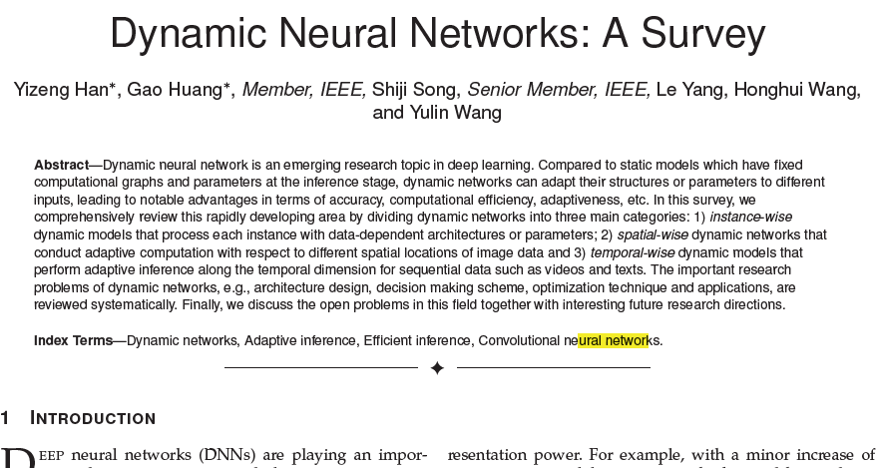
Image & AI Reading Group
Karol Desnos, Ph.D.
Associate Professor
IETR-VAADER, Rennes, France
2021.MM.DD
Notes:
Video Analysis and Architecture Design for Embedded Resources

Slide 2
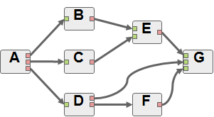

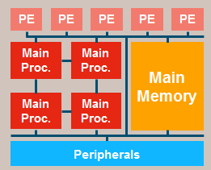
Prelude
My Research Interests:
Model-Based Computer Aided Design
Dataflow models of computations
Adaptive cyber-physical systems
Multi-optimized: Energy, Memory, Latency, QoS, …
Embeddable Reinforcement Learning
Image/Video Coding for Machines
Generic Evolvable Graphs for Efficient Learning of Artificial Tangled Intelligence

Slide 3
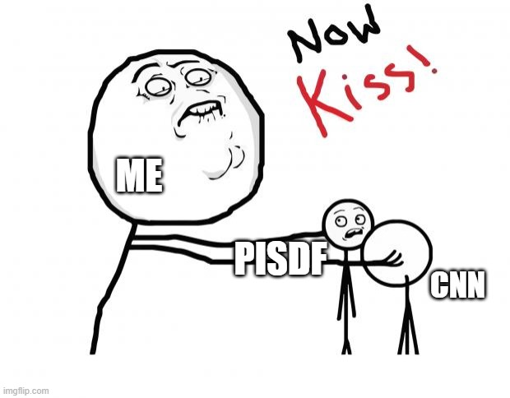
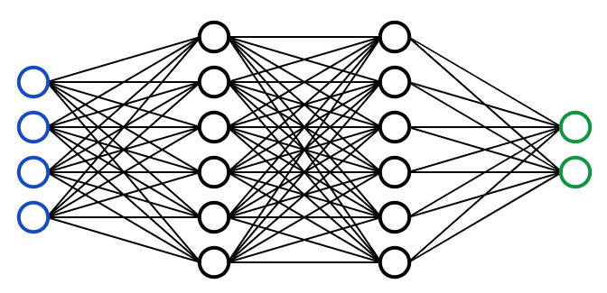
Prelude
Why today’s paper
Echo dataflow research
Size
A
1
Size
h
Size
3
B
Size
Size
x2*Size
Size
SetN
N
in
Size
Size/N
B
Size/N
Size
out
back
Size
Size/N
Size/N
Size
feed
Synchronous Dataflow
≈
Deep Neural Network
Reconfigurable/Dynamic Dataflow
≈
Dynamic Neural Network
?
?

Slide 4





Intro
(Static) Neural Network
Computations on all input samples are identical
Fixed network architecture and data-path
All input samples are processed by all neurons
Learned weights are fixed by training
$$y= ℱ(x, Θ)$$
$x$ : input
$ℱ(∙,Θ)$ : CNN Function parameterized by $Θ$
$y$ : output
$Θ$ : Learnable Parameter

Slide 5








Intro
(Static) Neural Network
Computations on all input samples are identical
Dynamic Neural Network
Computations are adaptively modified for input samples
$$y= ℱ(x, Θ)$$
$x$ : input
$ℱ(∙,Θ)$ : CNN Function parameterized by $Θ$
$y$ : output
$Θ$ : Learnable Parameter
$$y_{i}= ℱ_{(x_{i})}(x_{i}, Θ_{(x_{i})})$$
$x_{i}$ : input sample
$ℱ_{(x_{i})}(∙,Θ)$ : CNN Function parameterized by $Θ$ and $x_{i}$
$y_{i}$ : output sample
$Θ_{(x_{i})}$ : Learnable Parameter parameterized by $x_{i}$
Warning: These equations are not sound, they only give an intuition of what’s happening.

Slide 6
Intro
Why Dynamic Neural Network?
Accuracy++ Larger parameter space > Better “representation power”
Efficiency++ Selective computations > Less redundant & useless computat°
Adaptiveness++ Tradeoff between Accuracy & Efficiency
And also
Compatibility with latest advance in static NN design.
Generality of tasks: NLP, Signal, image, video
Interpretability: May be improved…

Slide 7
Intro
What this paper is about: How do Dynamic NN work?
Instance-wise
Spatial-wise
Temporal-wise
« Per-Sample »
dynamic constructs in neural network
architectures
Finer-granularity intra-sample dynamic constructs
Finer-granularity inter-sample dynamic constructs
Inference
Training
Not in this digest
What this paper is (unfortunately) NOT about:
Expected gains/loss in terms of accuracy, complexity*
Navigation map to select the most appropriate technique.
*: Possibly because this is a complex issue, cf. later discussion.

Slide 8
Intro
What this paper is about: 236 references!

Slide 9
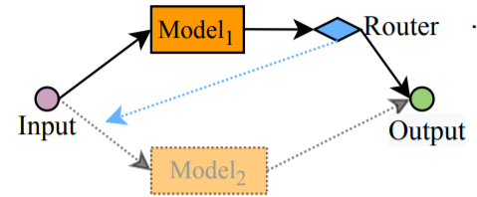
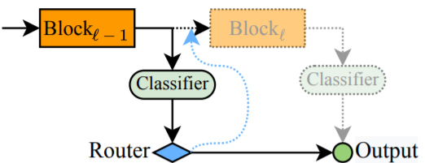
Instance-Wise Dynamic N.N.
1. Dynamic Architectures
Adapt data path to each sample by changing the network (1.1) depth or (1.2) width or by (1.3) routing data dynamically.
1.1. Dynamic Depth – 1.1.1 Early Exiting
Stop computations early for “easy” samples.
Confidence
threshold
a. Cascading networks
b. Intermediate classifier
☹ Redundancy between Model 1 and 2
☺ Less redudancy
Interference between classifiers at learning
High res. features bad for classif

Slide 10
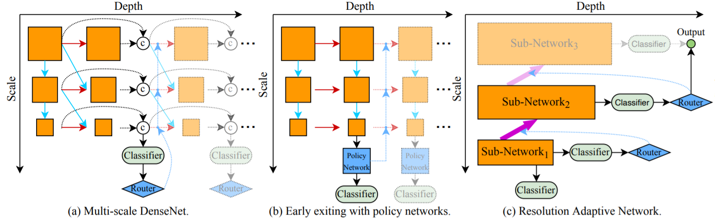
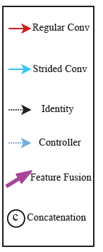
Instance-Wise Dynamic N.N.
1. Dynamic Architectures
1.1. Dynamic Depth – 1.1.1 Early Exiting
Stop computations early for “easy” samples.
Confidence
threshold
"Trained"
c. Multi-scale networks
☺ Better than both cascading and intermediate classif.
Touchy threshold tuning / training
Notes:
Scale = feature resolution.

Slide 11
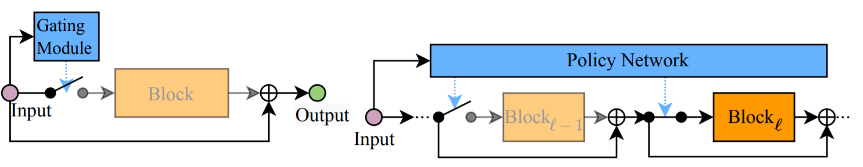
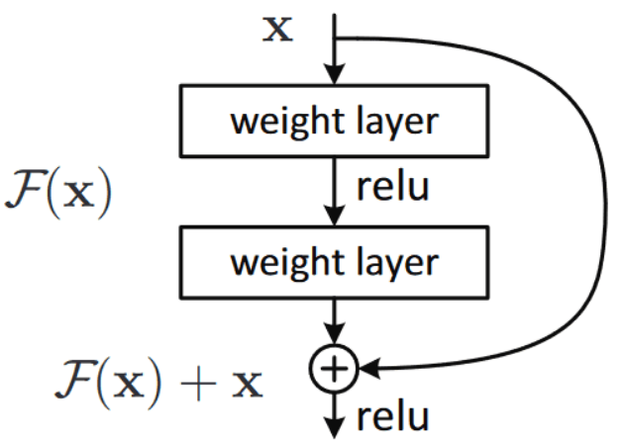
Instance-Wise Dynamic N.N.
1. Dynamic Architectures
1.1. Dynamic Depth – 1.1.2 Layer Skipping
Disable intermediate layers (requires “skip” connections)
Reminder:
Skip connection
a. Gating function for skipping a layer.
(also exists for dynamic bitwidth)
b. ML controlling more globally the activated layers

Slide 12
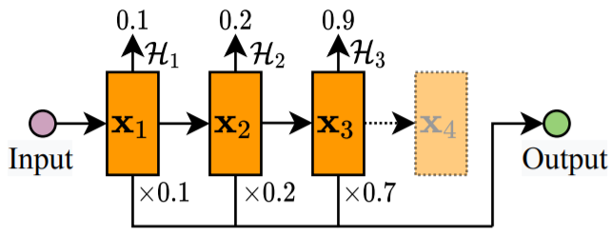
Instance-Wise Dynamic N.N.
1. Dynamic Architectures
1.1. Dynamic Depth – 1.1.2 Layer Skipping
Disable intermediate layers (requires “skip” connections)
H is accumulated for each time step
in each block.
Stops at a threshold
☺ Spatial/time adaptivity
c. Halting scores in a RNN stage
Notes:
Halting score:
Stage: multiple « blocks » with the same resolution, skippable thanks to skip connection.
Halting score works for « blocks » computed iteratively (iir like) in a cnn.

Slide 13
Instance-Wise Dynamic N.N.
1. Dynamic Architectures
1.2. Dynamic Width – 1.2.1 of Fully connected layer
Vague in the paper… (individual neuron activation, low rank approx.°)

Slide 14
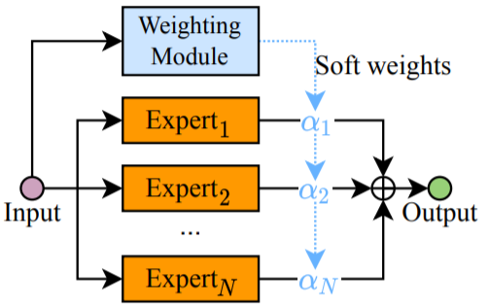
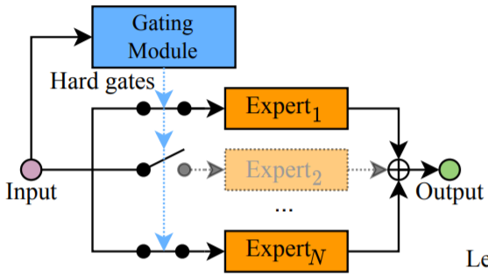
Instance-Wise Dynamic N.N.
1. Dynamic Architectures
1.2. Dynamic Width – 1.2.2 Mixture of Experts
“Expert” sub-networks run in parallel and fused.
a. Soft fusion
b. Hard gating
Accuracy+
Computations++
☺ Accuracy++
Computations--

Slide 15
Instance-Wise Dynamic N.N.
1. Dynamic Architectures
1.2. Dynamic Width – 1.2.3 Dynamic channel pruning
Selective deactivation of channel during computations.
a) Multi-stage archi Similar to early exiting: activate secondary channels when confidence criteria is not met.
b) Dynamic pruning with gating function Deactivate channels individually (e.g. using markov decision process)
Adaptive accuracy
Adaptive computations
Highy variable latency (full inference needed when confidence criteria is not met)
Adaptive accuracy (but less than mult stage)
Adaptive computations

Slide 16
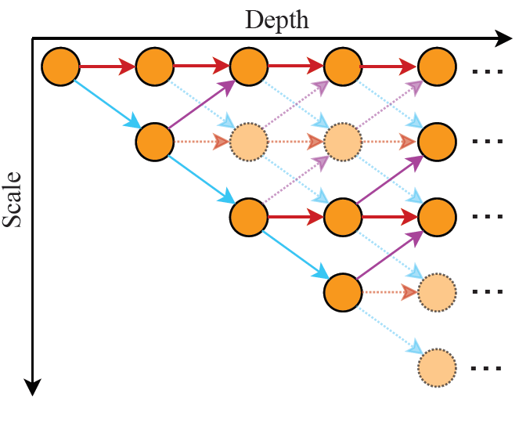
Instance-Wise Dynamic N.N.
1. Dynamic Architectures
1.3. Dynamic Routing
Dynamic data path in a “super-network”
Path selection: unique branch path never merged/fused
Neural tree: multiple branch paths never fused (i.e. multiple decisions)
Other
Adaptability++
Accuracy++
Complexity++
a. Dynamic routing in super network

Slide 17
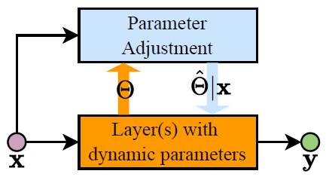
Instance-Wise Dynamic N.N.
2. Dynamic Parameters
Fixed Network Architecture
Dynamicaly change model parameters for each samples, by (2.1) Adjusting parameters, (2.2) Generating parameters, or (2.3) Rescaling features with soft attention.
2.1. Parameter Adjustment

Slide 18
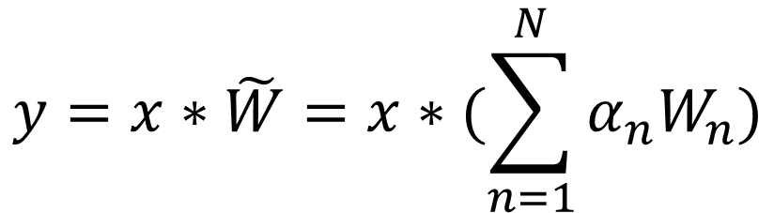
Instance-Wise Dynamic N.N.
2. Dynamic Parameters
2.1. Parameter Adjustment - 2.1.1 Attention on weight
Dynamically weight the different parameters before applying the convolution.
Trained weights
$$y=x∗\tilde{W}=x∗(\sum_{n=1}^{N}{α_{n}W_{n}})$$
Model Capacity++
Computations-- (compared to mixture of experts)
Model size--
Depends on x or even on « local » features within x (for segmentation-aware CNN)
Notes:
Memory– multiple kernel stored

Slide 19
Instance-Wise Dynamic N.N.
2. Dynamic Parameters
2.1. Parameter Adjustment - 2.1.1 Kernel Shape
Reshape convolution Kernel and achieve “dynamic reception of fields”
A bit vague in the paper…
Notes:
Memory– multiple kernel stored

Slide 20
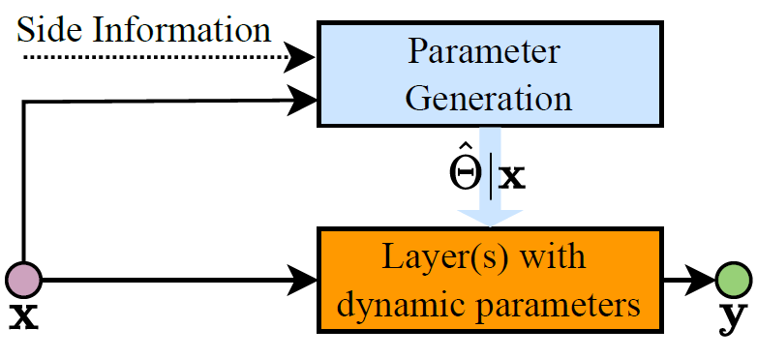
Instance-Wise Dynamic N.N.
2. Dynamic Parameters
2.2. Weight prediction
Instance-wise generation of the parameters
Often a smaller CNN itself

Slide 21
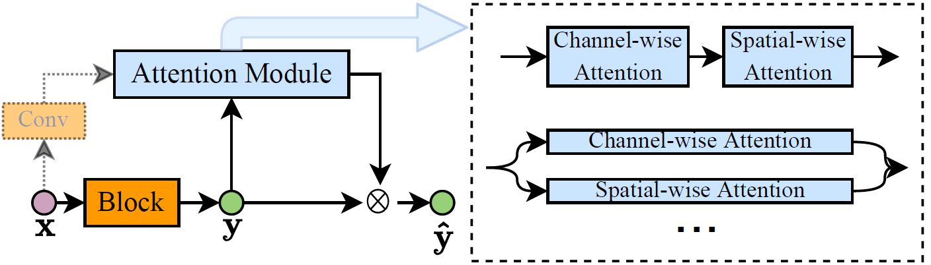
Instance-Wise Dynamic N.N.
2. Dynamic Parameters
2.3. Dynamic Features – 2.3.1/2 Channel/Spatial-Wise
Works on the convolution output, instead of convolution parameters themselves.
« Simpler » than modifying weights
Mathematically equivalent
Computations+ (soft attention weights existing computations)

Slide 22


Instance-Wise Dynamic N.N.
2. Dynamic Parameters
2.3. Dynamic Features – 2.3.3 Dynamic Activation
Change the activation function (instead of applying attention mechanisms before it)
Classic ReLU
$$y_{c}=max⁡(x_{c},0)$$
Channel index
Dynamic ReLU
$$y_{c}=max_{n}\{a_{c}^{n}x_{c}+b_{c}^{n}\}$$
Linear coeff computed from x
Simple modification of CNN
Good results for vision
Notes:
How are a^n_c and b^n_c computed is not in the paper.

Slide 23
Back to the beginning
What this paper is about: How do Dynamic NN work?
Instance-wise
Spatial-wise
Temporal-wise
« Per-Sample »
dynamic constructs in neural network
architectures
Finer-granularity intra-sample dynamic constructs
Finer-granularity inter-sample dynamic constructs
Depth
Pixel-wise
Computations--
Not GPU friendly
Width
Region-level (hard/soft attention on salient regions)
Param.
Resolution-level (Dynamic multi-scale whitchcraft)

Slide 24
Back to the beginning
What this paper is about: How do Dynamic NN work?
Instance-wise
Spatial-wise
Temporal-wise
« Per-Sample »
dynamic constructs in neural network
architectures
Finer-granularity intra-sample dynamic constructs
Finer-granularity inter-sample dynamic constructs
Depth
Pixel-wise
RNNs for text
Width
Region-level
RNNs for video
Param.
Resolution-level

Slide 25
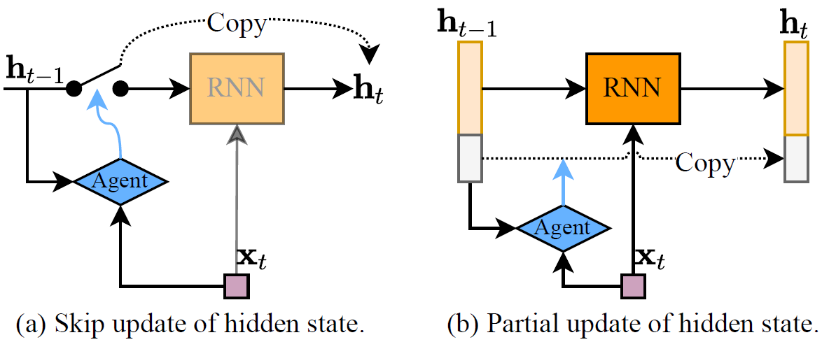
Temporal-wise Dynamic N.N.
1. Dynamic Update of Hidden State

Slide 26
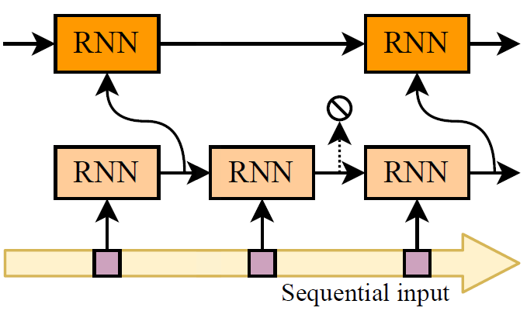
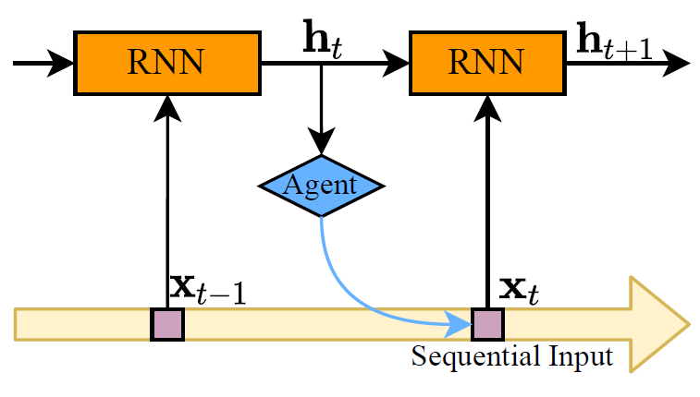
Temporal-Wise Dynamic N.N.
2. Multi-scale RNNs
3. Temporal Dynamic RNNs

Slide 27
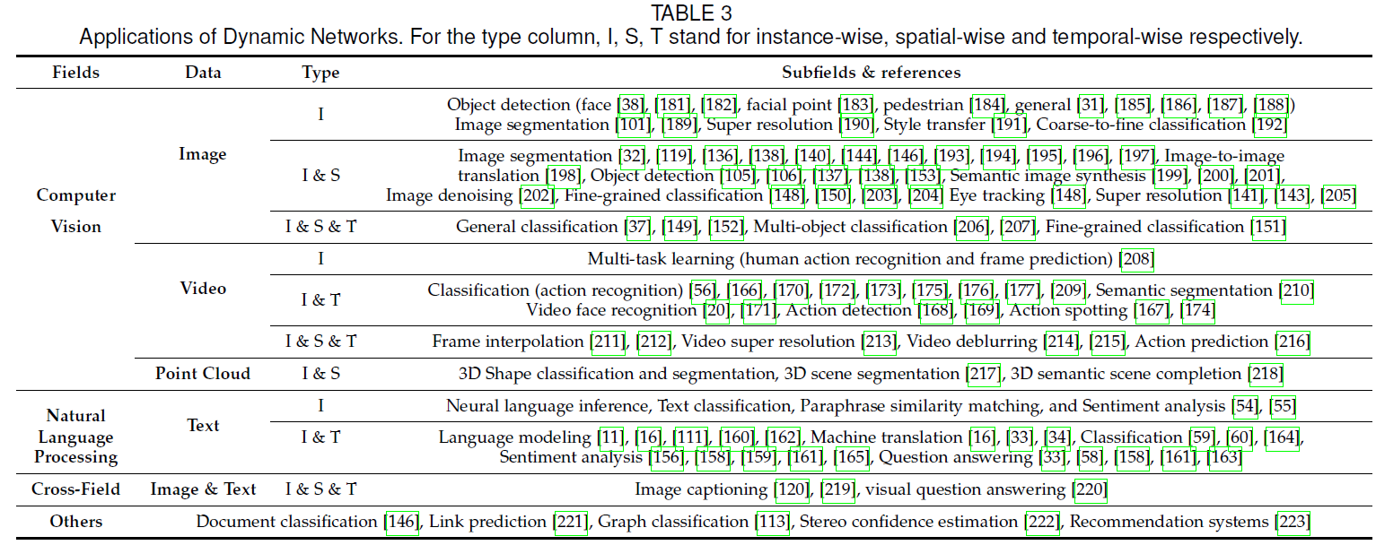
Applications

Slide 28
Discussion
Open issues for research
Theoretical background for dynamic archi.
Archi. Design for Dynamic Network (Most of dynamic network are currently derived from static archi.)
Applicability to more diverse tasks. (Most techniques tested on classif only…)
Efficient HW implementation (!!!) Computational gains do not translate well into perf. gains. (GPU ☹)
Robustness against Adversarial Attacks (!!!)
Interpretability

Slide 29
Thanks for enduring!

Slide 30
Motivations
Technology drivers
Source: ITRS & Hardware-dependent Software, Ecker et al., Springer

