Slide 1
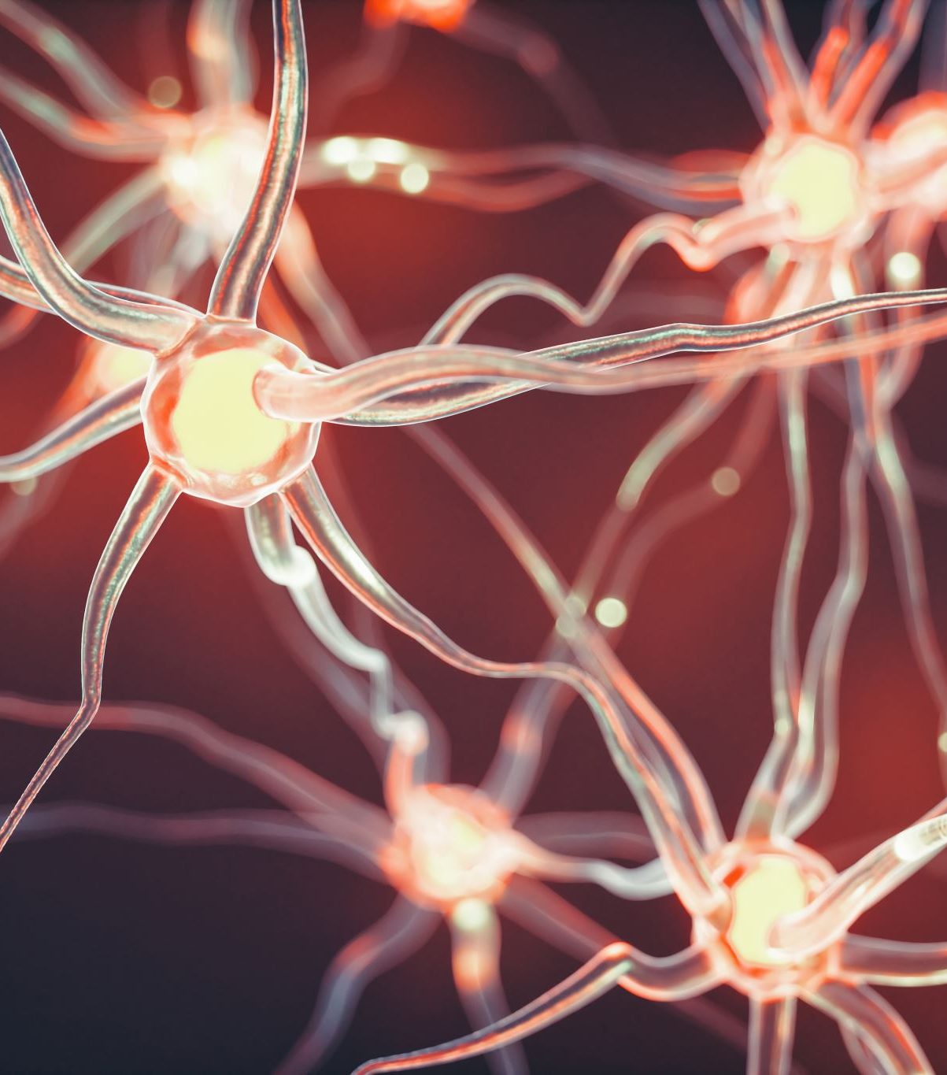
Hippocampal role in the interaction of semantic memory with learning and decision
Florian Leprévost
Prof. Dr. Bianca Wittmann
Justus-Liebig-Universität Gießen –
BION meeting 27.03.2017

Slide 2

How does semantic memory affects learning?

Slide 3
Associative Inference
1. Background
A
B
A
C
B
C

Slide 4
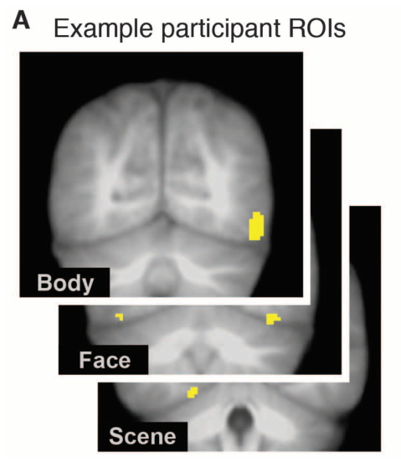
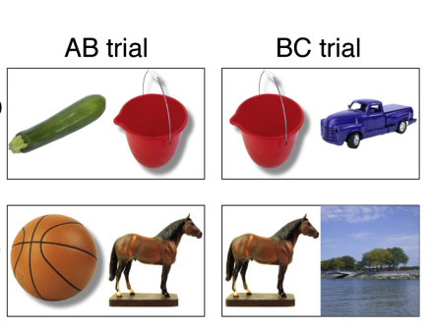
Reactivation of associated stimuli with learning
1. Background
Zeithamova et al 2012
Associative learning OOS
Category specific visual areas
Train category classifier

Slide 5
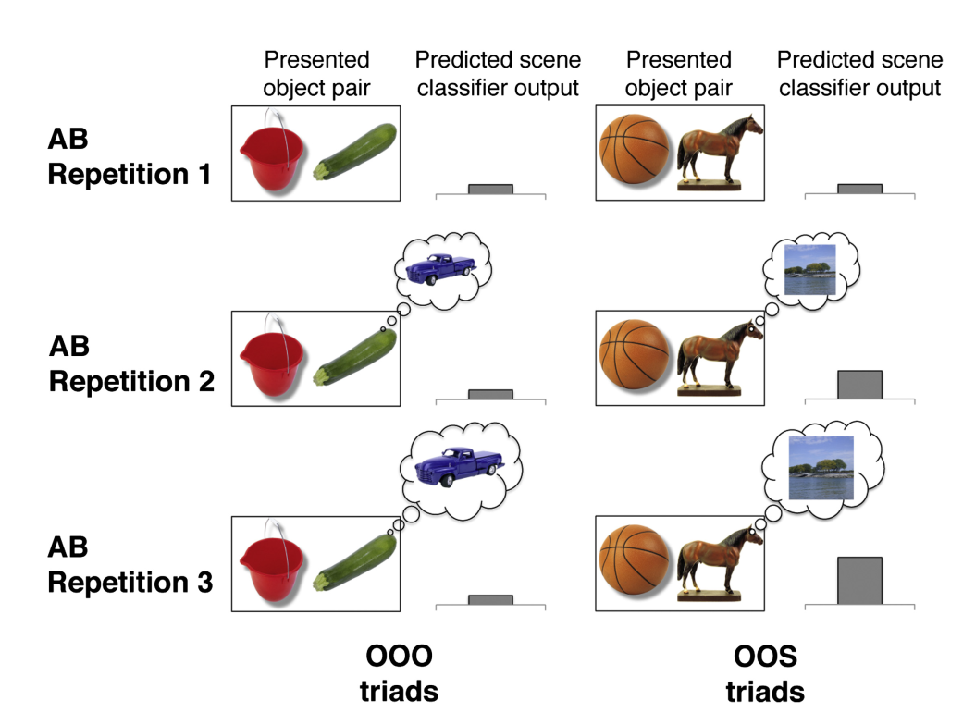
Reactivation of associated stimuli with learning
1. Background
Greater learning-related hippocampal decreases (first - last parameter estimate) across encoding repetitions were associated with greater AC performance at test.
Greater activation increases in VMPFC (last-first parameter estimate) across encoding repetitions were associated with greater AC performance at test

Slide 6
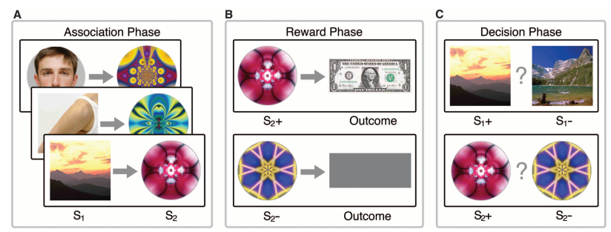
Wimmer & Shohamy 2012

Slide 7







