Slide 1
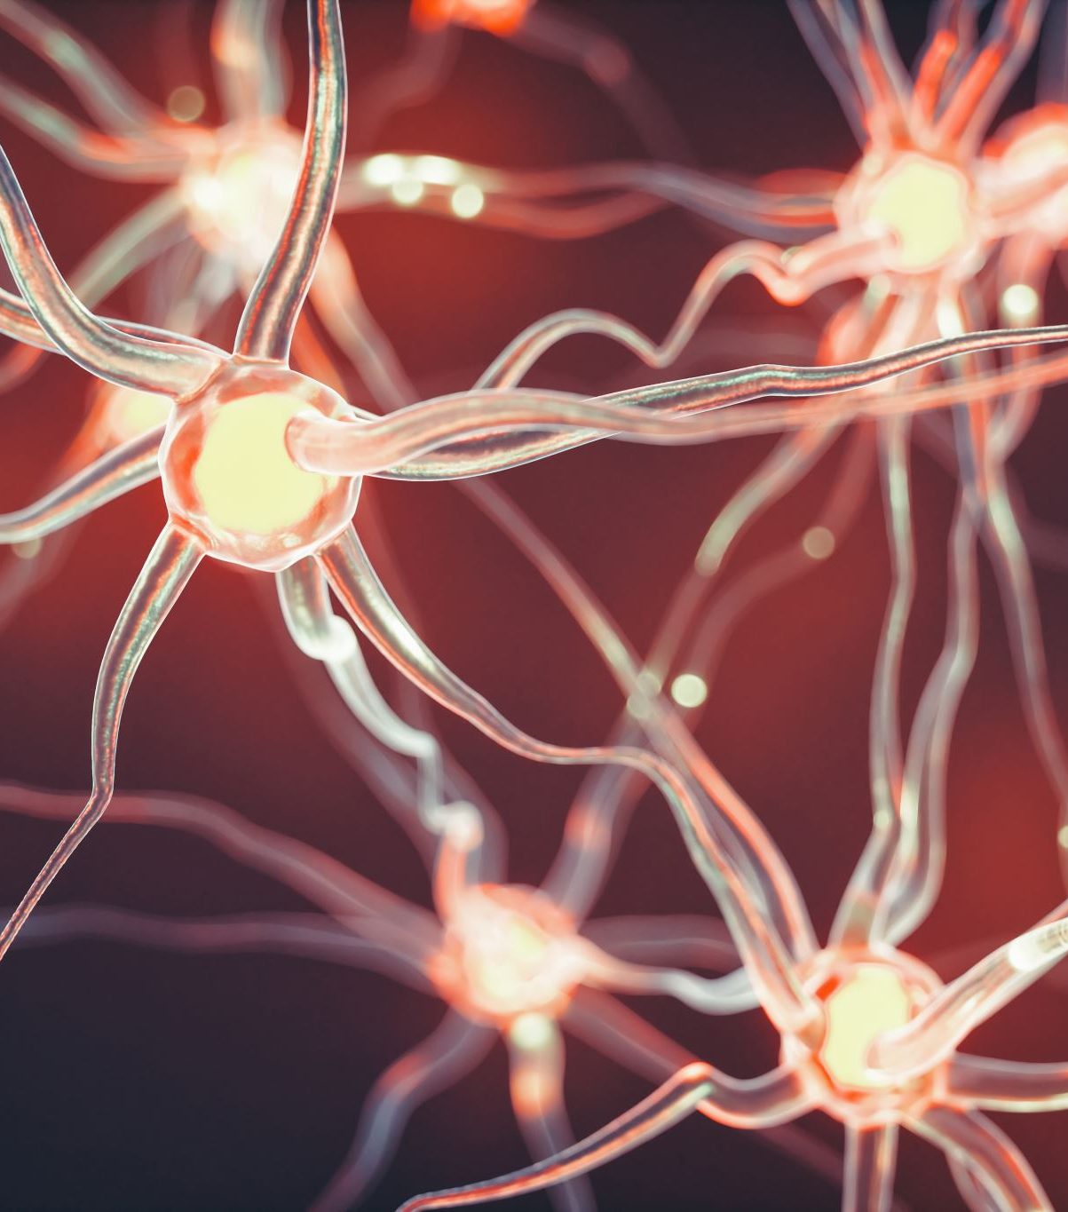
Hippocampal role in the interaction of semantic memory with learning and decision
Florian Leprévost
Prof. Dr. Bianca Wittmann
Justus-Liebig-Universität Gießen –
BION meeting 2022

Slide 2

How does semantic memory affects learning?

Slide 3
1.1 Associative Inference
1. Introduction
A
B
A
C
B
C

Slide 4
1.1 Associative Inference
1. Introduction
(V)MPFC-hippocampus for associative learning
Vmpfc helps (bad if lesion Spalding 2018), sadacca 2018
Dopamine helps (Lee 2021 , Clos 2019)
Role for midbrain dopamine (Shohamy 2018,, 2016)?
Kahnt 2012 FC striqtum hippo imp for généralisation
hPC-mpfc coupling during BC learning, Schlichting 2016
Jones 2012
Striatum – VTA for reinforcement learning
Anterior vs posterior hippocampus?
Anterior H for asso, giovanello 2004
Ant H configural strategy Duncan 2018
Ant H généralisation, Schlichting 2015
Ant H VTA coupling for novelty Cowan 2021
Ant H rpz prototype vs exemplar Bowman 2018
Ant H + episodiv vs post retrieval? Wang 2021
Ant H = pattern separation of non associated memory (RSA) Schlichting 2015
preexisting semantic associations seem to facilitate associative learning, but not for people with hippocampal lesions (Ryan et al., 2016, Pajkert 2017)
New = semantic link between A & B
Already existing link in hippocampus?

Slide 5
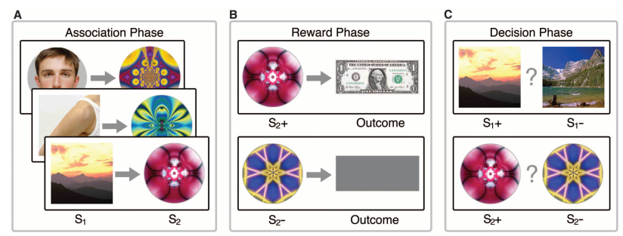
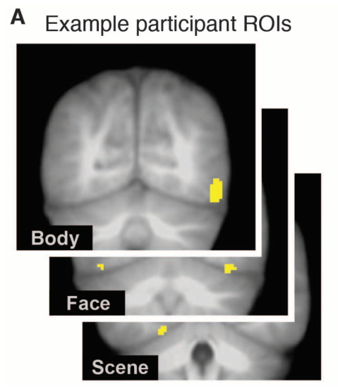
1.2 Paradigm
1. Introduction
Category specific visual areas
Train category classifier
Wimmer & Shohamy 2012

Slide 6
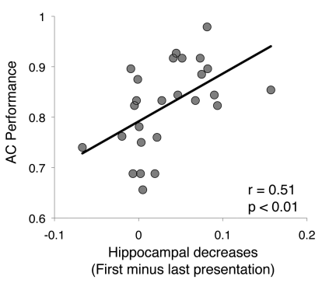
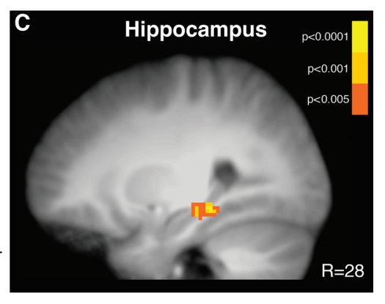
1.2 Paradigm – Association Phase
1. Introduction
Hippocampus activation during learning (A-B) predicts associative performance (in decision phase)
But decreases as learning occurs?
Less hippocampal involvement necessary for semantically linked pairs

Slide 7
1.2 Paradigm – Reward & Decision Phases
1. Introduction
Reactivation in Reward phase predict performance in Decision phase (Wimmer)
Striatum- (a)hippo FC during Reward phase correls with performance in Decision Phase (Wimmer)
Classifier trained to differentiate rewarded vs unrewarded stimuli during Reward phase can accurately classify Decision phase stimuli in OFC(Wang)
OFC-(post)hippo FC correls with reaction times during Decision phase (Wang)
for semantically linked pairs
More reactivation in Reward and Decision phase
Less hippo-striatum FC during reward phase correl w perf
Better decoding of (specific) object in scene activity during

Slide 8
Hypotheses
Reactivation of the associated stim earlier
asso phase
I only need scenes for that so ok?
Reduced functionnal connectivity hippo-striatum and hippo-OFC (because hippo not necessary anymore to recover associated stimulus state)
Mostly reward phase and decision phase?
Bold (a) hippo during Conditionning Phase doesn't predict performance, but another (semantic) region might
Reward phase
Representational similarity might predict performance in hippo/OFC? (state encoding – not in temporal cx otherwise douple dipping)
Asso phase nec for RSA???
Decoding of state and stim - to think about more
Interaction with reward - to think about more - hippo-striatum connectivity, strengthen effect

Slide 9
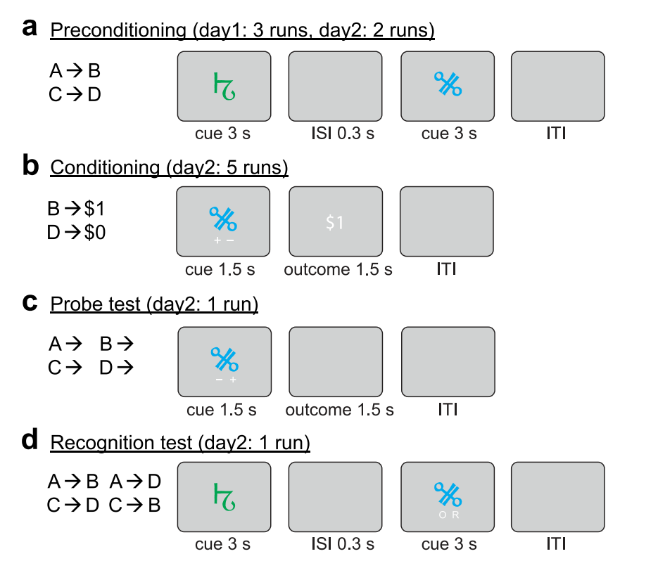

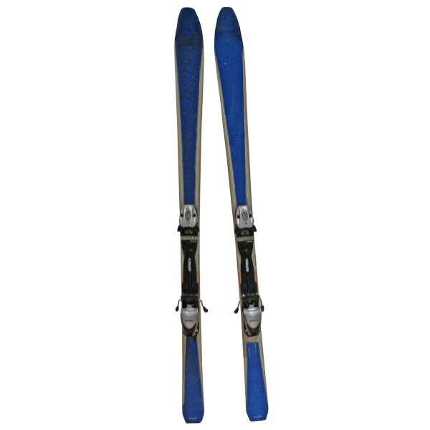

2.1 Design
2. Experiment
Association
Reward
Decision
Localizer
Distractor (avoid recency effects)
Memory

Slide 10
Summary
Association (preconditioning)
16 pairs, each repeated

Slide 11


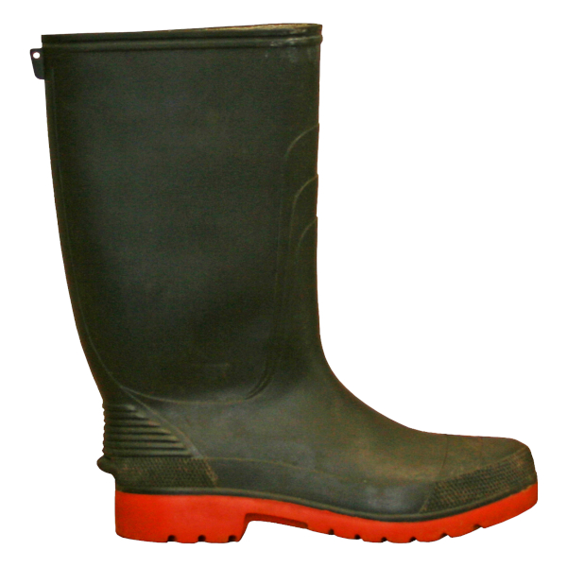

Slide 12
Wang et al. 2020

Slide 16
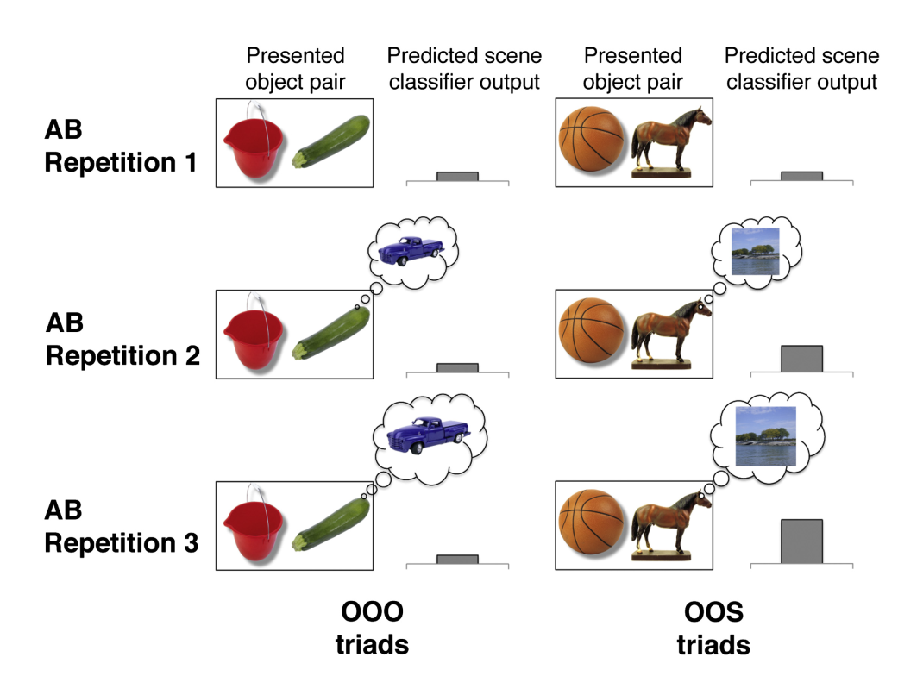
Reactivation of associated stimuli with learning
1. Background
Greater learning-related hippocampal decreases (first - last parameter estimate) across encoding repetitions were associated with greater AC performance at test.
Greater activation increases in VMPFC (last-first parameter estimate) across encoding repetitions were associated with greater AC performance at test

Slide 17
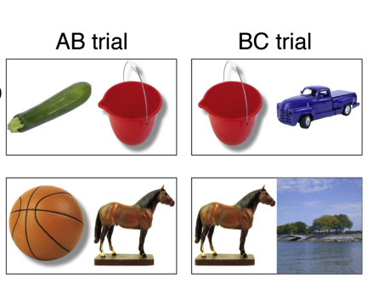
Reactivation of associated stimuli with learning
1. Background
Zeithamova et al 2012
Associative learning OOS
Category specific visual areas
Train category classifier

Slide 18
1.1 Associative Inference
1. Introduction
(V)MPFC-hippocampus for associative learning
Vmpfc helps (bad if lesion Spalding 2018), sadacca 2018, Hart 2020
Wikenheiser 2017 = hippo inactivation less state rpz in OFC
Dopamine helps (Lee 2021 , Clos 2019)
Role for midbrain dopamine (Shohamy 2018,, 2016)?
Kahnt 2012 FC striqtum hippo imp for généralisation
hPC-mpfc coupling during BC learning, Schlichting 2016
Jones 2012
Striatum – VTA for reinforcement learning
Anterior vs posterior hippocampus?
Anterior H for asso, giovanello 2004
Ant H configural strategy Duncan 2018
Ant H généralisation, Schlichting 2015
Ant H VTA coupling for novelty Cowan 2021
Ant H rpz prototype vs exemplar Bowman 2018
Ant H + episodiv vs post retrieval? Wang 2021
Ant H = pattern separation of non associated memory (RSA) Schlichting 2015
preexisting semantic associations seem to facilitate associative learning, but not for people with hippocampal lesions (Ryan et al., 2016, Pajkert 2017)
New = semantic link between A & B
Already existing link in hippocampus?

