Slide 1
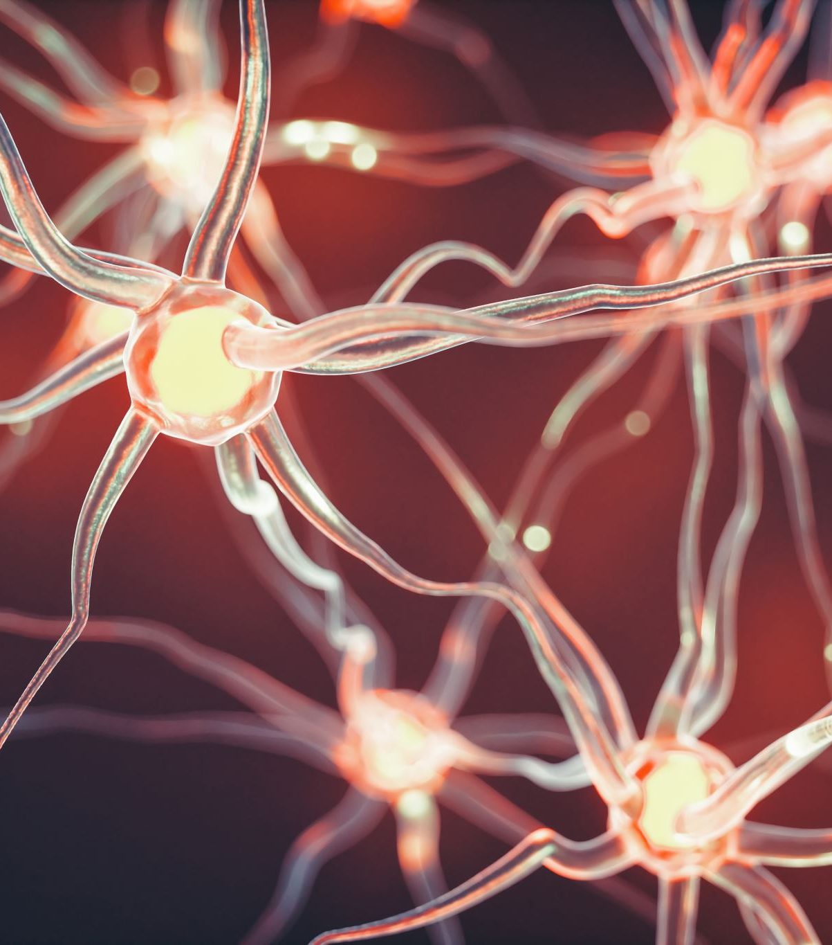
Hippocampal role in the interaction of semantic memory with learning and decision
Florian Leprévost
Prof. Dr. Bianca Wittmann
Justus-Liebig-Universität Gießen –
BION meeting 27.03.2017

Slide 2

How does semantic memory affects learning?

Slide 3
1.1 Associative Inference
1. Introduction
A
B
A
C
B
C

Slide 4
1.1 Associative Inference
1. Introduction
Vmpfc-hippo for abstraction/state
Vmpfc helps (bad if lesion Spalding 2018), sadacca 2018
Dopamine helps (Lee 2021 , Clos 2019)
Role for midbrain dopamine (Shohamy 2018,, 2016
Kahnt 2012 FC striqtum hippo imp for généralisation
hPC-mpfc coupling during BC learning, Schlichting 2016
Striatum – VTA for reinforcement learning
Anterior vs posterior hippocampus?
Anterior H for asso, giovanello 2004
Ant H configural strategy Duncan 2018
Ant H généralisation, Schlichting 2015
Ant H VTA coupling for novelty Cowan 2021
Ant H rpz prototype vs exemplar Bowman 2018
Ant H + episodiv vs post retrieval? Wang 2021
Ant H = pattern separation of non associated memory (RSA) Schlichting 2015
preexisting semantic associations seem to facilitate associative learning, but not for people with hippocampal lesions (Ryan et al., 2016)
New = semantic link between A & B
Already existing link in hippocampus?

Slide 5
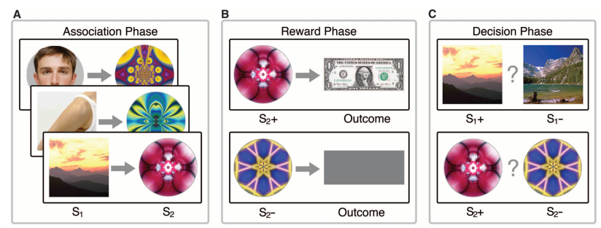
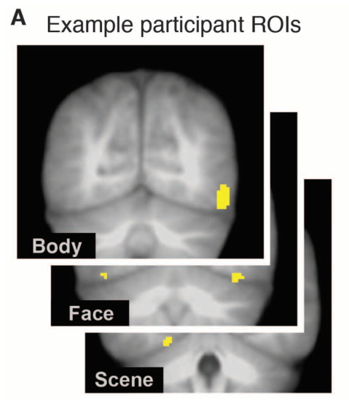
1.2 Paradigm
1. Introduction
Category specific visual areas
Train category classifier
Wimmer & Shohamy 2012

Slide 6
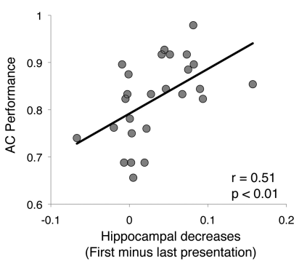
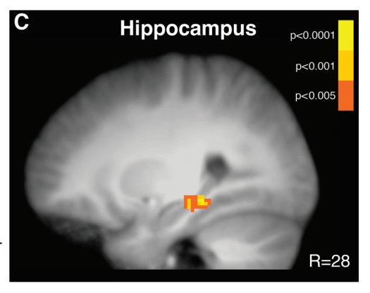
1.2 Paradigm – Association Phase
1. Introduction
Hippocampus activation during learning (A-B) predicts associative performance (in decision phase)
But decreases as learning occurs?
Less hippocampal involvement necessary for semantically linked pairs

Slide 7
1.2 Paradigm – Reward & Decision Phases
1. Introduction
Reactivation predict performance in Decision phase (Wimmer)
Striatum- hippo FC correls with performance in Decision Phase (Wimmer)
Classifier trained to differentiate rewarded vs unrewarded stimuli during Reward phase can accurately classify Decision phase stimuli in OFC(Wang)
OFC-hippo FC correls with reaction times during Decision phase (Wang)

Slide 8
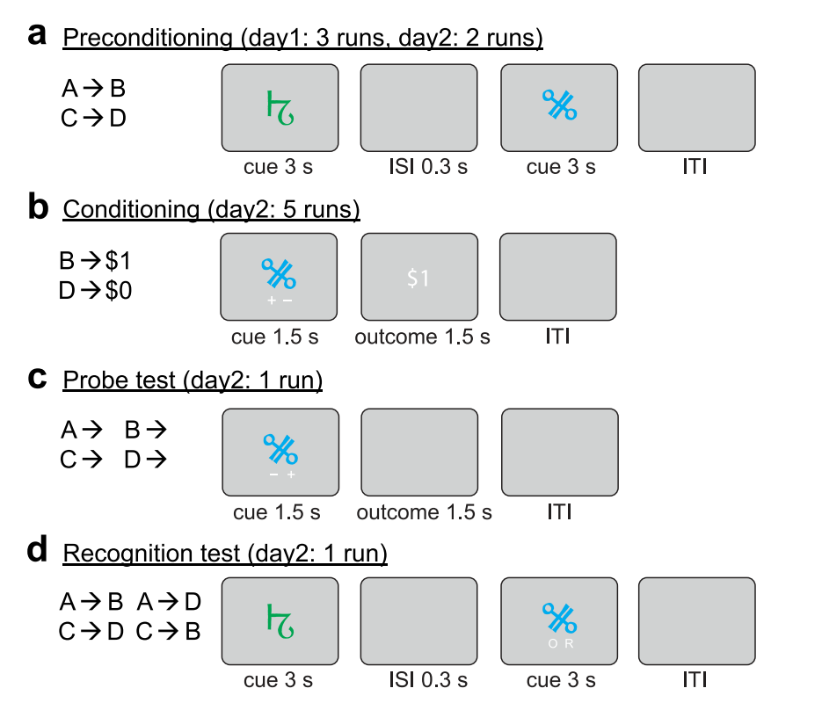

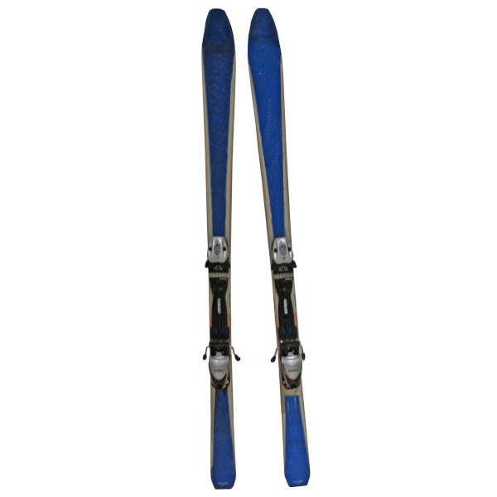

2.1 Design
2. Experiment
Association
Reward
Decision
Localizer
Distractor (avoid recency effects)
Memory

Slide 9


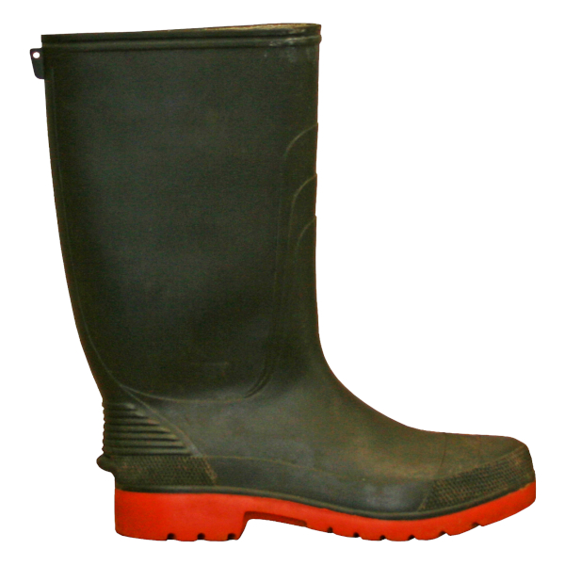

Slide 10
Wang et al. 2020

Slide 14
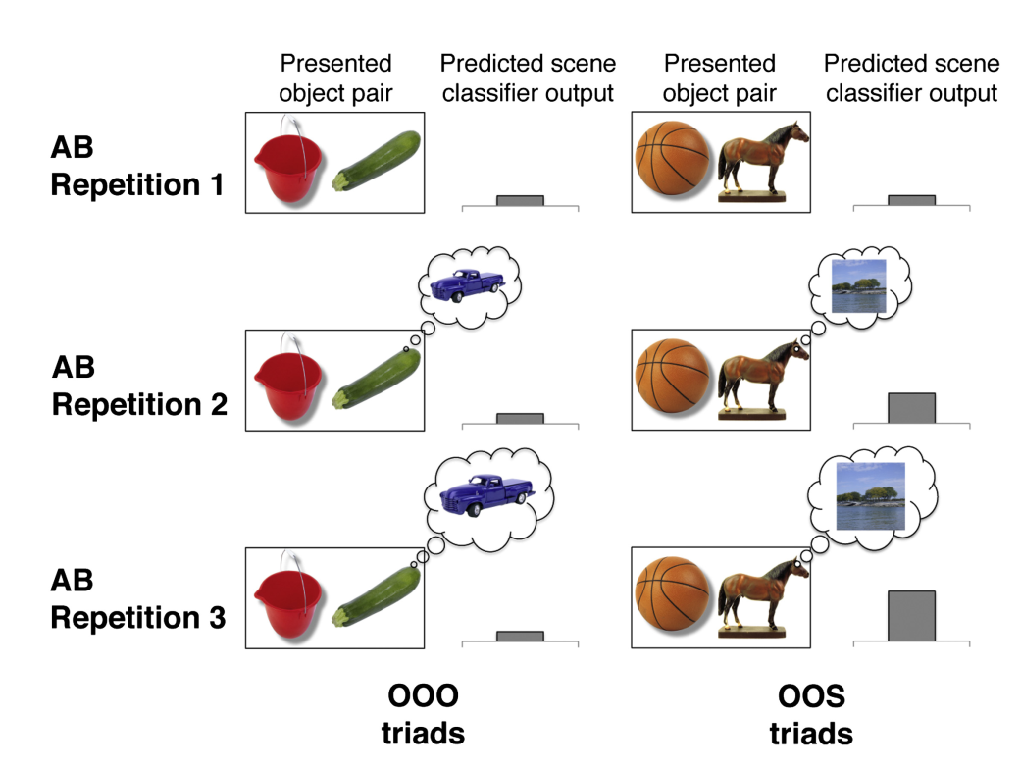
Reactivation of associated stimuli with learning
1. Background
Greater learning-related hippocampal decreases (first - last parameter estimate) across encoding repetitions were associated with greater AC performance at test.
Greater activation increases in VMPFC (last-first parameter estimate) across encoding repetitions were associated with greater AC performance at test

Slide 15
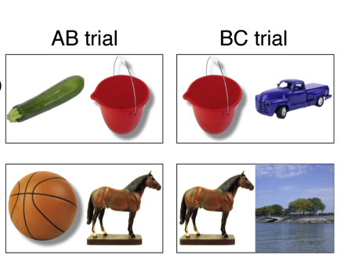
Reactivation of associated stimuli with learning
1. Background
Zeithamova et al 2012
Associative learning OOS
Category specific visual areas
Train category classifier

