Slide 1
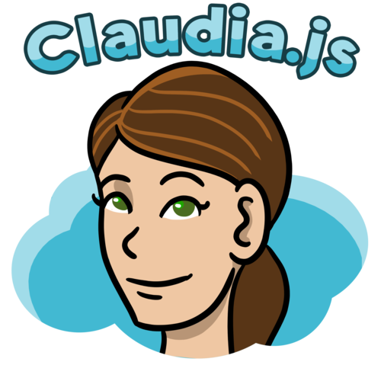
Management Summary
AWS Lambda and API Gateway can be tedious to set up.
Claudia.js makes it easy to deploy Node.js projects to AWS Lambda and API Gateway.
It automates all the error-prone deployment and configuration tasks.
Deploy and update using a single command. Claudia is just a deployment tool, without runtime dependencies. (claudia create, claudia update)
Skip all the boilerplate and focus on the code.
Manage multiple versions at the same time.
Build a Web API endpoint in just a few lines of code.
Test Lambdas directly from the command line.
Claudia.js is completely free.
Notes:
It automates all the error-prone deployment and configuration tasks, and sets up the way JavaScript developers excepect out of the box

