Slide 1
Partial reconfiguration on IOT device
Android on zynq featuring updateable FPGA-accellerated image processing and hashing
Ing. Andreas Dejmek, BSc
Christoph Grafl
Florian Muttenthaler, BSc
Benedikt Tutzer, BSc
Institute of Computer Technology
TU Wien
Notes:
1

Slide 2
Project
Zedboard: Xilinx Zynq developement board
Android OS
Output over HDMI
Input from USB-Touchscreen
Image processing app with programmable-logic accelerated algorithms
Server to retrieve updates to accelerators
programmable-logic hashing to verify the received bitstream
Dynamic partial reconfiguration of the programmable-logic

Slide 3
Android on Zynq
Issues with Android:
Hardware requirements for versions after android 2.3.7 not met
Older versions require out-of-date toolchain versions that are hard to find
Official repository shut down
Solutions:
Build on Ubuntu 12.04 (from 2012)
Use the cross-compiling toolchain from Xilinx ISE 14.4 (from 2012)
Use fork on github by use aimeemikaelac
Notes:
Hardware requirements not met:
ZedBoard only has 512mb RAM → Not enough (could be solved by using SWAP memory, but SWAP on SD-cards is very very slow)
No GPU. Even 2.3.7 is slow, people that got higher versions running (with SWAP memory) encountered unusable graphical user interfaces

Slide 4
Android on Zynq
Issues with custom Logic on the Zedboard
Reference Design out of date. Builds neither with current tools nor with tools from 2012
Cannot create custom Bitstream
u-boot requires tools not available in Ubuntu 12.04
Solutions:
Build using Xilinx ISE 14.4, but with some IP cores from Xilinx ISE 14.1
Build some tools (make, device-tree-compiler) from source
Notes:
We could have designed our own hardware design in Vivado, but this was deemed to be too much work for the short time we had available, since it must be designed with Linux compatibility in mind and none of us had the background knowledge to do that
Tools required by u-boot: right device tree compiler (dtc) version
Make 3.81 is required to build android, since there are some syntax errors in it’s makefiles and 3.82+ versions are more restrictive and generate errors

Slide 5
Final Software Setup
Linux Kernel Version 3.6 from Digilent
Configured to support Android
Configured to support Dynamic Partial Reconfiguration (DPR)
Configured to support USB Touchscreens
Android 2.3.7 customized for ZedBoard by Iveia
Distributed by aimeemikaelac
No Touchscreen support
Android app to trigger DPR, hashing entity and image filters
Kernel Modules to interface Hardware Logic
Notes:
Linux kernel can be configured with “make menuconfig”
Necessary configuration for Android found at https://elinux.org/Zedboard_Android
Necessary configuration for touchscreens is straight-forward
Iveia shut down their repositories for some reason
Touch issues: Touchscreen is detected fine by Linux, so no hardware incompatibility. Events are detected by android (android has a built-in getevent utility) but never dispatched to the GUI. The same happens with a mouse, which should be supported out-of-box. I tried to trace where the events are lost: They are enqueued by native code to be picked up by the dalvik virtual machine, but the VM never picks them up

Slide 6
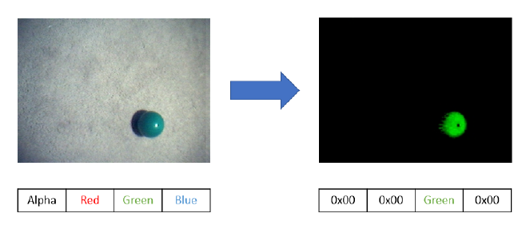
Image Filters

Slide 7
Image Filters
Using Xilinx Platform Studio for creating 3 different IPs with common AXI Interface
Implemented Linux Kernel Device Driver, which writes and reads raw ARGB Data from a .bin file and triggers the filter processes

Slide 8
Data Streaming
Filters are stored on a server and made accessible to client devices
Server
Stores and distribute bitstreams
Python 3, Flask
RESTful API
Create-Read-Update-Delete(CRUD)
Client
Native android app
Poll server periodically
Download bitstream
Reconfigure fabric

Slide 9
Data Streaming
Server-Client communication over HTTP
RESTful Server API:
HTTP GET /api/repos/soc_lab
Return all information about repo ‚soc_lab‘
HTTP POST /api/repos/another_soc_lab_repo + Data
Create a new repo ‚another_soc_lab_repo‘
HTTP PUT /api/repos/soc_lab + Data
Create or update a repo ‚soc_lab‘
HTTP DELETE /api/repos/soc_lab
Delete repo ‚soc_lab‘

Slide 10


Data Streaming
Client polls server for information
http:// … /api/soc_lab
Server returns relevant information from Database(version,changelog,filepath…)
Client compares his version with server version
Download bitstream, if not up to date
http:// … /api/download/<filepath>
Verify bitstream integrity
Match checksum
Reconfigure FPGA fabric

Slide 11
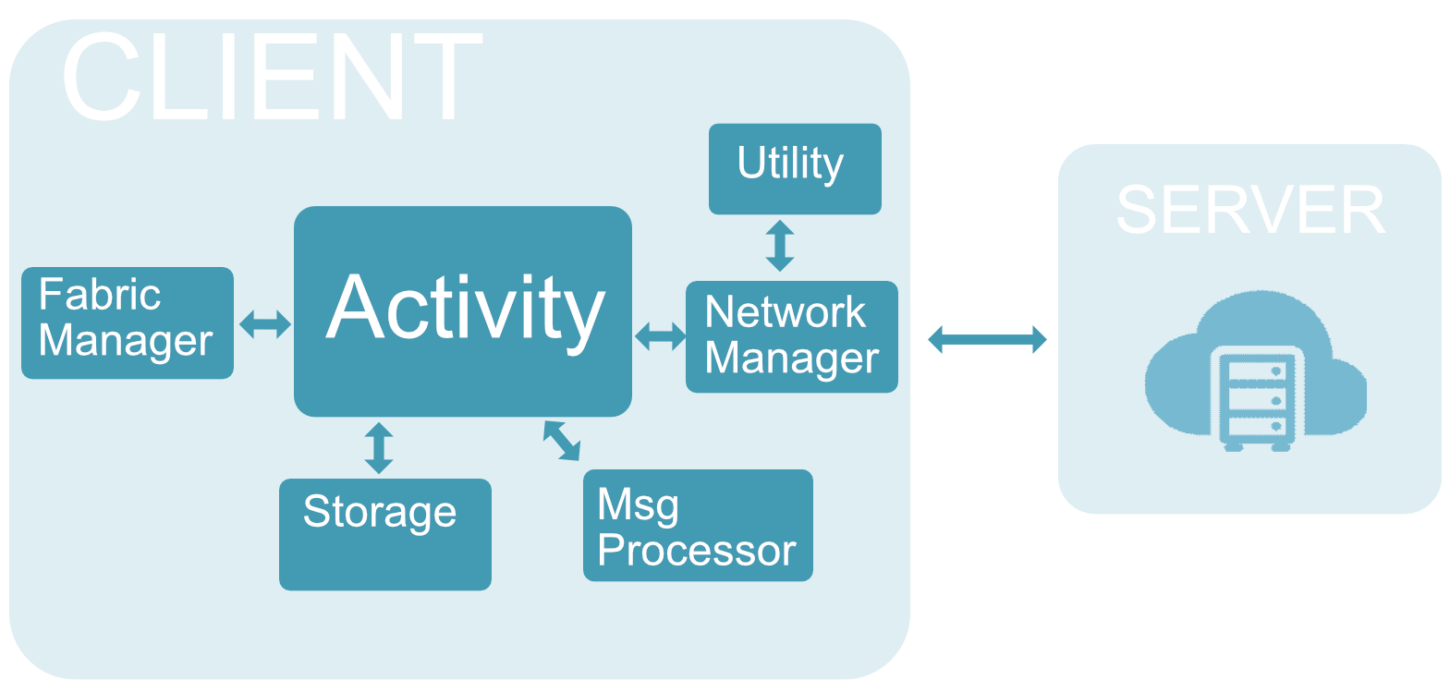
Data Streaming
Client Architecture

Slide 12
Data Streaming
Flow:
Activity configures Network Manager
Network Manager polls server for information
Received JSON File will be forwared to Msg Processor
Msg Processor retriev information from JSON file, compare bitstream version. Informs Activity if new bitstream is available.
Activity will initiate download through Network Manager.
Msg Processor check md5 from downloaded file
Save bitstream to disk
Fabric Manager forwards bitstream to ?OS?

Slide 13
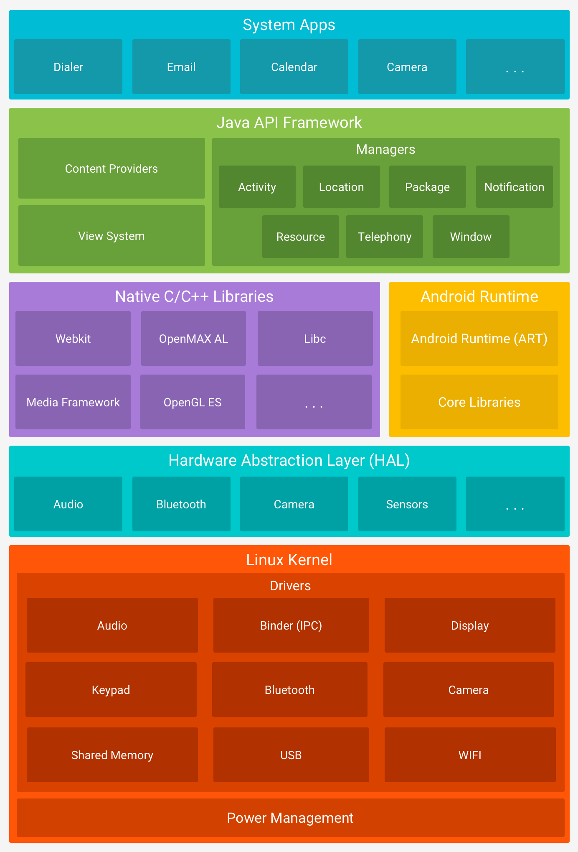
Data Streaming
Problems:
OS handles address allocation
Only access to virtual memory space

Slide 14
Created simple PR project for Zedboard
Consists of one PR region with two modules
LED shift left
LED shift right
Bitstreams generated but not tested yet

Slide 15
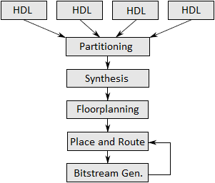
Partial reconfiguration
PR project flow (GUI based)

Slide 16
Control PR – two approaches
Control over Android
Using xdevcfg library
Supported in our Android version?
Load Bitstream from memory to PL over PCAP

Slide 17
Control PR – two approaches
Control over IP core
Using Partial Reconfiguration Controller v1.2
Android trigger the start of reconfiguration
IP load Bitstream from memory to PL over ICAP

Slide 18
FPGA fabric partitioning
Static portion
Control for image processing
Blake2b hash entity
(IP core PR controller ?)
Dynamic portion
Red filter
Green filter
Blue filter

Slide 19
Thank you for your attention

