Slide 1
Recap SW 4 Monday
Oechslin Florian
Brücker Stefan

Slide 2
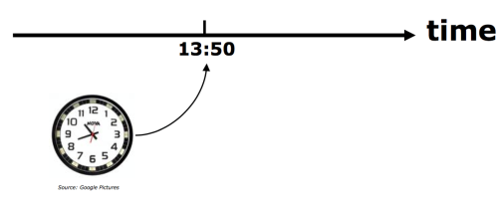
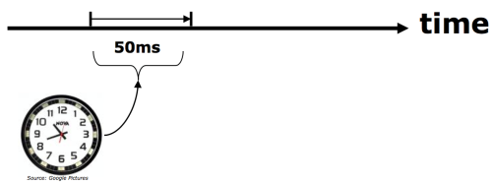
Clock & Timer
Realtime Systems Categories
Absolute
Relative

Slide 3
Clock Sources
External Crystal
External Oscillator
Internal Clock
 | FRDM | ROBO
Core Clock | 48MHz | 120MHz
Bus Clock | 24MHz | 60MHz
External Crystal | 8MHz | 8MHz

Slide 4
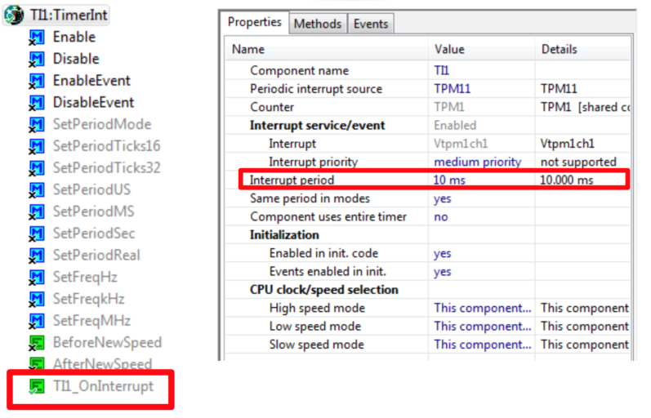
Timer
Notes:
No Low Power Timer.

Slide 5
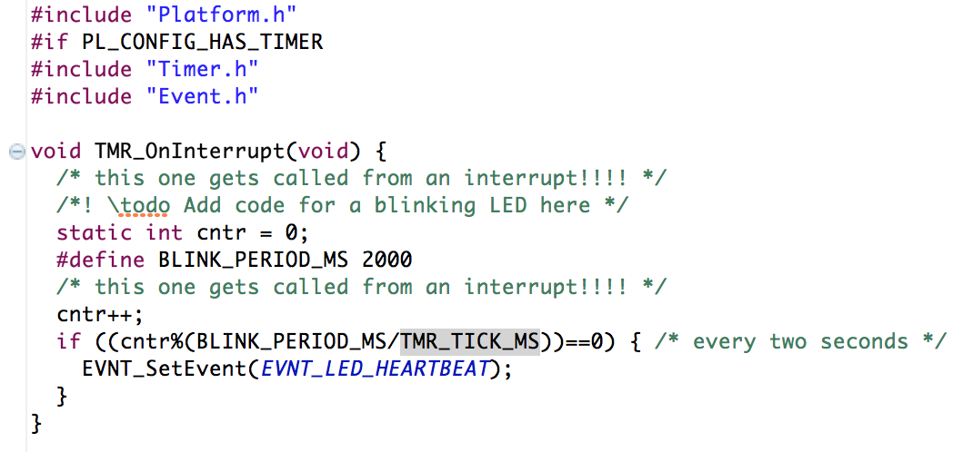
Timer Example
Notes:
TMR_TICK_MS 10 ms. Cntr muss nicht auf 0 zurückgesetzt werden wenn die Variable überläuft fängt sie widr von 0 an. unsigned

Slide 6
Questions
The two realtime systems categories?
The three different clock sources?
Why we don‘t have to reset the „cntr“ variable after the blink period?

Slide 7
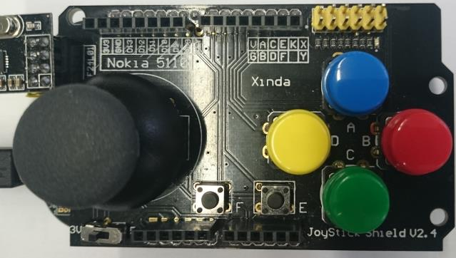
Push Buttons
Test point
Map
Test points
A
B
3.3V !
F
E
D
C
Key

Slide 8
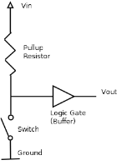
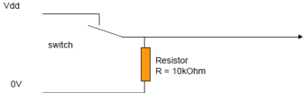
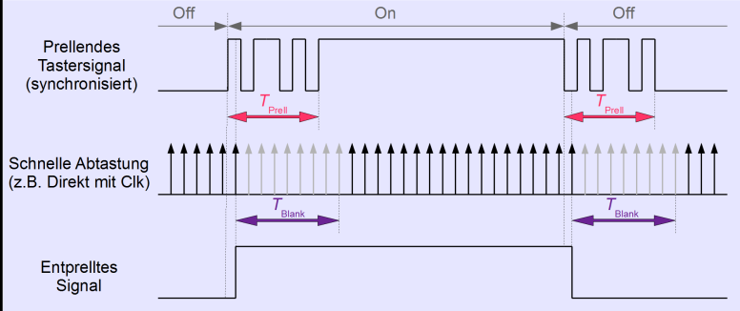
Pull-up / Pull-down, Debounce
Pull-down resistor
Pull-up resistor

Slide 9
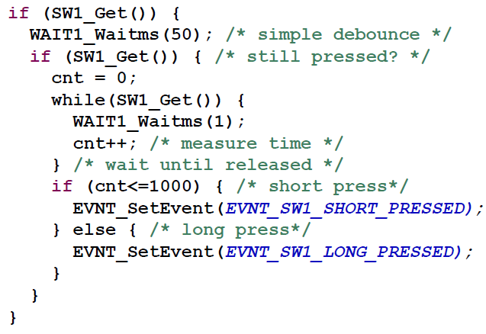
Synchronization – simple
+ simple
implemenation
+ detection of long
push actions
- Blocking of
of other buttons

Slide 10
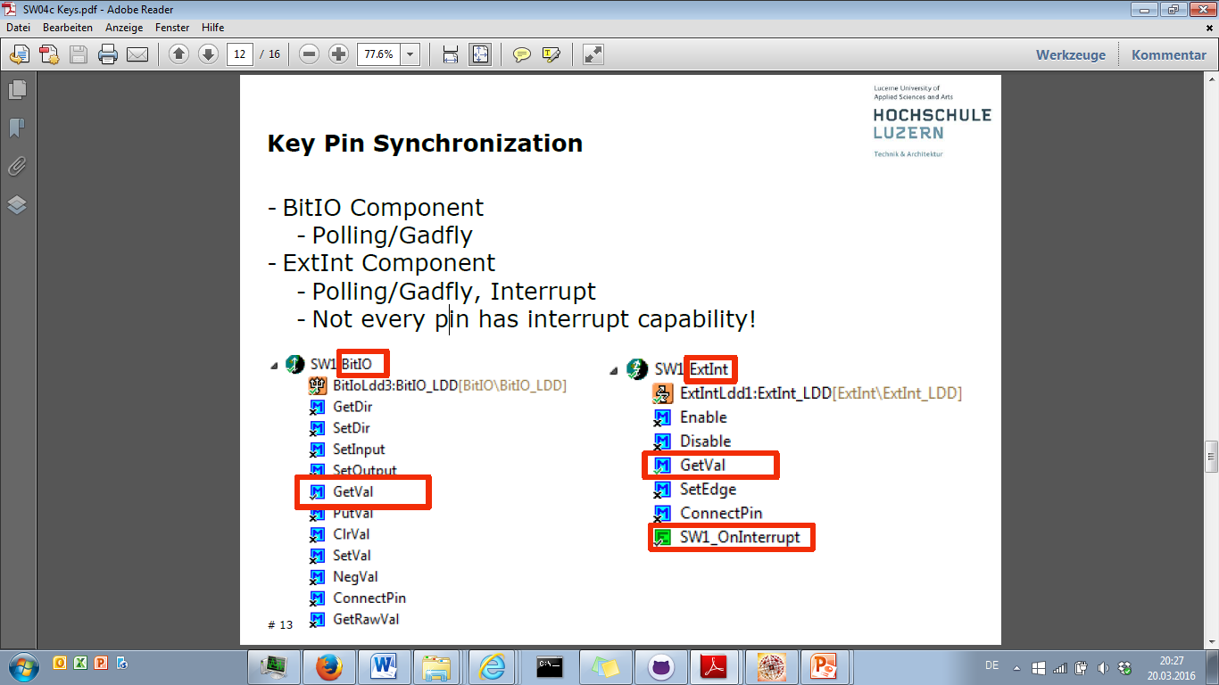
Key Pin Synchronization
BitIo Component
- Polling / Gadfly
- using as an ouput-pin
ExtInt Component
- Interrupt

Slide 11
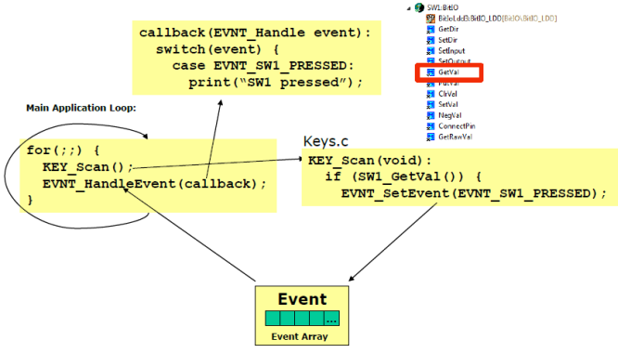
Synchronization – BitIO
For buttons we us polling…

Slide 12
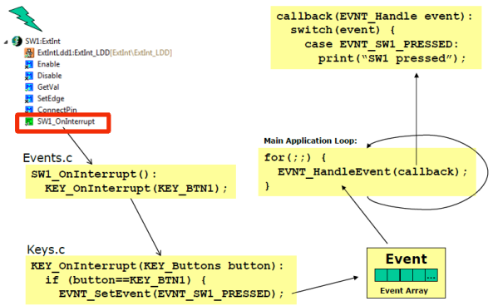
Synchronisation - ExtInt
…. And interrupts for all the other things!

Slide 13
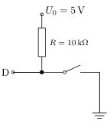
Questions
Is this a pull-up or pull-down resistor?
What is the disadvantage of simple polling without PE?
Which PE we use for interrupts-synchronization?

