Slide 1

Applied Data Science Capstone Project - Coursera
Finding the perfect neighborhood for your family trip to Canada

Slide 2





Overview
Proposal:
Let‘s go to Canada for a few days to relax!
Problem:
Where exactly should we go so everyone is happy?
Solution:
Location ranking!

Slide 3
Steps
Retrieving data on canadian neighborhoods
Cleaning and preparing the data
Visualizing on a Map
Utilizing Foursquare venues
Ranking the neighborhoods
Finding the neighborhood that is just right

Slide 4
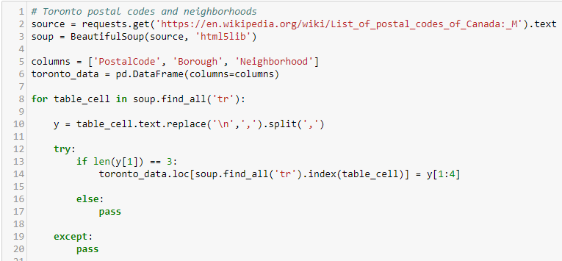
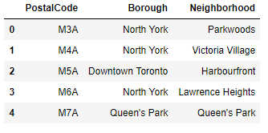
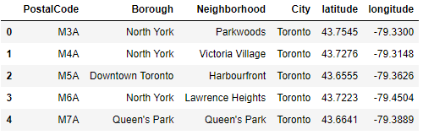
Data collection
Wikipedia – scraping postal codes and neighborhood names¹⁾
Geonames – latitude and longitude by postal code
Foursquare – venues and their location
1) Focusing on Toronto, Montreal, Vancouver, Edmonton and Calgary

Slide 5
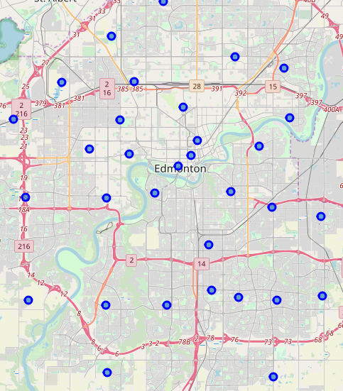
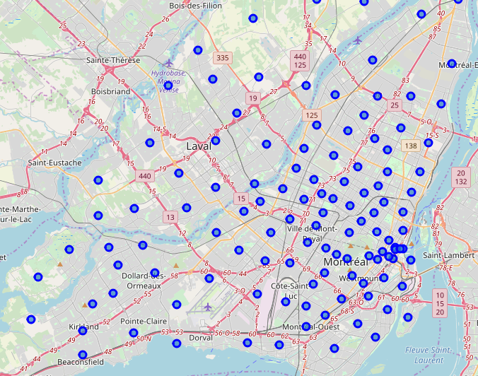
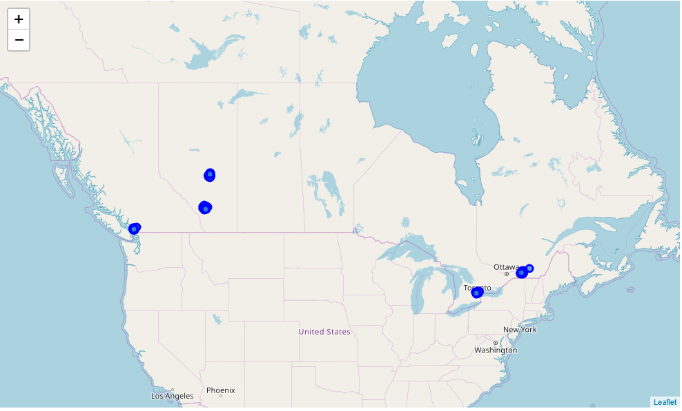
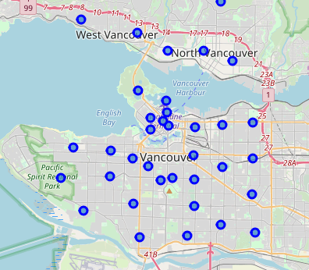
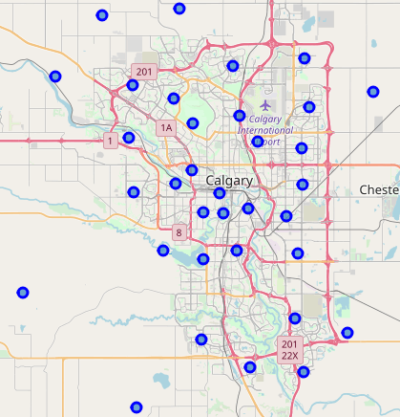
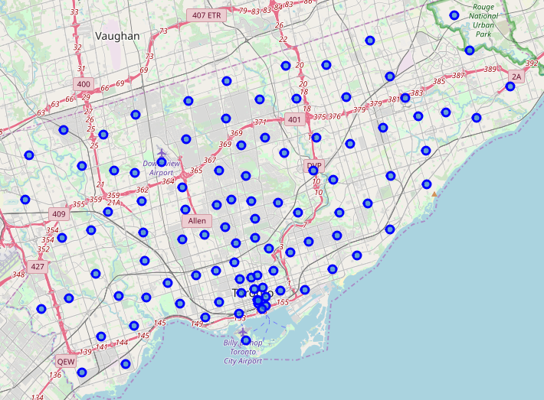
Neighborhoods on a map
Canada
Montreal
Edmonton
Vancouver
Calgary
Toronto

Slide 6
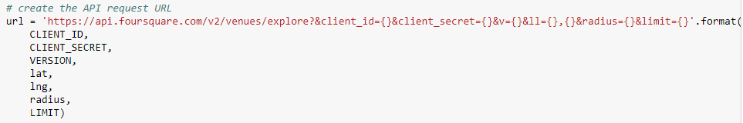
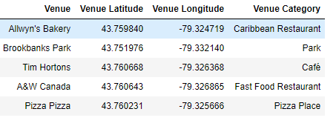

Foursquare venues
Top 100 venues within a 750m radius
One-hot-encoding to find venue categories by neighborhood

Slide 7
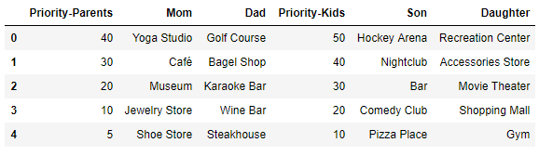
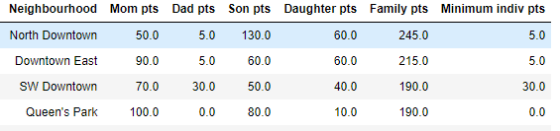
Ranking the neighborhoods
’Stereotypical‘ preferences
Score neighborhoods²⁾
Find highest score
2) Only includes neighborhoods with a venue of category hotel / hostel / inn. Occurances of a venue category within a neighborhood are scored only once per family member.

Slide 8
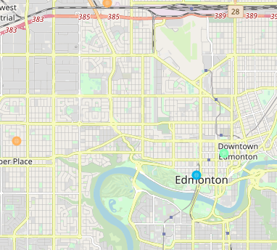
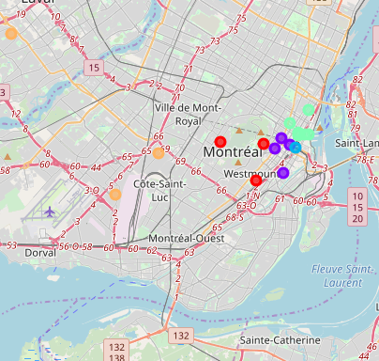
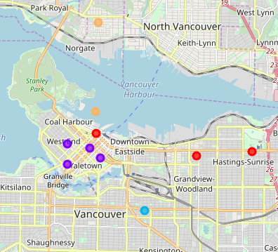
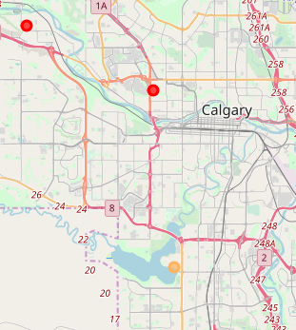
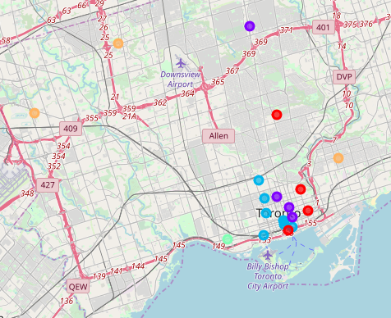
Cluster the neighborhoods
K-Clusters³⁾: 5
3: Highest score
1: Above average score
2: Average score
0: Below average score
4: Lowest score
Edmonton
Montreal
Vancouver
Calgary
Toronto
3) Clustering based on individual family members‘ as well as combined scores.

Slide 9
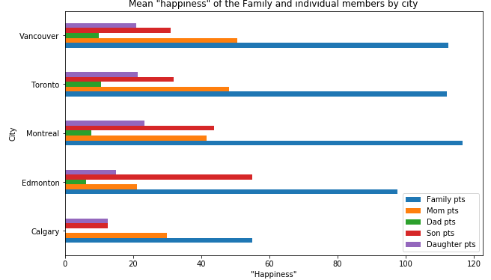
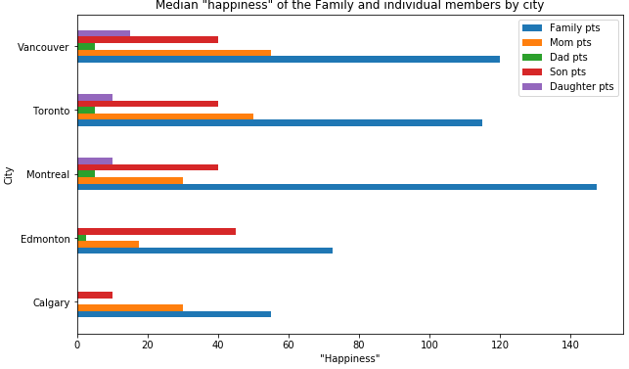
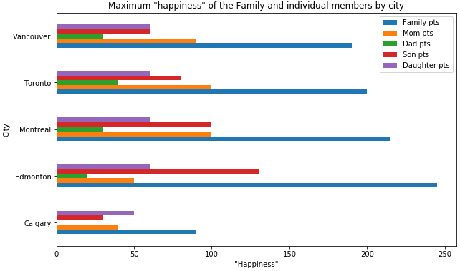
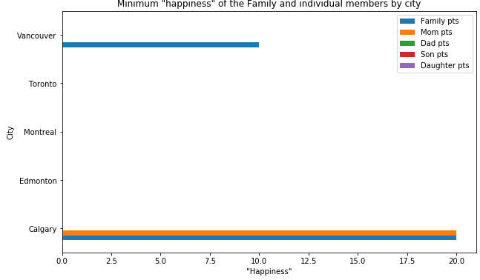
Happiness visualization by city

Slide 10

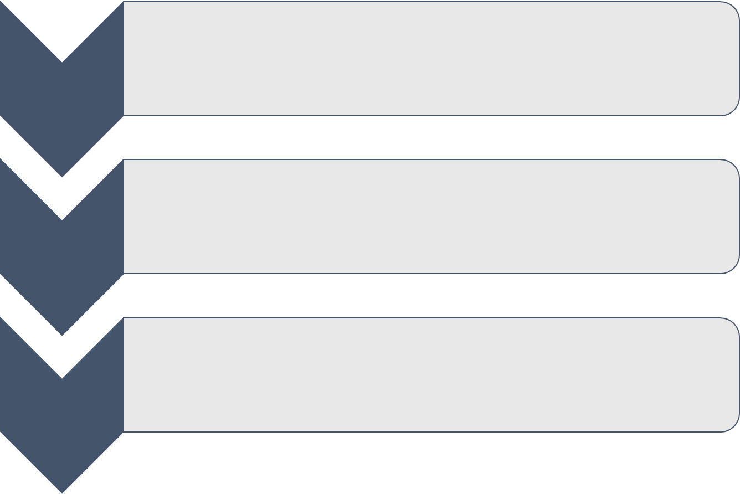


Conclusion
1

