Slide 1
Analyzing specific humidity
Florian Pausewang
Florian.pausewang@gmail.com

Slide 2
Data
Reanalysis Data overview: https://wiki.mpimet.mpg.de/doku.php?id=observations:reanalysis
Download Merra Data:
Dataset: MERRA-2 instM_3d_asm_Np: 3d,Monthly mean,Instantaneous,Pressure-Level,Assimilation,Assimilated Meteorological Fields V5.12.4 (M2IMNPASM)
ink to Dataset: https://disc.gsfc.nasa.gov/datasets/M2IMNPASM_5.12.4/summary
Link to wget instructions: https://disc.gsfc.nasa.gov/information/documents?title=Data%20Access#windows_wget
Download JR55 Data
Dataset: JRA-55 Monthly Mean 1.25 Degree Isobaric Average Diagnostic Fields
WGet Script from Website and to convert grip2nc: cdo -f nc --eccodes copy input out.nc
Get Merra2 2D Surface Data:
MERRA-2 instM_2d_asm_Nx: 2d,Monthly mean,Single-Level,Assimilation,Single-Level Diagnostics V5.12.4
Link to Dataset: https://disc.gsfc.nasa.gov/datasets/M2IMNXASM_5.12.4/summary?keywords=instM
Download JR55 2D Surface Values:
Name: JRA-55 Monthly Mean 1.25 Degree Surface Analysis Fields

Slide 3
Data
Downladed data:
./work/mh0066/m301053/Data/
Maximal time span RH SH T data in:
MERRA2: ./MERRA2_instM_3d_asm_Np_all/MERRA2_* (~130 files)
JRA-55: ./JRA-55_Monthly_1.25_Deg_isobaric_sh/*.nc (3 files)

Slide 4
Method to convert SH2RH
https://www.radiativetransfer.org/misc/typhon/doc/generated/typhon.physics.e_eq_mixed_mk.html#typhon.physics.e_eq_mixed_mk
https://www.radiativetransfer.org/misc/typhon/doc/generated/typhon.physics.vmr2relative_humidity.html#typhon.physics.vmr2relative_humidity
Equvalent to (but works in 3D)
https://github.com/atmtools/konrad/blob/main/konrad/physics.py

Slide 5
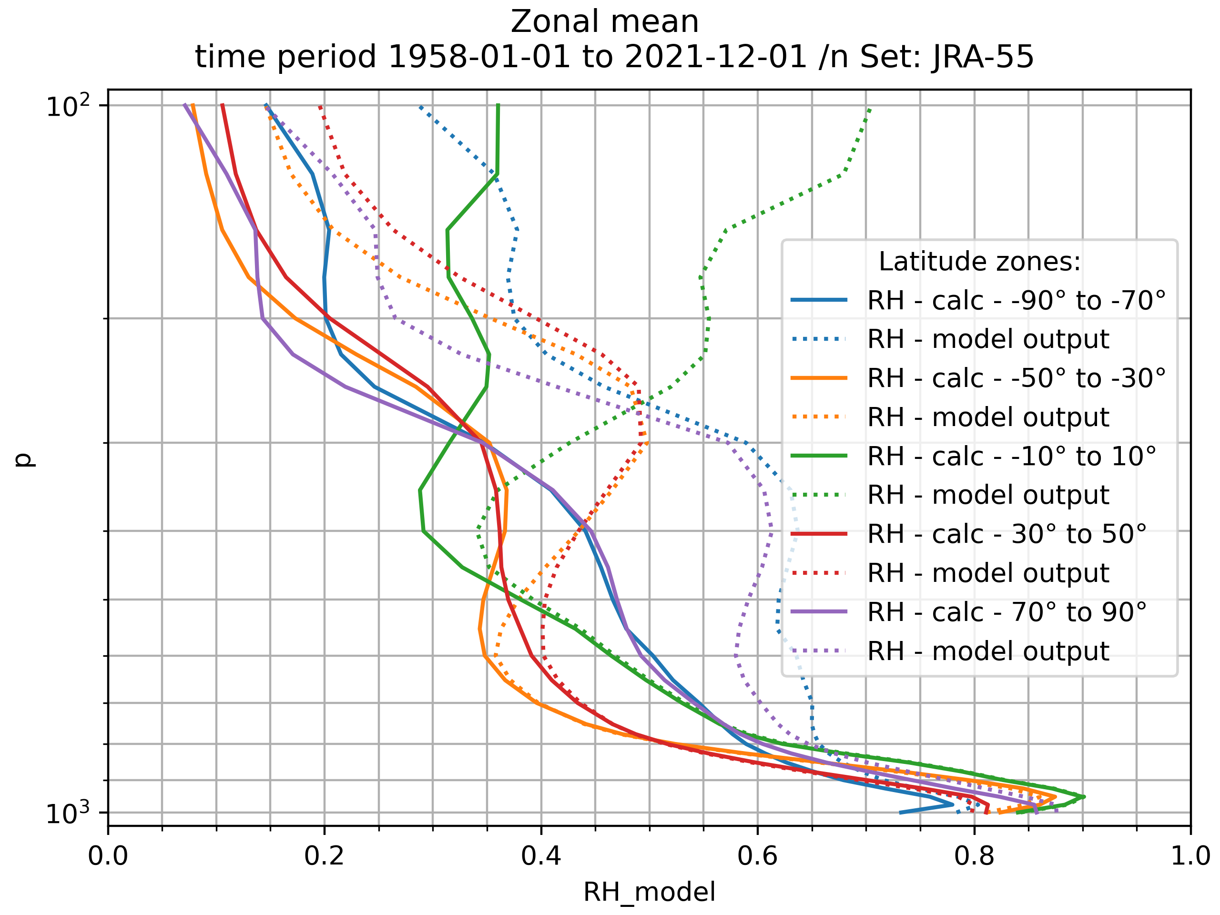

Slide 6
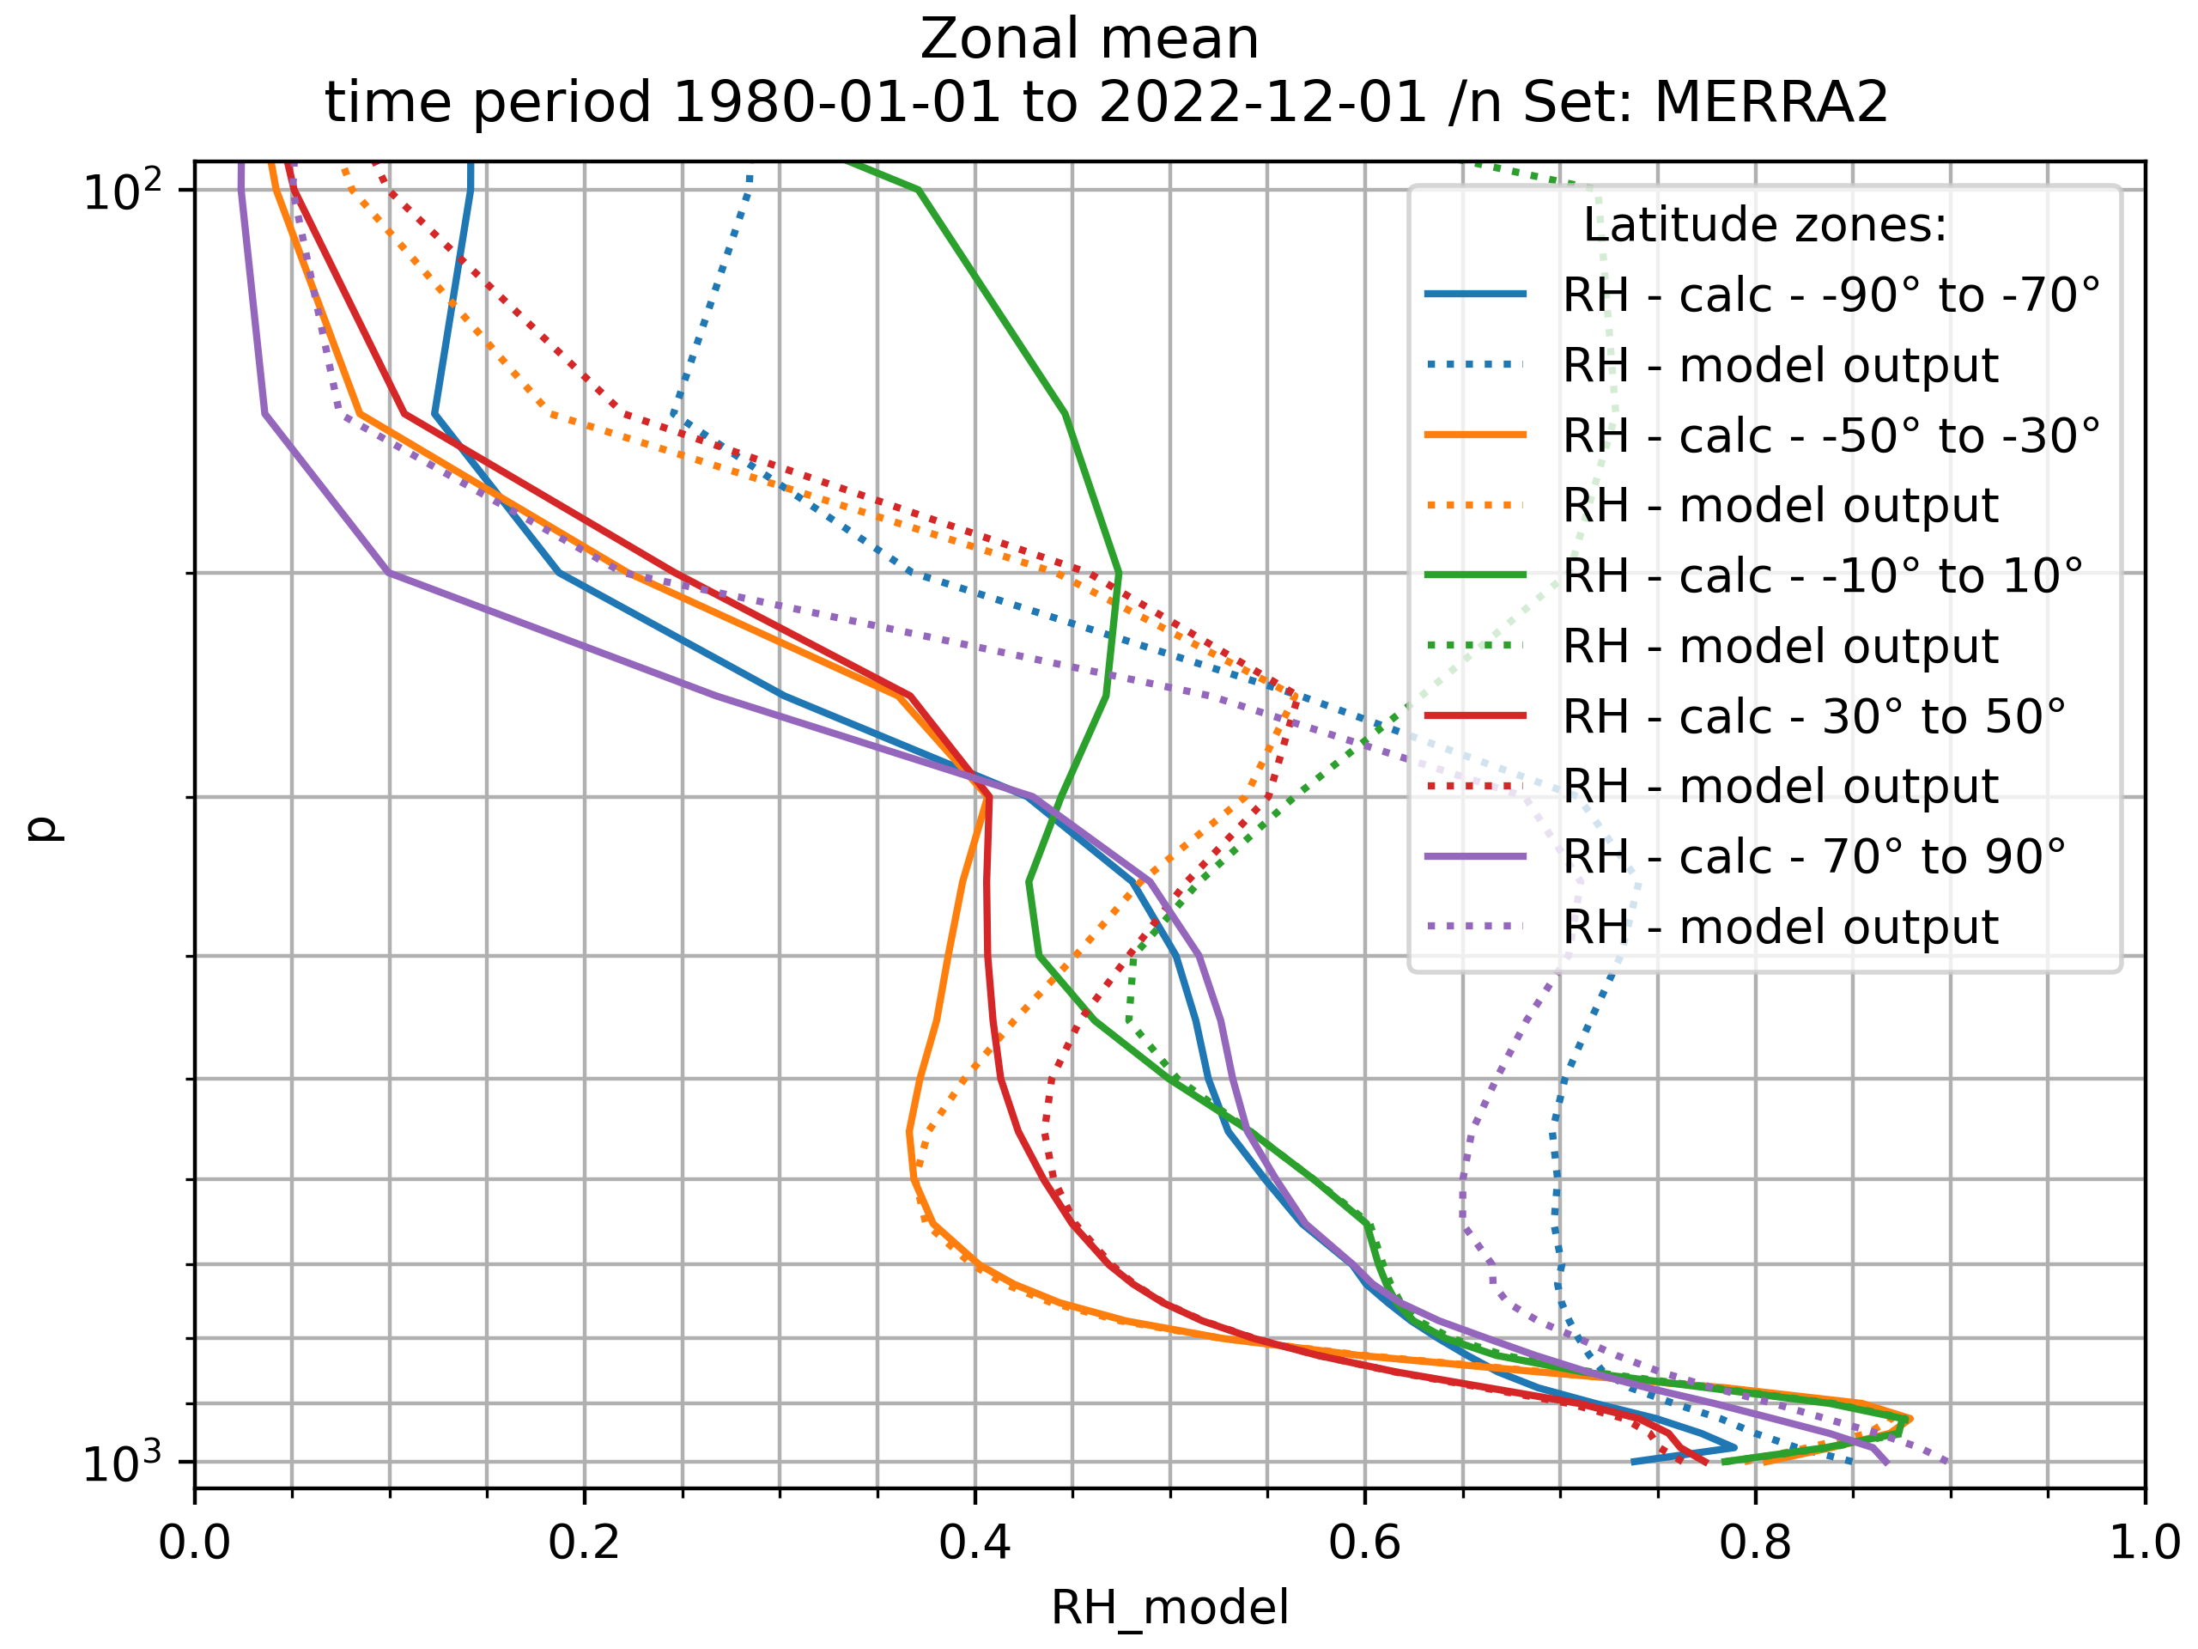

Slide 7
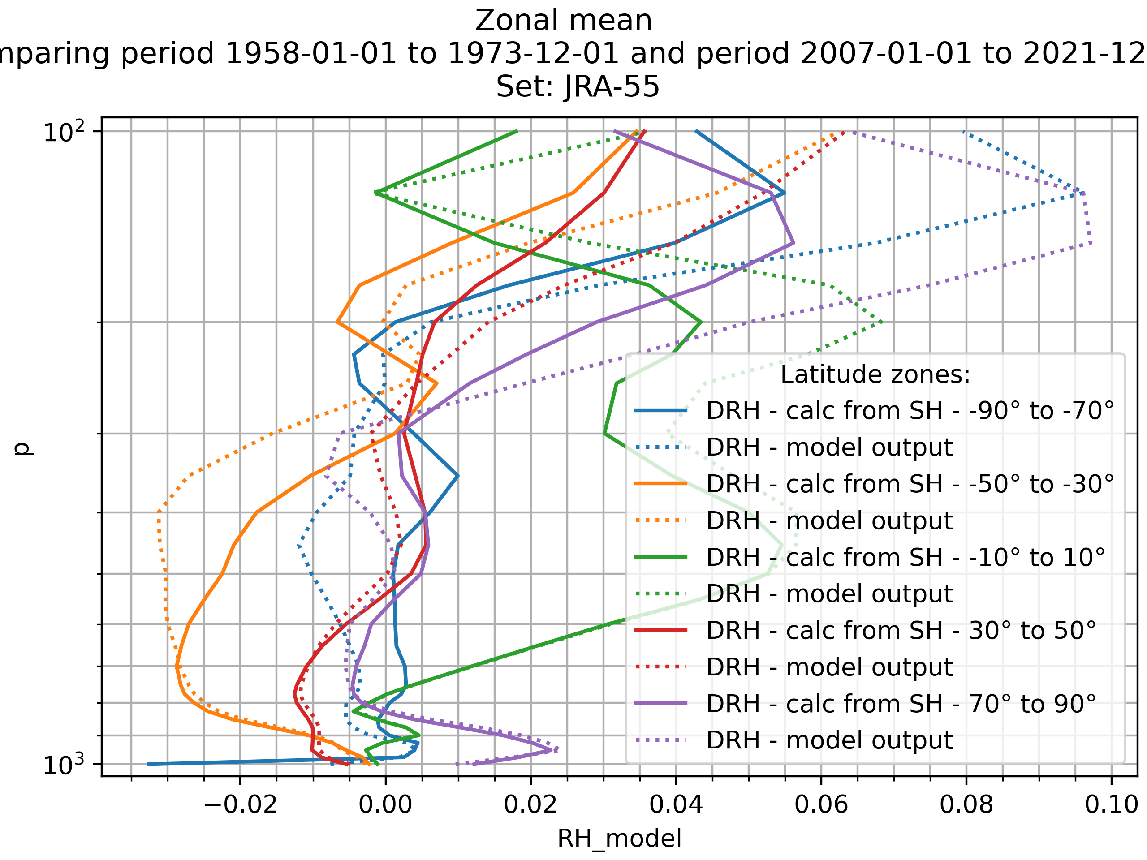

Slide 8
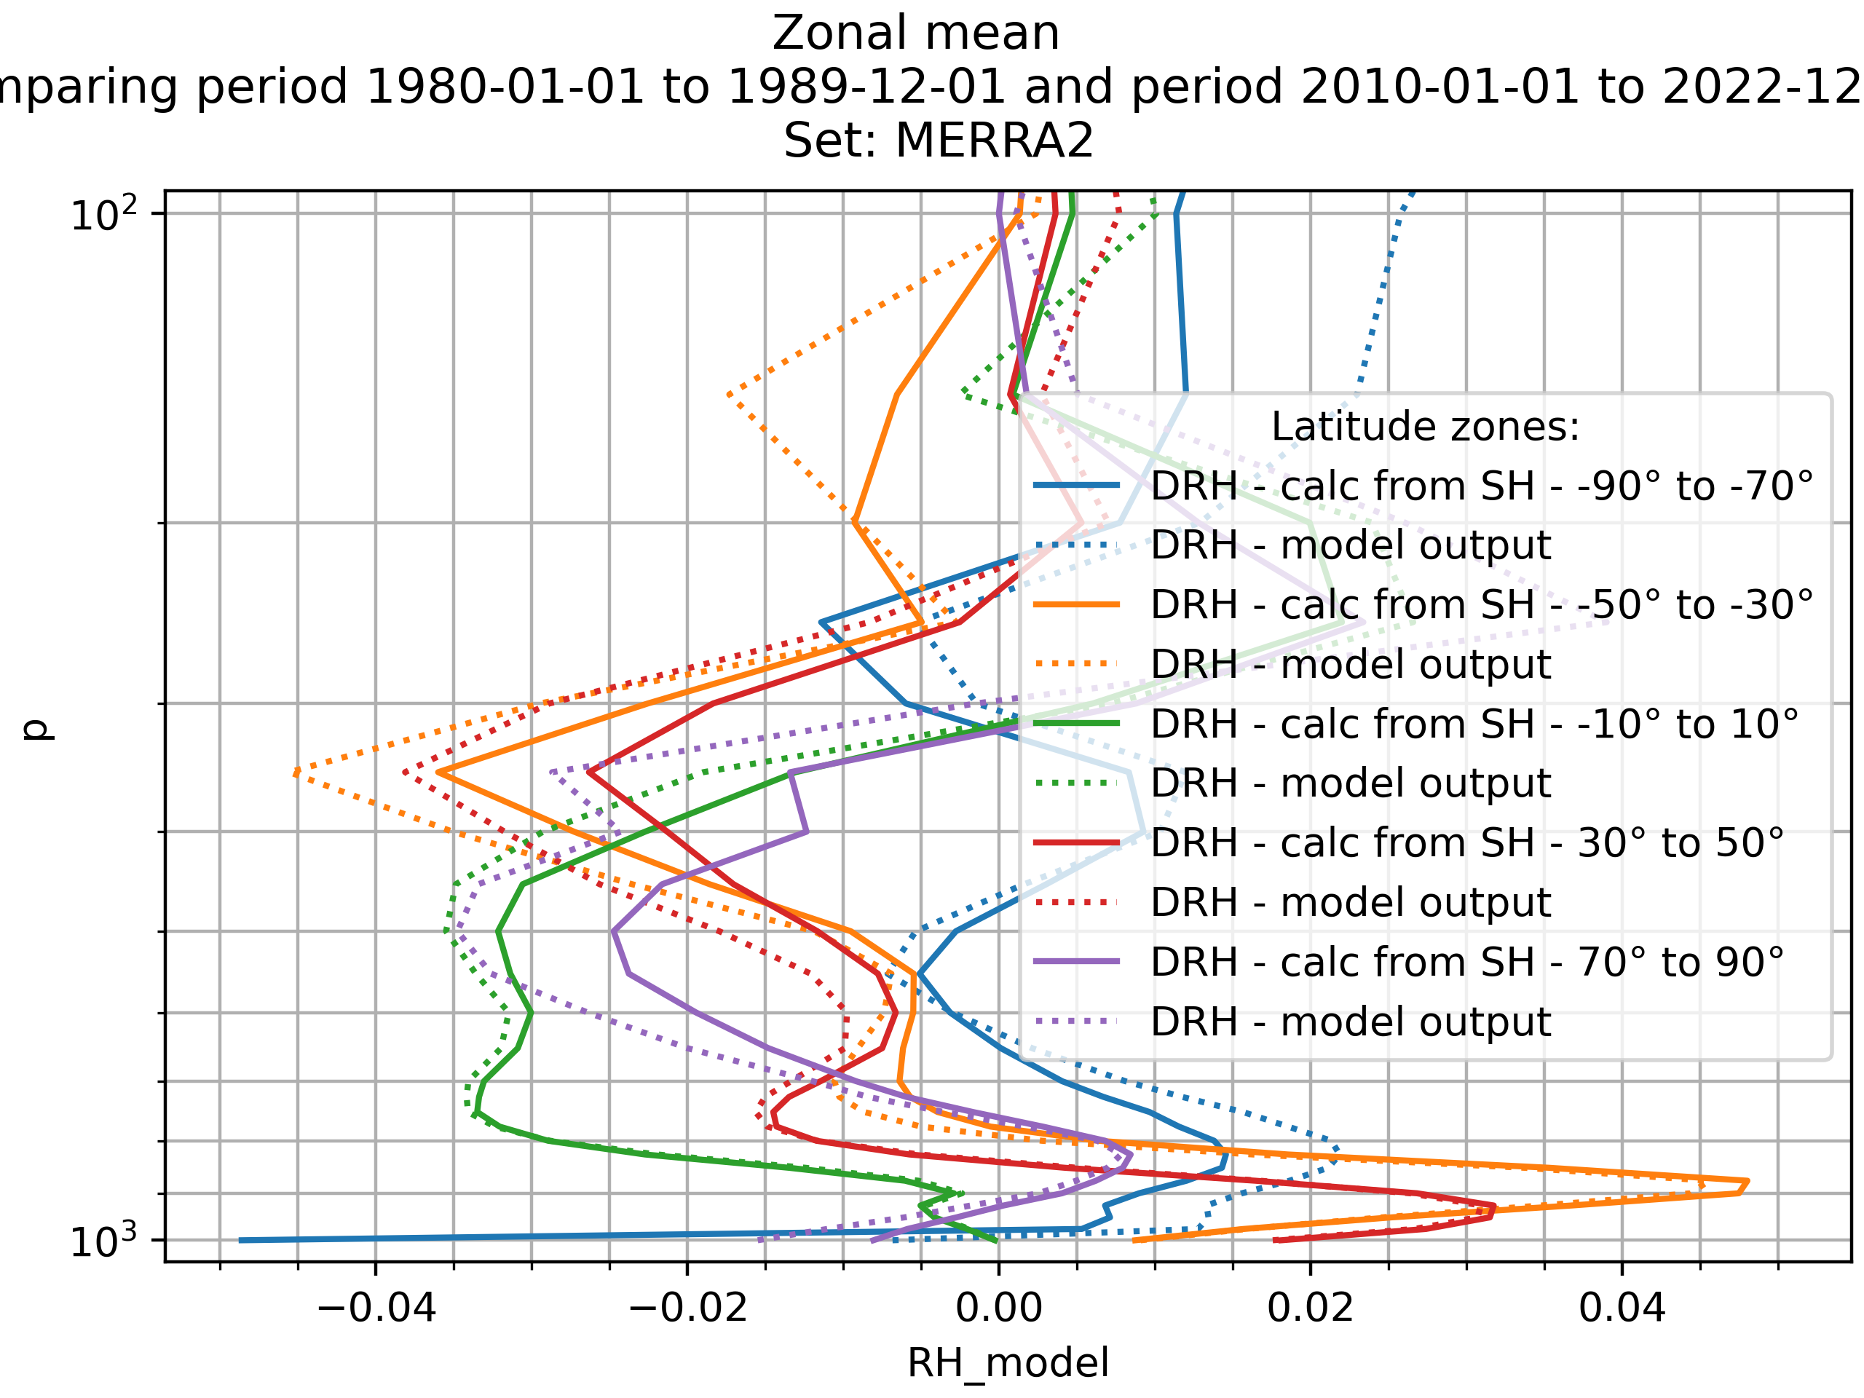

Slide 9
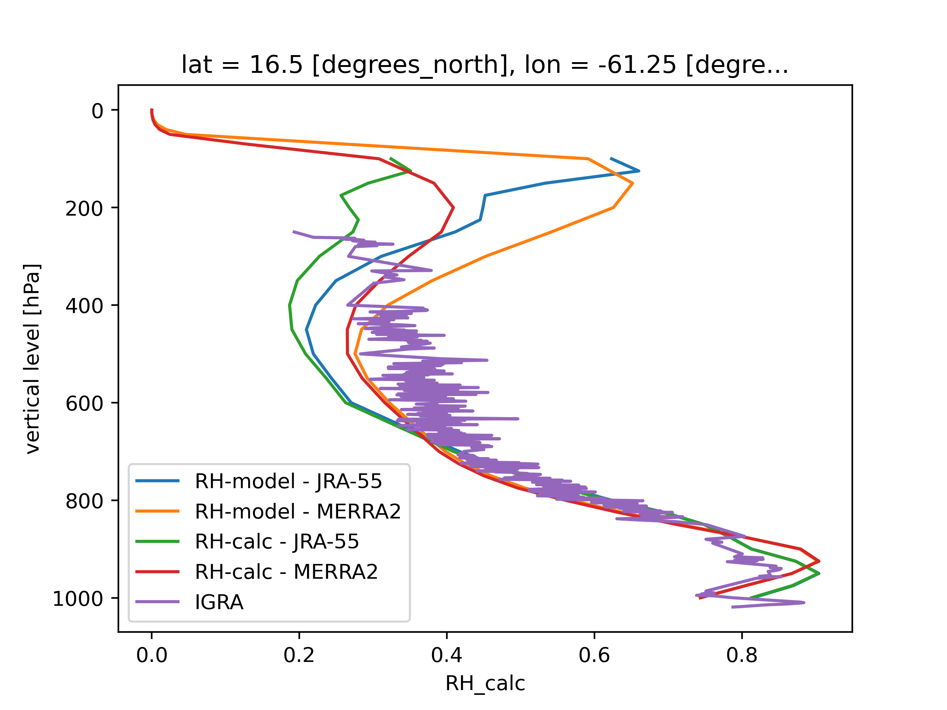
Comparison to radiosonde IGRA

Slide 10
