Slide 1
Market analysis of the districts of London

Slide 2
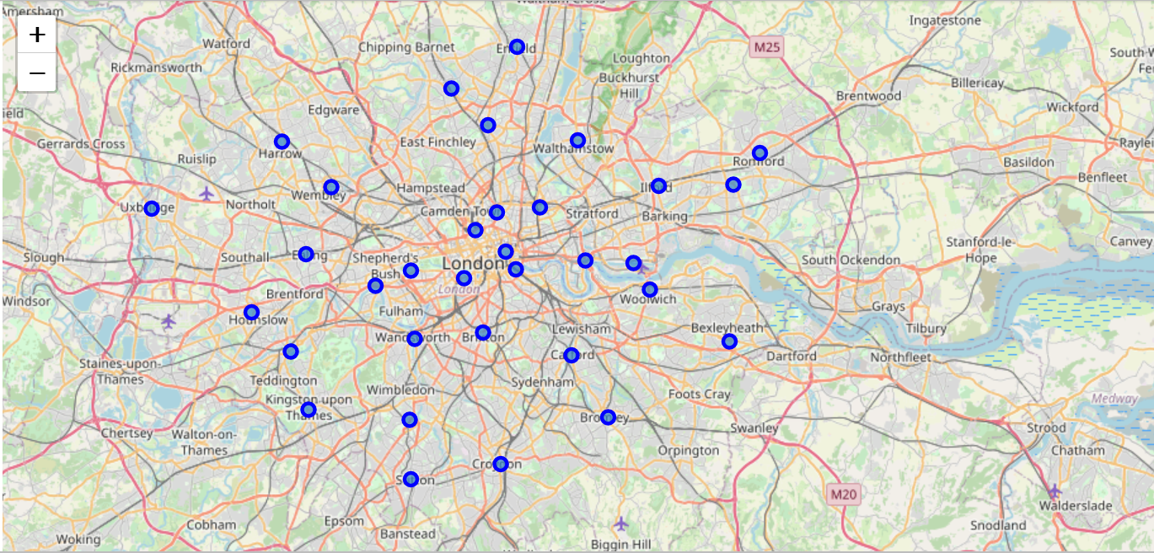
Situation: There are 32 boroughs in London (12 inner and 20 outer ones)
1. Introduction
Aim: Find the best location for a business project,
e.g. open a shop
Method: k-means algorithm to group boroughs into clusters and thus reduce
complexity of the problem

Slide 3
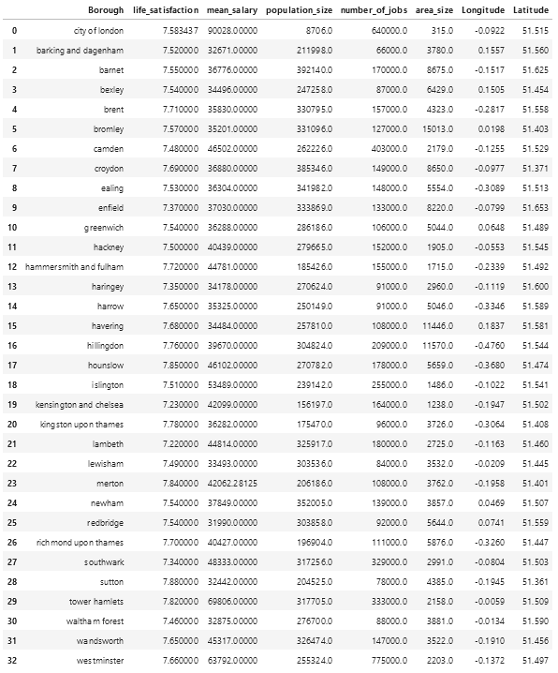
2. Data
Sources:
kaggle for information about mean salary,
population size, life satisfaction, numbe of
jobs and area size:
https://www.kaggle.com/justinas/housing-in-london
Wikipedia for information about geographical
coordinates of the boroughs:
www.wikipedia.org/wiki/List_of_London_boroughs
Foursquare API for information about common
venues in each borough:
https://developer.foursquare.com/

Slide 4
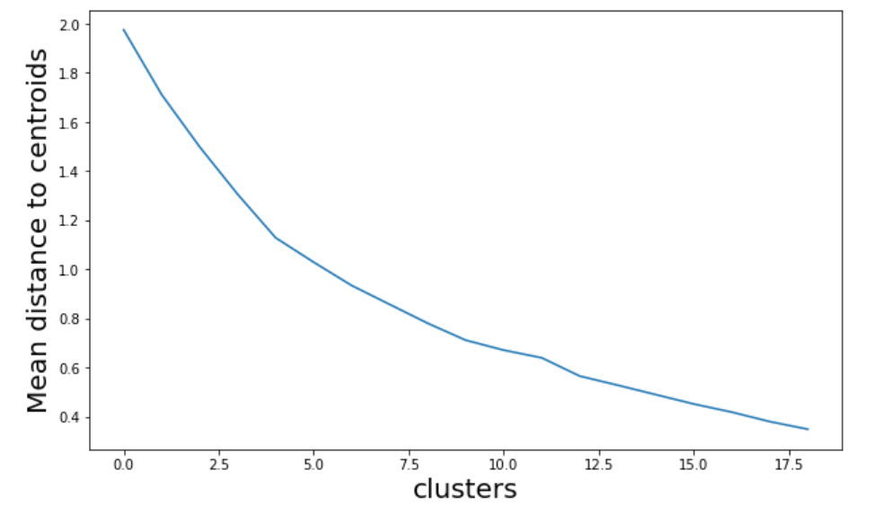
3. Method
K-means algorithm
unsupervised clustering algorithm
use elbow method to determine optimal value of k
Best value of k: k=4

Slide 5
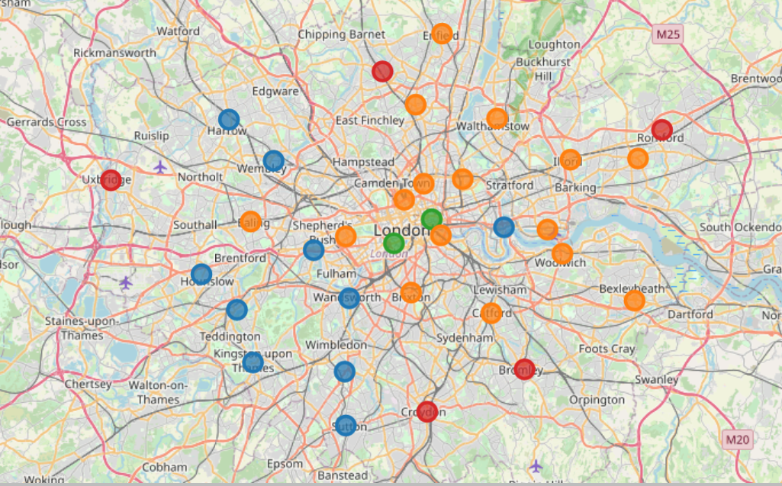
3. Results
We find four unique clusters

Slide 6
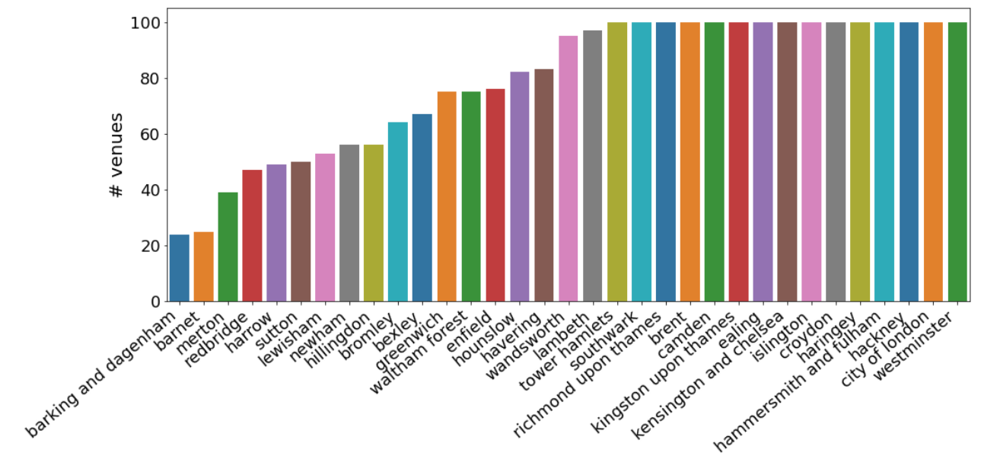
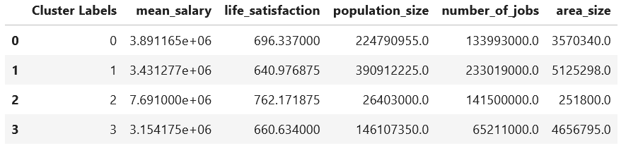
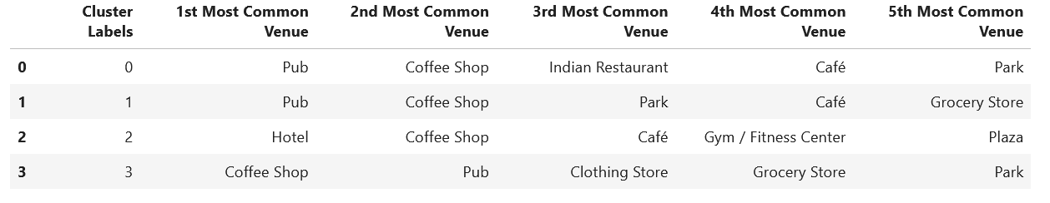
3. Results
We find four unique clusters

Slide 7
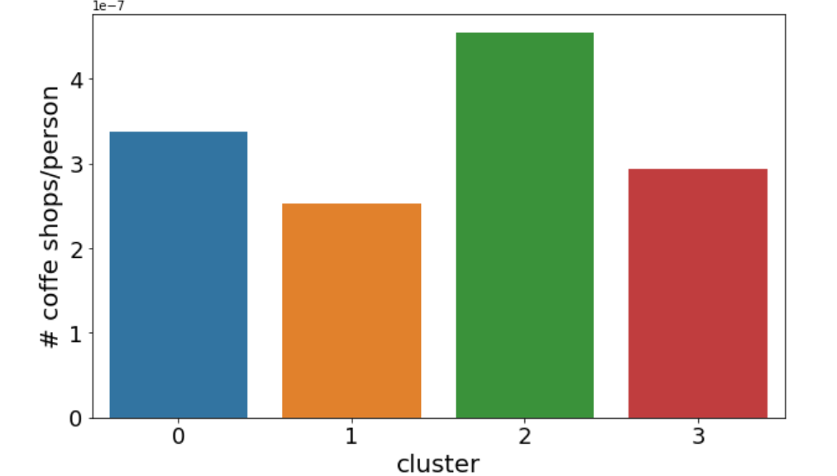
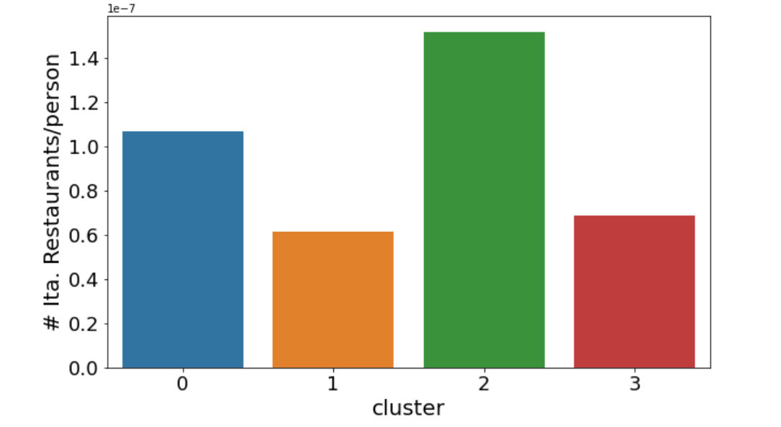
3. Results
We find four unique clusters

