Slide 1

Data engineering Project
Creators
Samy Hadj-said Jason Perez
Paul Abi-saad Florian Segard-gahery

Slide 2

Introduction

Slide 3

Présentation of subject
SafeGuardian

Slide 4
What technical/business constraints should the data storage component of the program architecture meet to fulfill the requirement described by the customer in paragraph «Statistics» ? So, what kind of component(s) (listed in the lecture) will the architecture need ?
Data Storage Component Requirements for Statistics

Slide 5
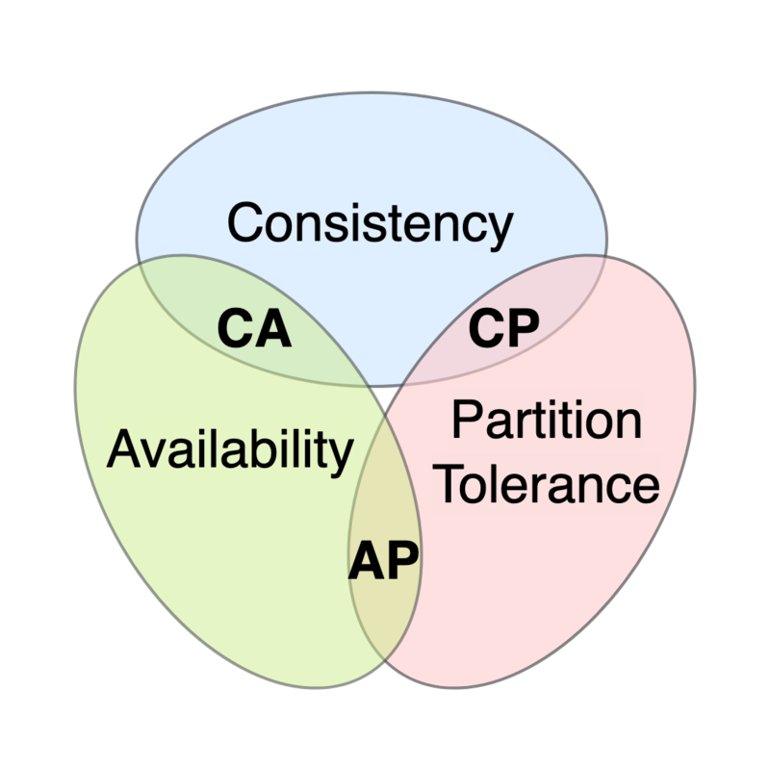

Answer

Slide 6
What business constraint should the architecture meet to fulfill the requirement describe in the paragraph «Alert»? Which component to choose?
Business Constraint and Component Selection for Alerts

Slide 7

Answer

Slide 8
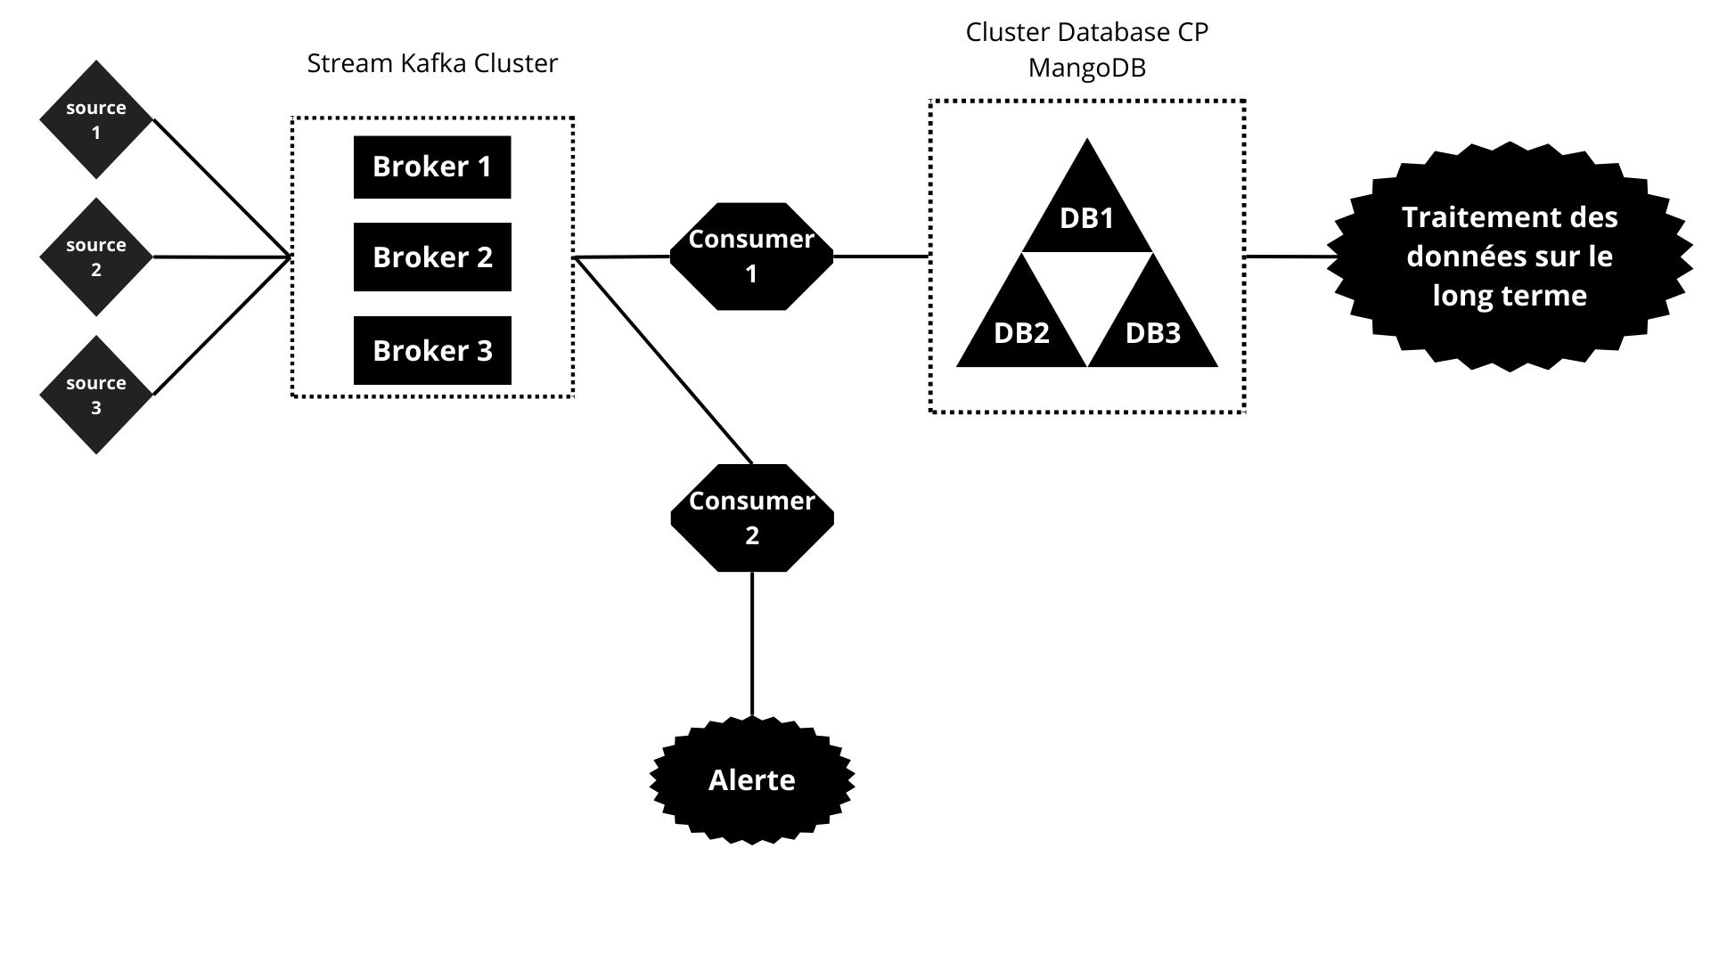
Our architecture

Slide 9
Conclusion

Slide 10

Thank you
We would like to express our sincere gratitude for your attention and support throughout our presentation

