Slide 1

Understanding a Statement
Components in an “xAPI Statement”

Slide 2
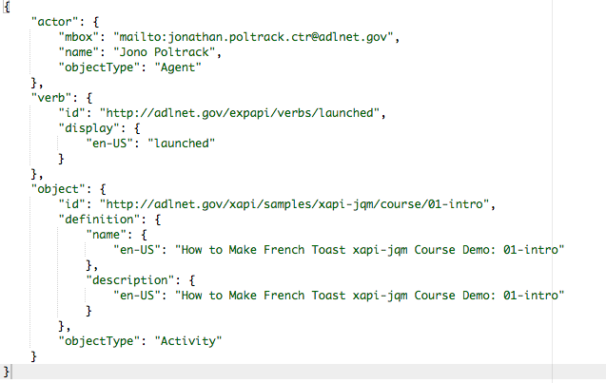
xAPI “Statements”
JSON data representation
“I did this” basic structure
Add
Context
Result
Attachments
Extensions

Slide 3
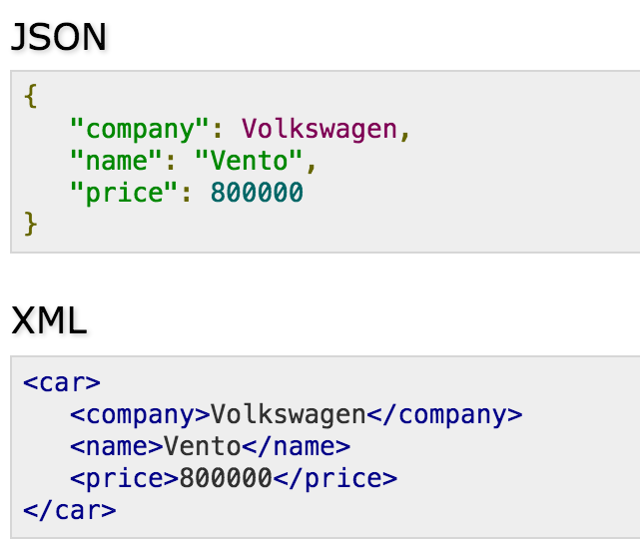
JSON Overview
JavaScript Object Notation (JSON)
Text-based open standard for human readable data exchange

Slide 4
Actor overview
The “I” part of the “I did this” statement
Can be a
Learner (or general user)
Group
Account
Different than the “authority”
"actor": {
"mbox": "mailto:jonopoltrack@gmail.com",
"name": "Jono Poltrack",
"objectType": "Agent"
}

Slide 5
Verb overview
The “did” part of the “I did this” statement
ADL-standard verbs
Completed
Initialized
Launched
etc.
Other verbs introduced in “profiles” by communities of practice
"verb": {
"id": "http://adlnet.gov/expapi/verbs/initialized",
"display": {
"en-US": "initialized"
}
}

Slide 6
Object Overview
The “this” part of the “I did this” statement
Object is typically an “activity” but could also be an “agent”, “substatement” or “statement”
Activities can be of different granularities and types
"object": {
"id": "http://adlnet.gov/xapi/samples/xapi-jqm/course/",
"definition": {
"name": {
"en-US": "How to Make French Toast xapi-jqm Course Demo"
},
"description": {
"en-US": "French Toast Cooking Course built on JQuery Mobile"
}
},
"objectType": "Activity"
}

Slide 7
Result
Adds to the “I did this” statement by allowing a “result” to be appended
Result can include:
Score (Scaled, Raw, Min, Max)
Completion
Success
Response
"result": {
"score": {
"scaled": 0.7,
"raw": 70,
"max": 100
},
"success": true,
"completion": false
}

Slide 8
Context
"context": {
"contextActivities": {
"grouping": [
{
"definition": {
"name": {
"en-US": "NATO E-Learning Forum xAPI Workshop"
},
"description": {
"en-US": "NATO E-Learning Forum xAPI Workshop"
}
},
"id": "http://adlnet.gov/xapi/workshops/2016/natoelearningforum/",
"objectType": "Activity"
}
]
}
}
A place for contextual information about a statement
Context can include:
Registration
Context Activities
Instructor
Team
etc.
Context is important for querying data later

Slide 9
Questions?

Slide 10
Thank you!

