Slide 1


Experience API
<name>
ADL R&D Team
<date>

Slide 2
Experience API
Track learner data of learning experiences, broadly defined
Enable machine-readable communication (interoperability), storage, and access of the data
28 April 2016

Slide 3
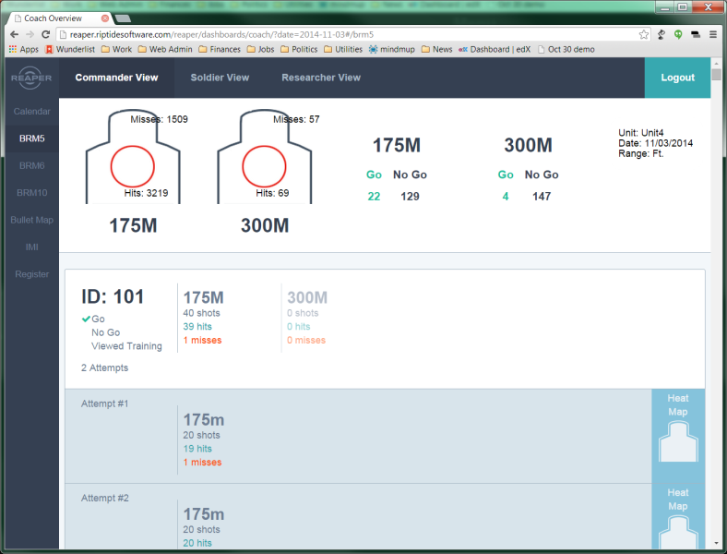
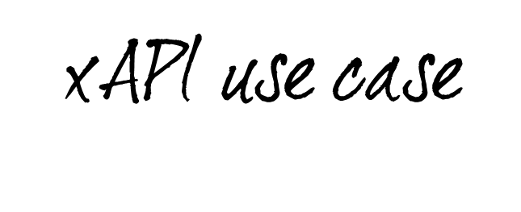
REAPER automated data capture and feedback with xAPI (marksmanship)
Notes:
Range Experience Acquisition Portal for Evaluation & Reporting (REAPER)
Performer: Riptide Software, Inc.
Why: Demonstrate the use of xAPI—and its positive impact on learning—in a marksmanship environment
Details: The REAPER project demonstrated the use of xAPI to collect real-time performance data from a live instrumented training range. The BAA performer, Riptide, developed a uniform mechanism for collecting marksmanship data from instrumented live-fire (LOMAH) ranges (U.S. Army Oscar 9 Range located at Ft Benning, GA) using xAPI/LRS. This proof of concept shows the ability to aggregate data sets for analysis and make the data available for individual trainees, trainers, analysts, and other systems. To provide customized views of the data, for the different users, Riptide created dashboards for individual Soldiers (personalized corrective IMI), Trainers/Coaches (Individual or group views—includes ability to filter), Analysts (Analyze across groups or targets), and Digital Training Management System (DTMS). Ultimately, the improved real-time access to analytics improved personnel’s performance.

Slide 4


Slide 5

(Human) Tutor
+ Mastery Learning
Average
Classroom Learning
Average
2Σ
NUMBER OF STUDENTS (FREQUENCY)
Top 2% of
Classroom Students
STUDENT LEARNING PERFORMANCE
Bloom (1984)
Notes:
Bloom, B. S. (1984). The 2 sigma problem: The search for methods of group instruction as effective as one-to-one tutoring. Educational Researcher, 13(6), p. 6.
From Wikipedia: Bloom's 2 sigma problem refers to an educational phenomenon observed by educational psychologist Benjamin Bloom and initially reported in 1984 in the journal "Educational Researcher". Bloom found that the average student tutored one-to-one using mastery learning techniques performed two standard deviations better than students who learn via conventional instructional methods^{[1]}—that is, "the average tutored student was above 98% of the students in the control class".^{[2]} Additionally, the variation of the students' achievement changed: "about 90% of the tutored students ... attained the level of summative achievement reached by only the highest 20%" of the control class.^{[3]} Bloom's graduate students J. Anania and A. J. Burke conducted studies of this effect at different grade levels and in different schools, observing students with "great differences in cognitive achievement, attitudes, and academic self-concept".^{[4]}
https://en.wikipedia.org/wiki/Bloom%27s_2_Sigma_Problem
See also:
Lesgold, A., Lajoie, S., Bunzo, M., & Eggan, G. (1988). SHERLOCK: A coached practice environment for an electronics troubleshooting job. In Computer assisted instruction and intelligent tutoring systems. Hillsdale, NJ: Lawrence Erlbaum.
Luckin, R., & du Boulay, B. (1999). Ecolab: The development and evaluation of a Vygotskian design framework. International Journal of Artificial Intelligence in Education, 10(2), 198–220.
VanLehn, K., Lynch, C., Schulze, K., Shapiro, J. A., Shelby, R., Taylor, L., et al. (2005). The Andes physics tutoring system: Lessons learned. International Journal of Artificial Intelligence and Education, 15(3), 147–204.

Slide 6


Static Computer-Based Learning
Same for everyone

Slide 7


Computer-Assisted Instruction
Different for different students
Notes:
from Kulik & Fletcher (2015) Meta-Analysis of 50 studies:
Computer tutoring is a late development in the long history of tutoring in education.
Whereas human tutoring has been used in schools for 2,500 years—or for
as long as schools have existed—computer tutoring is largely a product of the past
half century. The first computer tutoring systems to be used in school classrooms
(e.g., R. C. Atkinson, 1968; Suppes & Morningstar, 1969) showed the influence
of the programmed instruction movement of the time: They presented instruction
in short segments or frames, asked questions frequently during instruction, and
provided immediate feedback on answers (Crowder, 1959; Skinner, 1958). A different
type of computer tutoring system appeared in research laboratories and classrooms during the 1970s and 1980s (e.g., Carbonell, 1970; Fletcher, 1985;
Sleeman & Brown, 1982). Grounded in artificial intelligence concepts and cognitive
theory, these newer systems guided learners through each step of a problem
solution by creating hints and feedback as needed from expert-knowledge databases.
The first-generation computer tutors have been given the retronym CAI
tutors (for computer-assisted instruction tutors); the second-generation tutors are
usually called intelligent tutoring systems, or ITSs (VanLehn, 2011).

Slide 8
(Human) Tutor
+ Mastery Learning
Average
Classroom Learning
Average
NUMBER OF STUDENTS (FREQUENCY)
≈0.3Σ
CAI Average
STUDENT LEARNING PERFORMANCE
See Tamim, Bernard, et al. (2011)
and J. A. Kulik (1994)
Notes:
Effectiveness of Intelligent Tutoring Systems: A Meta-Analytic ReviewReview of Educational Research0034654315581420, first published on April 17, 2015
This meta-analysis shows that ITSs can be very effective instructional tools. Students who received intelligent tutoring outperformed students from conventional classes in 46 (or 92%) of the 50 controlled evaluations, and the improvement in performance was great enough to be considered of substantive importance in 39 (or 78%) of the 50 studies. The median effect size in the 50 studies was 0.66, which is considered a moderate-to-large effect for studies in the social sciences. It is roughly equivalent to an improvement in test performance from the 50th to the 75th percentile.
The same study discusses CAI (first generation additivity with only “outer loop”) vs. ITS (second generation additivity with both outer and the more granular inner loop additivity). ITS yielded about twice the benefit (0.66 Sigma) of CAIs (a meta-analytic average of 0.3 Sigma).

Slide 9

Intelligent Tutors
More responsive to different students
Notes:
from Kulik & Fletcher (2015) Meta-Analysis of 50 studies:
Computer tutoring is a late development in the long history of tutoring in education.
Whereas human tutoring has been used in schools for 2,500 years—or for
as long as schools have existed—computer tutoring is largely a product of the past
half century. The first computer tutoring systems to be used in school classrooms
(e.g., R. C. Atkinson, 1968; Suppes & Morningstar, 1969) showed the influence
of the programmed instruction movement of the time: They presented instruction
in short segments or frames, asked questions frequently during instruction, and
provided immediate feedback on answers (Crowder, 1959; Skinner, 1958). A different
type of computer tutoring system appeared in research laboratories and classrooms during the 1970s and 1980s (e.g., Carbonell, 1970; Fletcher, 1985;
Sleeman & Brown, 1982). Grounded in artificial intelligence concepts and cognitive
theory, these newer systems guided learners through each step of a problem
solution by creating hints and feedback as needed from expert-knowledge databases.
The first-generation computer tutors have been given the retronym CAI
tutors (for computer-assisted instruction tutors); the second-generation tutors are
usually called intelligent tutoring systems, or ITSs (VanLehn, 2011).

Slide 10
(Human) Tutor
+ Mastery Learning
Average
ITS Average
Classroom Learning
Average
≈0.75Σ
NUMBER OF STUDENTS (FREQUENCY)
≈0.3Σ
CAI Average
STUDENT LEARNING PERFORMANCE
from Kulik & Fletcher (2015)
Meta-Analysis of 50 studies
Notes:
Kulik & Fletcher (2015)
Effectiveness of Intelligent Tutoring Systems: A Meta-Analytic Review
Review of Educational Research, first published on April 17, 2015
This meta-analysis shows that ITSs can be very effective instructional tools. Students who received intelligent tutoring outperformed students from conventional classes in 46 (or 92%) of the 50 controlled evaluations, and the improvement in performance was great enough to be considered of substantive importance in 39 (or 78%) of the 50 studies. The median effect size in the 50 studies was 0.66, which is considered a moderate-to-large effect for studies in the social sciences. It is roughly equivalent to an improvement in test performance from the 50th to the 75th percentile.
The same study discusses CAI (first generation additivity with only “outer loop”) vs. ITS (second generation additivity with both outer and the more granular inner loop additivity). ITS yielded about twice the benefit (0.66 Sigma) of CAIs (a meta-analytic average of 0.3 Sigma).

Slide 11

Notes:
Meanwhile...

Slide 12

Typical e-learning uses SCORM, which tracks coarse-grain performance
SCORM also provides other capabilities, which have gradually become outdated over the last 10 years

Slide 13




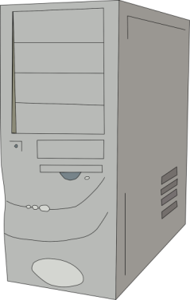


Old (Current) Model
LMS 1
LMS 4
CONTENT PACKAGE
LMS 2
LMS 3
Notes:
Distributed Content
Content Packages imported into LMSs
Content duplicated in each system
LMSs store the content, control access and manage learner data
The legacy model used by SCORM, AICC CMI 4/HACP and others includes the concept of a “course” or “content package” that is a physical file. This file is then “imported” into a learning management system (LMS). The LMS parses the course and is then able to “understand” how to launch, sequence, and track course activities. The LMS is a core component in this architecture as it MUST contain all courses/course files, learning records, users, etc.
In this model, content is duplicated in each system, so content lifecycle can be difficult to manage. For example, if you import a course in to LMSs A, B, C, and D above and later want to change some images in the course, you must perform this update four (4) times, once in each LMS.
This model is effective in DoD and Service environments, because the LMS can be located on a security network and is largely able to stand-alone.

Slide 14


Old (Current) Model
…is similar to the MP3 + MP3 Player model
Notes:
Legacy model is similar to MP3s, MP3 players and the associated MP3 standard
This works for:
For single learner-based learning content
For asynchronous learning
When the content is browser-based
When the content can be physically located in the LMS (or on the LMS domain)
For “small” data like scores, complete/incomplete, pass/fail
For the common formal, self-paced learning use cases

Slide 15



Old (Current) Model
LMS 1
LMS 4
CONTENT PACKAGE
LMS 2
LMS 3
Notes:
Problem 1: Limited performance tracking
Good for “small” data like scores, complete/incomplete, pass/fail

Slide 16
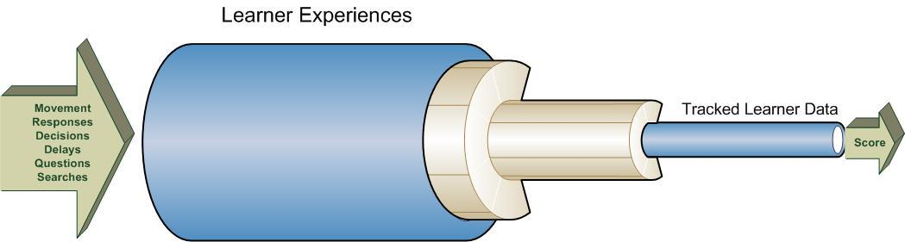
Problem #2
Old (Current) Model
So many learning “experiences” and so little data!

Slide 17






Old (Current) Model
LMS
Single Learner
Notes:
Problem 2: Only for single learner-based learning content
Problem 3: Only for asynchronous learning
Problem 4: Only when the content can be physically located in the LMS (or on the LMS domain)

Slide 18

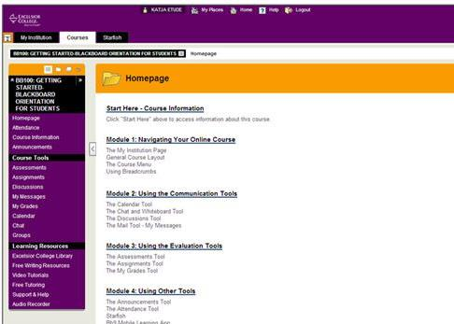

Old (Current) Model
Single Learner
Notes:
Problem 5: Good only when the content is browser-based and for the common formal, self-paced learning use cases

Slide 19

one part of the solution
Document and later access data on learners’ fine-grained interactions (experiences) in any formal, informal, operational, or other technology-based context
Notes:
xAPI isn’t about *content*
It’s about *data*
xAPI enables:
Flexible data format
Supports all internet-enabled platforms
PC, mobile, simulators, embedded devices
Tracks individuals or groups
Content can be hosted anywhere
Can track all types of events, not just pass/fail, etc.
Supports informal learning and exploration

Slide 20



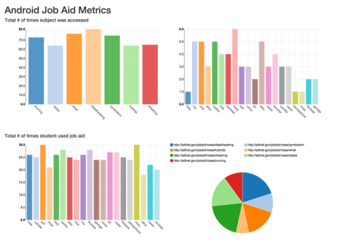





Limited Outcome Data
xAPI doesn’t replace SCORM for LMS/browser-based asynchronous e-learning content
They can be used together
LMS
CONTENT PACKAGE
Broad Experience Data
Notes:
Requirements
Track user data based on interactions with learning experiences
Provide access to data after it is initially stored
Flexible Format
Experience Application Programming Interface (xAPI) Core Spec
https://github.com/adlnet/xAPI-Spec
Communities of Practice & Profiles
E-Learning
Medical
…and many more

Slide 21




Experience Tracking
xAPI
Learner Profile
Competency Infrastructure
Content Brokering
New Tech & Methods

Slide 22

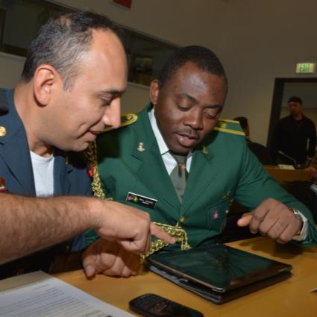
Notes:
What about new devices/content modalities?
Mobile apps (Android, Apple iOS, Windows, etc.)
Wearables: Smart watches (Android Wear, Apple Watch, Pebble, etc.), AR Glasses (Google Glass, Vuzix, Moverio, etc.), Fitness Bands, etc.
Simulations (LVC, Full-Scale, Desktop)
Games (Xbox, PlayStation, Steam, etc)
Social Media/Learning (Twitter, G+, LinkedIn, Yammer, etc)
Virtual Reality (Oculus Rift, Samsung Gear VR, Cardboard, etc)

Slide 23


Notes:
What about new devices/content modalities?
Mobile apps (Android, Apple iOS, Windows, etc.)
Wearables: Smart watches (Android Wear, Apple Watch, Pebble, etc.), AR Glasses (Google Glass, Vuzix, Moverio, etc.), Fitness Bands, etc.
Simulations (LVC, Full-Scale, Desktop)
Games (Xbox, PlayStation, Steam, etc)
Social Media/Learning (Twitter, G+, LinkedIn, Yammer, etc)
Virtual Reality (Oculus Rift, Samsung Gear VR, Cardboard, etc)

Slide 24
Questions?
<name>
ADL R&D Team
<date>

