Slide 1
JPEG
Ungureanu florin - catalin

Slide 2
dESCRIPTION
JPEG (or JPG) is not really a file format but rather an image compression standard. The JPEG standard is complicated with many different options and color space regulations. It was not widely adopted. A much simpler standard version was advocated at the same time, called JFIF. This is the image compression algorithm that most people mean when they say JPEG compression, and the one that we will be describing in this class. Note that the file extensions .jpeg and .jpg have stuck, even though the underneath algorithm is (strictly speaking) JFIF compression.

Slide 3
The JPEG algorithm is designed specifically for the human eye. It exploits the following biological properties of human sight:
(1) We are more sensitive to the illuminocity of color, rather than the chromatric value of an image, and
(2) We are not particularly sensitive to high-frequency content in images.
The algorithm can be neatly broken up into several stages: There is an input image I, which goes through the following process:
1) A colour transform, 2) A 2D discrete cosine transform on 8x8 blocks, 3) A quantization (filtering) stage, 4) Huffman encodin

Slide 4
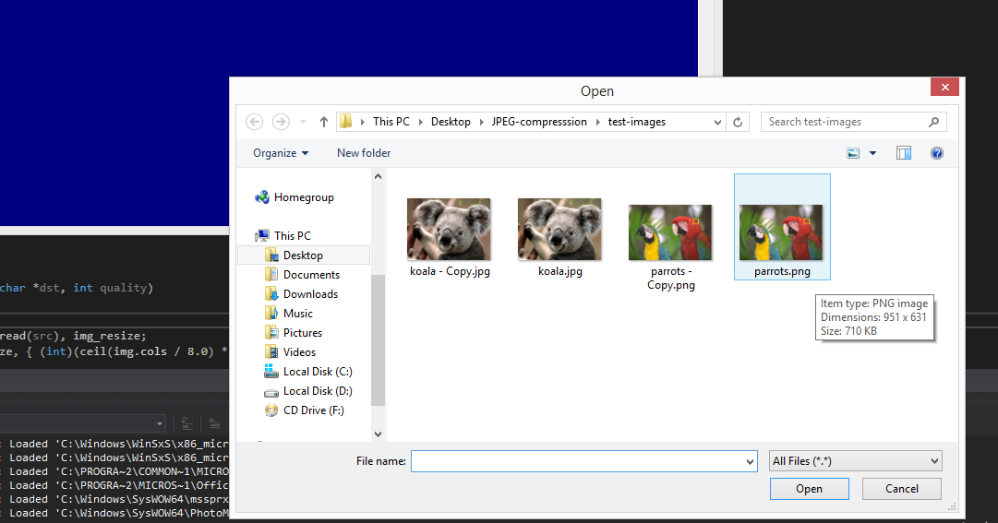
user manual
Choose to read an image and create a copy of the image in which we’ll save the compressed photo to make the compartation.

Slide 5
library/functions used
cvtColor(image, converted_image, CV_RGB2YCrCb);
With either the flag CV_RGB2YCrCb to convert from RGB to YCrCb
Or CV_YCrCb2RGB
waitKey(int delay=0)
imread(received_image, opening_type);
imshow("Display Image", image);

Slide 6
void namedWindow(const string& winname, int flags=WINDOW_AUTOSIZE )
name – Name of the window in the window caption that may be used as a window identifier.
flags –Flags of the window. The supported flags are:
WINDOW_NORMAL If this is set, the user can resize the window (no constraint).
WINDOW_AUTOSIZE If this is set, the window size is automatically adjusted to fit the displayed image (see imshow() ), and you cannot change the window size manually.
WINDOW_OPENGL If this is set, the window will be created with OpenGL support.

Slide 7
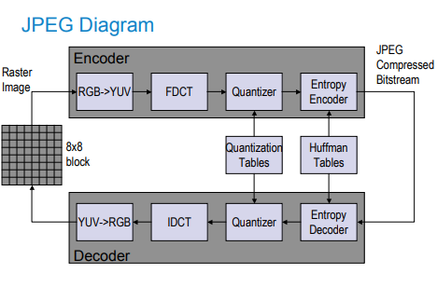
high level architecture

Slide 8

implementation details for the most difficult part
FCDT

Slide 9
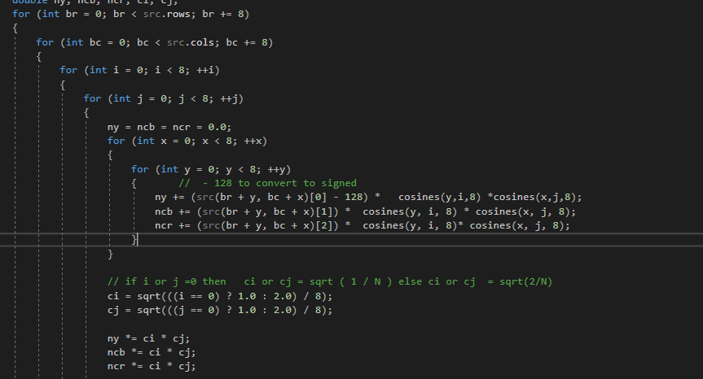

Slide 10
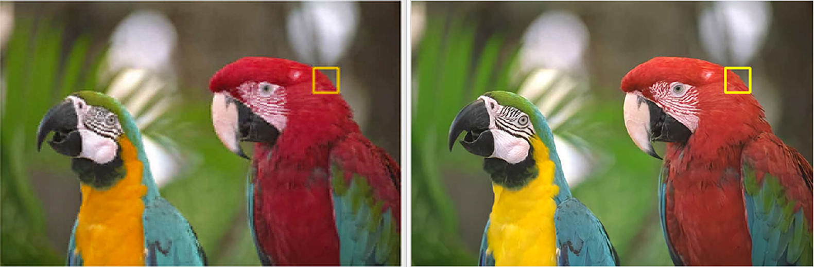
Demo
Parrots-Copy 583 KB
Parrots 712 KB

Slide 11
