Slide 1
Define the system power requirements
Design and test the refrigeration cycle model
Add additional thermal fluid components and test the final model
Add detailed vehicle components (out of scope for this example)
Check model initialization and simulation speed. Fix eventual issues.
System-level thermal plant modeling

Slide 2
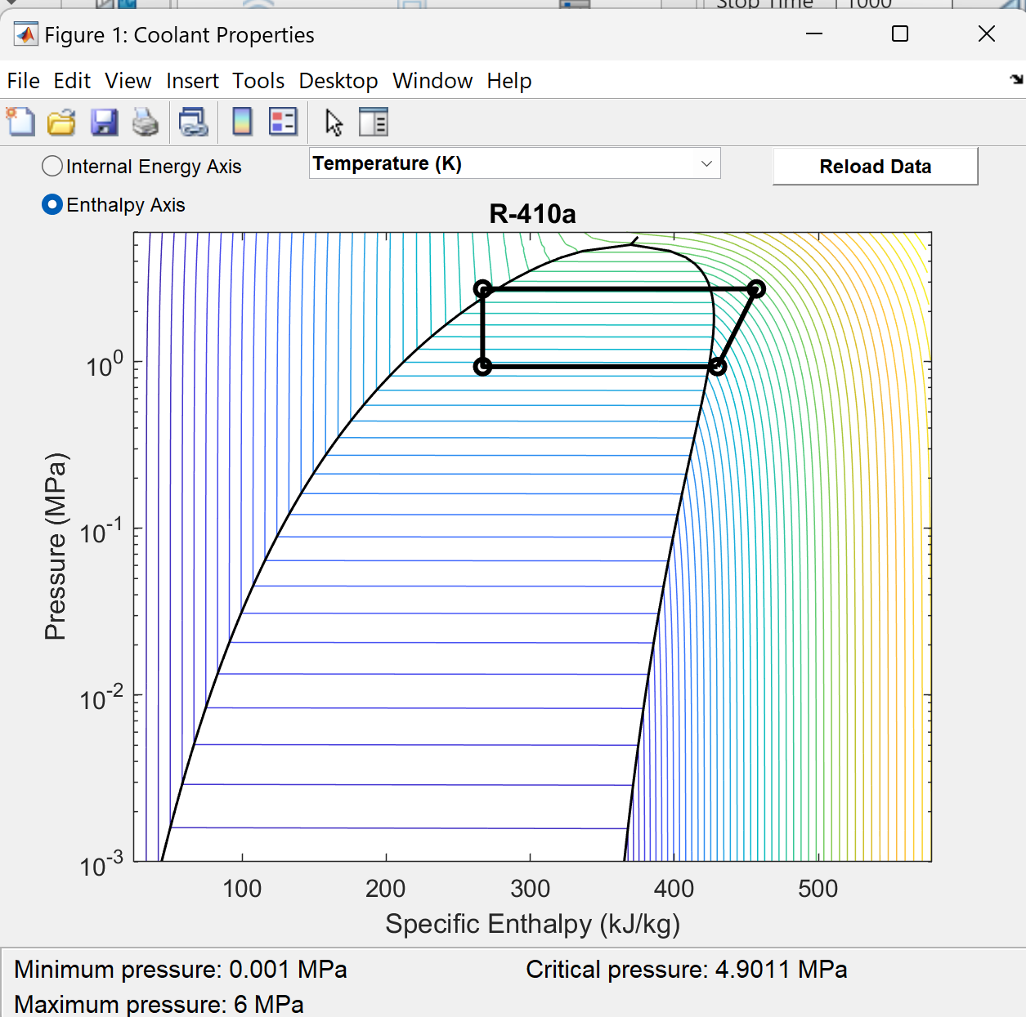
Subcooling temperature
③
Condenser
②
Expansion
valve
Evaporator
Compressor
④
①
Subcooled
liquid
Superheat temperature
Mix region
Fluid
(two-phase)
Compressor work (H2-H1, kJ/kg)
(to find power in kW, you need to multiply with mass flow rate, kg/s)
Condenser work is H3-H2 and is negative because is extracting heat from the refrigerant and heats the ambient air.
Evaporator work is H1-H4 and is positive because is extracting heat from the cooling zone and heats the refrigerant.
Superheated
vapor

