Slide 1
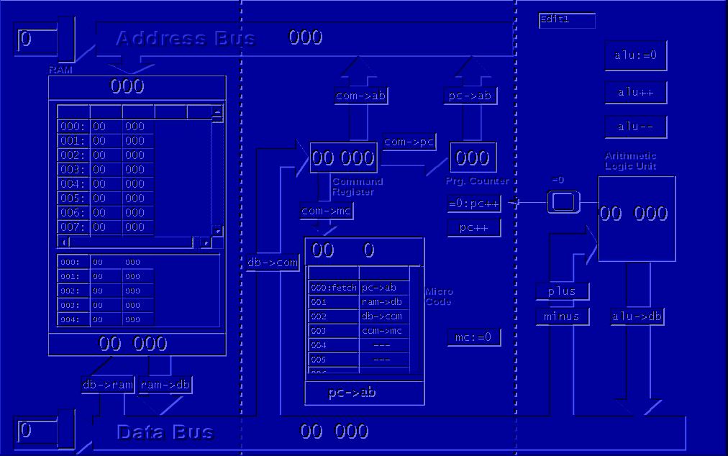
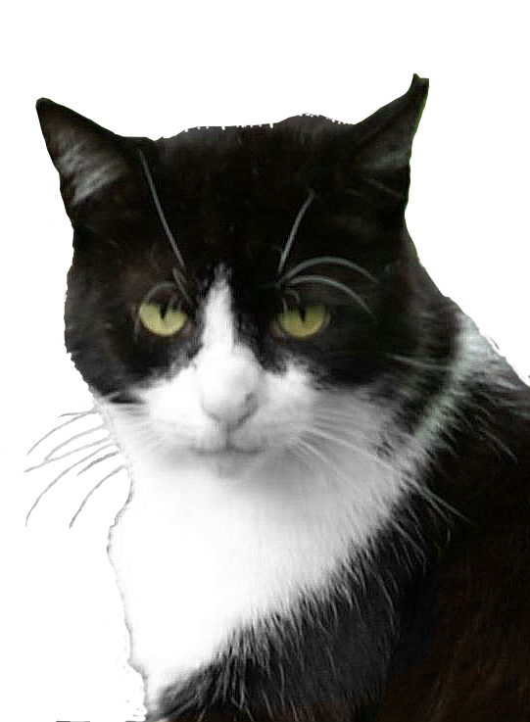

Johnny 1.01
Open Source Simulation
of a Simplified
Von Neumann Computer
Peter Dauscher,
2009-2014
Developed in
Free Pascal / Lazarus
Dedicated to my cat Guido who inspired me.

