Slide 1
Volunteero
Bringing Super heroes together as one

Slide 2
Poza qubiz cu spatele together we are one

Slide 3

Another platform for helping those in need

Slide 4

What’s out there and how scalable is it

Slide 5
NGO apps
Everybody in the system is known and verified
Scalability: Low
Security: High

Slide 6
Apps for volunteers with centralized verification
apps where people from around the globe can join the platform
Every participant needs to be verified
Scalability: Low
Security: Medium

Slide 7
Apps where everybody is allowed to join
Apps with only some registration form, with no manual verification
Scalability: High
Security: Low

Slide 8
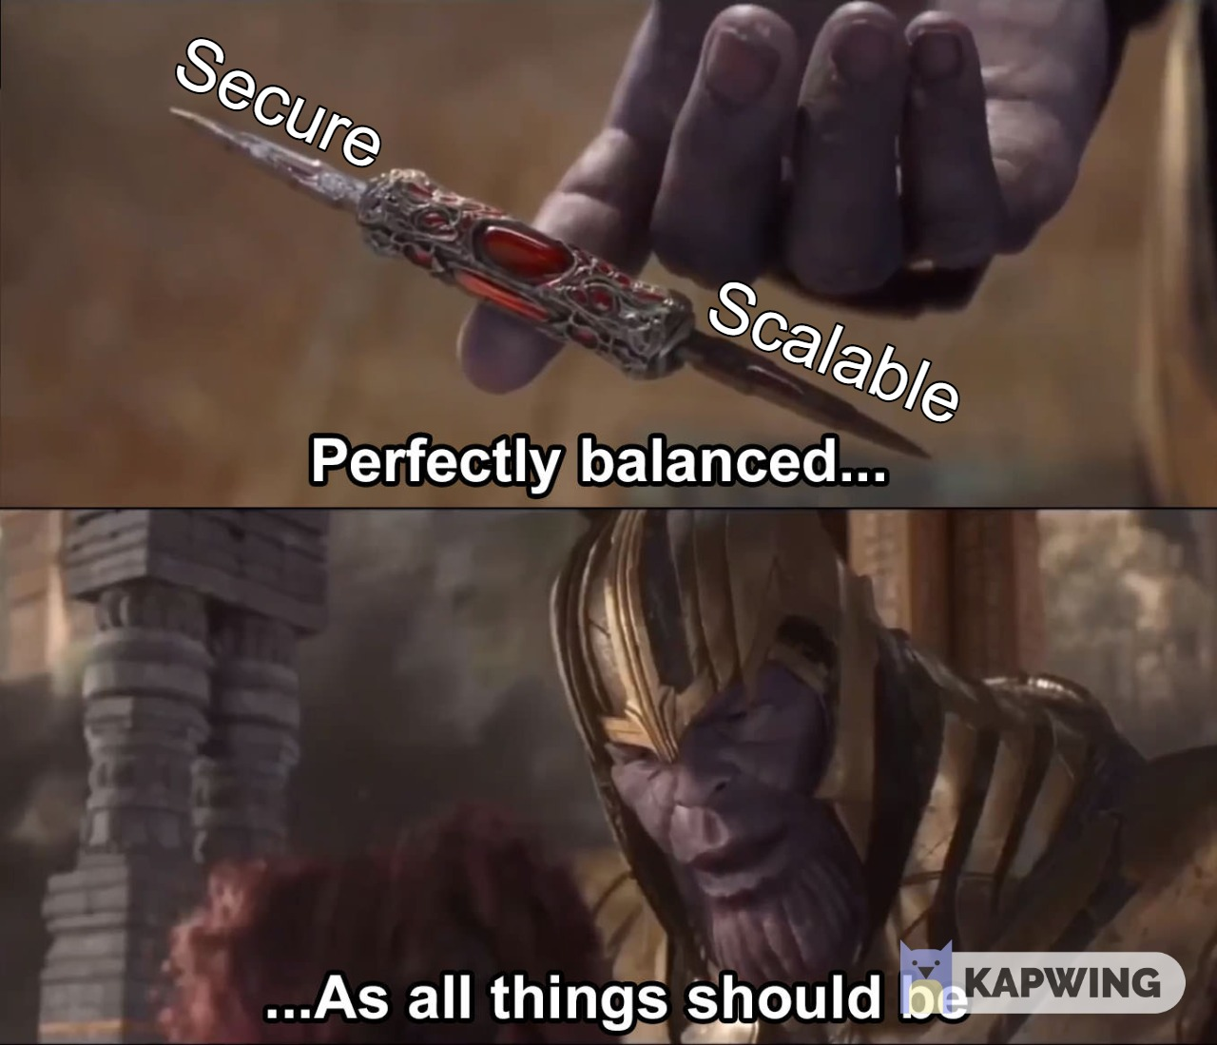
Volunteero
Have multiple NGO’s do the manual validation
Do multiple automatic verification steps
Focus on security from start to finish
Scalability: Medium-High
Security: High

Slide 9
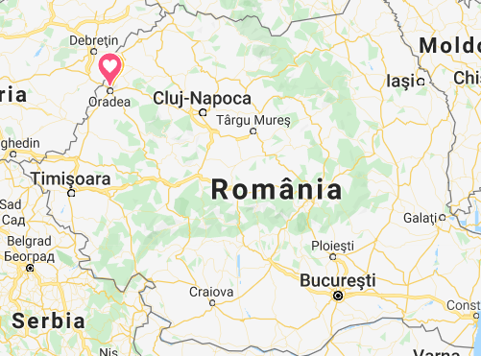
How Secure is it? 5 Factor Authentication*
It may seem crazy to have 5FA, but we are from the same city as TypingDNA so it might be something with this city related to security

Slide 10
5 Factors for authentication
Registration
Automatic Email Validation at the registration using Link sent to email
Automatic Phone validation using SMS
Manual validation by the closest NGO or by the platform admin
Login:
Username/Password or External login -using NGO users database
Google Authenticator or Microsoft Authenticator (TOTP)

Slide 11
What about secure storage of the data?
SQL with transparent data encryption
For normal files we use 256-bit AES encryption FIPS 140-2 compliant with
Encryption Key storage: Key Vault - FIPS 140-2 Level 2 validated HSM
We use Zone redundant Storage, each file is stored in multiple AZ

Slide 12
Who can see beneficiary’s data?
Only those who need to help him
Match making is done by the system based on GPS coordinates and other rules
Only those allocated to the person will see the sensitive data

Slide 13
Why enterprise level security for hacakton?
Because we have sensitive information about vulnerable people
Because personal safety is more important than money

Slide 14
I get that you have pretty good cryptography, but are you scalable?
And here comes PGP (Pretty good Privacy) we create a web of trust.
Platform Admin adds trusted NGO’s Admins
Platform can delegate to some NGO Admin the right to add other NGO’s in the system
NGO’s validate the super heroes
Some of the volunteers can add/verify beneficiaries

Slide 15
Ok – did you really implemented all of this?
It was developed on Github and it is open source, check it yourself
It is deployed in Azure, and we have a public url, check it there also

Slide 16
Do you have clients using it?
Logo 1 – Client 1
Logo 2 –Client 2
We are helping also:
Logo 3 – client 3
Logo 3 – client 3

Slide 17

How can #matchaton team help?
Help us match of super heroes – Textul mai mare pe toate pagina

Slide 18
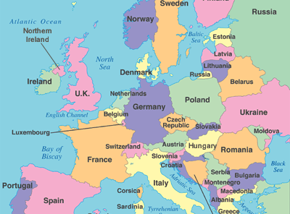
More descriptive?
Help us to have this map full of trusted super heroes
We will take care of linking them together to make them act as one

Slide 19

Make us press the scale button on Azure

Slide 20
Future plans?
Have assistant super heroes that are making super deals for the first wave of super heroes
Consider them super heroes, and give them prizes ☺
Stop when the entire Europe is a super hero

Slide 21
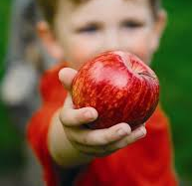
Dar din dar se face rai
This can be translated to: “Gift from gift we are making heaven”

Slide 22
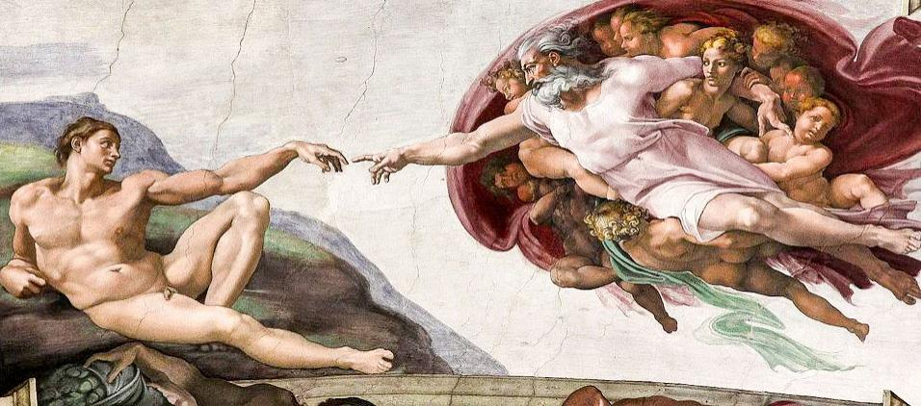
Let’s make our world a heaven again With trusted Super Heroes

