Slide 1

Git & GitHub
Learn how to control your source code

Slide 2
Intro to Git & GitHub
What is Git?
Git is a version control system, designed for individual and collaborative source code management.
What is GitHub?
GitHub is a cloud platform hosting and sharing Git repositories of source code.
How do these help?
Incrementally develop large projects.
Prevent source code loss by cloud backup.
Collaborate with other developers on the same code base without breaking each other’s code.
Prerequisites:
Create a free GitHub account: https://github.com/
Login and create a git “repository”
Download and install the following (installed in this order):
VS Code | https://code.visualstudio.com/Download
Git | https://git-scm.com/downloads
GitEx | https://gitextensions.github.io/

Slide 3

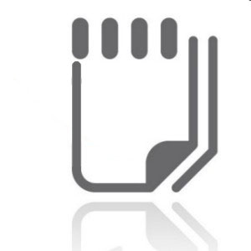


Git & GitHub for individual work
Premise: Amy is starting a new project named FancyApp. It is going to be large, with database and web-API source code. She doesn’t want to lose anything if her computer crashes. It is going to be complex, so she wants to set restore points along the way: in case she’s facing hard technical challenges and the project stops working she will be able to reset it to a “last known good” state.
Amy is using GitHub as a cloud repository for the project and Git as a source control management system. She’ll use a laptop and a desktop for her coding.
Amy creates a free account on www.github.com and once in, she creates a new code repository named FancyApp. The repository comes by default with a main branch, hosted in the cloud (remote).
Amy/FancyApp
1
Using the repository URL listed on GitHub website, she is cloning the FancyApp repository into a local folder on her desktop. That folder is now under Git monitoring as the local main branch.
main
2
1
Amy then starts creating files for the project in the local folder. Frequently she’s setting restore points by staging files to the Git index which she is occasionally committing the staged changes to the local main. As she continues to code, Amy can compare the content of any file with versions of the same file from previous commits.
3
Sometimes Amy is pushing the local main branch to GitHub cloud, into the remote main. This way nothing is lost if the computer crashes. Files are accessible from other computers.
4
origin / remote
With her files in the cloud, Amy clones the same repository on her laptop and goes to work from a coffee shop.
5
2
5
8
After a few hours of work, she is committing changes to local main on her laptop and pushes ( ) the branch upstream.
6
7
4
7
Back at home, Amy moves to her desktop and pulls the most recent code from the remote main into her desktop’s local main. She can now pick up her work from where she left it, at the coffee shop.
8
main
main
Sometimes Amy feels the need to restructure the code more drastically, but she’s unsure if the changes will pan out or will only damage the currently working code. She’s forking a local branch named trial, from her local main such that she can experiment ( ) in isolation from the good code.
9
6
3
10
10
9
Trial code being fine, she can simply merge the trial branch into the local main then delete the branch. Should that not have been the case, she could have switched back to main and delete the trial branch.
trial
11
11
Amy’s laptop
Amy’s desktop

Slide 4



Git & GitHub for collaborative work
Premise: Lilly and Joe are joining Amy’s FancyApp project, which involves a database and a web API. A Git repo (repository) is already set-up in GitHub by Amy, their Project Manager. Amy configured Lilly’s and Joe’s GitHub accounts as “collaborators” (read-write permissions) to her FancyApp repo. Lilly is generally working on the database while Joe is generally working on the webAPI but they both know to some degree the entire code base.
8
Both Lilly and Joe cloned the repo Amy/FancyApp from GitHub. They now have a local main branch, tracking the remote main branch on the origin.
1
Amy
Amy/FancyApp
Lilly is creating a local branch dbWork forked from her local main.
Joe is creating a local branch webAPI forked from his local main.
2
dbWork
3
8
Lilly starts writing database code. As she is writing more and more, she’s frequently committing the changes to her local dbWork branch.
Joe starts writing web interfaces. As he is writing, he’s frequently committing the changes to his local webAPI branch.
7
4
9
main
5
Lilly wrote a large part of the code and she’s now pushing it from her local dbWork branch into a remote dbWork branch. She forgot a small fix which she’s quickly committing to local dbWork and pushes it again to remote dbWork.
6
Lilly is now satisfied with her code. She wants the remote main branch to pull all her changes from the remote dbWork. From GitHub web portal She’s sending a pull request to the entire team.
origin / remote
7
6
1
1
10
Joe and Amy are both reviewing Lilly’s changes. They may recommend changes which Amy commits to local dbWork ( ) and pushes to remote dbWork quickly ( ).
12
8
4
main
main
6
When everybody approves Lilly’s pull request, she is merging the remote dbWork branch into the remote main branch.
dbWork
webAPI
9
2
3
As Joe starts his next workday, he is pulling all of Amy’s recent code changes from the remote main into his local webAPI branch.
4
5
10
13
As Lilly starts her next workday, she is deleting the local dbWork branch, pulls all the remote main changes into her local main ( ) and forks from it a new local branch scripts ( ) to continue her work.
Lilly
Joe
11
11
scripts
12
13
Lilly’s laptop
Joe’s laptop

Slide 5

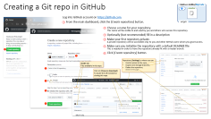


Working with Git in Visual Studio Code
Setting up GitHub cloud How to set-up a GitHub account and to create your first Git repository in the GitHub cloud.

Slide 6
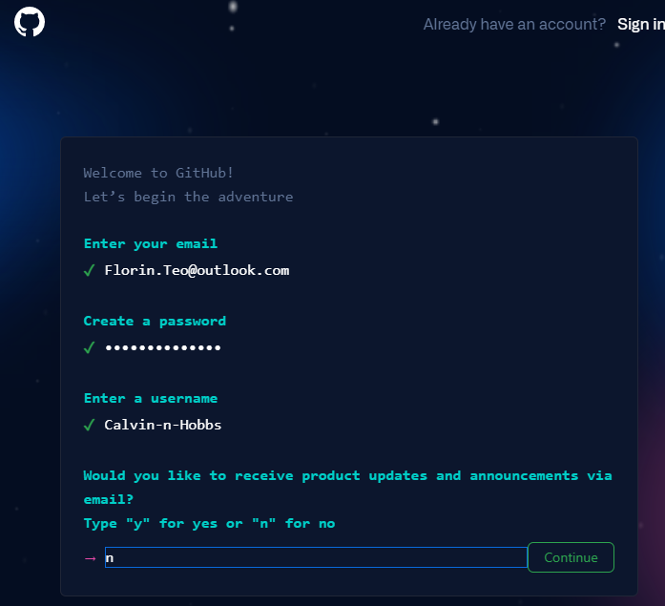

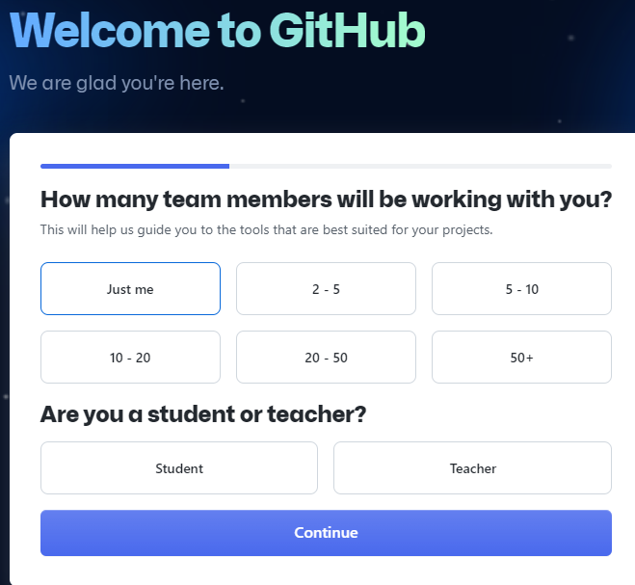
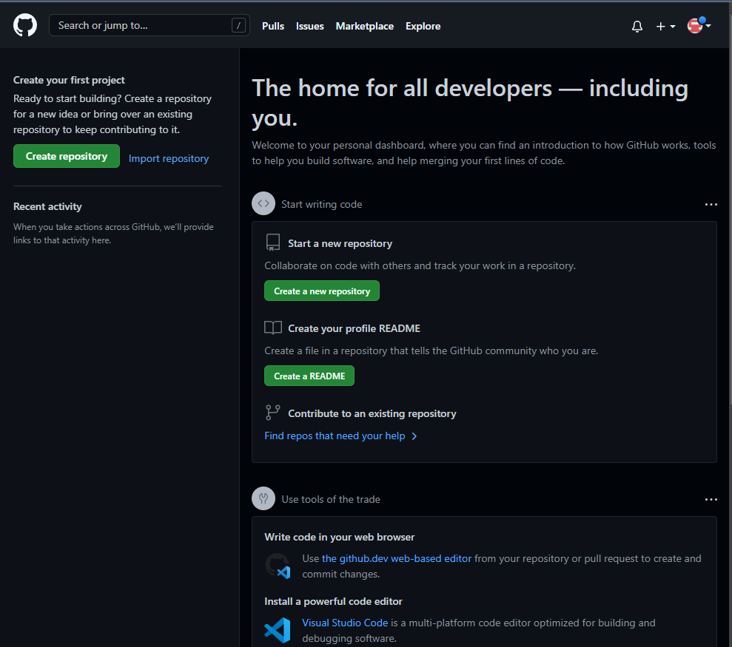
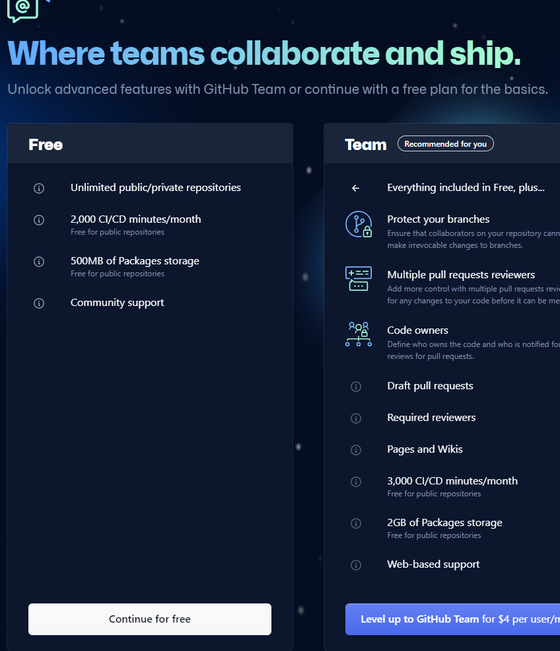
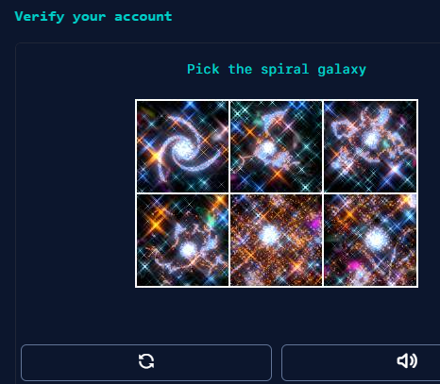
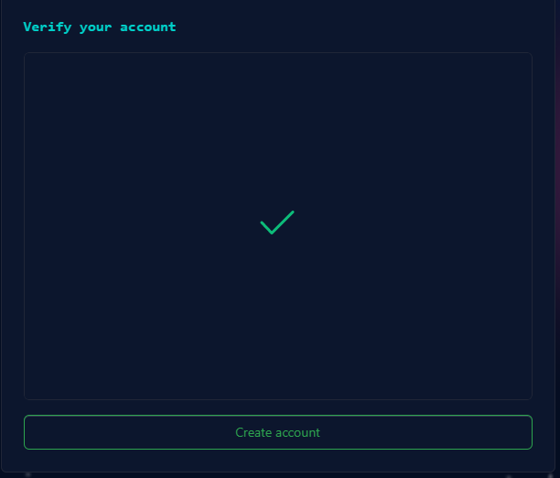
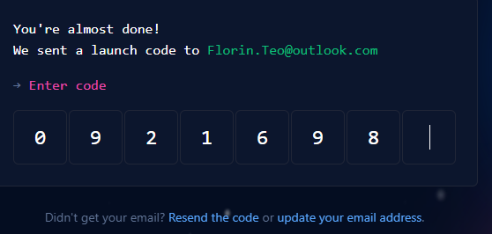
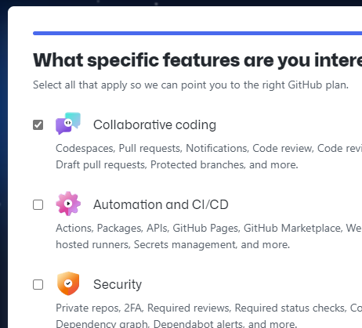
Setting up GitHub account
Free GitHub accounts can host public and private repositories. By default, make your repositories private. You may want to have one public repository showcasing your coding prowess and referenced on your resume.
See https://github.com/pricing for a comparison of plan features.
Calvin-n-Hobbs
If you don’t have a GitHub account already, go to https://github.com and create one:
Click [Sign up for GitHub] then choose a valid email address, password and a username and [n] for advertisement offerings.
Resolve a puzzle to prove you are human e [n] for advertisement options, complete a puzzle then click [Create account]
1
origin
2
Your GitHub portal
This is your main dashboard for all the source code repositories hosted in the cloud. Any time you are logged in your GitHub account, clicking [ ] lands you in the main dashboard.
3
A verification email will then be sent to your sign-in email. Check your inbox and enter the code received there in the sign-in pager.
4
Answer a few profiling questions then click [Continue] button.
5
Select [Collaborative coding] for specific features of interest.
1
6
Chose the free plan by clicking [Continue for Free].
7
Congratulations! You landed in your new GitHub portal.
4
2
7
3
5
6

Slide 7
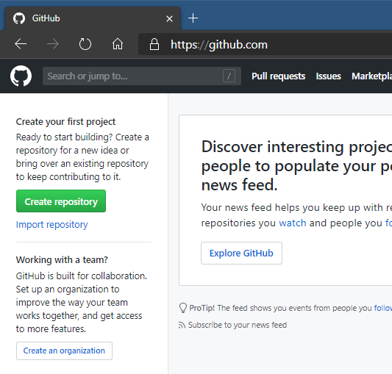
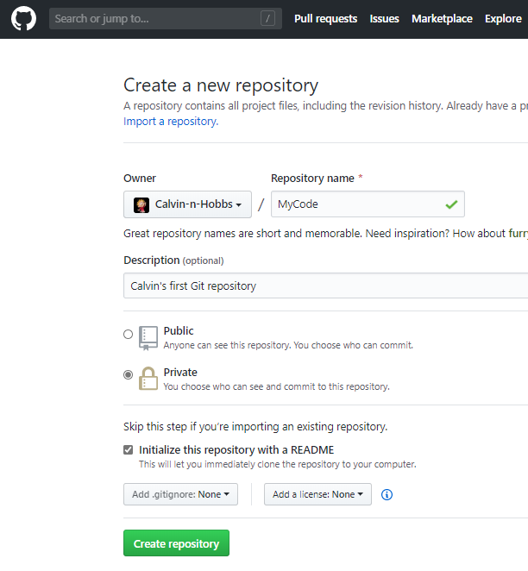
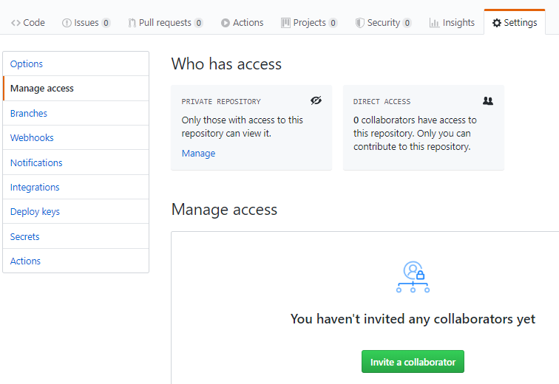
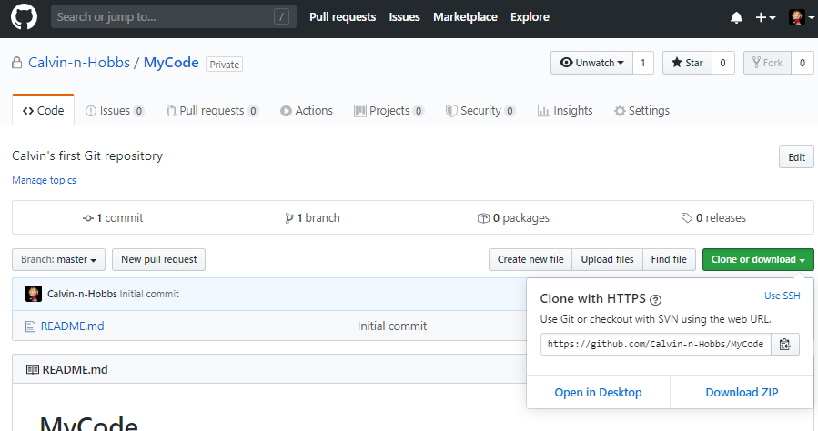
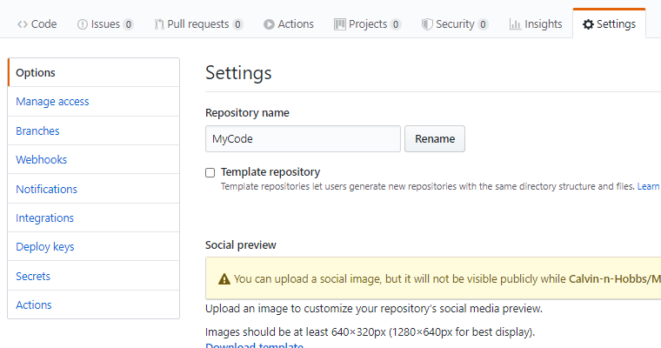
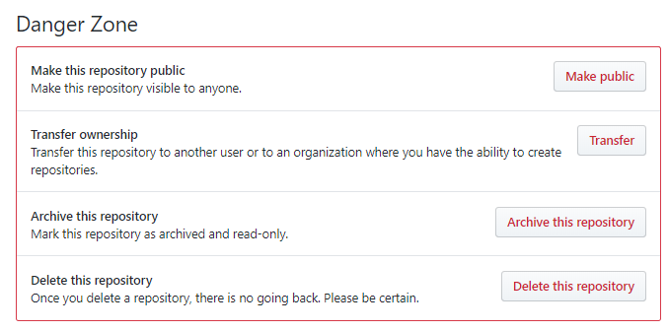
Creating a Git repo in GitHub
Calvin-n-Hobbs/MyCode
master
Log into GitHub account on https://github.com.
From the main dashboard, click the [Create repository] button.
1
origin
2
Choose a name for your repository.
This name will be visible to and used by you and others who access this repository.
Optionally (but recommended) fill in a description
Make your first repository private.
A private repository will be accessible only to you and other GitHub users whom you grant access.
Make sure you initialize the repository with a default README file
This is needed in order to have the repository already fit with a master branch.
Click [Create repository] button.
3
4
5
1
6
2
Repository [Settings] is where you can:
Control access to the repo,
Inspect and manage branches,
Delete the repository (bottom of the page)
[Code] tab
Files available in this repo.
3
Click on [Clone or download]
To locate the URI needed for cloning this repo.
4
5
6

