Slide 1
Lists – Calculator
Learn how to design and use double linked lists Practice with polymorphism, exception handling, unit testing

Slide 2
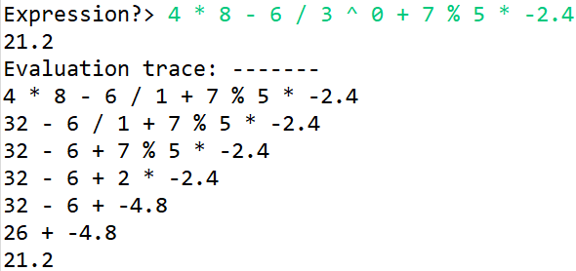
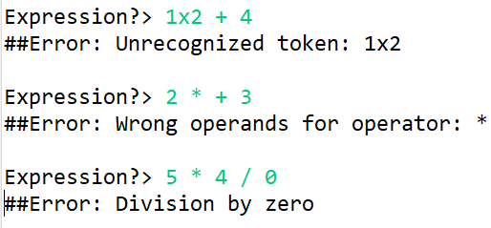
Calculator specification
In this lab you will develop a simple, yet powerful numerical calculator. The user will be able to type in numerical expressions of integer or double numbers, and in return, the program will evaluate and print out their result. Each printed result will include an evaluation trace, which is the sequence of steps leading to the result, as shown below:
The specific project constraints are as follows:
The expression is a sequence of operands and operators, separated by spaces.
The operands are double numbers, positive or negative.
The operators are: + (addition), - (subtraction), * (multiplication), / (division), % (modulo) and ^ (power).
The evaluation follows the operator precedence rules (ref: 1, ref: 2). Additionally, the ^ (power) operator has the higest precedence.
The evaluation trace is the sequence of expressions reduced by substituding one operator at a time with the result of its evaluation.
The program should include error handling: any errors in the expression string should result in an error message and returning to the prompt for inputing another expression.
The program terminates when the user enters quit or exit (case insensitive) at the command prompt.

Slide 3
Calculator grading
You are provided with a startup project which includes some classes and methods, as well as stub unit tests. You are also provided with suggestions on how to design and structure the project. You are however not restricted to using these recommendations, if your own implementation covers the requirements. When complete, your project will be graded as follows:
Design and usage of linked / double-linked-lists. |  | 10 points
Functionality |  | 15 points
Evaluates all operators correctly | 6
Obeys precedence rules | 6
Prints out correct evaluation trace | 3
Error handling |  | 10 points
Does not crash on invalid input | 5
Prints relevant error messages | 5
Unit Testing |  | 5 points
Includes unit tests for linked-list / double-linked-list operations | 3
Over 60% code coverage for core classes | 2
 | Total | 40 points
At the end of this slide deck you will find some hints and code examples that may be useful in spots of your program.

Slide 4
Calculator class model (UML)
Models a generic node in a double linked list containing a raw string as its content. In addition to simple accessors, it has the ability to add another node either immediately following or as the last node in (tail of) the list.
Models the numerical calculator. It contains an expression organized as a double-linked-list, evaluation traces as a double-linked-list and the operators precedence table as a double array of operator codes. It is able to evaluate an entire expression and to return the traces of the most recent evaluation.
Program main class. Contains the main entry method. Implements the command loop and makes use of a NumCalc instance to evaluate expressions and to print their evaluation traces. It captures all exceptions in a try {} catch {} block.
RawNode
NumCalc
Program
String _rawContent
RawNode _prev
RawNode _next
RawNode _head
RawNode _trace OpNode.OpCode [][] _opPrecedence
static void main(String[] args)
RawContent(String rawContent)
NumCalc()
static RawContent createNode(String rawContent)
String getRawContent()
RawNode getNext()
RawNode getPrev()
RawNode addNext(RawNode other)
RawNode addTail(RawNode other)
void buildExprList(String[] exprStrings)
void String evalExprList()
Void addTraceFrame()
String evaluate(String expression)
String toString()
Models a numerical node, as an extension of a generic raw node.
NumNode
OpNode
OpNode.OpCode
double _numValue
OpCode _opCode
UNKNOWN
ADDITION
SUBTRACTION
MULTIPLICATION
DIVISION
MODULO
POWER
NumContent(String rawContent)
OpCode(String rawContent)
static NumContent createNode(String rawContent)
String getNumValue()
static NumContent createNode(String rawContent)
OpCode getOpCode()
NumNode evaluate()
Models an operator node, as an extension of a generic raw node. It contains an operator code and is able of evaluating itself by using the values of its neighboring numerical nodes.
Enumeration class listing the codes of all the supported operators.

Slide 5
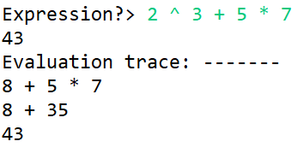
Calculator object model
OpNode.OpCode [][]
[ [ POWER ],
[ MULTIPLICATION, DIVISION, MODULO],
[ ADDITION, SUBTRACTION ] ]
Program
static void main(String[] args) userInput ← "2 ^ 3 + 5 * 7" NumCalc numCalc
NumCalc
OpNode.OpCode [][] _opPrecedence
_head
_trace
NumCalc evaluate() calls buildExprList() to build the double linked list referenced by _head. It then calls evalExprList() which is reducing the expression list to one node. Lastly, it returns the value in that node.
buildExprList() is splitting the expression, constructing either NumNode or OpNode objects and adds then to the tail of the list referenced by _head.
evalExprList() is iterating through each row in _opPrecedence table. It then scans the expression list and evaluates the OpNodes matching the current operator.
NumNode
OpNode
NumNode
OpNode
NumNode
OpNode
NumNode
NumCalc()
_rawContent ← "2"
_prev
_next
_rawContent ← "^"
_prev
_next
_rawContent ← "3"
_prev
_next
_rawContent ← "+"
_prev
_next
_rawContent ← "5"
_prev
_next
_rawContent ← "*"
_prev
_next
_rawContent ← "7"
_prev
_next
void buildExprList(String[] exprStrings)
void String evalExprList()
Void addTraceFrame()
String evaluate(String expression)
String toString()
_numValue ← 2.0
_opCode←
POWER
_numValue ← 3.0
_opCode←
ADDITION
_numValue ← 5.0
_opCode←
MULTIPLICATION
_numValue ← 7.0
NumCalc evalExprList() is calling addTraceFrame() each time the expression list is reduced. addTraceFrame() scans _head list, concatenating the rawContent of each node into one string, then adds that string to the tail of the _trace list.
NumNode
OpNode
NumNode
OpNode
NumNode
RawNode
_rawContent ← "8"
_prev
_next
_rawContent ← "+"
_prev
_next
_rawContent ← "5"
_prev
_next
_rawContent ← "*"
_prev
_next
_rawContent ← "7"
_prev
_next
_rawContent ← "8 + 5 * 7"
_prev
_next
_numValue ← 8.0
_opCode←
ADDITION
_numValue ← 5.0
_opCode←
MULTIPLICATION
_numValue ← 7.0
RawNode
NumNode
OpNode
NumNode
_rawContent ← "8 + 35"
_prev
_next
_rawContent ← "8"
_prev
_next
_rawContent ← "+"
_prev
_next
_rawContent ← "35"
_prev
_next
_numValue ← 8.0
_opCode←
ADDITION
_numValue ← 35.0
RawNode
_rawContent ← "43"
_prev
_next
NumNode
_rawContent ← “43"
_prev
_next
_numValue ← 43.0

Slide 6
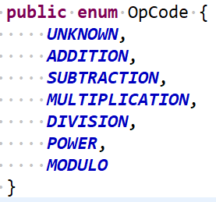
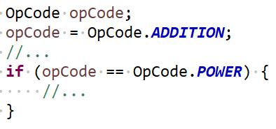
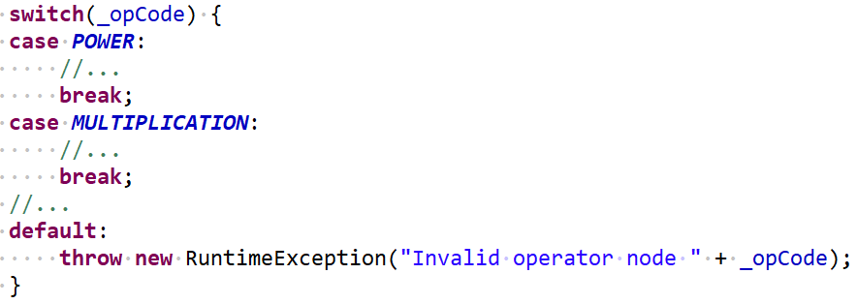
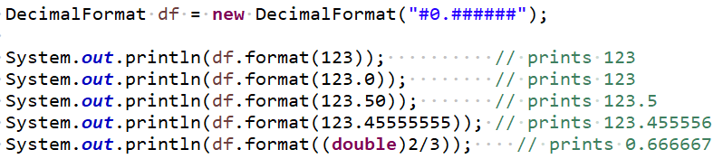
Calculator references
Java Enums | Java language feature which allows grouping a set of constants under a class name. In the Calculator project, OpNode enum type can be defined to assign a code (constant) to each of the supported operators and use them in code in a simplified manner:
Java switch..case statement | Java statement allowing for a simplified manner of separating a set of distinct cases based on the value of a given expression. Switch..case statements are generally used for replacing a sequence of if() .. else if() … else if () … else statements.
break and continue keywords | Java keywords allowing either the premature exit from any loop, such as for(), while(), do..while(), or by shortcutting one iteration and moving to the next from such loops.
Java Decimal format | Java class allowing a custom formatting when converting double numbers into Strings. In the Calculator project Decimal format class can be used when formatting the result of an OpNode as the rawContent of the new NumNode.

