Slide 1
Diagram Editing
with Mermaid
Nastase Maria Magdalena · Tudor Florina Iuliana

Slide 2
Agenda
01
Introduction
What is Mermaid? Diagrams as code.
02
Editing Model
Source files, operations, preview cycle, export.
03
Comparison
Mermaid vs PlantUML vs graphical tools.
04
Login Flow Example
Flowchart, sequence diagram, and syntax error demo.
05
Conclusion
Key lessons and tool selection guidance.

Slide 3
Introduction
Diagrams as Code
Editing Environments
Editable artifact is text, not shapes drawn with mouse. Stored in version control like source code.
VS Code
Mermaid Preview extension
Live side-by-side view
What Mermaid Is
JavaScript-based renderer. Converts text syntax into SVG/PNG. Native to GitHub & GitLab Markdown.
Live Editor
What Mermaid Isn't
mermaid.live
Browser-based, no install
Not a full MDE environment — no metamodel, constraints, or code transformations (unlike EMF/GME).
CLI (mmdc)
Why We Chose It
Export PNG/SVG
CI/CD pipeline validation
Wanted to study day-to-day editing: which editor, how preview works, error handling, and report export.

Slide 4
The Editing Model
Write / Edit
Text
Save
File
Preview
Diagram
Check
& Fix
Export
PNG / SVG
Declare Type
Nodes & Labels
Links / Edges
First line sets diagram type
(flowchart TD, sequenceDiagram…)
Parse error if misspelled
ID stays stable; only label
in brackets changes when
renaming — links don't break
One line per connection;
--> for arrows, |label|
for edge annotations
Subgraphs
Styling
Comments
Group related nodes visually;
subgraph Name["Label"]
...
end
classDef assigns colors/borders;
applied via class keyword
to node identifiers
%% lines ignored by renderer;
useful for author notes
and code review context

Slide 5
Comparative Analysis
Aspect
Mermaid
PlantUML
Graphical Tools
Installation
Browser or npm
No Java
Java + server/CLI
Heavier setup
Download installer
Usually free/paid
GitHub Markdown
✓ Native support
Needs plugin
Export image only
UML Notation
Practical / informal
Closer to standard
Freehand / formal
Version Control
Text in Git
Diff friendly
Text in Git
Diff friendly
Binary / proprietary
Diagram Types
Growing set
Larger set
Unlimited (mouse)
Learning Curve
Low — quick start
Medium
Low for drawing
High for large teams

Slide 6
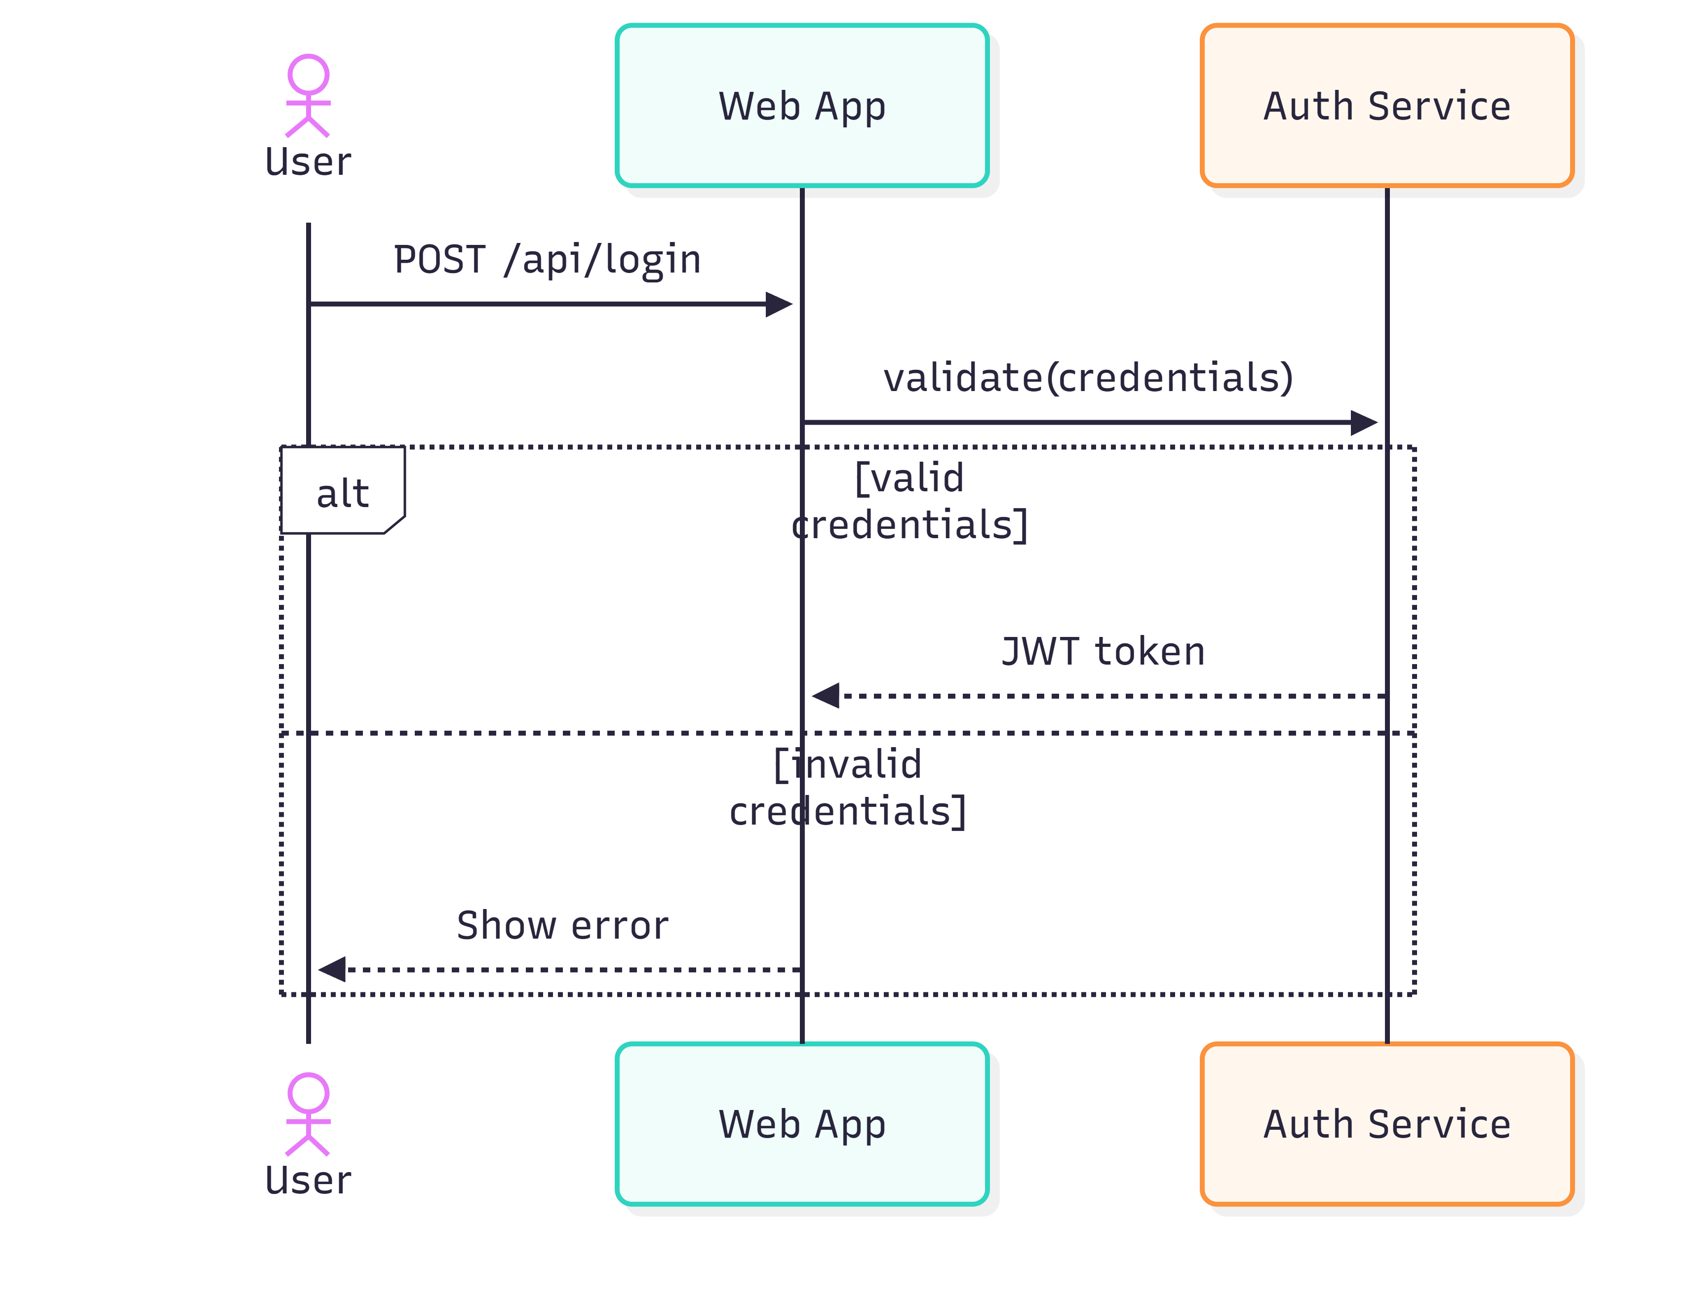
Practical Work: Login Flow
Flowchart
Sequence Diagram
sequenceDiagram
actor U as User
participant W as Web App
participant A as Auth Service
U->>W: POST /api/login
W->>A: validate(credentials)
alt valid credentials
A-->>W: JWT token
else invalid credentials
W-->>U: Show error
end

Slide 7
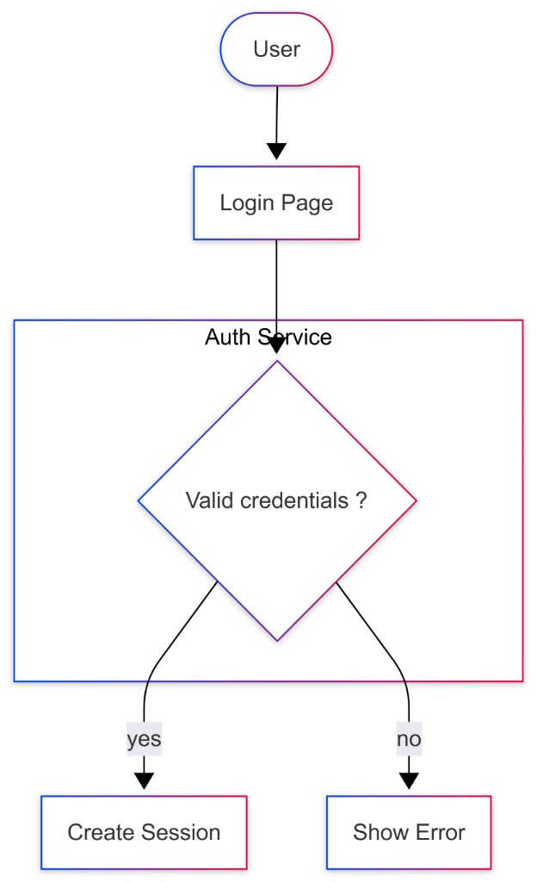
Practical Work: Login Flow
Flowchart
Se Diagram
flowchart TD
A([User])
B[Login Page]
C{Valid credentials?}
subgraph Auth["Auth Service"]
C
end
A --> B
B --> C
C -->|yes| D[Create Session]
C -->|no| E[Show Error]

Slide 8
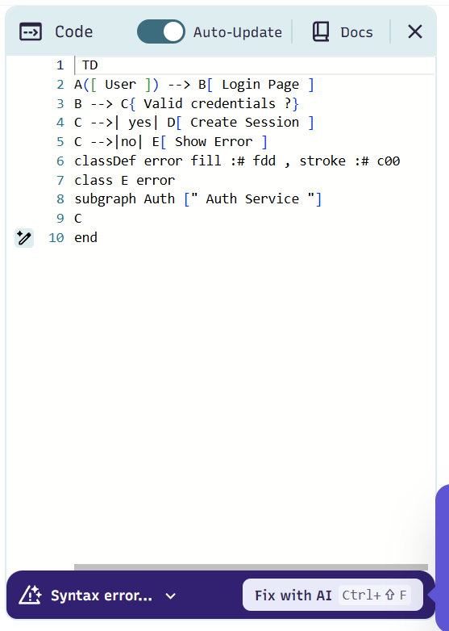
Syntax Error During Editing
Fast Feedback Loop
Mermaid reports errors immediately when the file is saved — similar to a compiler error.
First Line Matters
The diagram type keyword on line 1 must be exact. One typo stops rendering entirely.
CI/CD Integration
Run mmdc in a build pipeline to fail the build if any diagram cannot render — catch errors before publishing.
Short Iteration
The fast error cycle encourages small, frequent edits rather than big-bang changes.

Slide 9
Difficulties & Limitations
Layout Crossing Edges
No Automatic Message Numbering
With many nodes, the automatic dagre layout may draw crossing edges. Optional ELK layout engine exists but requires extra configuration.
Sequence diagrams lack automatic step numbering. PlantUML provides this out of the box, which is useful for formal documentation.
Special Characters in Labels
Large Diagram Readability
Characters like slashes (e.g., /api/login) must be quoted or escaped. Easy to overlook and causes unexpected parse errors.
Mermaid is excellent for small-to-medium diagrams. Very large graphs become hard to manage without switching to a dedicated modeling tool.
C4 Architecture Support Still Evolving
Limited Layout Control
C4 architecture diagram features are not yet mature. Some authors prefer PlantUML or dedicated tools for enterprise architecture diagrams.
Unlike graphical tools (Visio, Lucidchart), node placement is fully automatic. Precise positioning for formal deliverables is not possible.

Slide 10
Conclusion
Choose Mermaid when…
Choose PlantUML when…
Diagrams appear in GitHub / GitLab Markdown
Stricter UML notation compliance is required
Team needs quick start — no Java or server setup
Richer sequence diagram features (numbered msgs, frames)
Flowcharts and sequence diagrams are sufficient
Larger set of diagram types needed in one toolchain
Text diff and code review workflow is required
Team already has Java in the build environment
Students or small teams with simple documentation needs
Complex enterprise architecture models (C4, etc.)
Key insight: Choose by purpose, not by ranking. Both tools keep diagrams as text in Git — a foundation for maintainable, reviewable documentation.

Slide 11
Thank You

