Slide 1
Main Robot

Slide 2
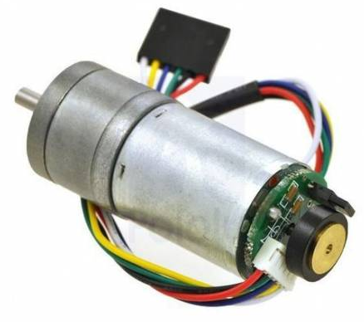
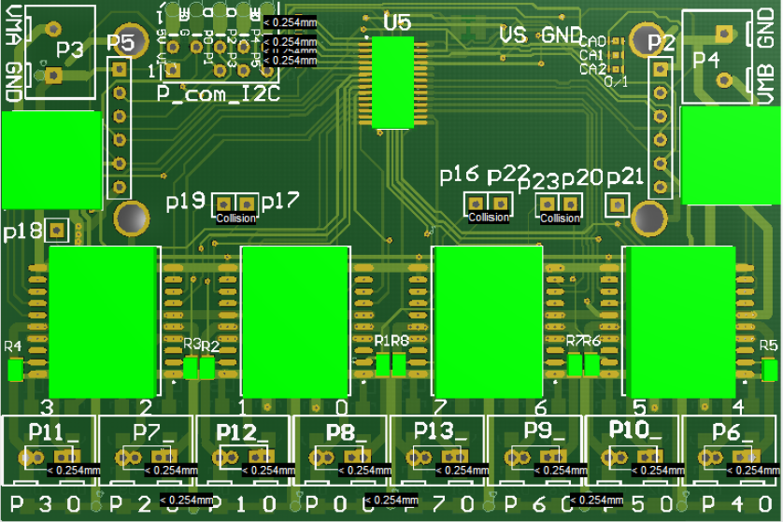
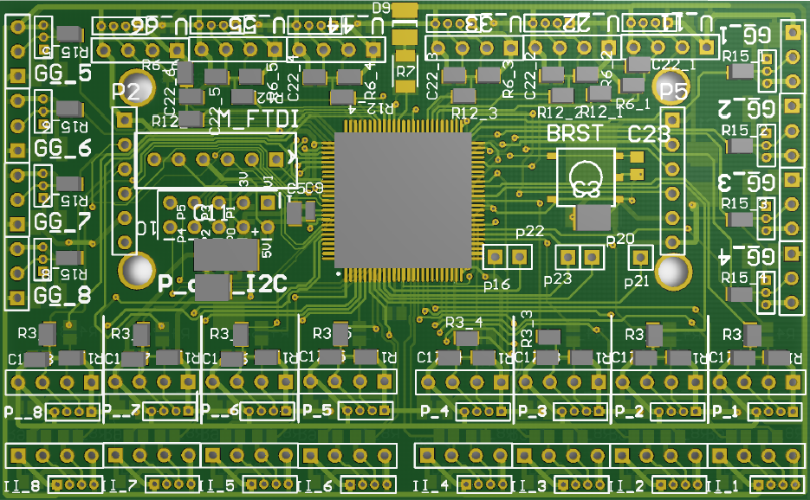
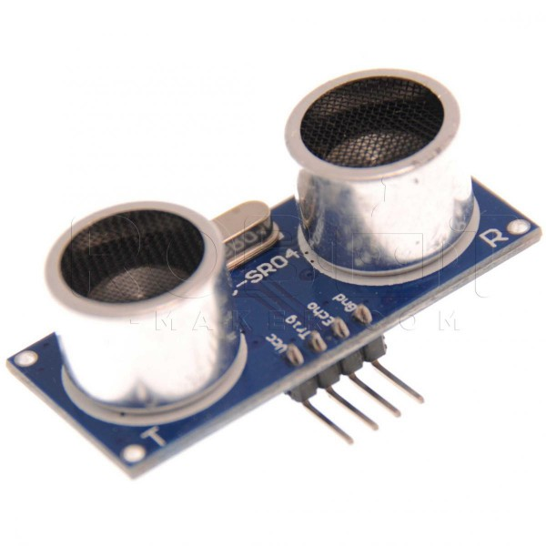
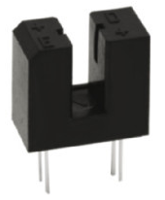
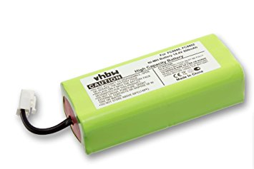
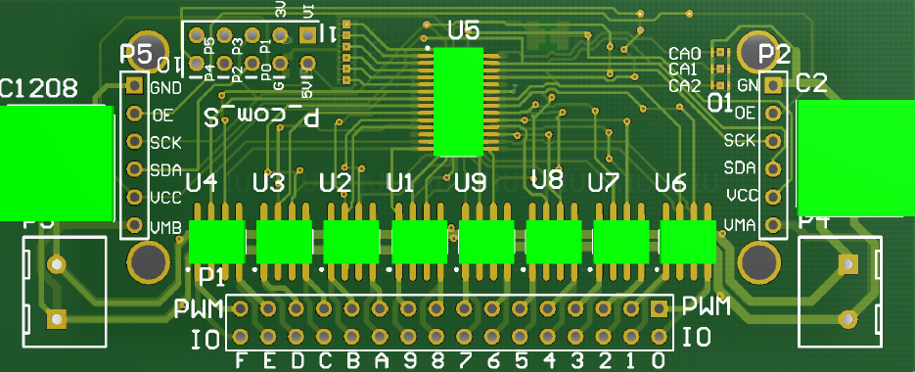
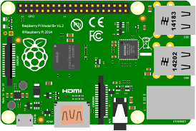
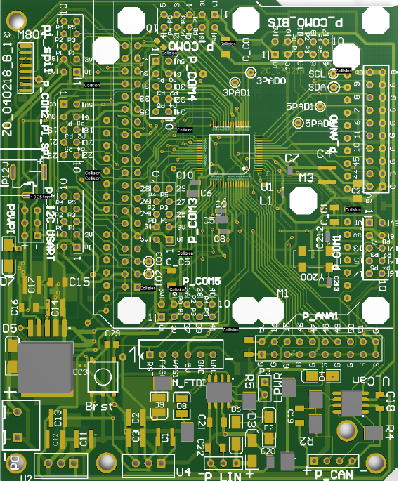
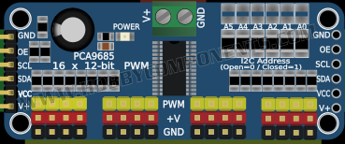
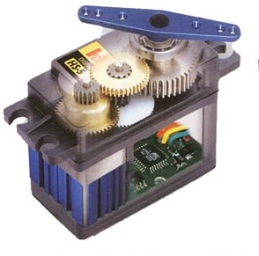
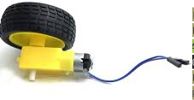
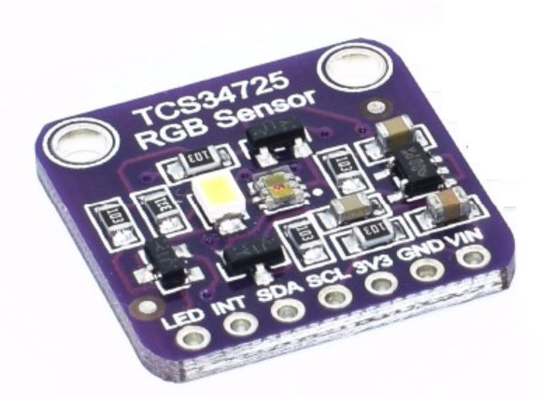
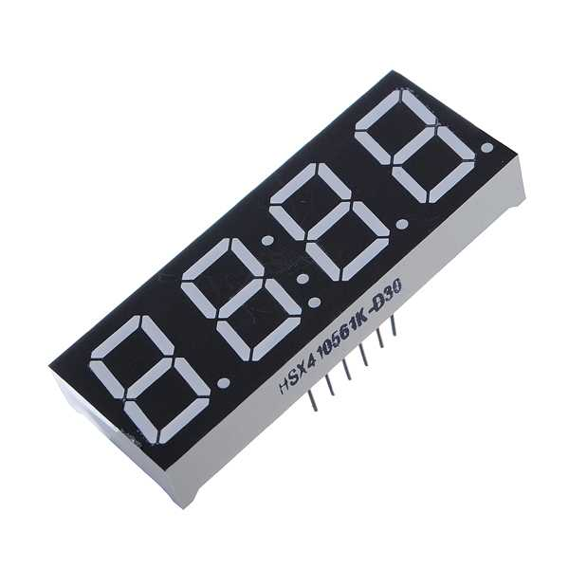
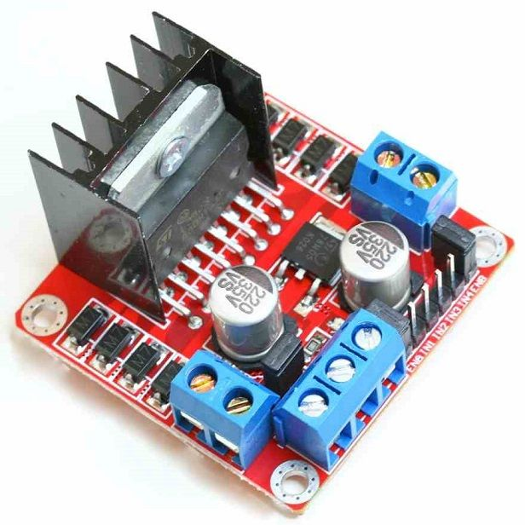
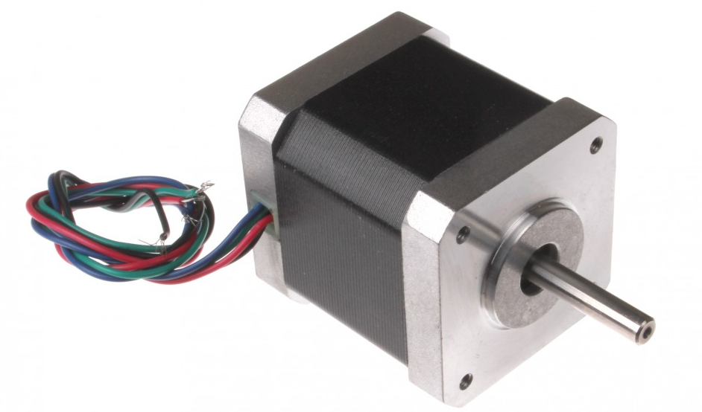
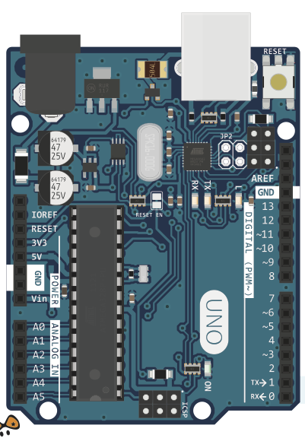
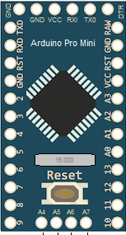
Captor board : 81 I/O
Motor3 : 8 PWM 3A
coder
8 Telemetre analog
Color Sensor
TCS34725
8 Telemetres pulse
5V
I2C
8 On/off analog
5V
I2C
Pilo : 53 I/O
Motor2 : 16 PWM 800mA
5V3A
usart
5V
I2C
Raspberry PI
Module PCA9685 : 16 servo
5V
2 wire
5V
I2C
Color Sensor
TCS34725
5V
I2C
Color Sensor
TCS34725

Slide 3
Captor 1 : captor board
HC-SR04
HC-SR04
HC-SR04
HC-SR04
HC-SR04
HC-SR04
8 coder whole
8 IR captor
8 sharp
6 HC-SR04
1 P com (usart/I2C)
2 I2C
1 FTDI
5 Isense(motor3)
Stackable : PCA9685/motor2/motor3
Sharp
Sharp
Sharp
Sharp
FTDI
48Mhz
32 bit
256ko
3/5V
WireA
WireB
Sharp
P COM
Sharp
Sharp
Sharp
coder
coder
coder
coder
coder
coder
coder
coder
IR
IR
IR
IR
IR
IR
IR
IR
(Home made)

Slide 4
Pilo : RapberryPi/arduino I/O extention
2x8 analog
5/7 Pcom
usart
I2C
Spi
3V 150mA
5V 150mA
1 (FTDI)
1 CAN
1 LIN
1 raspberry Pi(stackable)
3A 5V supply
I2C/USART
SPI/PCOM
Pi1,2,3,Zero
1 arduino : (stackable)
Uno/mega256
I2C
1 NRF24L01 : 2.4Ghz
1Vin : 6-36V 30W
Vin
Vin
NRF24L01
PI :
5V 3A
5V 3A
Pi :I2C / USART
PCOM
PI : SPI
Arduino
Raspberry PI
PCOM
PCOM
FTDI
PCOM
PCOM
48Mhz
32 bit
265Ko
LIN
PCOM
Analog x8
CAN
Arduino
PCOM
Analog x8
(Home made)

Slide 5
Motors boards
Motor3
4+4 motors DC or 2+2 Step motor
VinA 5-36 / VinB 5-36
PWM/HiZ/Stop : 2/3A
8 Isense
IC2 : 3 output
Stackable captor/PCA9685/motor2
Motor2
8+8 motors 0.8A
VinA 5-12 / VinB 5-12
IC2 : 3 output
Stackable captor/PCA9685/motor2
(Home made)

Slide 6
Generic connector PILO
P_COMx
P_ANAx
FTDI : USB-usart
Or debug

Slide 7
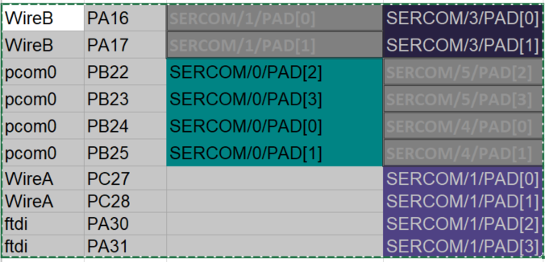
Captor board
Sda
Clk
SDA
SCK

Slide 8
Captor color
PCOM1 : 5V
PCOM4 : 3V

Slide 9
Improvement
I2C resistor
3 strap PCOM0 captor
1 strap vdd captor
WireA/B location d=2,5mm

