Slide 1
Traffic road sign detection
Pop Tudor Petrean Florin group 30432 teaching assistant Ion Augustin Giosan Teaching Assistant : Ion Augustin Giosan

Slide 2
Contents
1. Introduction
2.Theoretical background
3.Design and Implementation

Slide 3
Introduction
The aim for this project is design and implement using OpenCV library a program to detect road signs from various images. This program will be helpful in the future, solving the problem of road signs detection for self-driving cars.

Slide 4
Theoretical background
For the image processing part of the project, a good approach to detecting road signs is to have an already established database of those and compare them with the fetched road sign from our source image and see if they match at least 90%.
We need some sort of contour detection (that means detecting when there is a big color change from one pixel to another) to see where the road sign edges begin and end.

Slide 5
Design and Implementation
So the basic algorithm would be:
Transfer the source image to HSV
using the method given at the laboratory session
Compare the colors with the predefined road sign colors and adjust with a threshold.
iterate through each road sign colour and try to find it in the source image
Fetch the road sign from the source image
analyze and detect all objects that have colour matching with any of the colours from our road sign database(array of images)
store all objects in their respective colour category
Compare the edges with the database images.
use an edge detection algorithm and compare the edges of each object with the road sign database shapes
use an contour detection algorithm to verify the number of edges given by the edge detection algorithm

Slide 6
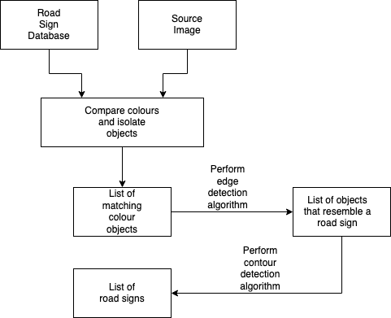
Flow chart diagram

Slide 7
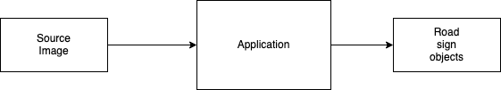
Block diagram

