Slide 1
Economics-Informed Neural Network for US Inflation Forecasting
Florent Samson

Slide 2
Motivation
Standard macro forecasting models (AR, VAR) impose linear structure
Deep learning models improve forecast but are black boxes
New Keynesian Philips Curve provides structure
Post-2020 inflation surge exposed limits of both: black-box models failed out-of-distribution, and NKPC parameters appear to have shifted
This project: embed the NKPC as a structural constraint inside a neural network — borrowing the Physics-Informed Neural Network (PINN) framework from engineering

Slide 3
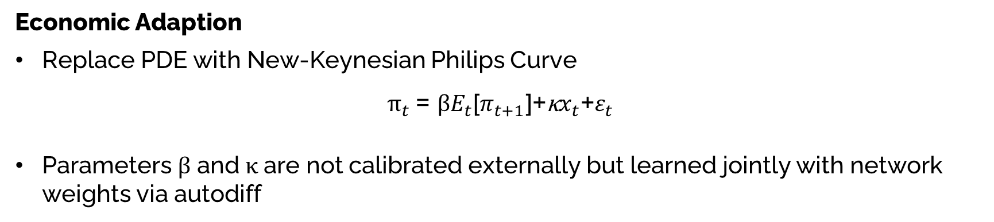
Background
Physics-Informed Neural Networks (PINNs):
Raissi et al . (2019) “Physics-informed neural networks: A deep learning framework for solving forward and inverse problems involving nonlinear partial differential equations”
Neural Networks embedding physical laws into the loss function
Economic Adaption
Replace PDE with New-Keynesian Philips Curve
$$π_{t} \text{​=} \text{β}E_{t}\text{​[}π_{t+1}\text{​]+}\text{κ}x_{t}\text{​+}ε_{t}\text{​}$$
Parameters β and κ are not calibrated externally but learned jointly with network weights via autodiff

Slide 4
Data
All data taken from FRED. Monthly. Standardized.
Variable | FRED Code | Role | Notes
CPI Inflation | CPIAUCSL | Target (12-months% change) | Log-diff, annualized
Unemployment Rate | UNRATE | Gap | Gap = UNRATE - NAIRU
CBO NAIRU | NROU | Gap | Interpolated to monthly
UMich Expectations | MICH | Inflation Expectations | t+12 instead of t+1
Macroeconomic covariates | INDPRO, WTISPLC, PPIACO, FEDFUNDS, NFCI, etc | Input to NN
Lags of inflation, gap, and expectations | CPIAUCSL, UNRATE, NROU, MICH | Input to NN

Slide 5
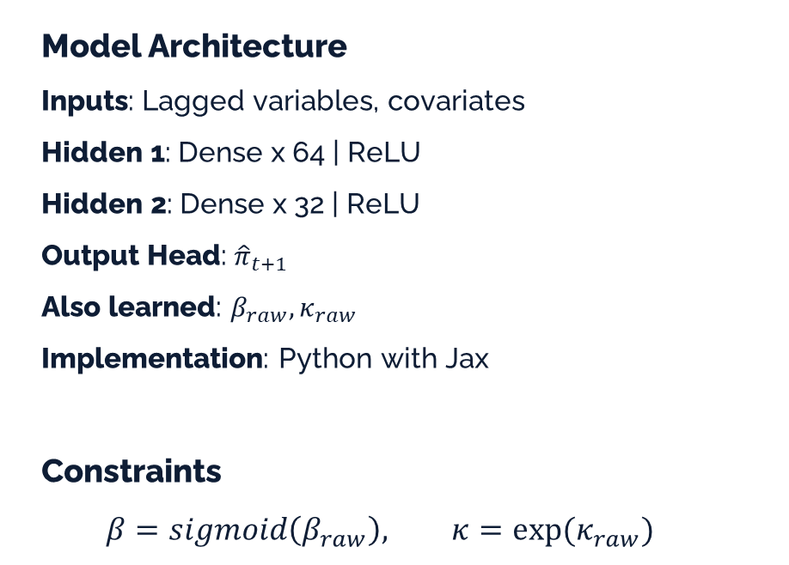
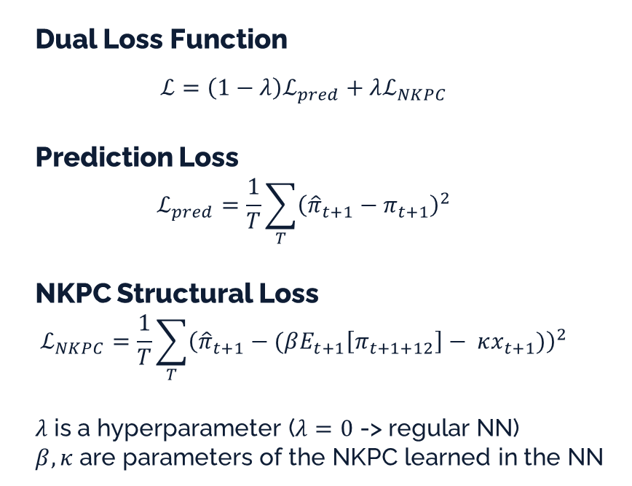
Model Architecture
Dual Loss Function
$$ℒ=\left(1−λ\right)ℒ_{pred}+λℒ_{NKPC}$$
Prediction Loss $$ℒ_{pred}=\frac{1}{T}\sum_{T}{{\left({\hat{π}}_{t+1}−π_{t+1}\right)}^{2}}$$
NKPC Structural Loss $$ℒ_{NKPC}=\frac{1}{T}\sum_{T}{{\left({\hat{π}}_{t+1}−(βE_{t+1}\left[π_{t+1+12}\right]− κx_{t+1})\right)}^{2}}$$
$λ$ is a hyperparameter ($λ=0$ -> regular NN)
$β,κ$ are parameters of the NKPC learned in the NN
Model Architecture
Inputs: Lagged variables, covariates
Hidden 1: Dense x 64 | ReLU
Hidden 2: Dense x 32 | ReLU
Output Head: ${\hat{π}}_{t+1}$
Also learned: $β_{raw}, κ_{raw}$
Implementation: Python with Jax Constraints
$$β=sigmoid\left(β_{raw}\right), κ=exp⁡(κ_{raw})$$

Slide 6
Benchmarks
Compare EINN (Economic-Informed Neural Network) performance against econometrics and NN benchmarks
AR(1)
LASSO
VAR (CPI Inflation, Slack, Expectations, Covariates)
Basic Neural Network (Same architecture and inputs, normal loss function)

Slide 7
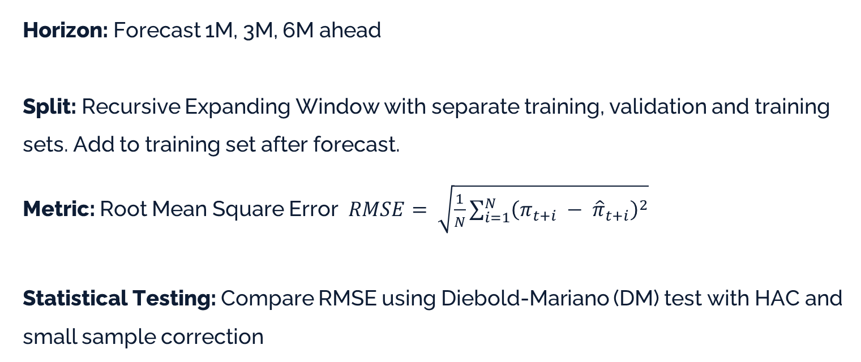
Evaluation
Horizon: Forecast 1M, 3M, 6M ahead
Split: Recursive Expanding Window with separate training, validation and training sets. Add to training set after forecast. Metric: Root Mean Square Error $RMSE= \sqrt{\frac{1}{N}\sum_{i=1}^{N}{{\left(π_{t+i} − {\hat{π}}_{t+i}\right)}^{2}}}$
Statistical Testing: Compare RMSE using Diebold-Mariano (DM) test with HAC and small sample correction

Slide 8
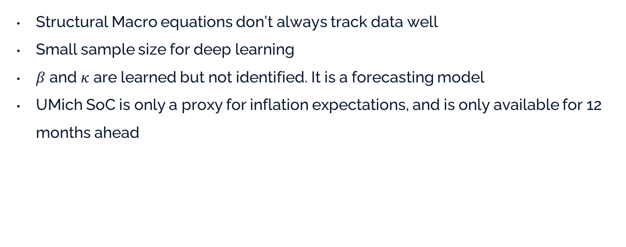
Weaknesses
Structural Macro equations don’t always track data well
Small sample size for deep learning
$β$ and $κ$ are learned but not identified. It is a forecasting model
UMich SoC is only a proxy for inflation expectations, and is only available for 12 months ahead

Slide 9
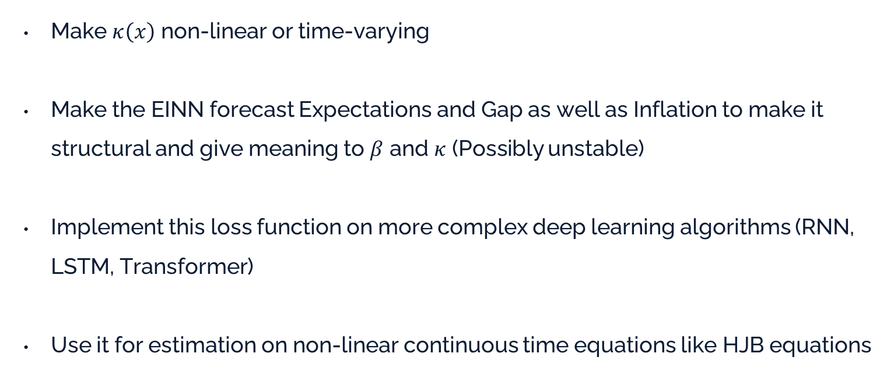
Extensions
Make $κ\left(x\right)$ non-linear or time-varying
Make the EINN forecast Expectations and Gap as well as Inflation to make it structural and give meaning to $β$ and $κ$ (Possibly unstable)
Implement this loss function on more complex deep learning algorithms (RNN, LSTM, Transformer)
Use it for estimation on non-linear continuous time equations like HJB equations

