Slide 1
Evaluating LLM Causal Knowledge Extraction from Central Bank Communications
Florent Samson

Slide 2
Central Banking & FOMC Minutes
Federal Reserve
Set monetary policy to maintain price stability and maximize employment
People and markets’ expectations about the economy shape the trajectory of these variables
Central banks influence expectations through their communications to the public
Financial markets react in real time to Central Banks’ communications
FOMC Minutes
The FOMC meets 8x per year. Release meeting minutes to the public afterwards
Staff Review of the Economic Conditions
Participant’s View on Current Conditions
Policy Decision & Rationale

Slide 3
Research Question & Contributions
“How reliably can LLMs extract causal relationships from Central Banks communications, and do failure rates and failure modes vary systematically across linguistic complexity and economic regime?”
Motivation
Application to specialized field
Automate knowledge extraction
Heavily hedged language
Contributions
Faithfulness benchmark stratified by complexity
Characterize 5 failure modes
Evolution of faithfulness & failure across time/regimes

Slide 4
Dataset
“FOMC Meeting Statements and Minutes dataset (Tasca, 2023)” from Kaggle
Sample 10 meetings per periods:
Great Moderation (1994-2007)
Post-Crisis ZLB (2010-2019)
Post-COVID (2022-2025)
Select relevant sections
Split into passages of max 5 sentences using NLTK
Randomly sample 67 passages from each period for a total of 201 passages

Slide 5
Causal Triplet
Cause: factor producing the effect
Effect: outcome affected
Connector: core causal verb/mechanism
Hedge: uncertainty modifying the connector
Direction:
"positive": cause and effect move in same direction
"negative": cause and effect move in opposite directions
"ambiguous": otherwise

Slide 6
Causal Triplet Example
"Rising oil prices boosted inflation. The Fed's rate hikes, which were expected to slow demand, contributed to a cooling labor market.“
"cause": "rising oil prices", "connector": "boosted", "effect": "inflation", "hedge": "", "direction": "positive“
"cause": "Fed rate hikes", "connector": "slow", "effect": "demand", "hedge": "were expected to", "direction": "negative“
"cause": "Fed rate hikes", "connector": "contributed to", "effect": "cooling labor market", "hedge": "", "direction": "negative"

Slide 7
Methodology
Select sample from dataset and divide into passages
Process each passage with Gemini 3 Flash via Google AI Batch API
Evaluate causal sentences based on Complexity (1-5) manually
Evaluate each Causal Triplet on faithfulness manually. Unfaithful triplets are assigned one of 6 failure modes
Aggregate results by Complexity and by Period

Slide 8
Evaluation
Complexity
1-2: Explicit causal statement, minimal hedging
3: Moderate hedging or mild implicit structure
4-5: Heavy hedging, multi-hop chains, or highly implicit causation requiring domain knowledge
Failure Mode 0: Missed causal triplet
1: Hallucinated/correlation only
2: Wrong direction
3: Wrong Cause/Effect/Connector
4: Hedge Failure
5: LLM technical error

Slide 9
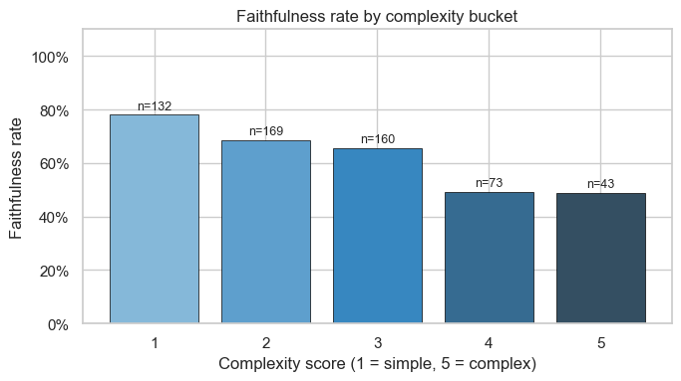
Overall Faithfulness

Slide 10
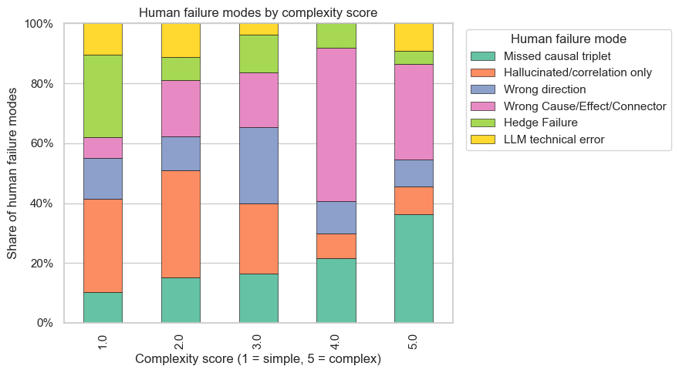
Failure Mode Distribution

Slide 11
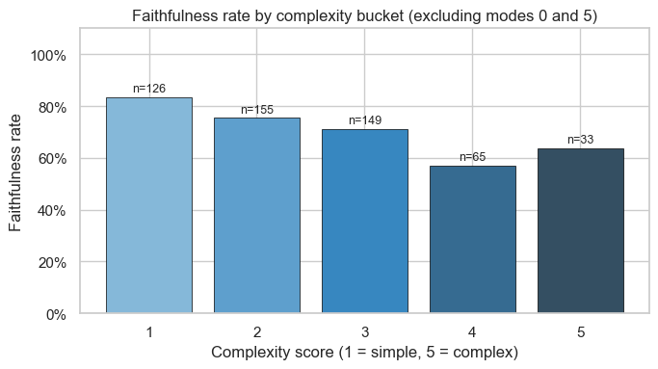
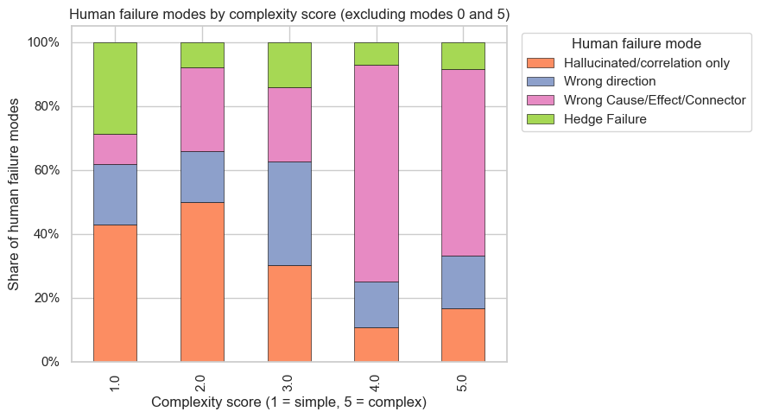
Faithfulness and Failure on existing triplets only

Slide 12
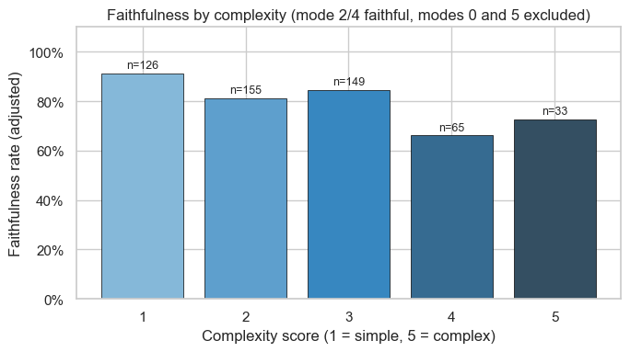
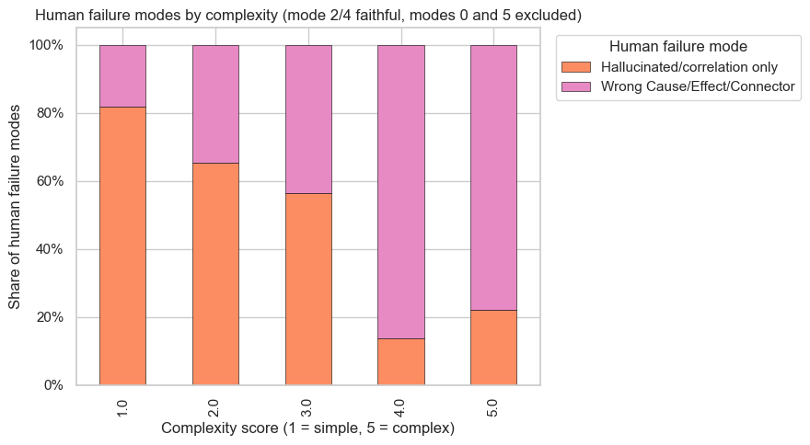
Faithfulness and Failure on Cause/Effect/Connector

Slide 13
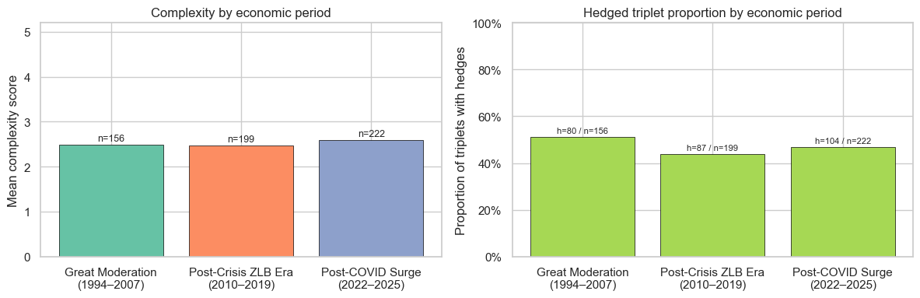
Complexity across Periods

Slide 14
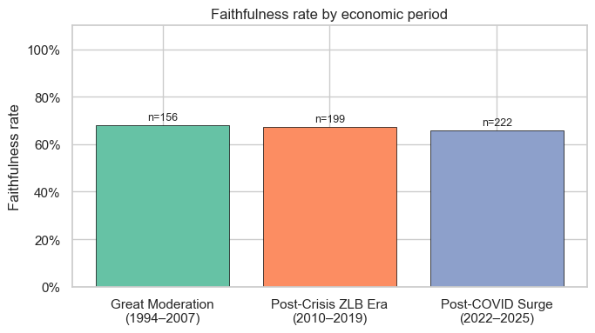
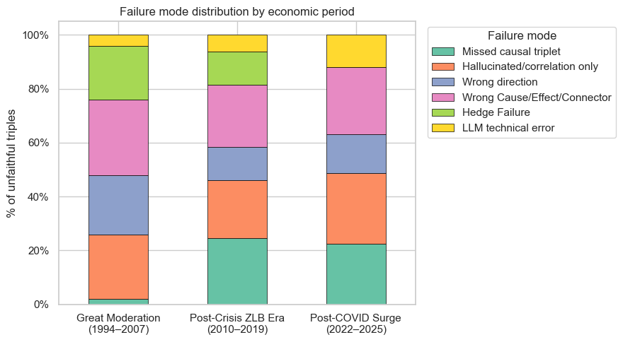
Faithfulness & Failure by Period

Slide 15
Takeaway
Average faithfulness not high enough for automated construction yet (67% in full evaluation, 80% in base triplets only)
Faithfulness declines with complexity
Models miss more triplets and capture wrong cause/effect more as complexity increases
Hedging is correctly identified regardless of complexity
Different periods exhibit same complexity and hedging rate, faithfulness and failures

Slide 16
Insights and Weakness of Analysis
Clustered Errors
Negative Causality
Length vs Cutoff
Errors tend to cluster in the same passages.
Model struggle with sentences such as “Despite high unemployment, consumer spending increased.”
Longer passages lead to more failure and technical errors, but shorter passages risk separating causality across passages.
Statistical vs Economical
Human Judgement
Output Variability
Difficulty distinguishing economic causation and statistical causation
The boundary of causality and correlation is not always clear, leading different judges to different analysis
LLMs aren’t deterministic, complicating replication.

Slide 17
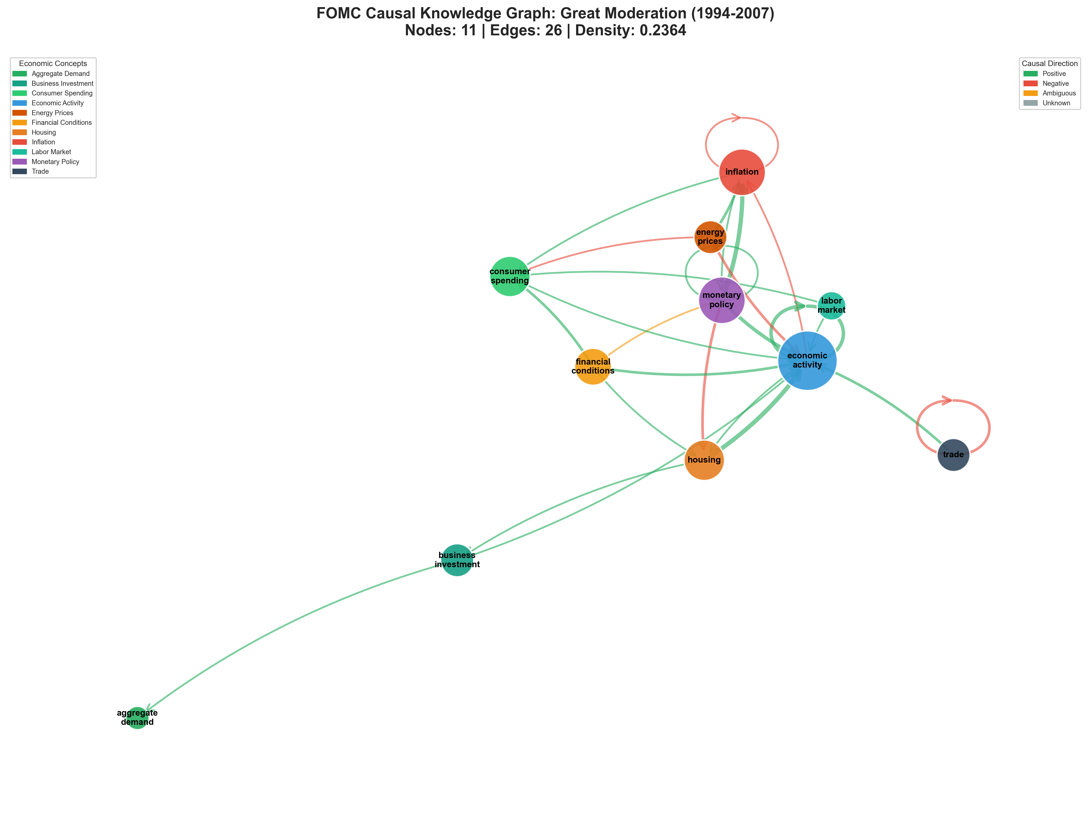
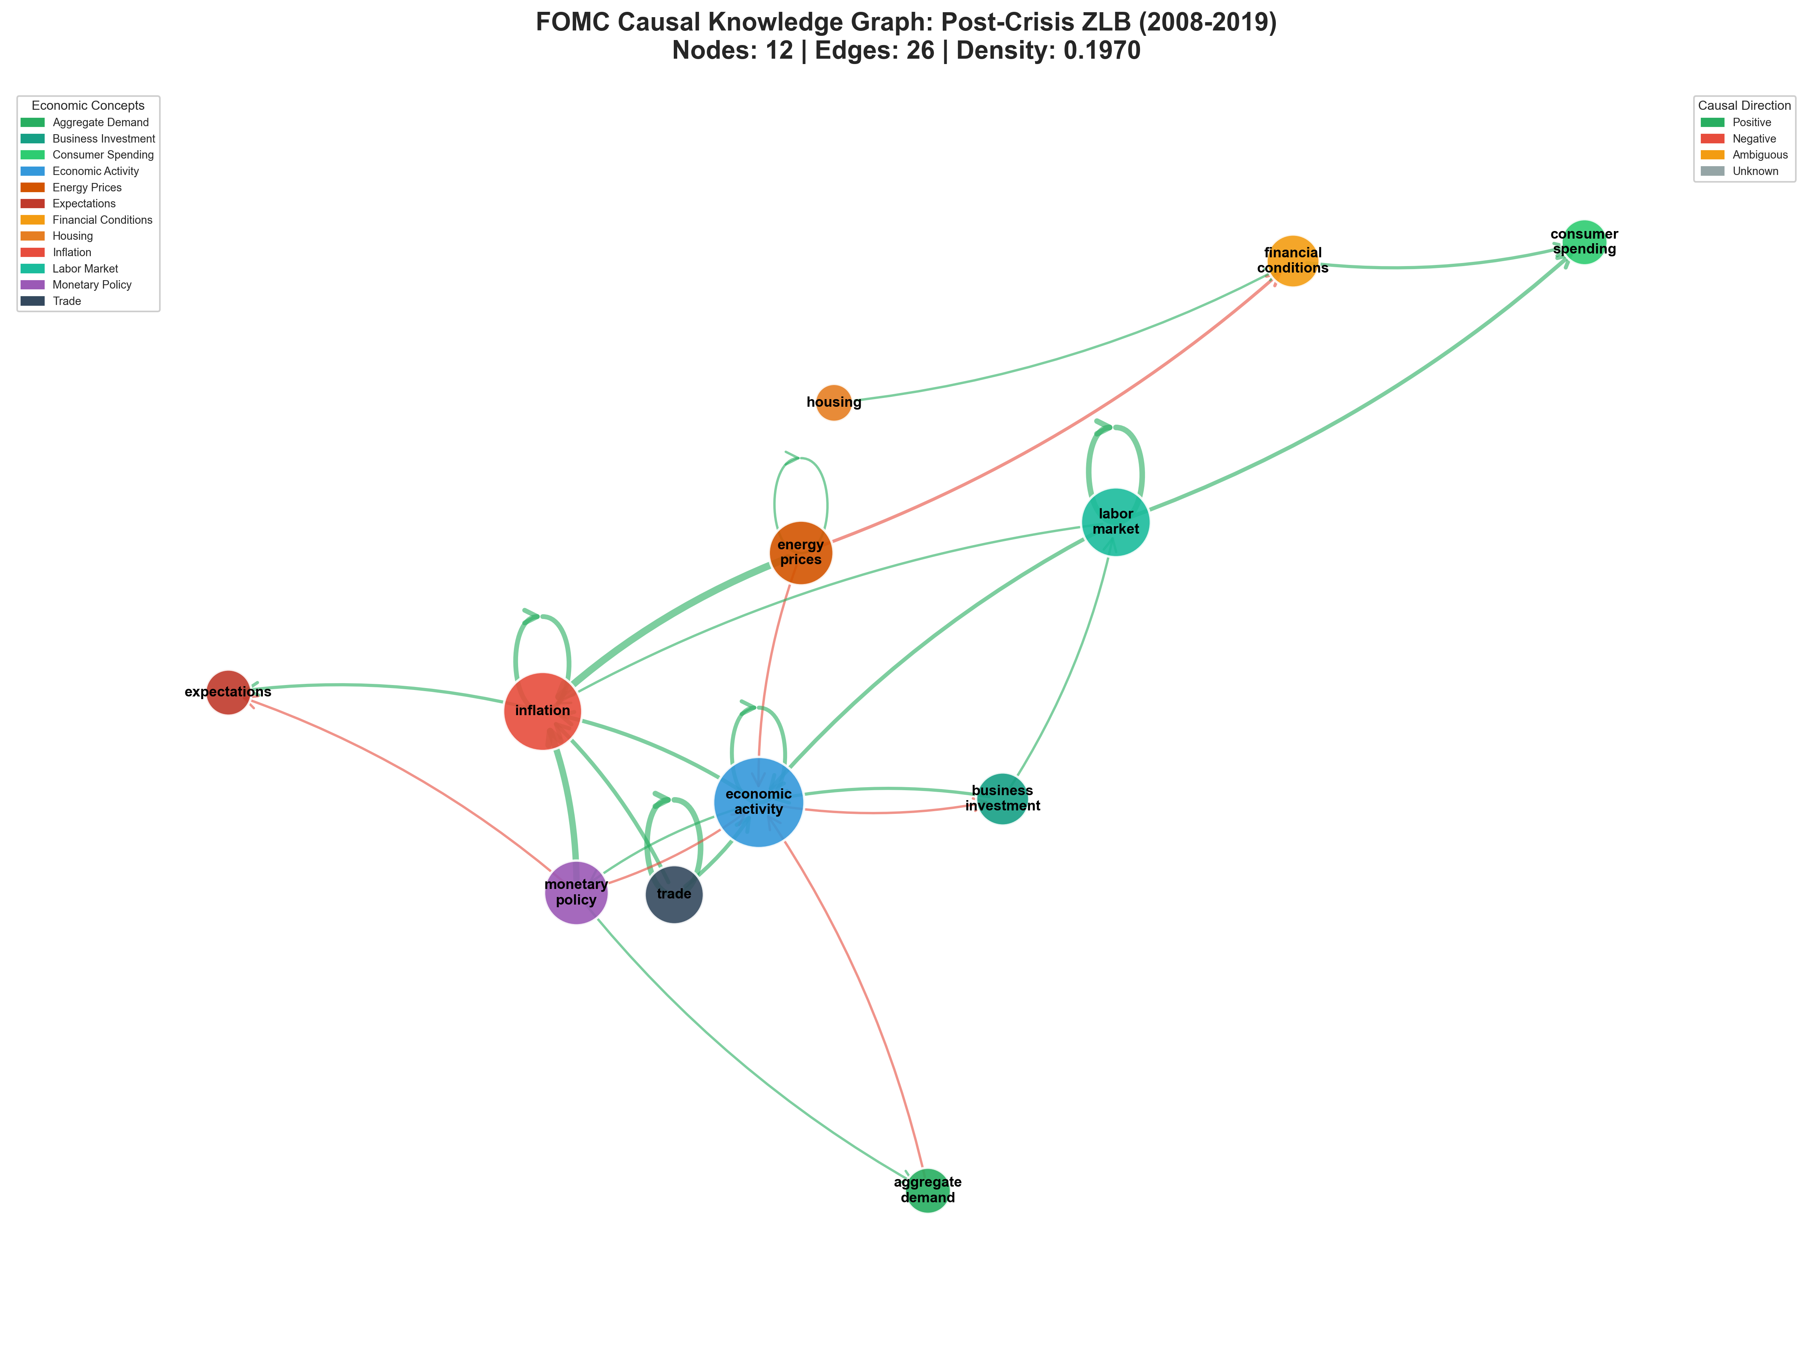
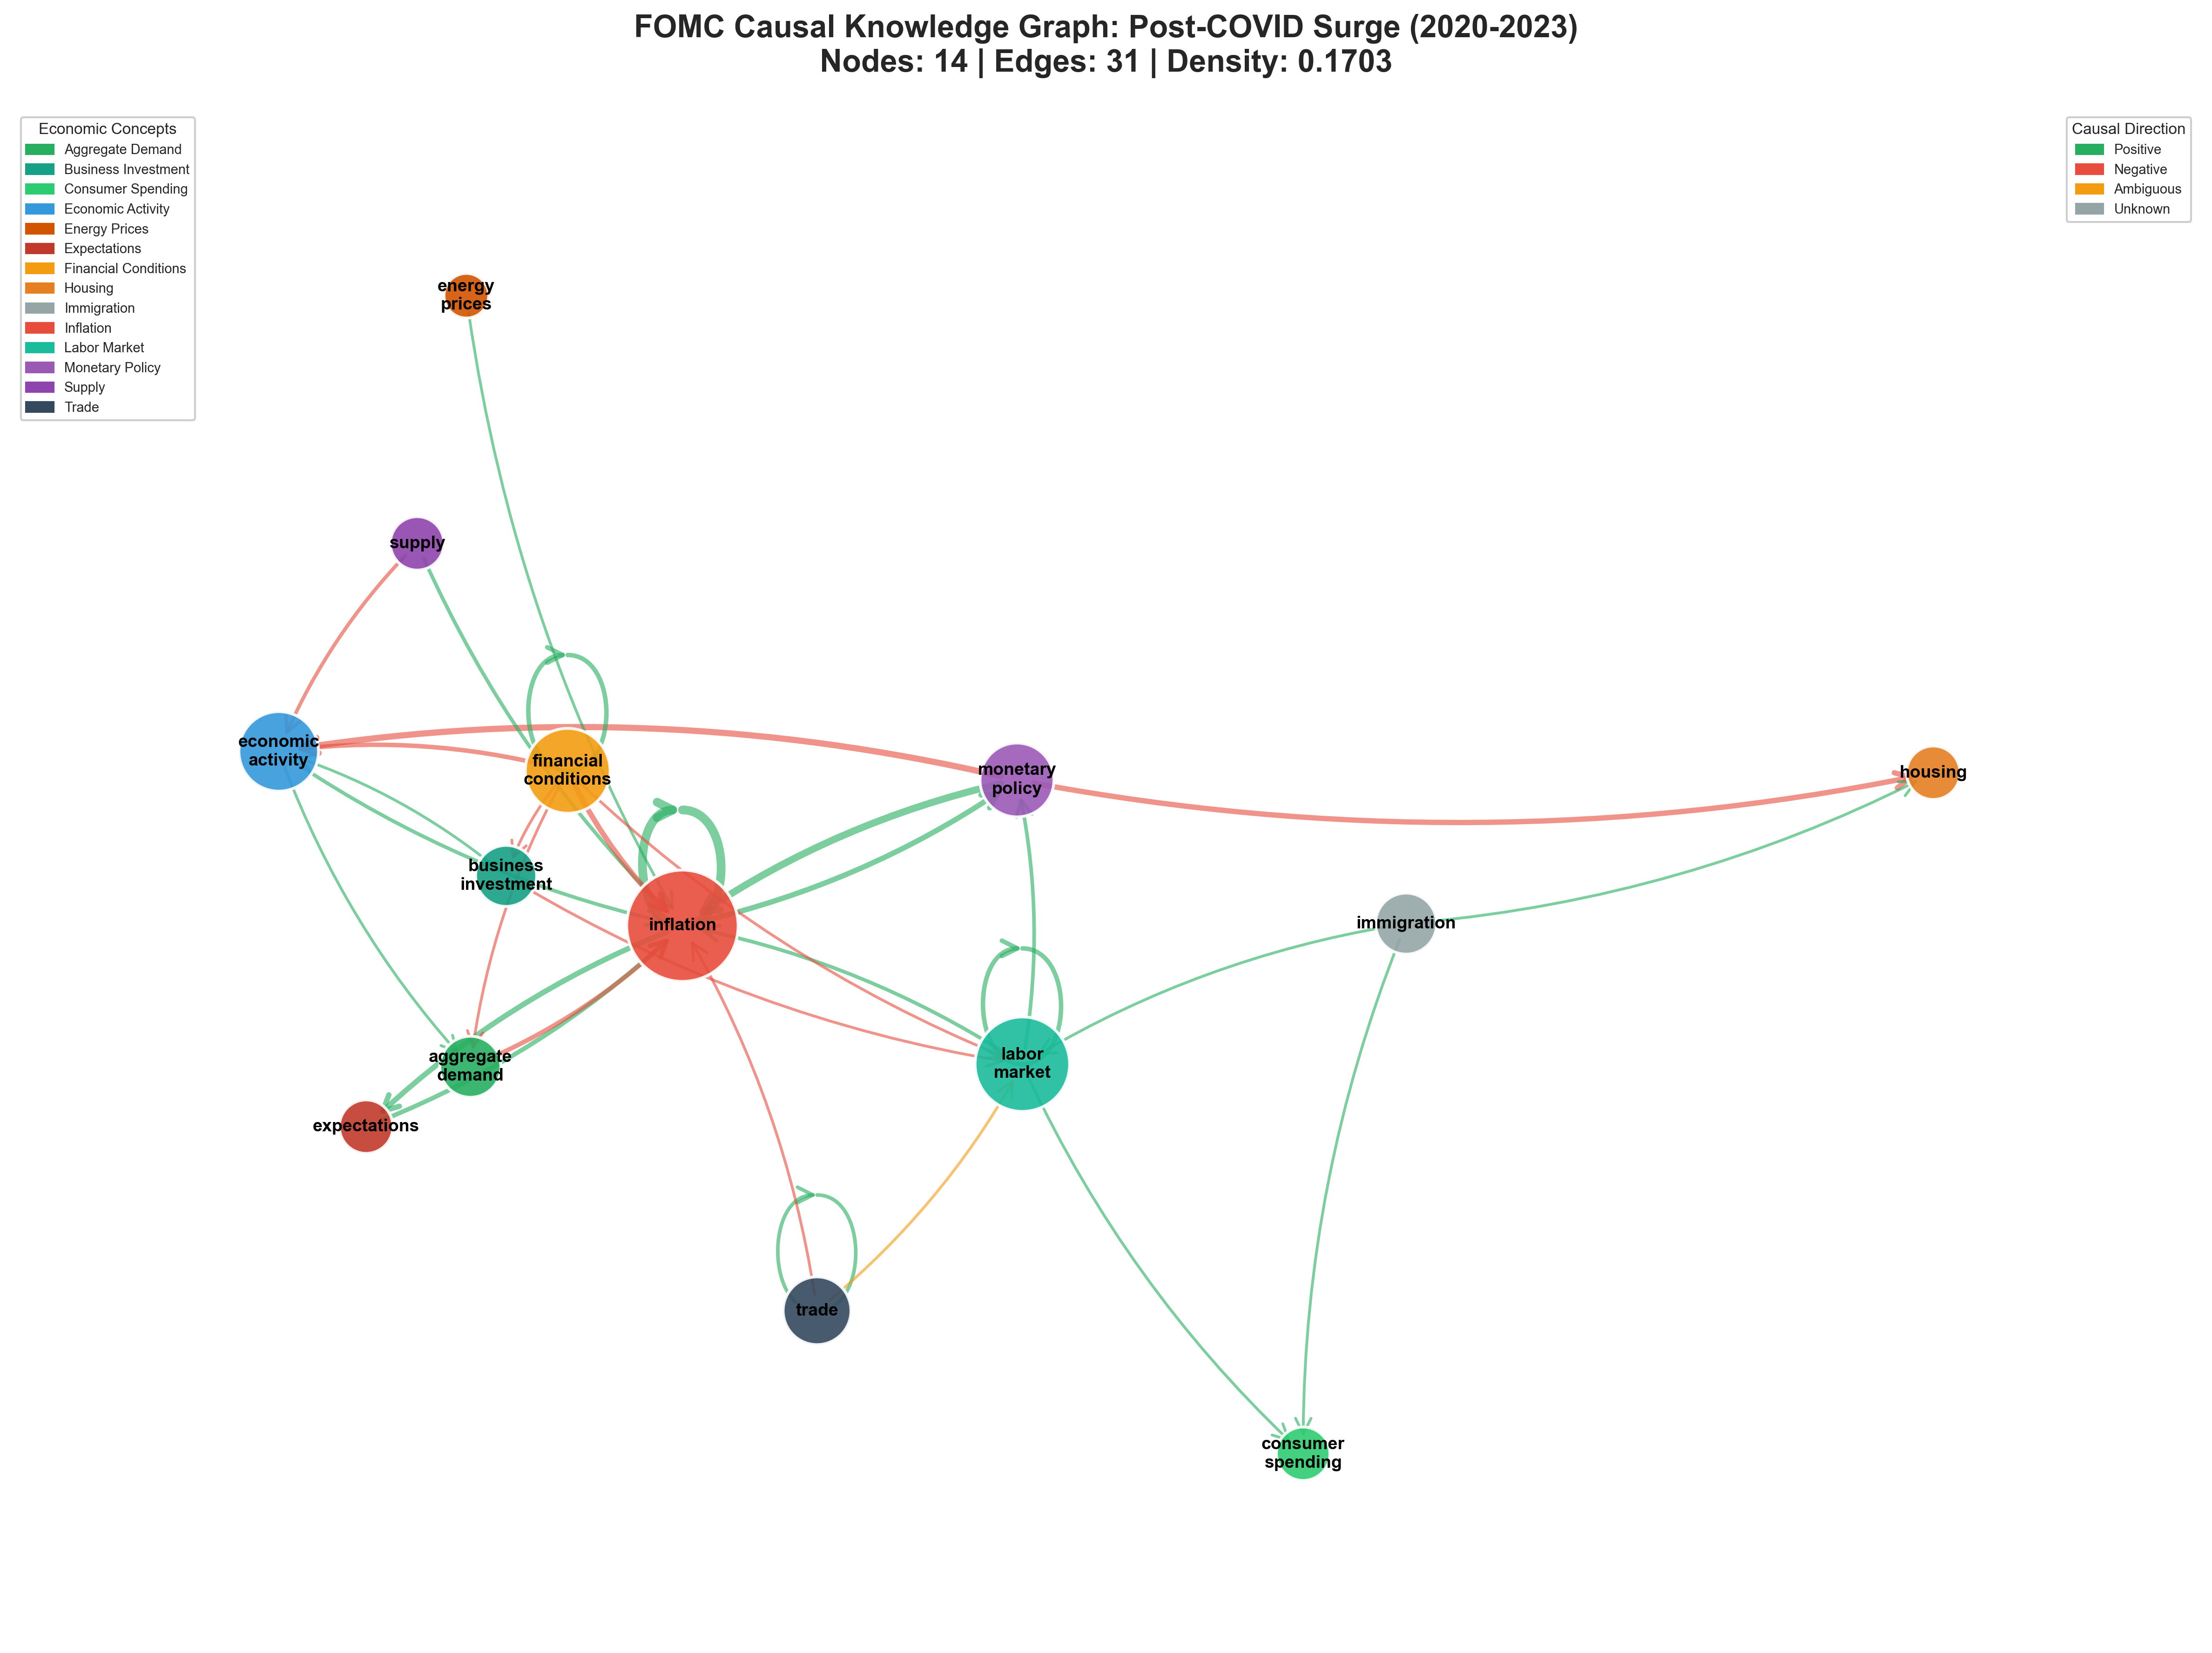
Causal Graphs
Denser Graph
Clear Policy -> Inflation -> Growth transmission
External factor (energy, trade) dominate
Policy transmission weaker
Inflation becomes central
More concepts (immigration, expectations, supply)
More trade-offs (negative edges)

Slide 18
Next Steps
Use deterministic linguistic complexity measure
Compare human judgement to LLM-as-a-judge
Use RAG to provide relevant example and improve faithfulness
Create knowledge graphs using the triplets from all meetings to see how causality changed by period

