Slide 1
TamaGo Styleguide
Max Moser

Slide 2
Overview
Fonts
Colorpallete
GUI Elements

Slide 3


Fonts
Normal Text
Josefin Sans
Light 300 Italic
Headings
Light 400
Notes:
https://fonts.google.com/share?selection.family=Josefin+Sans:ital,wght@0,100..700;1,100..700

Slide 4
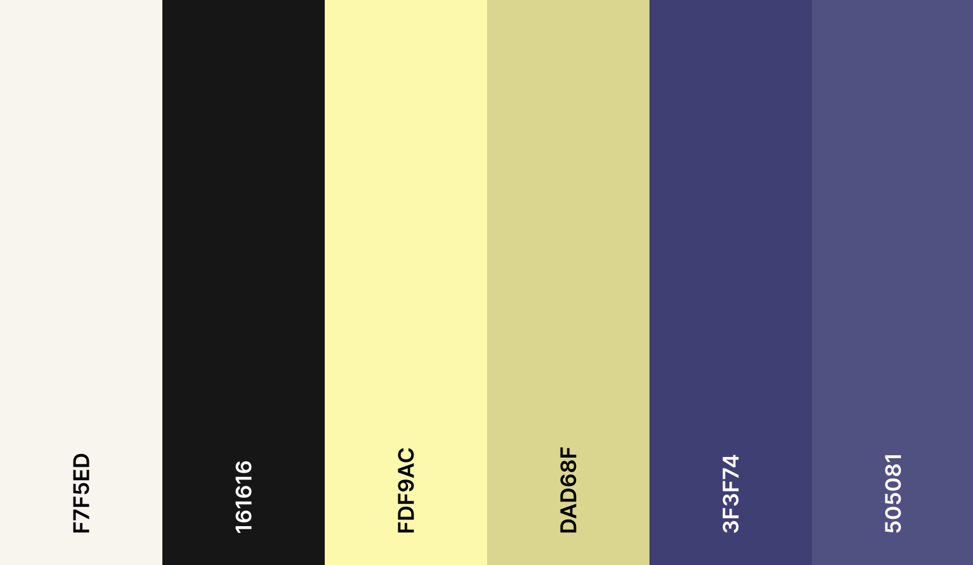
Colorpallete
TEXT
TEXT
ELEMENTS PRIMARY
BACKGROUND PRIMARY
ELEMENTS SECONDARY
BACKGROUND SECONDAY
Notes:
https://coolors.co/f7f5ed-161616-fdf9ac-dad68f-3f3f74-505081

Slide 5


GUI Elements
Rounded corners (4px)
Buttons are circles or oval (25px)
Textboxes have rounded corners (4px)

